Slide 1



Hackathon Proof of Concept
Understanding patterns in battery range variation and building examples to allow predictive maintenance of e-bikes
Alexis Djodjimadji & Patrick Uwayo
Supervisors: Vera Vinçon & Lorenzo Verstraeten
October 2023

Slide 2



Team
Alexis Djodjimadji
A Data Scientist with good experience in Python, and R programming as well as in data analysis, machine learning and deep learning, Alexis is passionate about the applications of data mining and AI for enlightened decision-making.
From Chad, Likes watching movies, playing video games
Patrick Uwayo
A Data Scientist with experience in Python programming, data analytics as well as machine learning and deep learning. Tech enthusiast and passionate about building AI systems and solving real world problems. From Rwanda-Kigali, Likes Arts

Slide 3
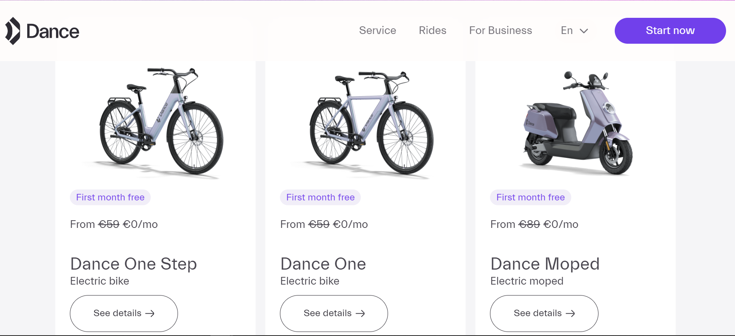
Introduction
Dance is an electric mobility subscription company that makes the urban exploration easier and greener with e-bikes and e-moped. It is currently available in 5 major European cities: Berlin, Hamburg, Munich, Paris and Vienna.
https://dance.co/

Slide 4

Problem Overview
Analyse changes in battery range and develop predictive maintenance models for e-bikes:
check out the distribution of battery range to the state of charge;
explore e-bikes performance as the batteries age;
examine any variation in battery range across ambient temperature;
develop models for predictive maintenance.

Slide 5
Data Description
The available data for this project comes from Dance's subscription service.
They include information collected on e-bikes activities during their availability to the user.
Attributes of focus
vehicle_id
user_id
battery_serial_number
occurred_at_time
total_mileage
battery_state_battery_soc
battery_state_battery_soh
dance_area
assist_level
ble_data.csv
29 attributes
3215664 rows
13 categorical attributes
16 numerical attributes

Slide 6

Methodology
Data processing: Clean and preprocess the collected data to remove irrelevant information, examine the distribution of variables to identify potential incoherence, outliers, missing values, etc.
Exploration Approach: Analyze characteristics of vehicle mainly the batteries range.
Model Development: Use machine learning algorithms to propose the predictive maintenance.

Slide 7
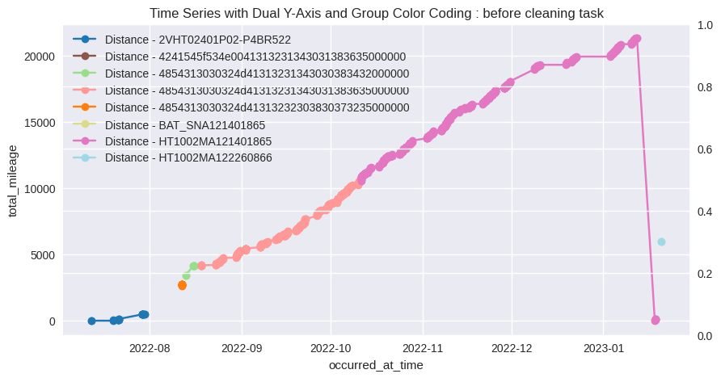
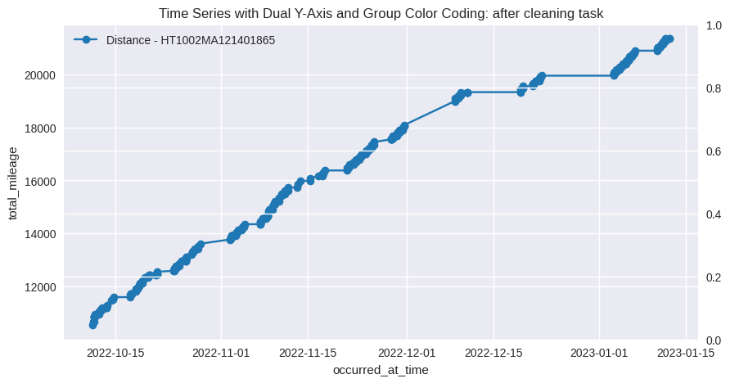
Exploratory Data Analysis

Slide 8
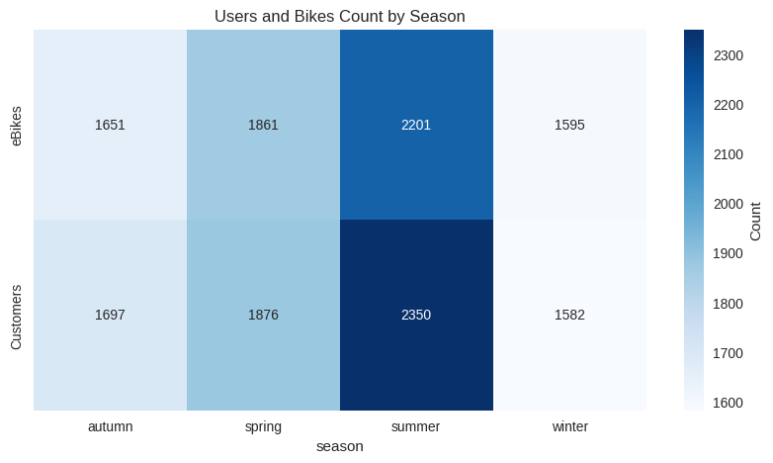
Exploratory Data Analysis

Slide 9
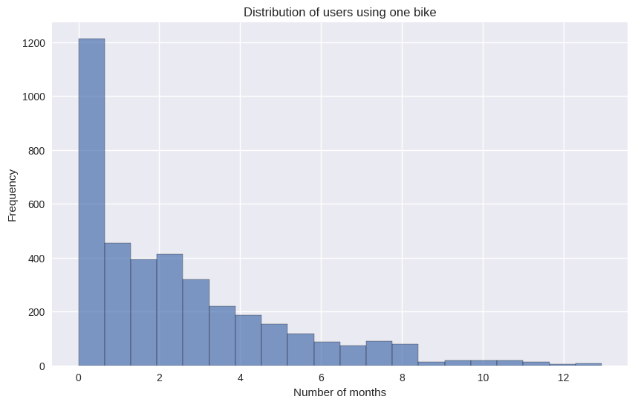
Exploratory Data Analysis

Slide 10
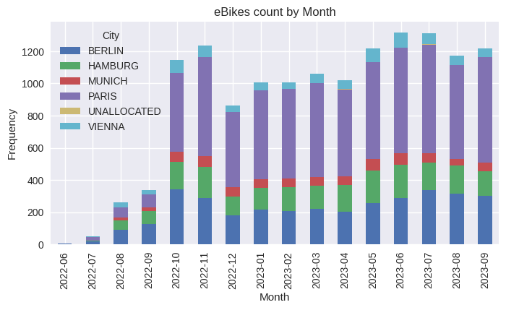
Exploratory Data Analysis

Slide 11
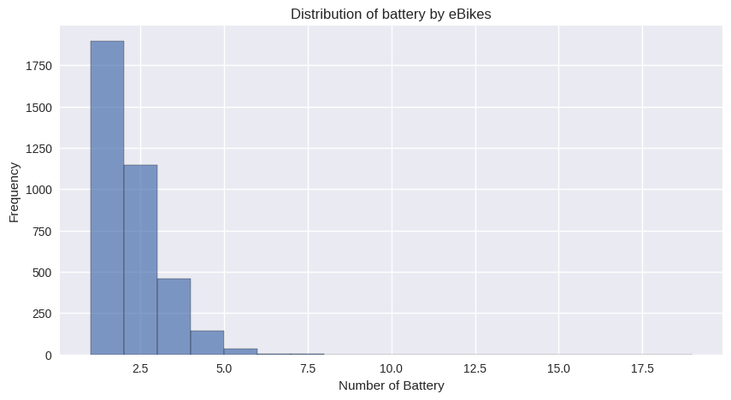
Exploratory Data Analysis

Slide 12
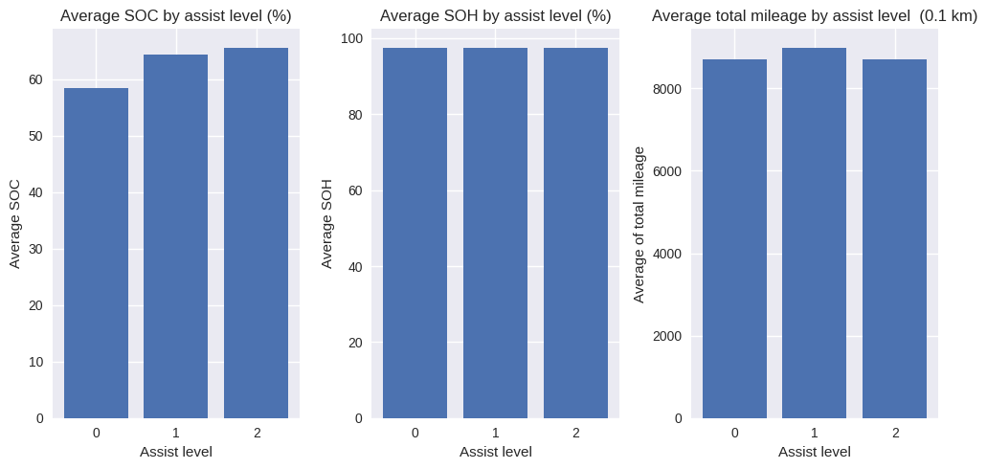
Exploratory Data Analysis

Slide 13
Retrospective: Learnings and Challenges
Data reading and understanding
Data cleaning
Data analysis

Slide 14
Suggestions for next phase of project
- Looking for a subset of eBikes or Batteries for further analysis

Slide 15
Thank you!

