Slide 1



Predictive Maintenance for e-Bikes
Proof of Concept
Alexis Djodjimadji & Patrick Uwayo
Supervisors: Vera Vinçon & Lorenzo Verstraeten
October 2023

Slide 2



Team
Alexis Djodjimadji
A Data Scientist with good experience in Python, and R programming as well as in data analysis, machine learning and deep learning, Alexis is passionate about the applications of data mining and AI for enlightened decision-making.
MSc in Data Science from AIMS
Patrick Uwayo
A Data Scientist with experience in Python programming, data analytics as well as machine learning and deep learning. Tech enthusiast and passionate about building AI systems and solving real world problems.
MSc in Data Science from AIMS

Slide 3



Proof of Concept
Concept
Discovery
Outcome
better understand the current performance of the product and service
build examples of where the data can be used to allow predictive maintenance.
Variation in battery range & SOC across:
different cities
battery ages (time/SOH)
…
Proactive & informed maintenance will help Dance to:
✔ minimize unplanned downtime
✔ increase customer satisfaction
✔ allow better maintenance planning & reduce cost

Slide 4
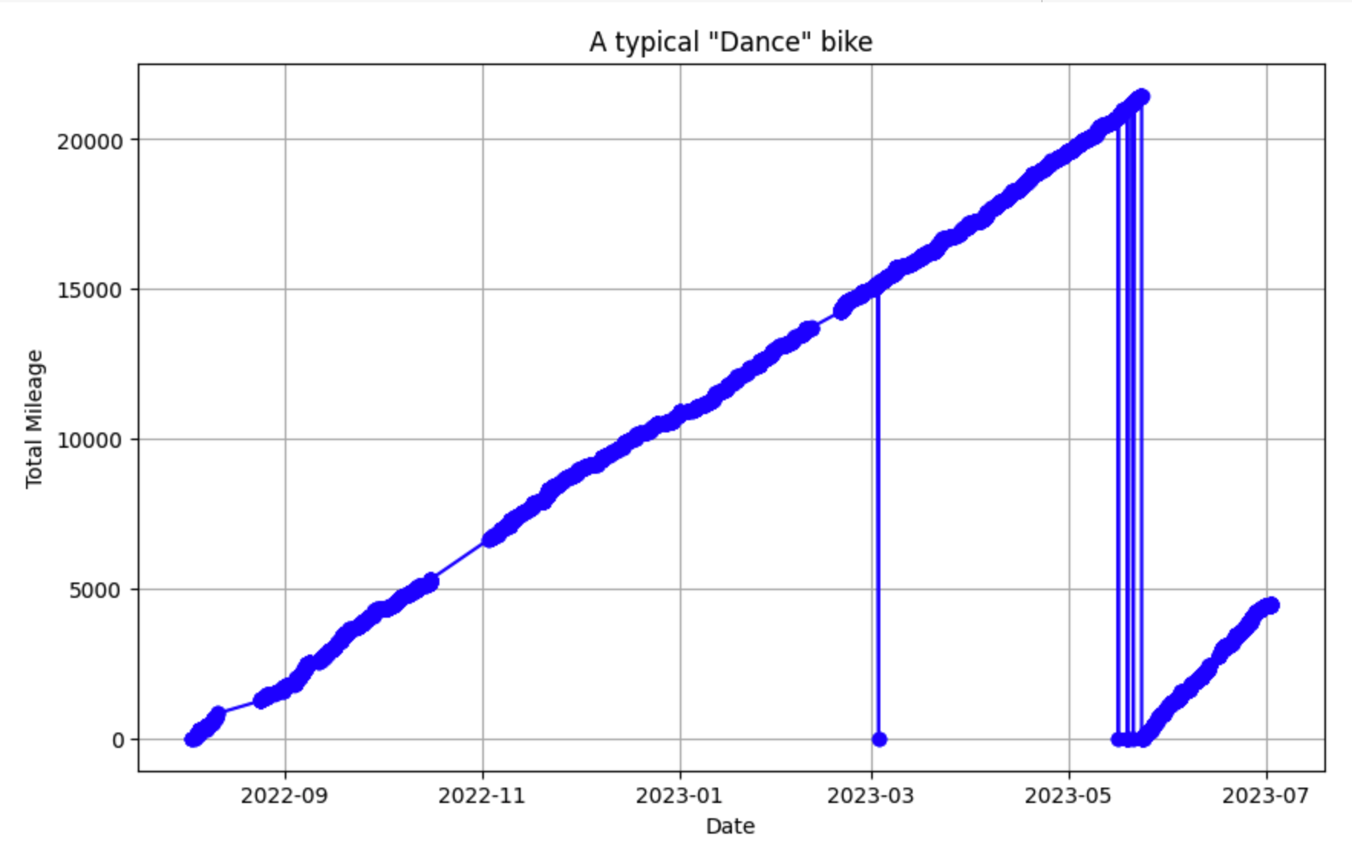
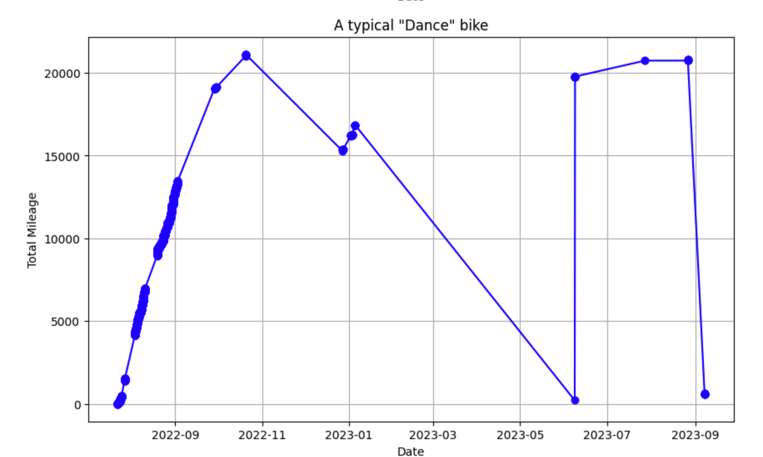
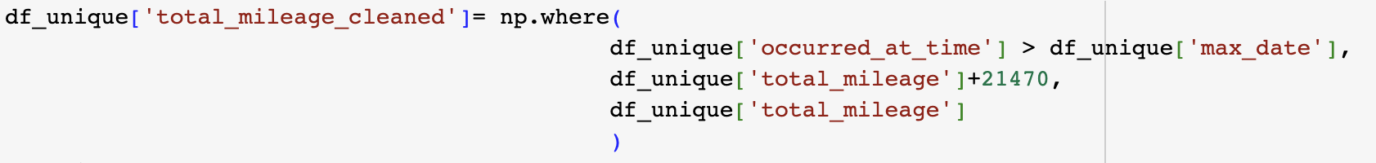
Exploratory Data Analysis (EDA)
Main Challenges with Data Quality:
Mileage reset after ~ 2’100km to 0 for all e-bikes
Random outliers
Long periods per bike without any observations
Other Observations:
Data duplication
Missing values (e.g. total mileage)
Incorrect Entries (e.g. battery serial number)
(0.1 km)
(0.1 km)

Slide 5
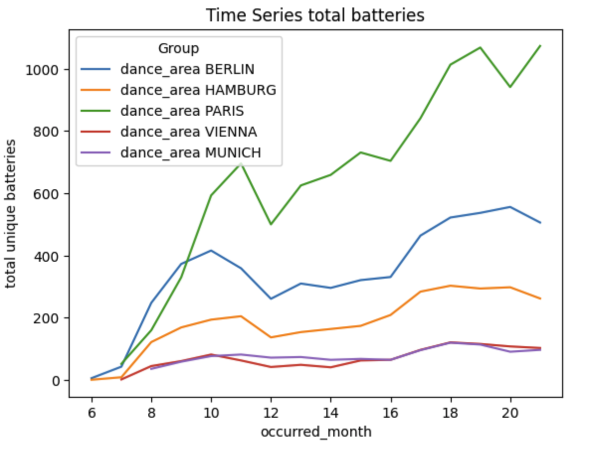
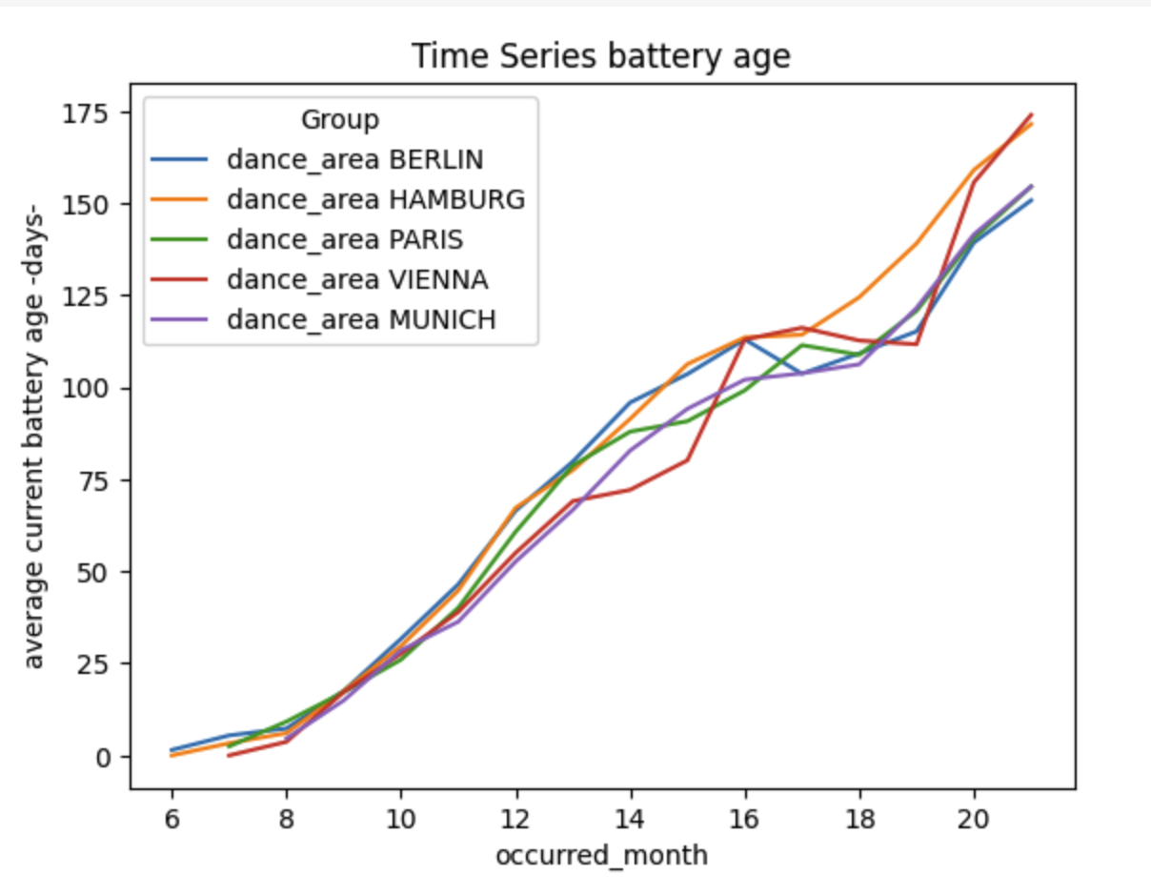
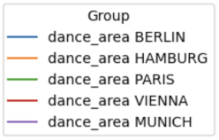
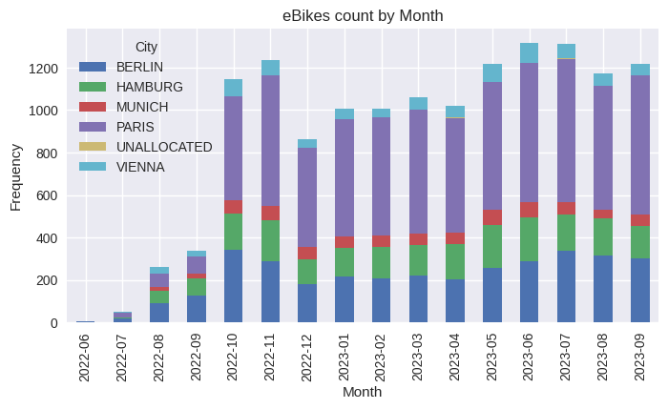
Data Insights
A look at total batteries and battery age over time.
winter
winter

Slide 6
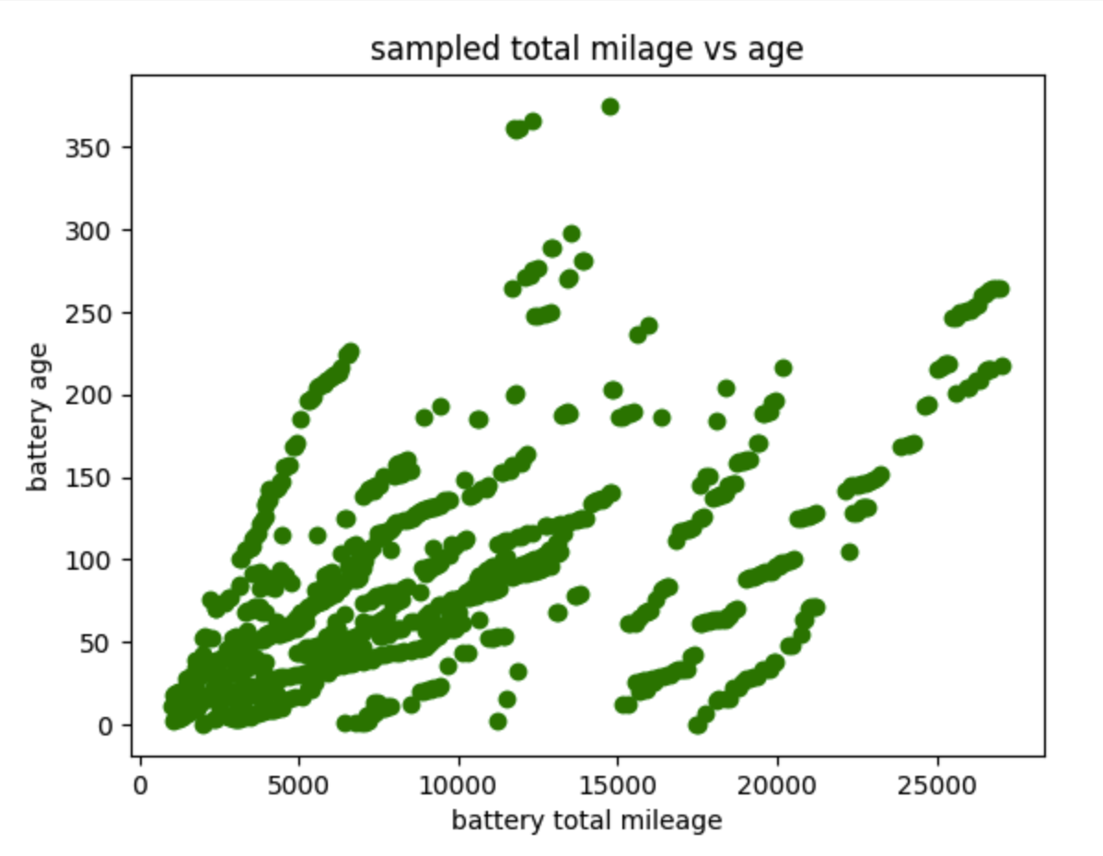
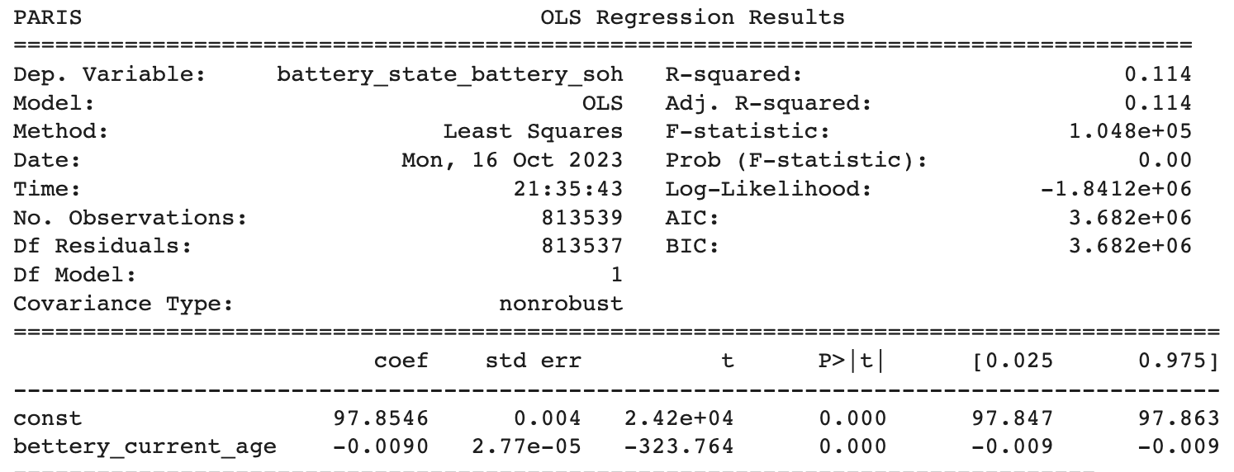
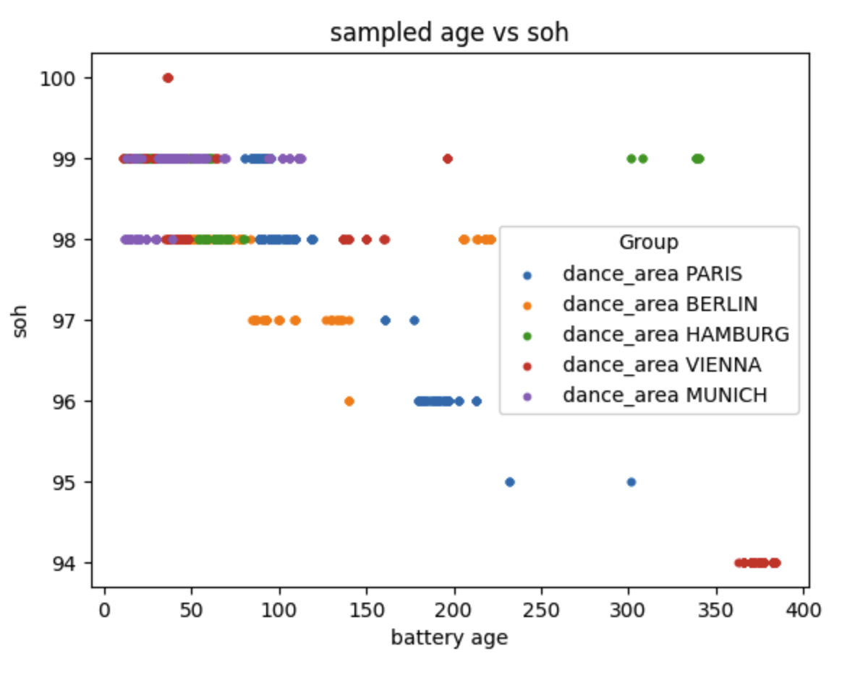
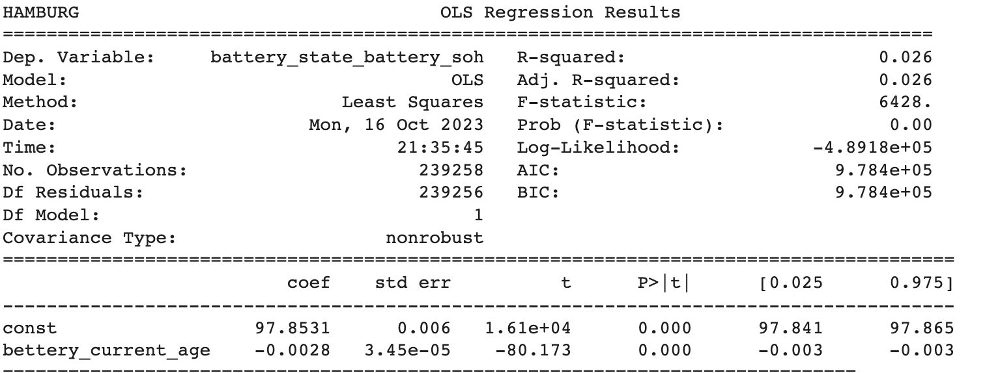
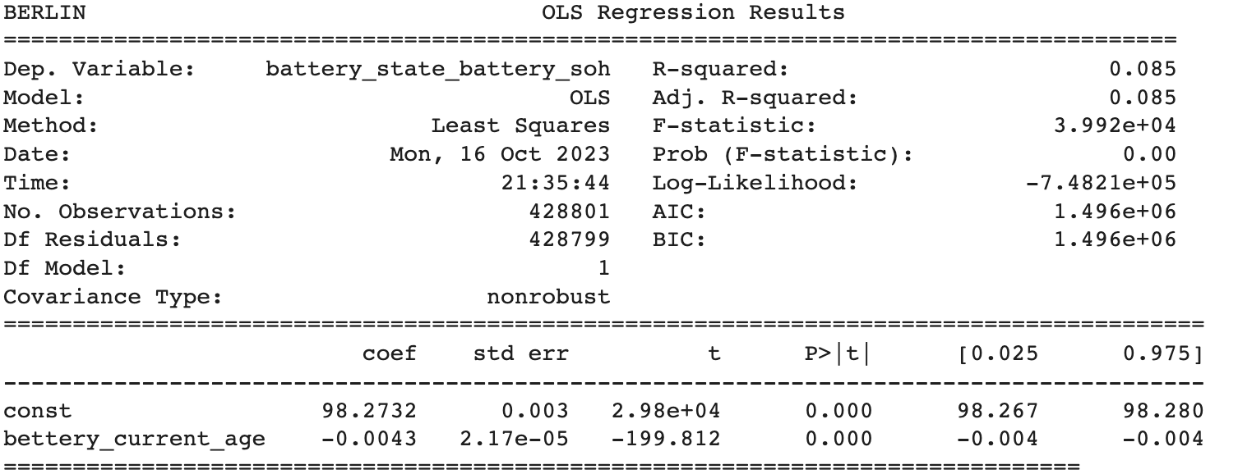
Data Insights
A look at battery age vs SOH.
(in days)

Slide 7
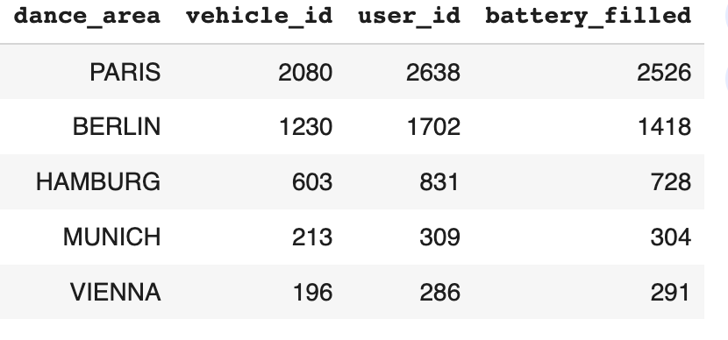
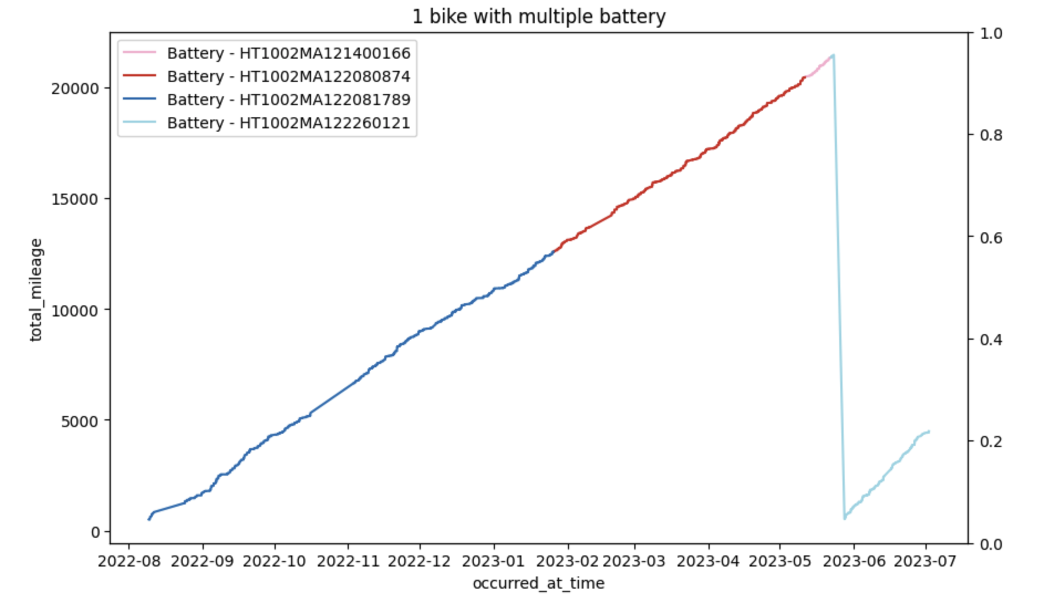
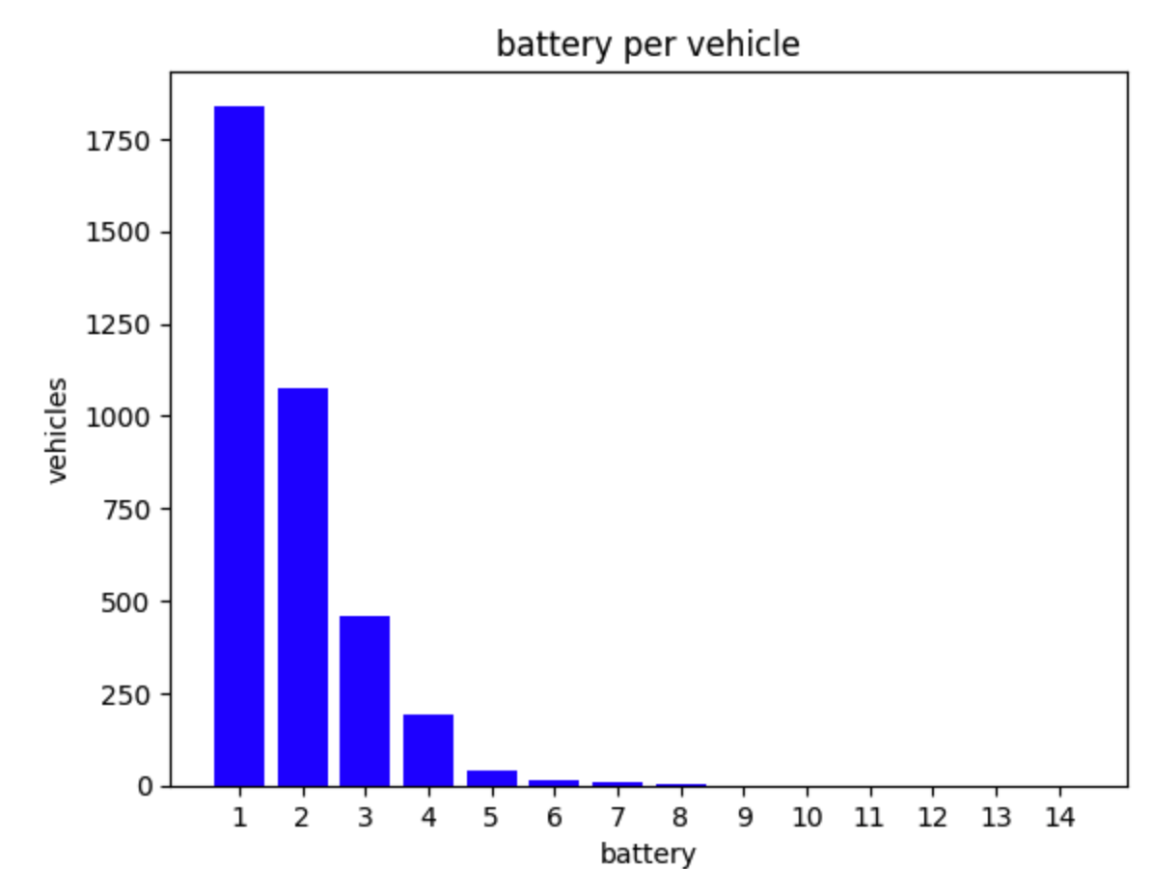
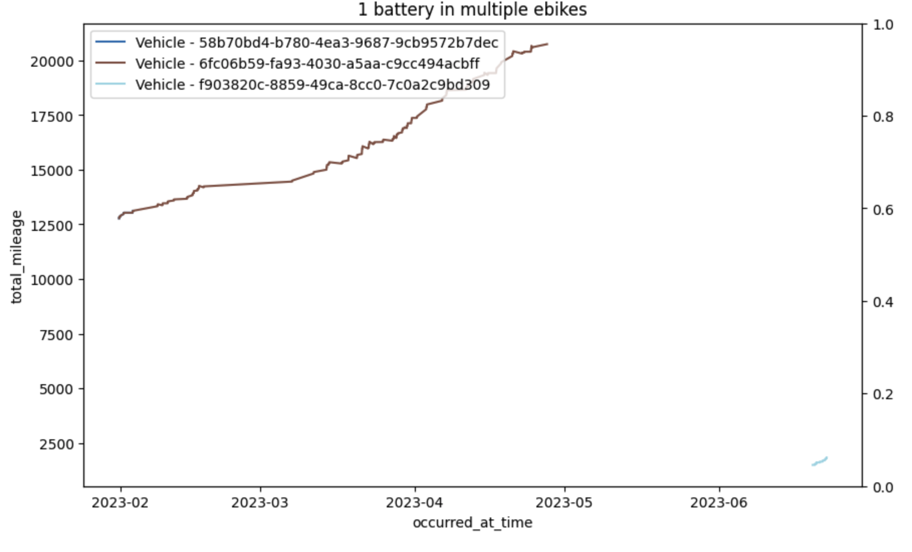
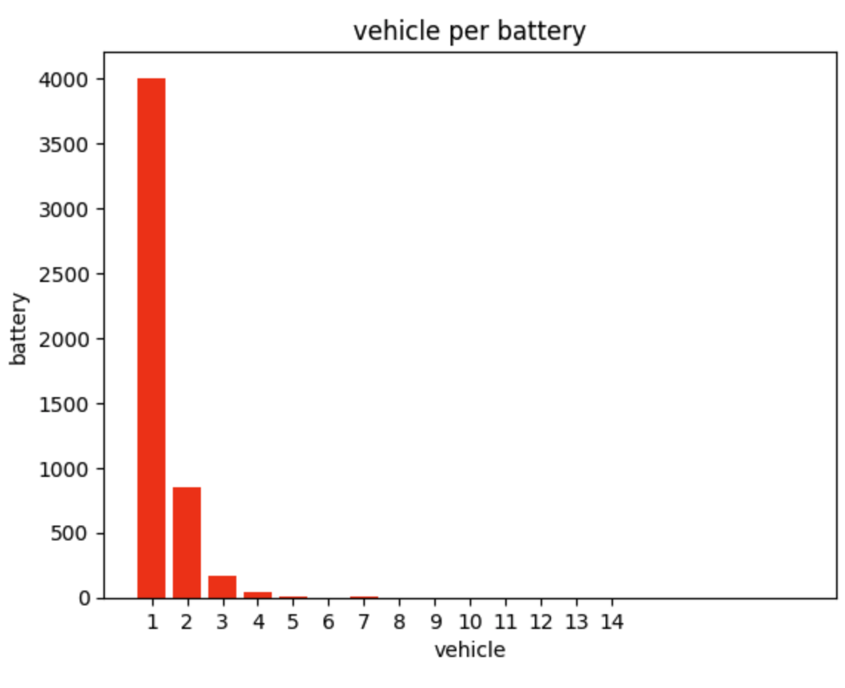
Changing bike vs Changing battery
One bike can have more than one battery over time, e.g.:
~1800 bikes operated with only one battery
~200 bikes with 4 batteries
The same battery can be used in different bikes, e.g.:
~4000 batteries are used in only one bike
~100 batteries are used in 3 bikes
(0.1 km)
(0.1 km)
→ change of batteries within a bike is more common than using the same battery across bikes

Slide 8
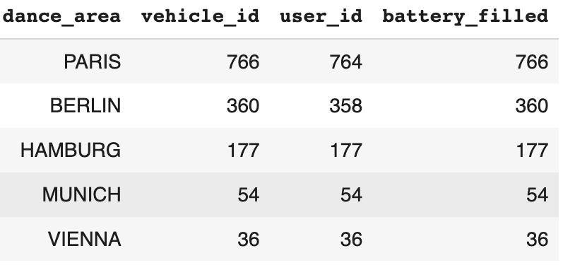
Smaller Population
1 bike - 1 battery subpopulation for tractability
→ lose > 50% of the population
One bike can have more than one battery over time
The same battery can be used in different bikes
(0.1 km)
(0.1 km)
subpopulation: 1 bike - 1 battery

Slide 9
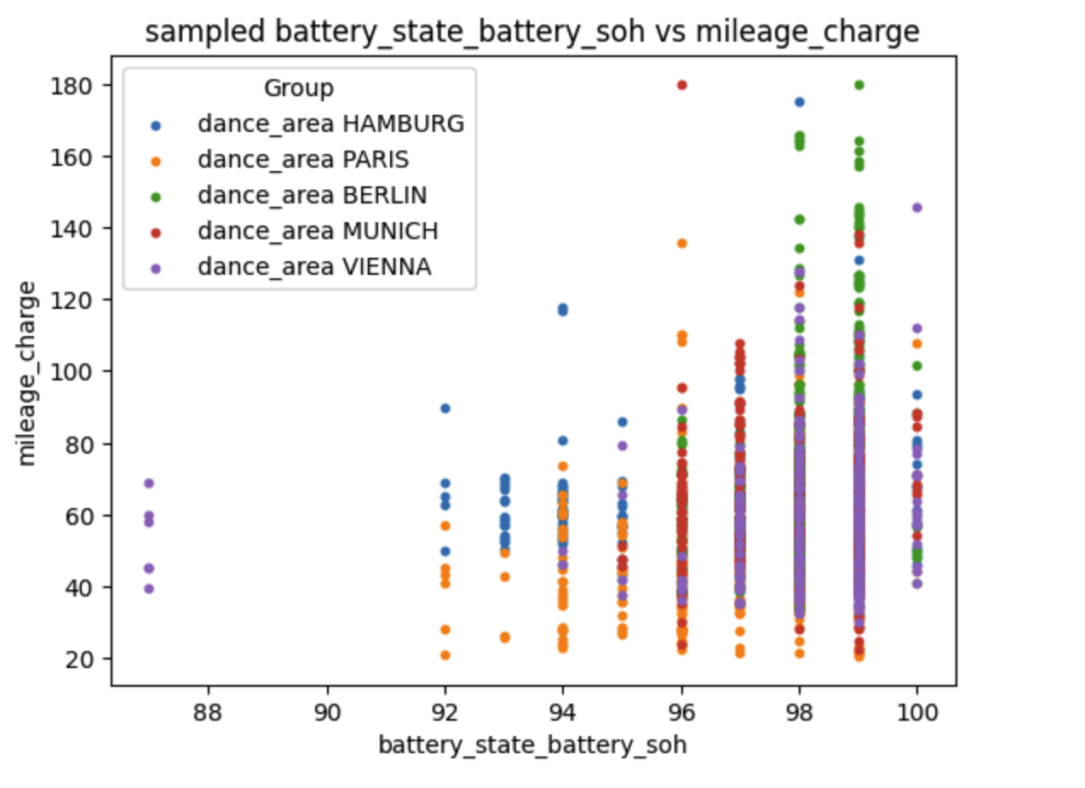
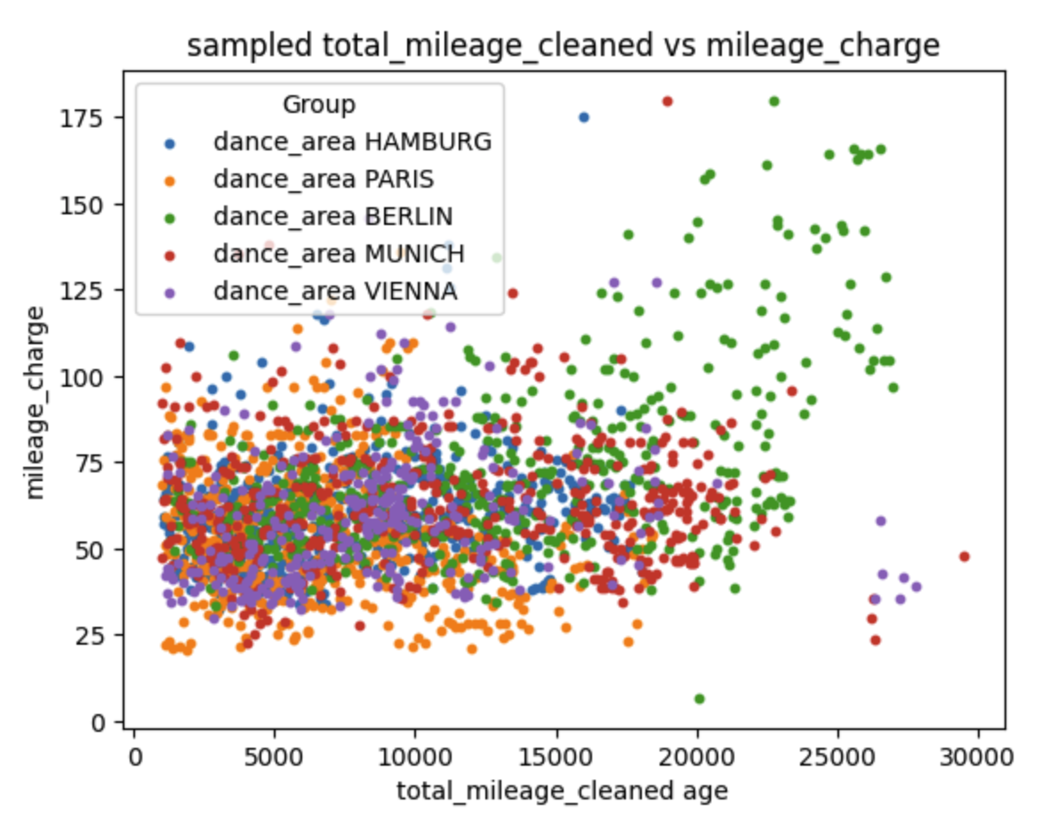
Data Insights
Compute how many kms you do with a full battery charge and try to understand how to explain.
As expected:
Unexpected:
( km)
( km)
(0.1 km)

Slide 10
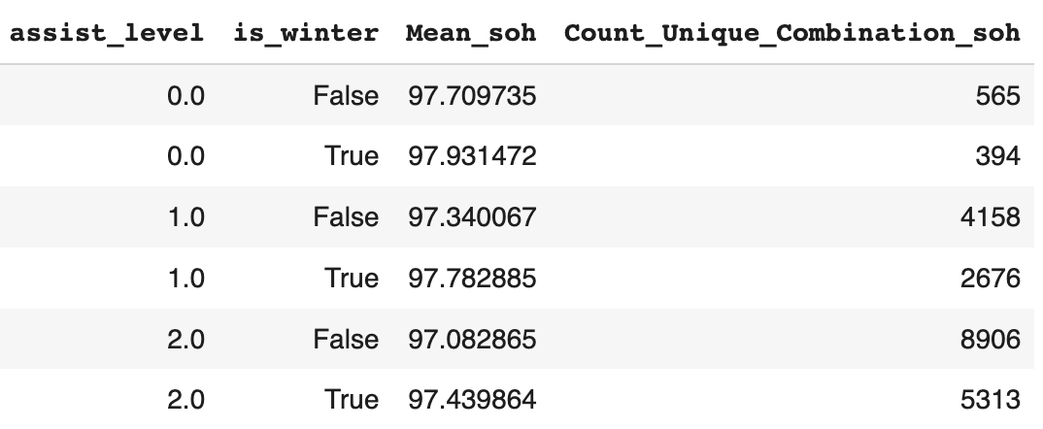
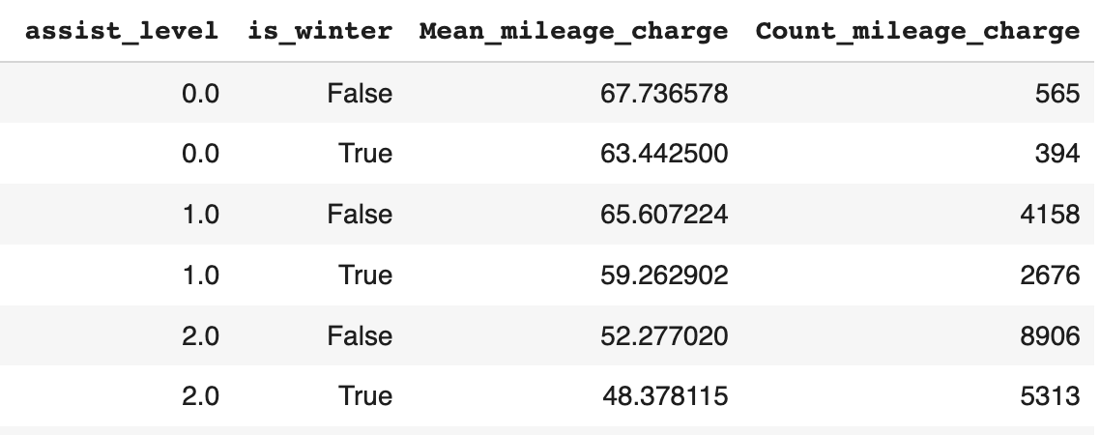
Data Insights
SOH explained
milage_charge explained

Slide 11
Possible Next Steps
The biggest issue is Data Quality:
Investing in a better data stream technology
Investing more into data cleaning
Work close with the product team to know more about the business
Look deeper into some of the findings
Test some of the assumptions

Slide 12
Thank You!
Comments and Questions
alexis.djodjimadji@aims.ac.rw
&
linkedin.com/in/djodjimadji
patrick.uwayo@aims.ac.rw
&
linkedin.com/in/patrick-uwayo-67aa81260

