Slide 1


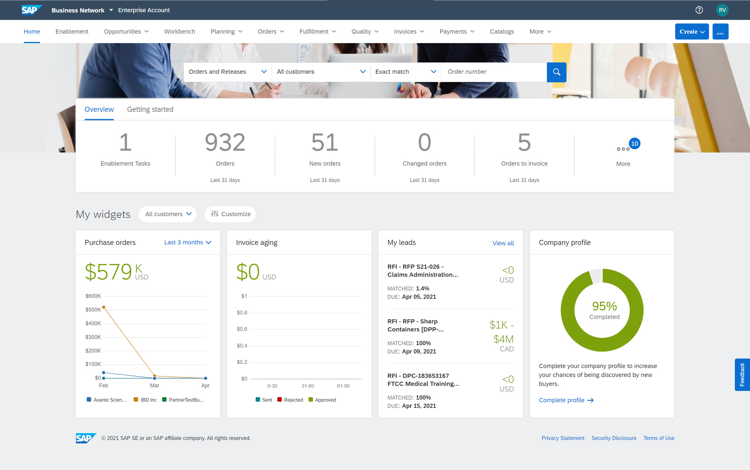
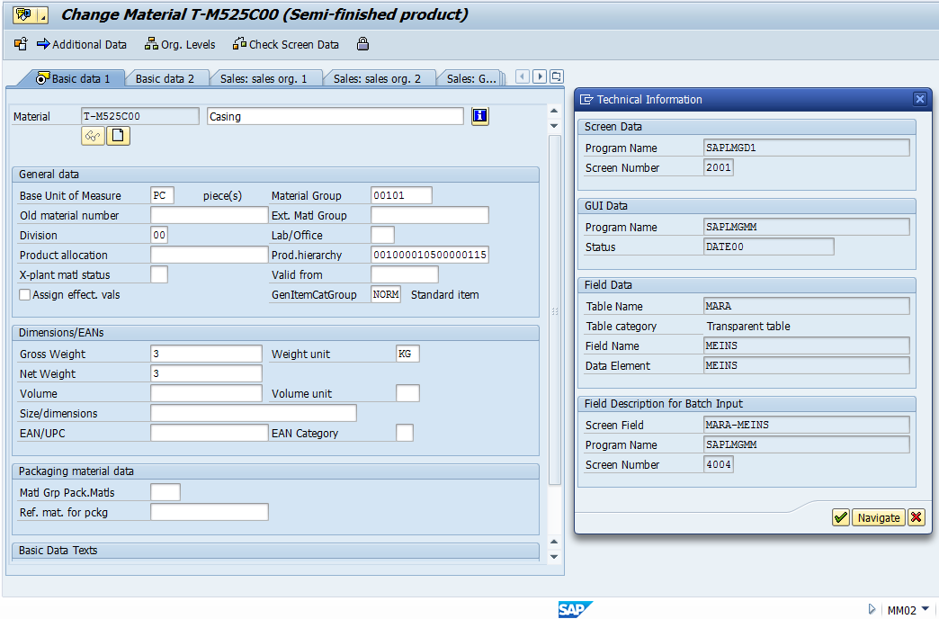




SAP Internship for Puget Sound Energy Presenter: Aislinn O’Connell; Faculty Mentor: Min Chen Sponsor: Kevin Chen
Company Overview
What I have done
Outcomes / What I Learned
Puget Sound Energy (PSE) is a local energy utility company based in Washington that provides over a million people with electricity and natural gas.
Features provided are:
Interface between customers and needed energy resources
Maintaining and growing local energy infrastructure towards cleaner energy sources
Covering the whole lifecycle from energy creation all the way to consumption
Enterprise Software:
Learned the basics of navigating and inputting data into SAP, specifically material management and finance
Understand how PSE uses SAP to connect their various departments into one cohesive business
Write a short guide on how to make a purchase order in Ariba for other interns
Learning new software and understanding the role it plays within business operations.
What a real workplace is like, and witnessing the collaboration that happens between teammates, and different departments.
Gained insight into different jobs and roles withing the technology field
Learned about the usages of enterprise software, and how it encompasses business needs for companies
Objective
Related Coursework
Learn the basics of SAP, an enterprise software, and how it is utilized by PSE
Create a seamless user experience by ensuring that material codes are aligned across SAP applications
Experience a real work environment; Network with peers, and professionals alike
CSS 301 – Technical Writing
CSS 310 – Introduction to Information Assurance & Cybersecurity
CSS 350 – Management Principles
CSS 360 – Agile, Waterfall & Kanban Software Development Strategies
CSS 461 – Software Project Management
CSS 480 – Human Computer Interactions
Project:
Ensure that material codes align between Ariba and SAP to prevent miscataloging materials
Understand the connection between different users that utilize enterprise software at PSE
Collaborate with a team to ensure that SAP and Ariba are curated for the PSE users
Tools & Languages
Acknowledgements
Programming Languages: N/A
Tools: SAP, Ariba, Excel, Winshuttle
Thank you to PSE for providing me with this opportunity. I gained insight on the various tech industry careers, and it has great work environment.
Thank you to Professor Min Chen for her willingness to assist me with my Capstone Project.

