Slide 1
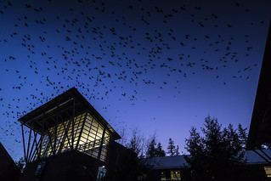
Determining the Resistance of Campylobacter Isolates Recovered from Crow Feces with Various Antibiotics
Bessy Bao, Kindra Fuller, and Pooneh Hajian
Notes:
kindra

