Slide 1
Burying Hazardous Waste
Continental Imports to United States Landfills from 2007 - 2012
Notes:
Created by Constanza Bravo & J. Michelle Hu for Cart Lab Design Challenge 2015

Slide 2
Ports of Entry
Notes:
Where landfilled hazardous waste crosses into the US --- data selected by expected management method as landfill, data with no listed ports of entry were omitted from this caclulation

Slide 3
Final Destinations

Slide 4
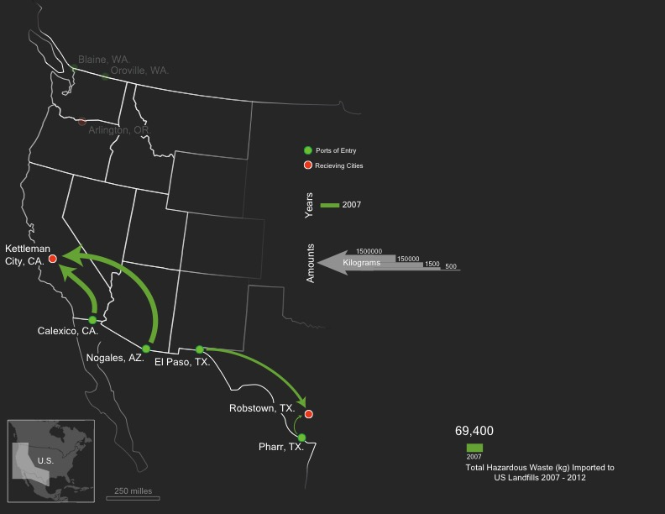
Waste Transported in 2007

Slide 5
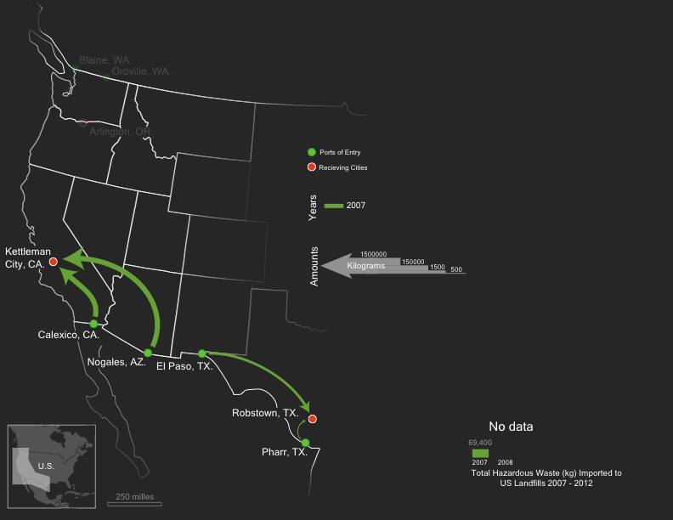
No Data for Waste in 2008

Slide 6
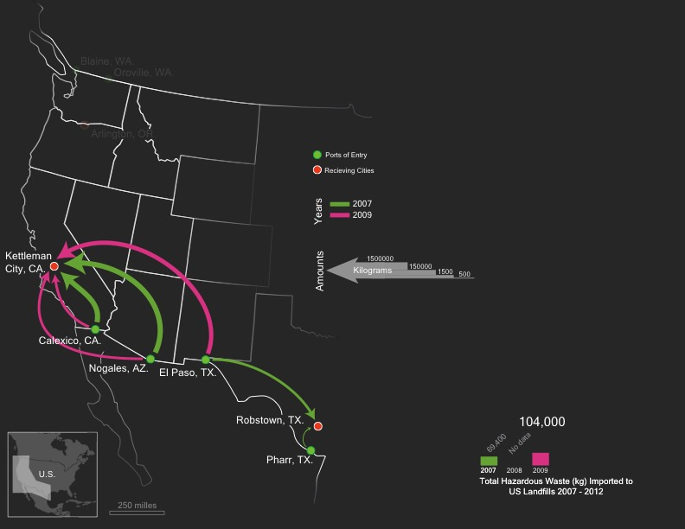
Waste Transported in 2009
Notes:
All waste to Kettleman City in 2009

Slide 7
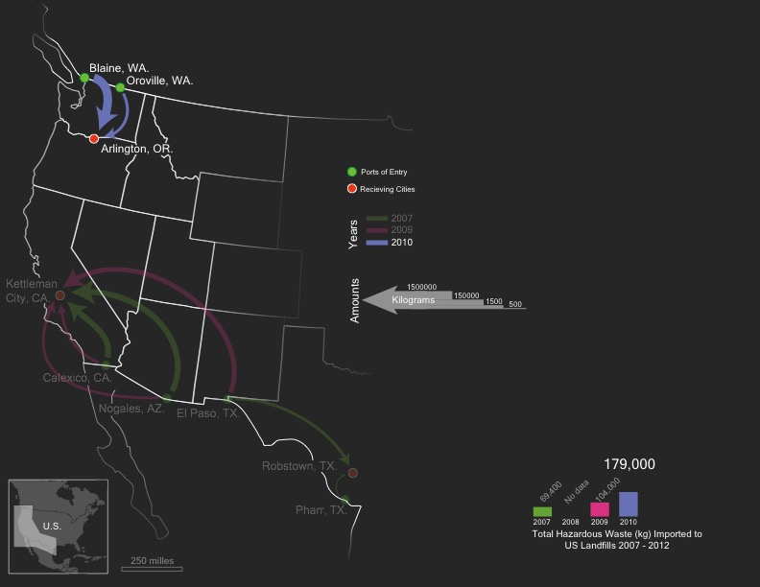
Waste Transported in 2010
Notes:
Not a full dataset

Slide 8
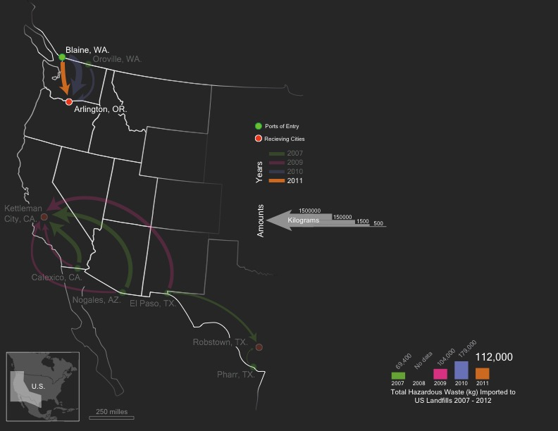
Waste Transported in 2011
Notes:
Not a full data set

Slide 9
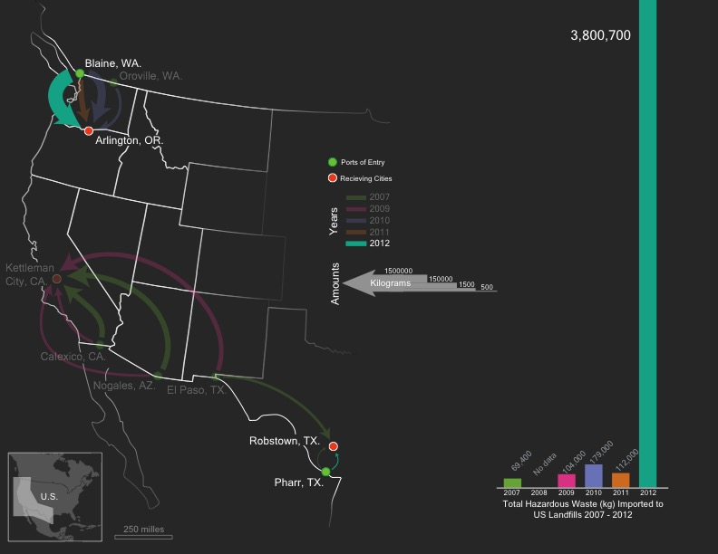
Waste Transported in 2012
Notes:
Banner year in 2012 from Blaine to Arlington – not a full data set

Slide 10
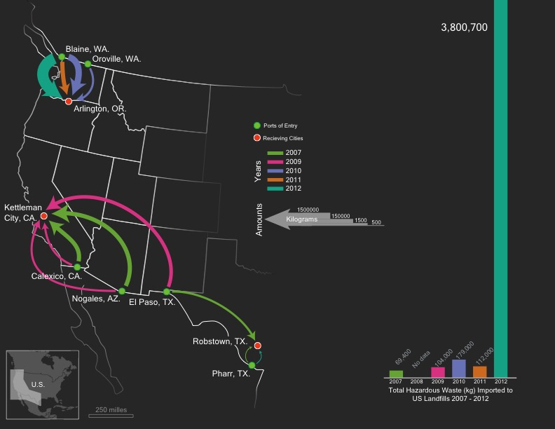
Total Hazardous Waste Transported to Landfills 2007-2012

Slide 11
What is a landfill?
“Excavated or engineered sites where non-liquid hazardous waste is deposited for final disposal and covered.”
There are 21 landfills across the country for hazardous waste. From 2007 to 2012, three of the 21 sites received waste from Canada and Mexico.*
Notes:
* assuming missing data does not contradict this statement

Slide 12
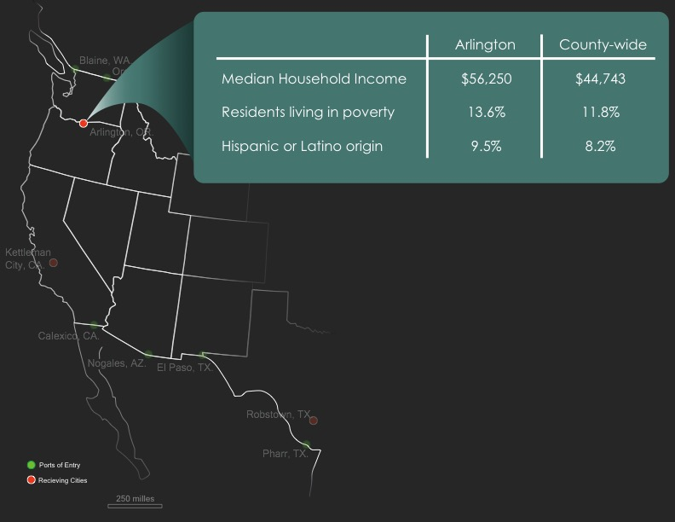
Arlington, OR
Notes:
Greater median income
Similar levels of poverty and ethnic breakdown

Slide 13
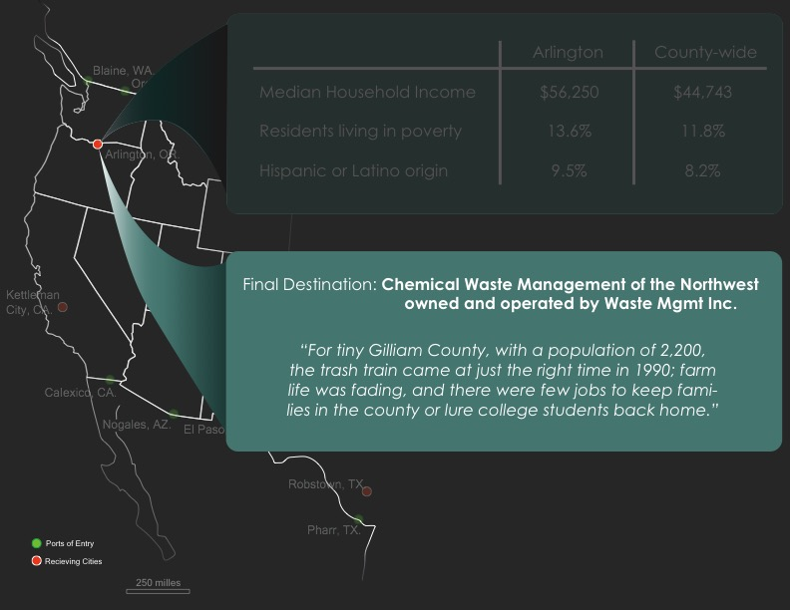
Arlington, OR

Slide 14
Arlington CCD, Gilliam county, Oregon
Population: 933
Chemical Waste Management of the Northwest is owned and operated by Waste Management Inc.
Providing jobs for 15.5% of residents, Waste Management is Arlington’s
single largest employer.
Notes:
Chemical Waste Management of The Northwest Inc is located at 17629 Cedar Springs Lane in Arlington, OR and has had no violations over the past three years. - resulting in 1 enforcement action and $18,400 in fines.
There is a population of 2 people (7% minorities) within a 3 mile radius of the facility and the Toxic Release Inventory for the site is 13,370,458 pounds. The last inspection of Chemical Waste Management of The Northwest Inc took place 224 days ago.
From Find the Data EPA sites
Census Data from AS OF 2013 ACS 5 year survey

Slide 15
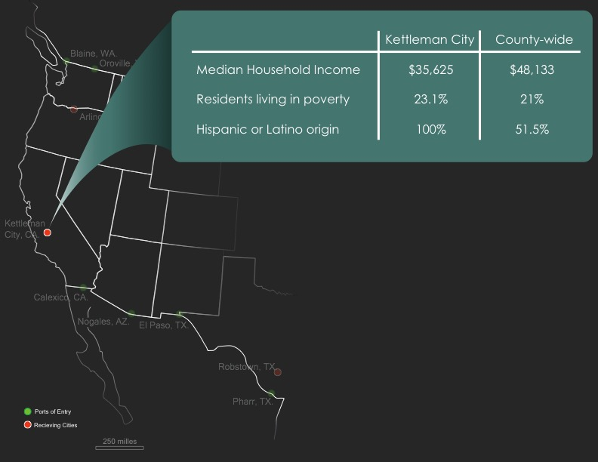
Kettleman City, CA
Notes:
Substantially lower median income
Similar rates of poverty
Much higher percentage non-white than county-wide statistics

Slide 16
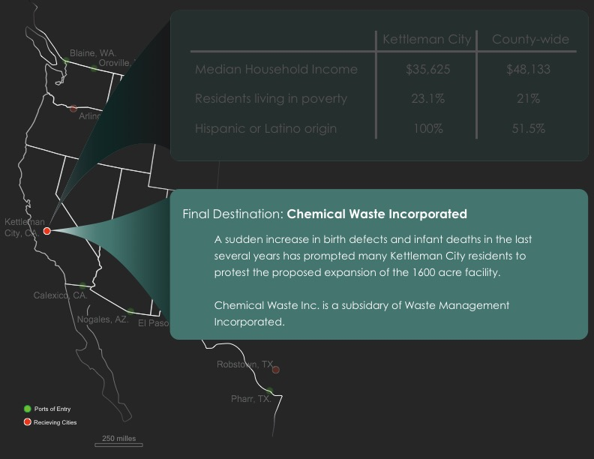
Kettleman City, CA
Notes:
Population = 1,439

Slide 17
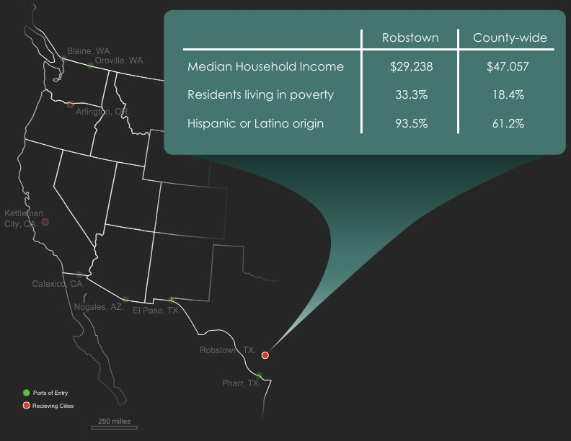
Robstown, TX
Notes:
Much lower median income
Much higher poverty
Much higher non-white population than county-wide statistics

Slide 18
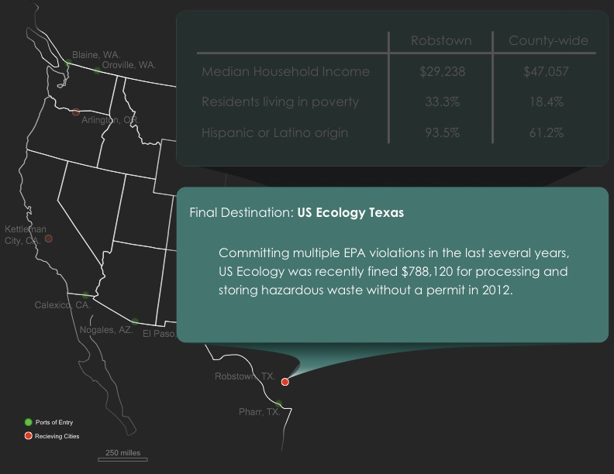
Robstown, TX
Notes:
Employs < 4.7% of population
Population = 12,836
Us Ecology Texas Inc is located at 3 1/2 South Petronila Road in Robstown, TX and has had violation(s) over the past three years.
3 quarter(s) of Clean Water Act violations
12 quarter(s) of Resource Conservation and Recovery Act violations- resulting in 4 enforcement action and $283,457 in fines.
There is a population of 18 people (79% minorities) within a 3 mile radius of the facility and the Toxic Release Inventory for the site is 1,750,886 pounds. The last inspection of Us Ecology Texas Inc took place 506 days ago.
http://epa-sites.findthedata.com/l/517568/Us-Ecology-Texas-Inc
EPA Reaches Settlement with US Ecology Texas and TD*X Associates for Violation of Federal Environmental Laws
DALLAS – October 4, 2012) The Environmental Protection Agency today announced it has reached a settlement with US Ecology Texas and TD*X Associates in Robstown, Texas, for violating federal hazardous waste laws. The settlement, a legal document called a Consent Agreement and Final Order (CAFO), resolves three counts against US Ecology of Texas and TD*X Associates for processing hazardous waste without a permit or interim status and one count against US Ecology Texas for storing hazardous waste without a permit or interim status at its facility on County Road 69 in Robstown.
The CAFO requires US Ecology Texas and TD*X Associates to follow specific standards for what can be processed at the facility, apply to the Texas Commission on Environmental Quality (TCEQ) for a hazardous waste permit and pay a fine of $788,120.
The EPA has authorized the TCEQ to administer and enforce federal hazardous waste laws within the state of Texas.
A hazardous waste permit is a legally binding document that establishes the waste management activities that a facility can conduct and the conditions under which it can operate. The permit outlines facility design and operation, lays out safety standards and describes activities that the facility must perform, such as monitoring and reporting.

Slide 19
Robstown, Nueces county, Texas
Population: 12,836
US Ecology operates a 240 waste facility just outside of Robstown.
This facility has a substantial track record of violations and most recently suffered from a chemical fire in May 2014.
Notes:
Taken from ACS 2013 census
Corpus Christi Caller – Fire at US Ecology plant

Slide 20
Notes:
How much waste was stored at each site and the most common materials sent to landfill from 2007 to 2012

Slide 21
Notes:
Basically, there are a lot of health effects if this material leaks out from the landfill structures

Slide 22
Notes:
Symbolic representation of proportional amount in kg of waste at each site documented in this data

Slide 23
Thank You!
Created by: Constanza Bravo & J. Michelle Hu
Cartography Lab Design Challenge 2015
Transnational Trade of Hazardous Waste

