Slide 1
Hazardous Waste Treatment Facilities: The Communities
Economic Overview
Prepared by Dean Olsen University of Wisconsin

Slide 2
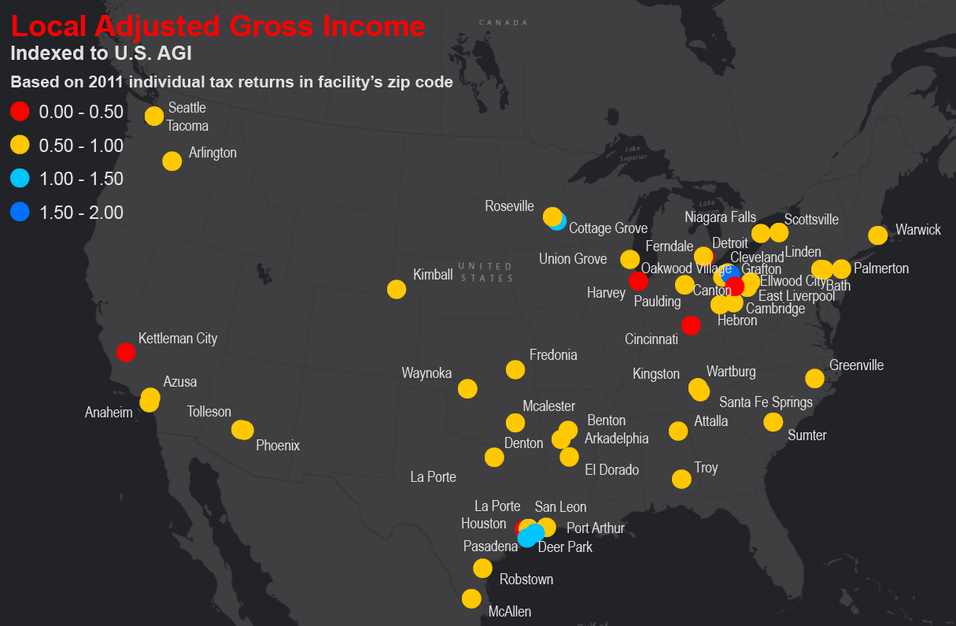
Income: 2011 Adjusted Gross Income
The 53 communities are less affluent than the nation as a whole:
Average AGI = $45,679 (75% of U.S. AGI of $60,894)
Median AGI = $43,628 (72% of U.S. AGI)
Highest: Oakwood Village, Ohio at $99,080 (163% of U.S.)
Lowest: Cincinnati at $20,367 (33% of U.S.)
Source: AIG by zip code, 2011 data from IRS through www.melissadata.com/lookups/TaxZip

Slide 3
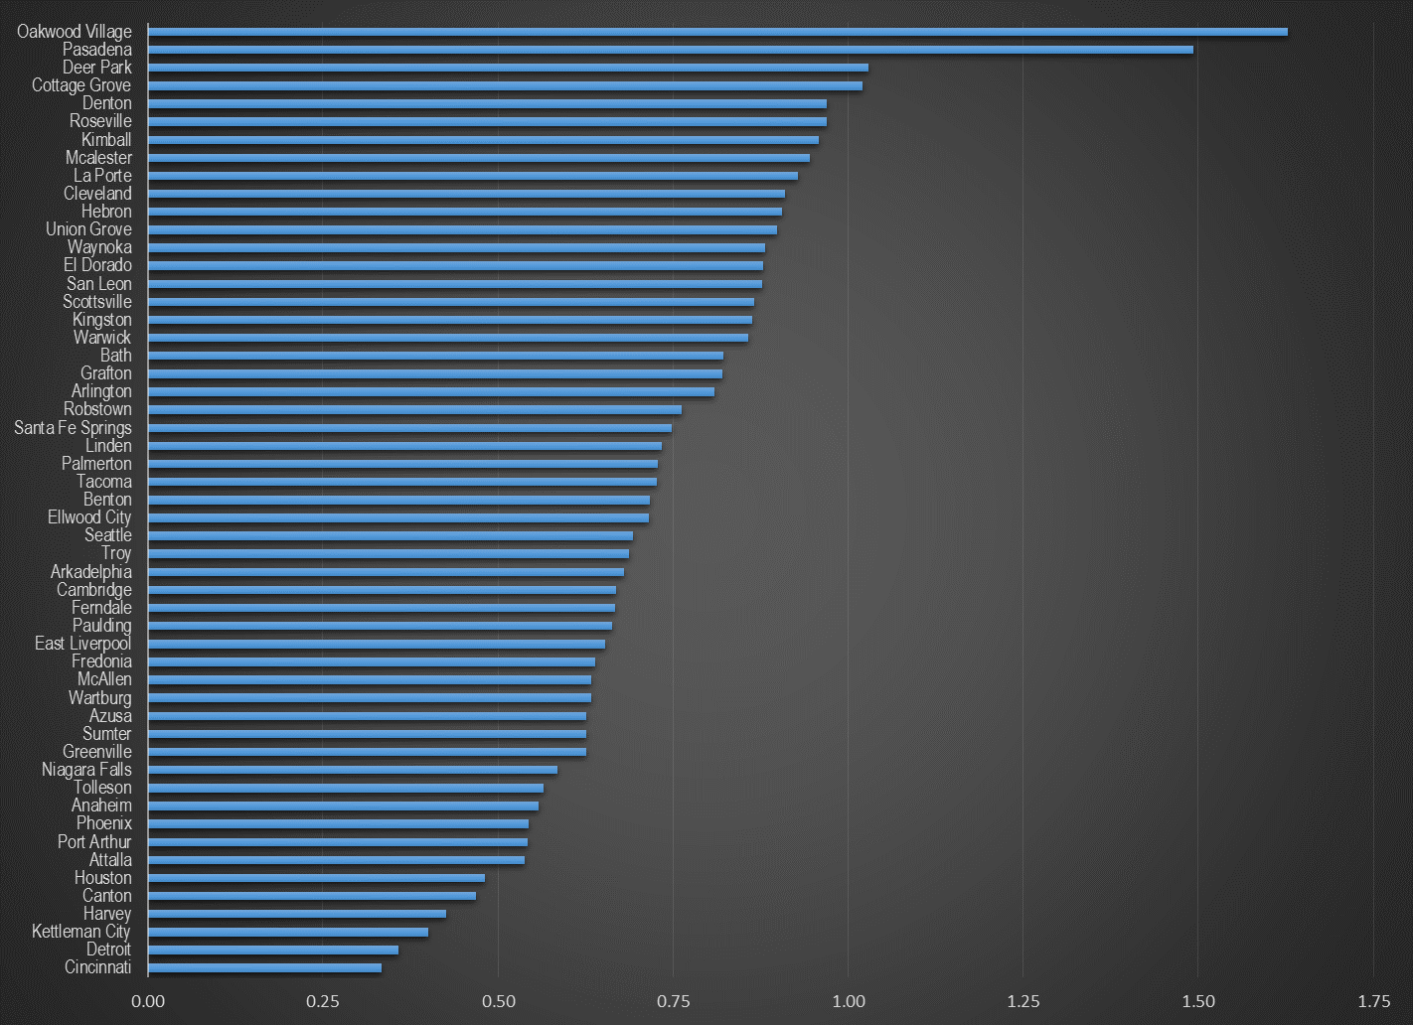
Income: 2011 Indexed Adjusted Gross Income by Town
Sidebar
US AGI = 1.0
Source: AIG by zip code, 2011 data from IRS through www.melissadata.com/lookups/TaxZip

Slide 4
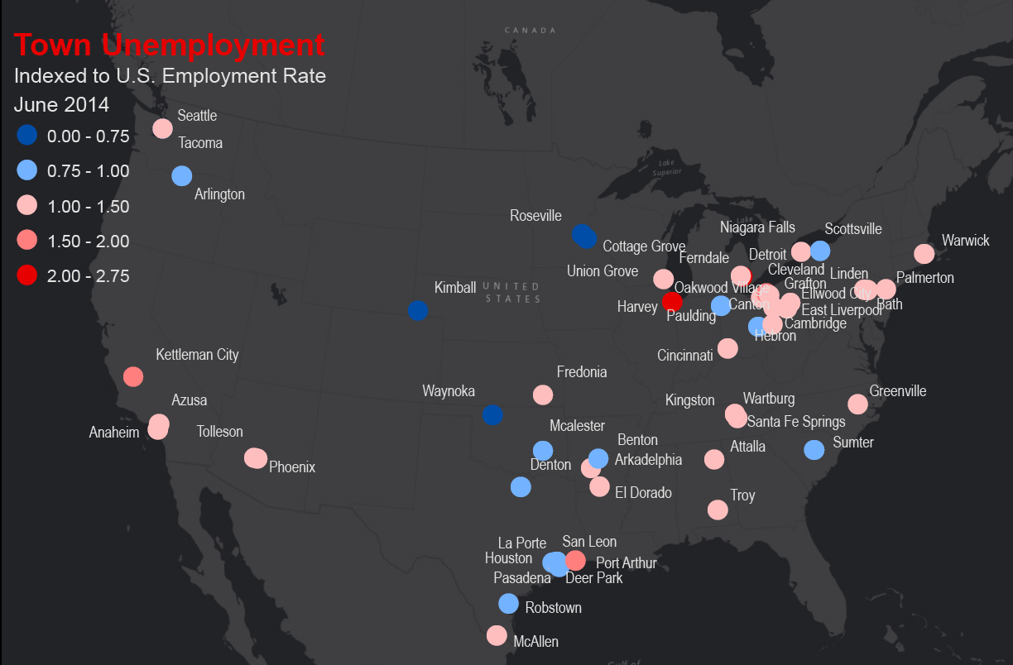
Unemployment: June 2014 Unemployment
The 53 communities have higher unemployment rates than the U.S. though the difference is less pronounced than with AIG.
Average Unemployment= 6.9% (112% of U.S. rate of 6.1%)
Median Unemployment = 6.4% (105% of U.S. Rate)
Highest = Detroit at 16.4%
Lowest = Wynoka, OK at 3.3%
Source: City statistics at homefacts.com

Slide 5
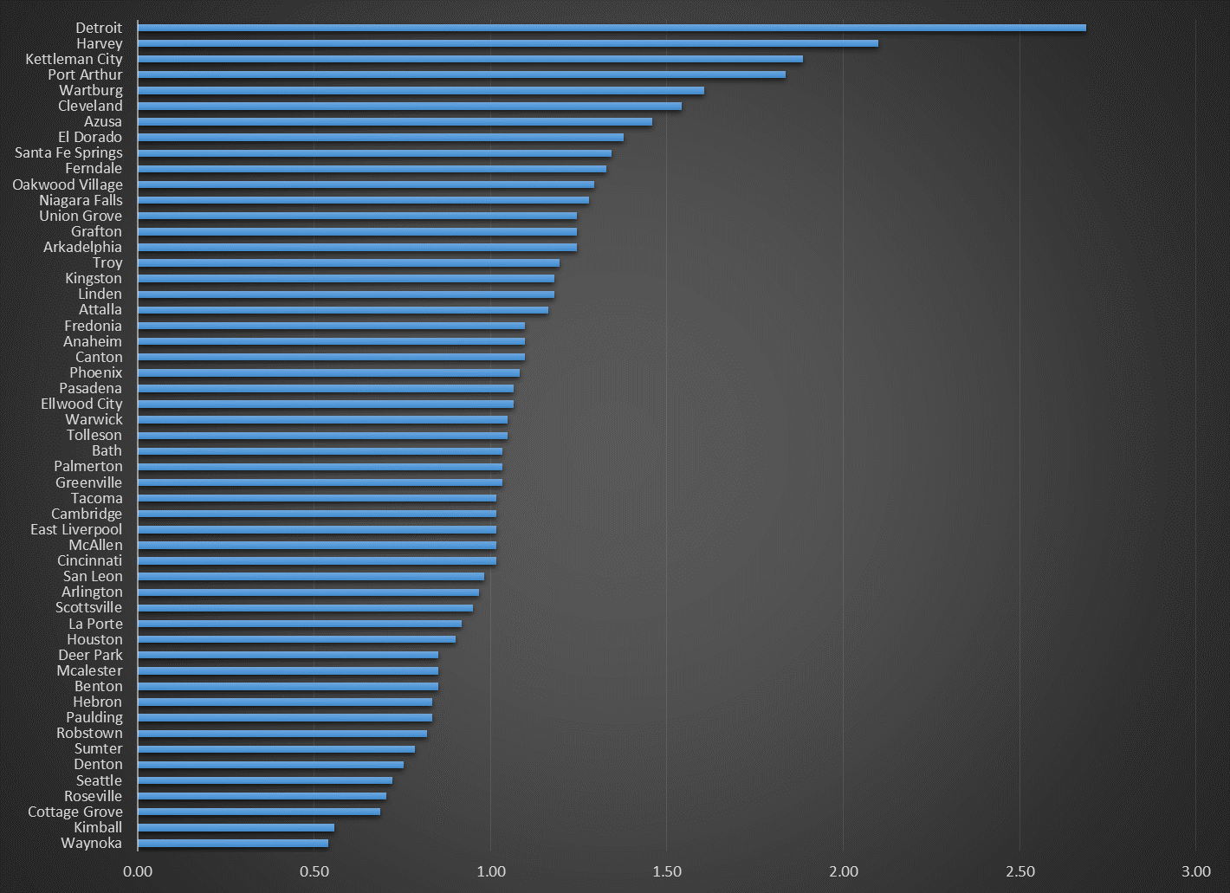
Unemployment: June 2014 Indexed Unemployment by Town
Sidebar
US Unemployment Rate = 1.0
Source: City statistics at homefacts.com

Slide 6
Income: By Educational Attainment
No HS diploma: $23,500
With HS Diploma: $30,000
With BA: $54,700
Source: Chronicle of Higher Education at http://work.chron.com/average-salary-college-degree-1861.html

Slide 7
Employment: Hazardous Materials
Compensation
2012 Median Pay : $37,590 per year
2012 Hourly Wage: $18.07 per hour
Number of Jobs: 37,500 (2012)
Education Requirements
High school diploma or equivalent
On-the-job Training: Moderate-term on-the-job training
No work experience required in a related occupation
Employment Outlook
2012-22: 14% (As fast as average)
2012-22: 5,300 additional workers
Source: Bureau of Labor Statistics at http://www.bls.gov/ooh/construction-and-extraction/hazardous-materials-removal-workers.htm

Slide 8
Employment: Recycling
Compensation (May 2010)
Sorters, laborers, freight, stock, and material movers: $23,570
Drivers: $29,610
Industrial machinery mechanics: $47,280
Maintenance workers: $41,870
Bus and truck mechanics and diesel engine specialists: $38,780
Sales Reps: $52,540
Education Requirements
High school diploma or equivalent
On-the-job Training: Moderate-term on-the-job training
Employment Outlook
Solid growth is expected though it was not quantified by BLS
Source: Bureau of Labor Statistics at http://www.bls.gov/green/recycling/

