Slide 1
S&P500 Returns Analysis
Ui-Wing Cheah

Slide 2
Agenda and Approach
Quantify, with S&P 500 price data, whether large market moves are happening more regularly and with greater speed than in the past.
S&P500 price data from 12/31/1928-12/31/2018:
90 years of daily returns.
30 non-overlapping 3-year samples.
Samples 28,29,30 covering periods 2010-12, 2013-15, 2016-18 will be considered recent.
The analysis will address this question from three perspectives:
1: Are recent returns larger (in absolute) than in the past and are the differences statistically significant?
2: Is the market more volatile and has volatility been changing more rapidly recently?
3: Have there been more market surprises i.e. more unexpectedly large events?
Approach will be to associate measures to each of these hypotheses and evaluate their statistical significance in relation to their empirical distributions derived from the 30 non-overlapping samples.

Slide 3
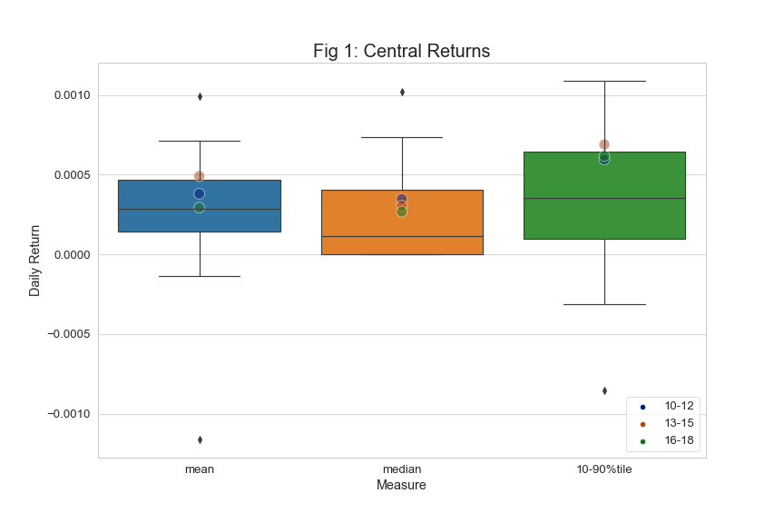
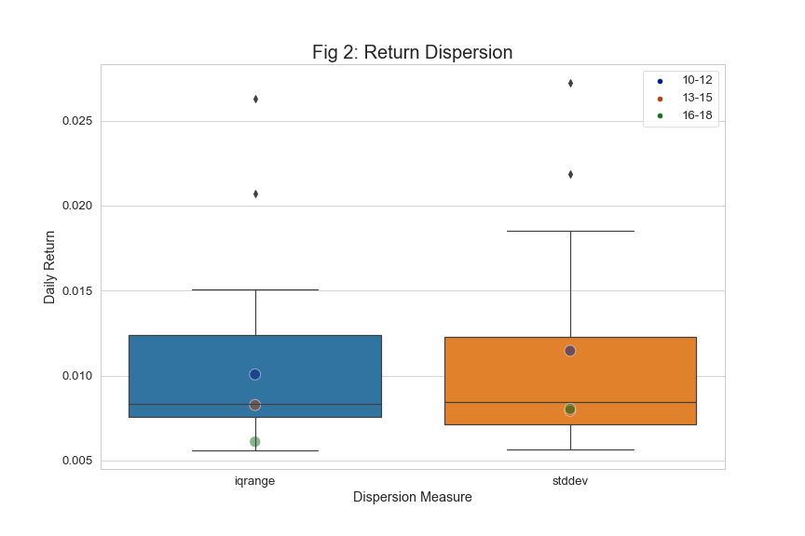
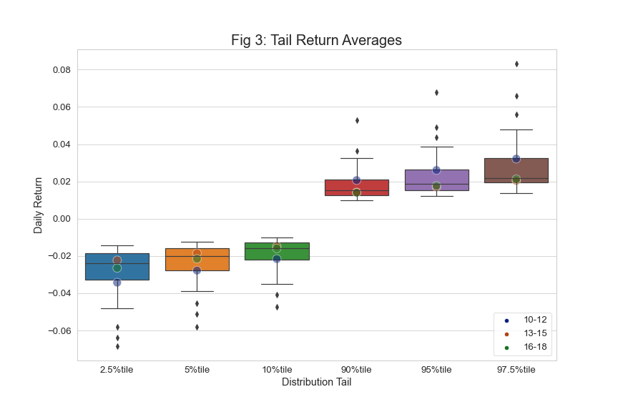
1: Are Recent Market Returns Larger?
Compare recent returns with previous. What is the empirical probability of observing a recent sample statistic assuming that returns are drawn from the same distribution?
Compute summary statistics:
mean, median, 10%-90%tile average.
tail averages.
std. dev and interquartile range.
We have 30 observations for each statistic.
Compute percent-of-rank value of each statistic from the 30 observations. This is the empirical probability of observing this or smaller values at random. A p-value can then be inferred.
The only measure that approaches statistical significance is the interquartile range of returns in the 2016-18 sample.
In general returns have been slightly larger on average (as seen by the mean, median and 10-90%tile) but outlier returns (absolute) in the recent period are not unusually large.

Slide 4
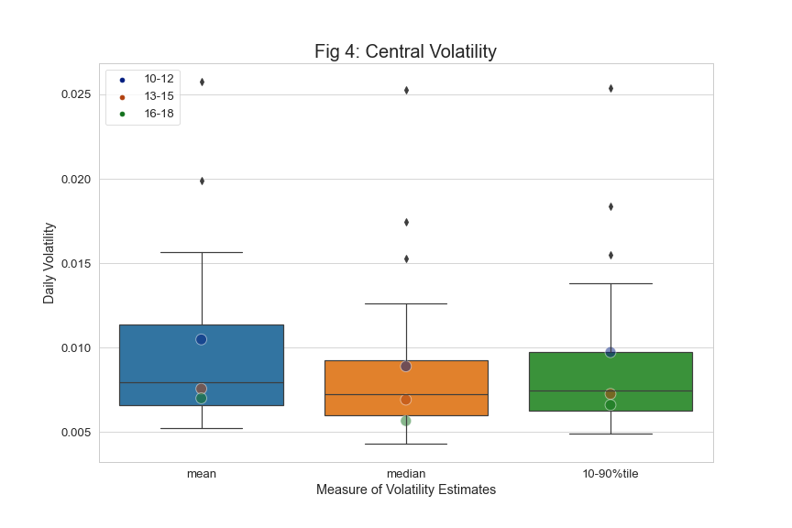
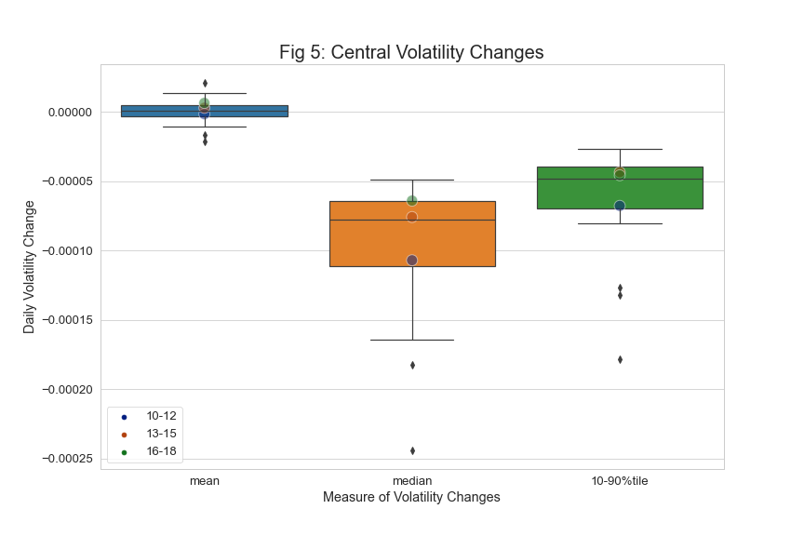
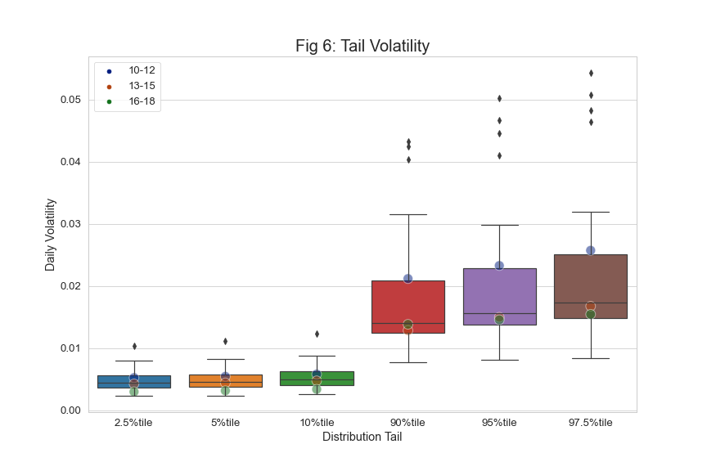
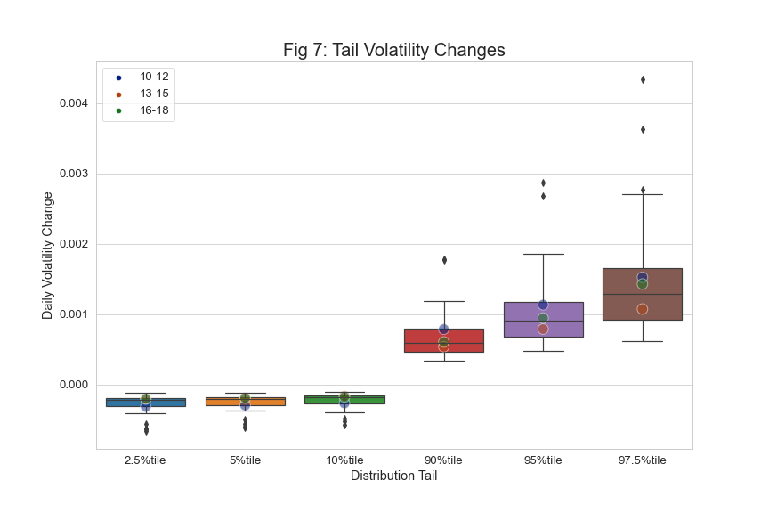
2: Is The Market More Reactive?
Compare the reactivity of market returns by estimating volatility with an exponential window and comparing the levels and daily changes.
Use a fast estimator: 2-week half-life.
Compute summary statistics, as previous - including tail averages -of both levels and daily changes.
Perc. value tables in appendix.
Nothing statistically significant.
2016-18 period marked by somewhat unusually low volatility (in the left tail, 2%tile and 5%tile indicated in fig 6).

Slide 5
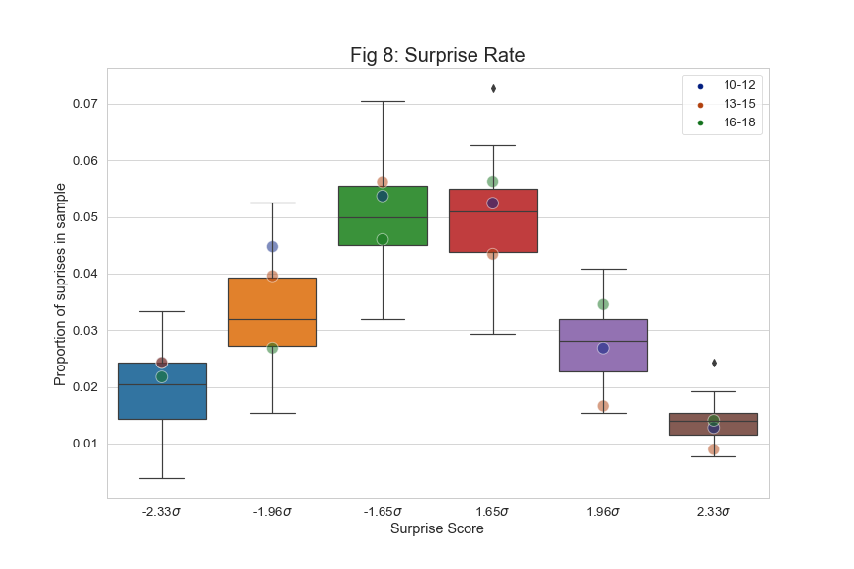
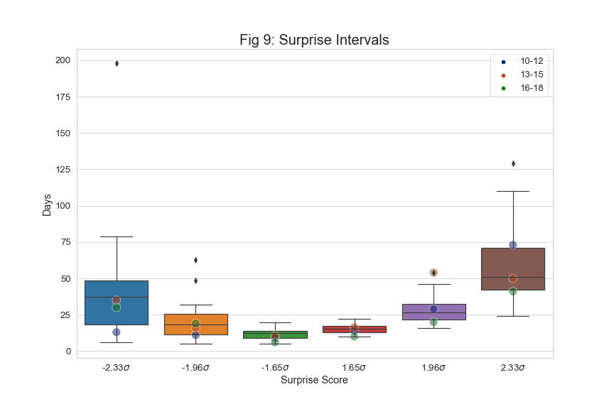
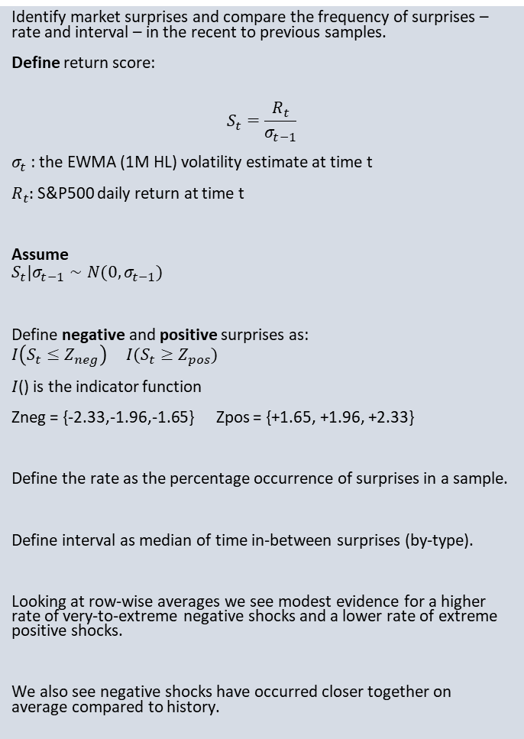
3: Have There Been More Market Surprises?
Identify market surprises and compare the frequency of surprises – rate and interval – in the recent to previous samples.
Define return score:
$$S_{t}=\frac{R_{t}}{σ_{t−1}}$$
$σ_{t}$: the EWMA (1M HL) volatility estimate at time t
$R_{t}:$ S&P500 daily return at time t
Assume
$$S_{t}|σ_{t−1}∼N(0,σ_{t−1})$$
Define negative and positive surprises as:
$$I\left(S_{t}≤Z_{neg}\right) I(S_{t}≥Z_{pos})$$
$I$() is the indicator function
Zneg = {-2.33,-1.96,-1.65} Zpos = {+1.65, +1.96, +2.33}
Define the rate as the percentage occurrence of surprises in a sample.
Define interval as median of time in-between surprises (by-type).
Looking at row-wise averages we see modest evidence for a higher rate of very-to-extreme negative shocks and a lower rate of extreme positive shocks.
We also see negative shocks have occurred closer together on average compared to history.

Slide 6
Preliminary Conclusions
No evidence that recent returns are statistically larger than historical returns. With most distribution features, recent returns are consistent with the historical distribution. We see evidence consistent with average positive performance over the 2010-2018 period, but tail returns are not statistically different from previous periods.
No evidence that return volatility or volatility changes, when measured with a fast estimator, are significantly higher in recent periods when compared to previous periods.
While surprises are not occurring much more frequently on average, we do see some evidence that certain negative surprises occurred more frequently in the recent period.
Surprise intervals have seemingly shortened on average for negative surprises though the evidence is most consistent for the specific 2010/12 sample.
From just the evidence at hand, we cannot infer with a reasonable degree of confidence that large market moves are happening more regularly or with greater speed than in the past.

Slide 7
Possible Next Steps
Robustness analysis with block-bootstrapping – possibly more relevant if longer sample lengths are desired
Code was written and provided.
Results for Q1 (return sizes) were consistent with the analysis presented.
Sensitivity analysis for Q2 & Q3
Do the inferences change with changing volatility estimators?
For market surprises, consider incorporating richer dynamics i.e. how long it takes for a market to mean revert after a surprise.
For market velocity consider looking directly at some representative trend strategies to see if recent performance and signal decay is different from previous periods.
Look at related markets and indicators e.g. VIX, intraday returns, Hi-Lo prices, etc..

Slide 8
Appendix

Slide 9
Volatility Level and Change Percentiles

