Slide 1

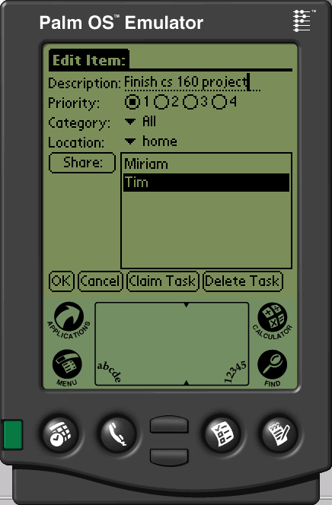
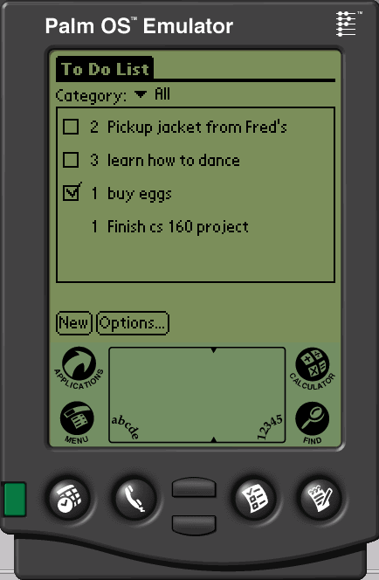
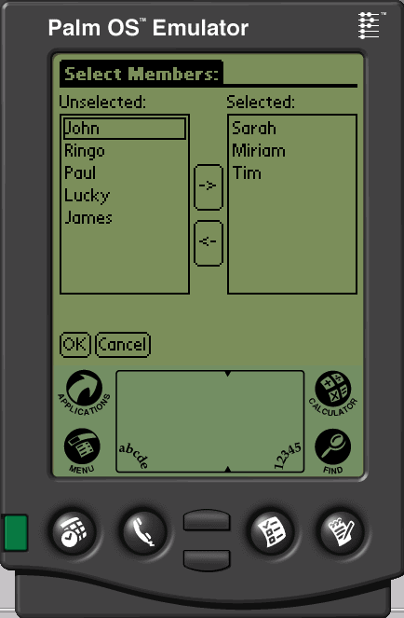
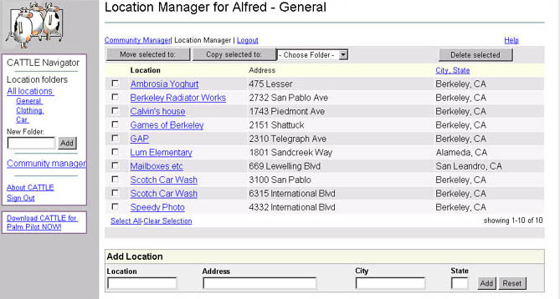
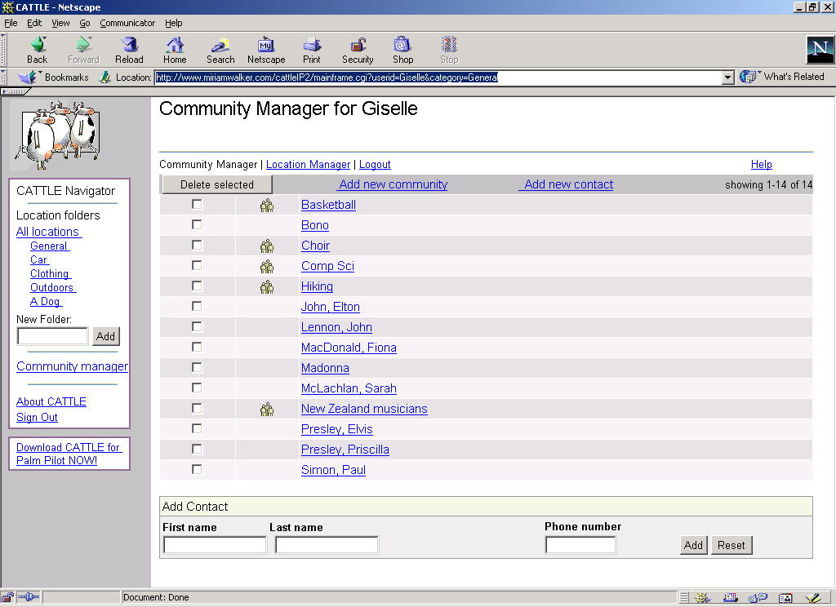
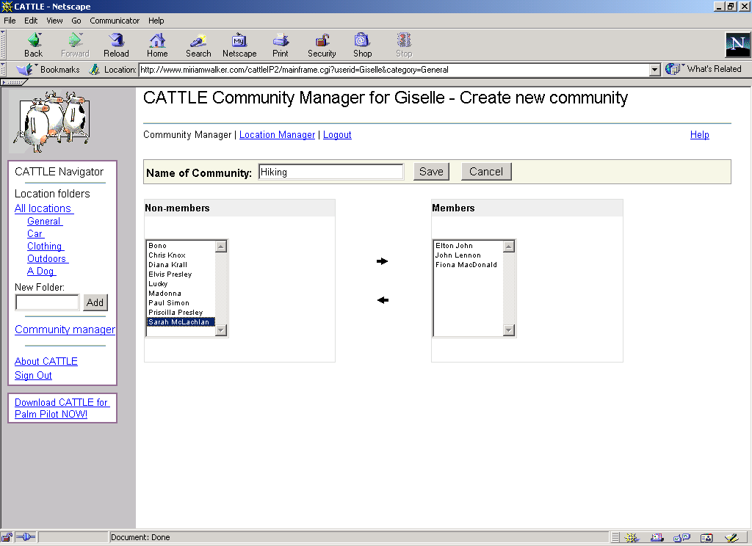
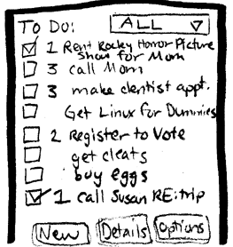
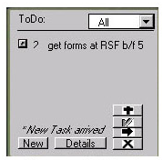
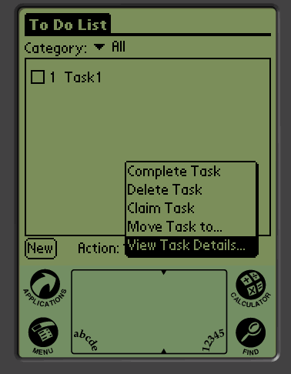
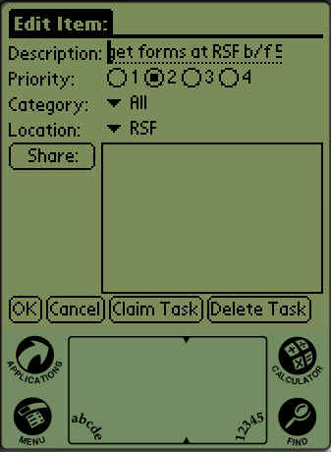
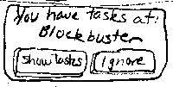
Project Title
Subtitle or Value Proposition
Overview
The basic problem you are attacking.
Gain a cursory understanding of our approach to solving within their first 15 seconds of scanning
Our Solution
Put key features here
Use appropriately sized fonts especially for titles
Use navigational cues to tell audience where to look next
Pick one color scheme & stick to it
Lots of images & limited text
Line stuff up using the drawing toolbar (View/Toolbars/Drawing || Draw -> Align). It’s cool.
View at 100% to see how BIG it will be when done
Design Iteration
Show initial sketch
Paper-prototype
Denim prototype (or even results from user test here)
Alexis Hope . Ryder Ziola . James Fogarty . Waldo
http://www.cs.washington.edu/440/sp11/project_files/cluster/
C S E 4 4 0
Spring 2011

