Slide 1
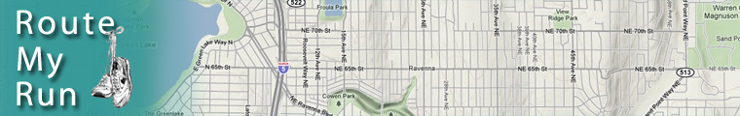

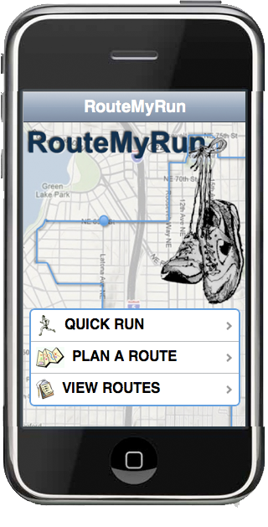
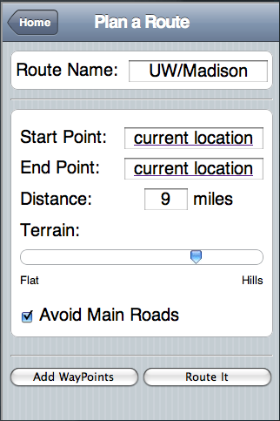
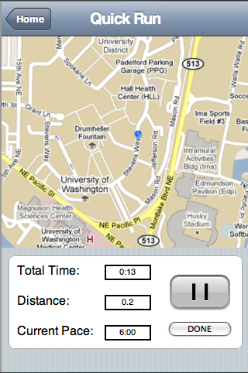
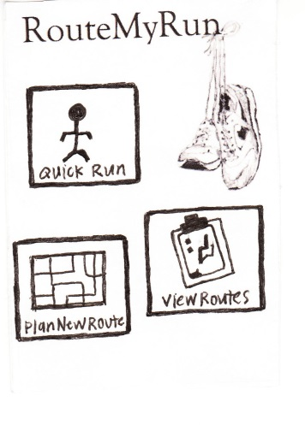
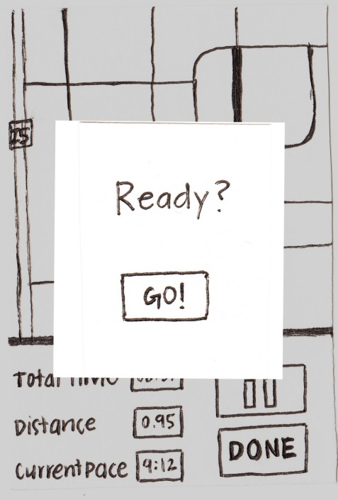
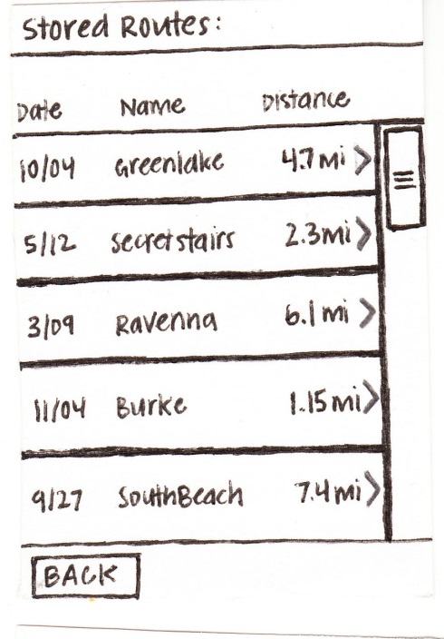
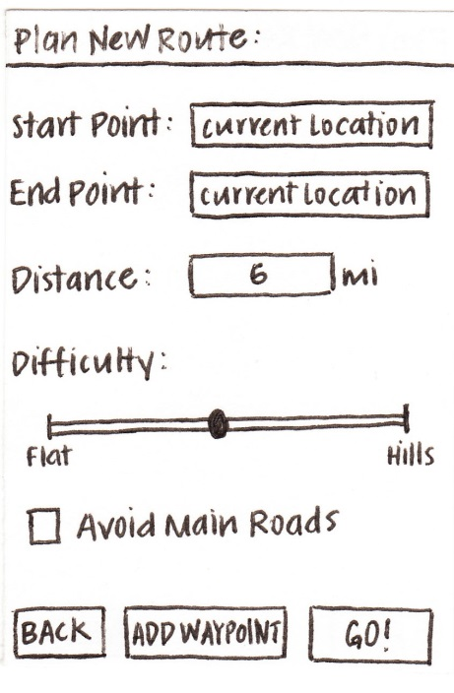
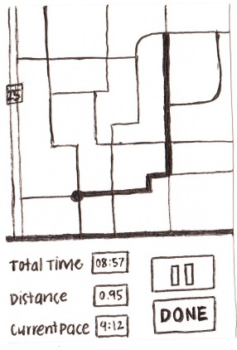
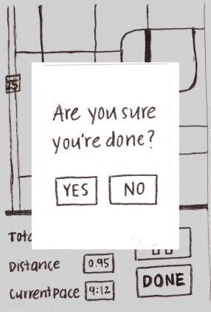
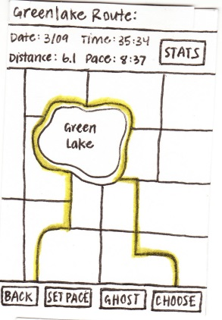
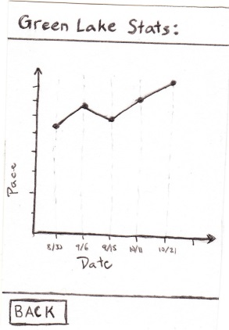
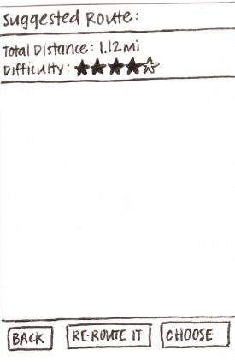
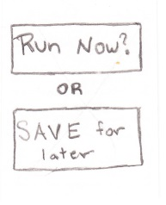
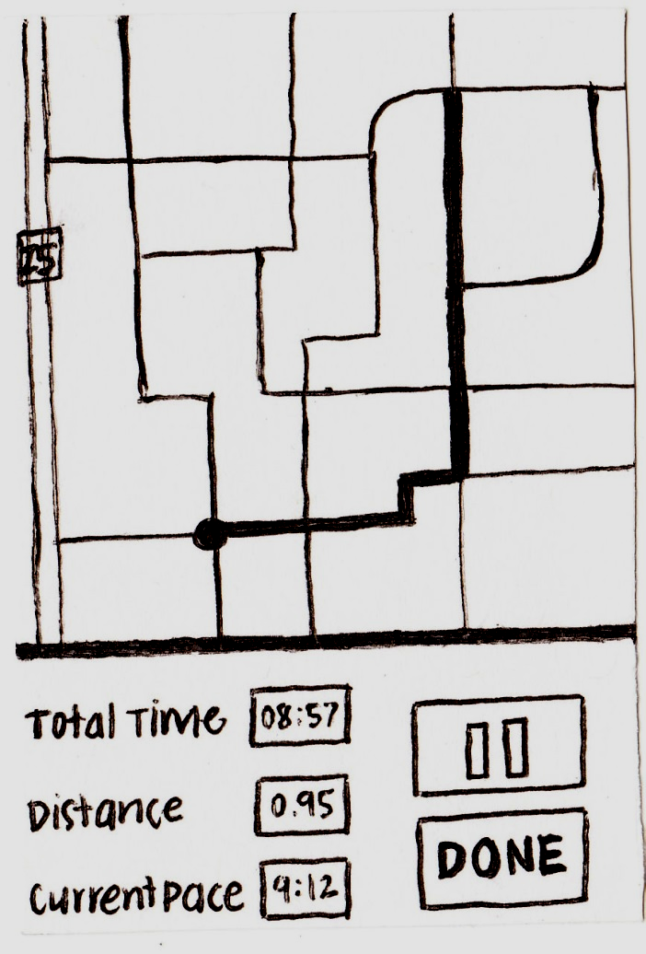
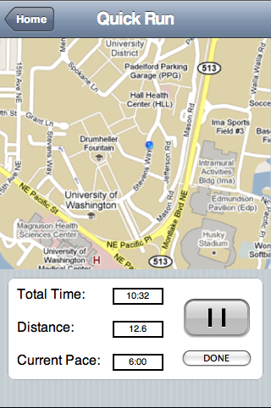
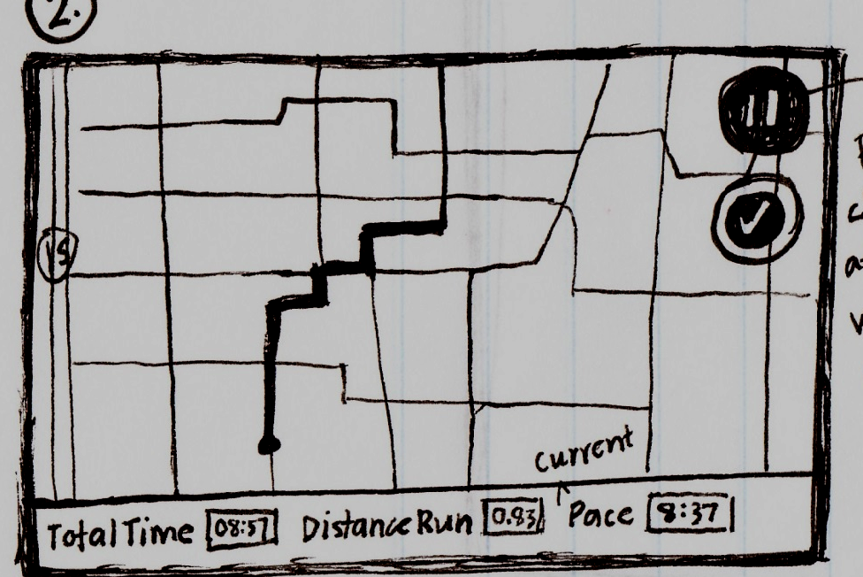
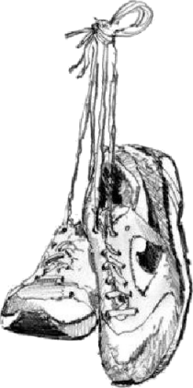
Mission: To provide a mobile tool that will allow runners to easily plan safe and enjoyable running routes.
Overview
Runners don’t have a good handle on where to run
Quality of run hindered due to an unfamiliar with the area
No good route planning tool exists
Our Solution
Location tracking & real time statistics
One button “Quick Run”
Plan new routes
Review old routes
Store and view running statistics
Set desired pace
Race personal best
The Prototype
Low-fidelity prototype
Design Iteration
Brainstorming -> Refinement
Sketches -> Prototype
Holistic -> Route Focused
Contextual Inquiry
Low-fidelity testing
Prototype
Steven Myhre - Stephanie Smallman - Toby Escarez - Lisa Fiedler
http://www.cs.washington.edu/education/courses/cse440/CurrentQtr/projects/routemyrun/
C S E 4 4 0
Autumn 2009
RouteMyRun

