Slide 1

Default-all is dangerous!
Version June 20, 2011
Wolfgang Gatterbauer
Alexandra Meliou
Dan Suciu
3rd USENIX Workshop on the Theory and Praxis of Provenance (Tapp'11)
Database group
University of Washington
http://db.cs.washington.edu/causality/

Slide 2
Overview Provenance Definitions
Why?
Where?
Naive
Witness
"SQL interpretation"
Why-provenance =
witness basis (α_{w})
Where-provenance =
propagation (α_{p})
Provenance
definition
Buneman et al. [ICDT’01]
Buneman et al. [PODS’02]
QRI definition
(Query-Rewrite-
Insensitive)
Minimal
witness basis (α_{w}^{m})
Default-all
propagation (α_{p}^{d})
Buneman et al. [ICDT’01]
Bhagwat et al. [VLDB’04]
We do not discuss here whether QRI is desirable (see also ),
but merely point out that, if aiming for QRI, care has to be taken about the ramifications of the proposed semantics.
Has problems if one interprets annotations on attribute values
Minimal
propagation (α_{p}^{m})
Glavic, Miller [Tapp'11]
Proposed in this paper!
Independent work presented at this WS

Slide 3
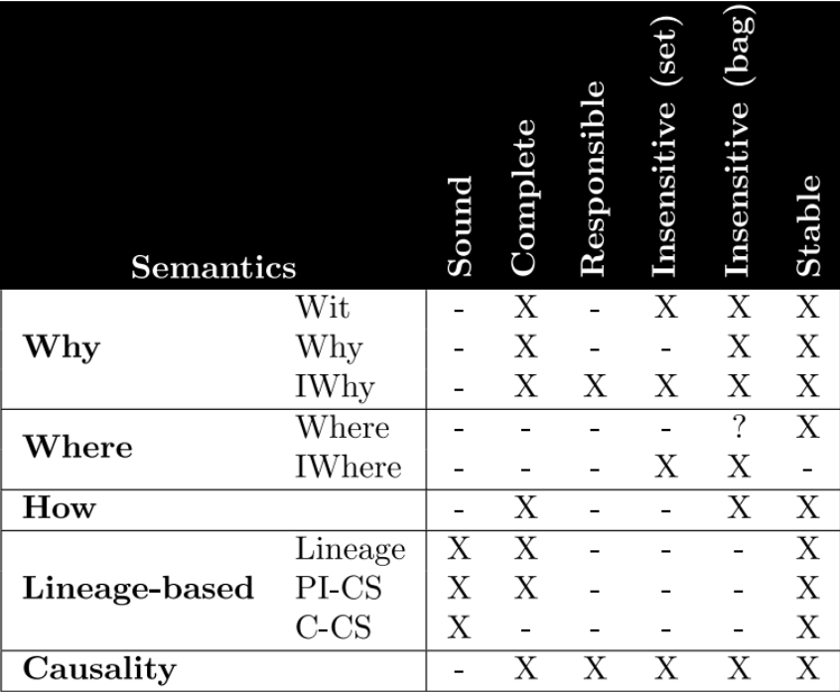
Overview Provenance Definitions
Why?
Where?
Naive
Witness
"SQL interpretation"
Why-provenance =
witness basis (α_{w})
Where-provenance =
propagation (α_{p})
Provenance
definition
Buneman et al. [ICDT’01]
Buneman et al. [PODS’02]
QRI definition
(Query-Rewrite-
Insensitive)
Minimal
witness basis (α_{w}^{m})
Default-all
propagation (α_{p}^{d})
Glavic, Miller [Tapp'11]
Buneman et al. [ICDT’01]
Bhagwat et al. [VLDB’04]
Has problems if one interprets annotations on attribute values
Minimal
propagation (α_{p}^{m})
Proposed in this paper!
Note that Minimal propagation is "stable", in contrast to Default-all

Slide 4
Example 1: Query-Rewrite-Insensitivity (QRI)
Why
Why-provenance = witness basis (α_{w})
Lineage (α_{l})
Minimal witness basis (α_{w}^{m})
Input
Query 1
Query 2 ≡ Query 1
R
Q₁(x,y):-R(x,y)
Q₂(x,y):-R(x,y),R(_,y)
A
B
A
B
A
B
t₁
1
2
1
2
{{t₁}}
1
2
{{t₁},{t₁,t₃}}
{{t₁}}
{t₁,t₃}
t₂
1
3
1
3
{{t₂}}
1
3
{{t₂}}
{{t₂}}
{t₂}
t₃
2
2
2
2
{{t₃}}
2
2
{{t₃},{t₁,t₃}}
{{t₃}}
{t₁,t₃}
Where
Where-provenance = propagation (α_{p})
Minimal propagation (α_{p}^{m})
Default-all propagation (α_{p}^{d})
Input
Query 1
Query 2 ≡ Query 1
Rª
Q₁(x,y):-Rª (x,y)
Q₂(x,y):-Rª(x,y),Rª (_,y)
A
B
A
B
A
B
A
B
A
B
1ª
2^{b}
1ª
2^{b}
1ª
2^{b,f}
1^{a,c}
2^{b,f}
1ª
2^{b}
1^{c}
3^{d}
1^{c}
3^{d}
1^{c}
3^{d}
1^{a,c}
3^{d}
1^{c}
3^{d}
2e
2^{f}
2e
2^{f}
2e
2^{b,f}
2e
2^{b,f}
2e
2^{f}
Example adapted from
Cheney et al. [Foundations and Trends in DBs’09]

Slide 5
Real example: Why Default-all is dangerous
Hanako queries a community DB for contents of LF-milk*:
Community Database
Hanako's query
Rª
Q (y):-Rª(‘LF Milk’,y)
Food
Content
b
Bob, March 18, 2011
Don't drink, lots of Cesium!
Content
LF Milk
Cesium-137^{b}
Cesium-137???
LF Milk
Calcium^{d}
f
Fuyumi, March 19, 2011
No Cesium, save to drink!
Calcium^{d}
SC Water
Cesium-137^{f}
Default-all propagation makes her drink the milk:
Default-all propagation (α_{p}^{d})
Minimal propagation (α_{p}^{m})
Content
Content
Cesium-137^{bf}
"semantically irrelevant information": annota-tions leak over from SC Water tuple to LF Milk
Cesium-137^{b}
Calcium^{d}
Calcium^{d}
b
Bob, March 18, 2011
Don't drink, lots of Cesium!
b
Bob, March 18, 2011
Don't drink, lots of Cesium!
f
Fuyumi, March 19, 2011
No Cesium, save to drink!
"all relevant and only relevant"
* Note the one-to-one correspondence of this example with example 1
Notes:
* "semantically irrelevant information:"
information "leaks over" from one to another tuple (James Cheney)
here in the example from SC Water to LF Milk
* "all relevant and only relevant:"
see definition next slide

Slide 6
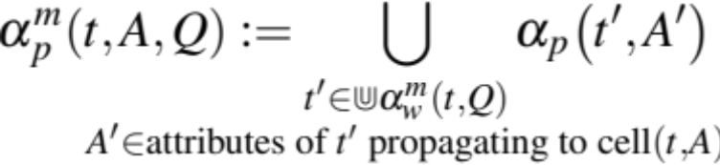

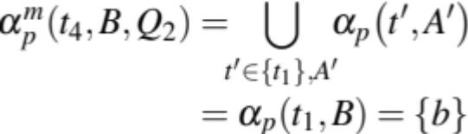
Definition Minimal propagation (α_{p}^{m})
Intuition:
Return the intersection between:
query-specific where-provenanc (α_{p})
and QRI minimal witness basis (α_{w}^{m})
transforms 'sets of sets' into 'sets',
hence something like QRI lineage
"all relevant ... and only relevant"
Example 1
Where provenance (α_{p})
Minimal propagation (α_{p}^{m})
Input
Query 2
Rª
Q₂(x,y):-Rª(x,y),Rª (_,y)
A
B
A
B
A
B
t₁
1ª
2^{b}
1ª
2^{b,f}
{{t₁}}
{t₁}
t₄
1ª
2^{b}
t₂
1^{c}
3^{d}
1^{c}
3^{d}
{{t₂}}
{t₂}
t₅
1^{c}
3^{d}
t₃
2e
2^{f}
2e
2^{b,f}
{{t₃}}
{t₃}
t₆
2e
2^{f}
α_{w}^{m}
Minimal witness basis (α_{w}^{m})
Notes:
* "all relevant ...":
consider all annotations in the where-provenance
* "... and only relevant:"
only annotations on tuples in the minimal witness basis

Slide 7









Example 1: Illustration of "minimal" versus "all"
Why-provenance
Why-provenance (α_{w})
Minimal witness basis (α_{w}^{m})
Where-provenance
Where-provenance (α_{p})
Default-all propagation (α_{p}^{d})
Minimal propagation (α_{p}^{m})

Slide 8
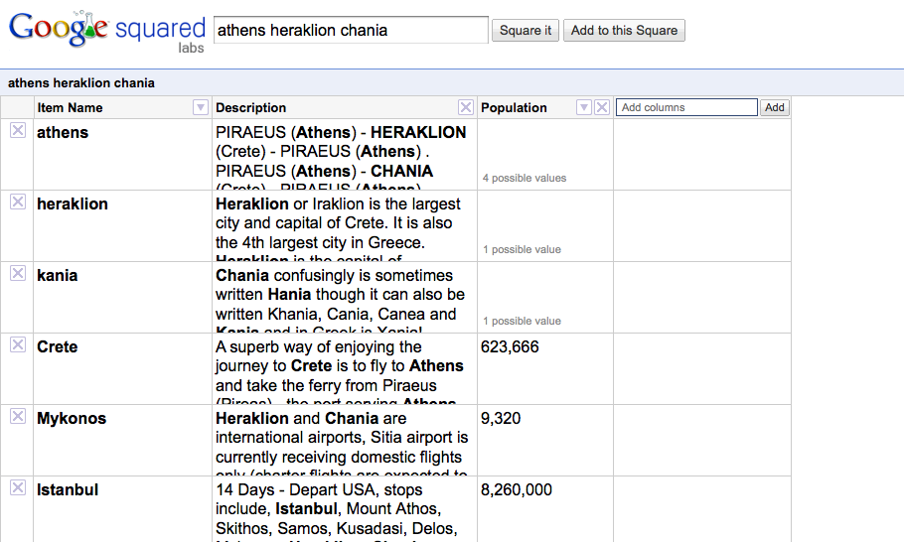
Interpretation of Annotations 1: Attribute Value*
* Interpretation of annotations on entity attribute values favored by us and underlying our model

Slide 9
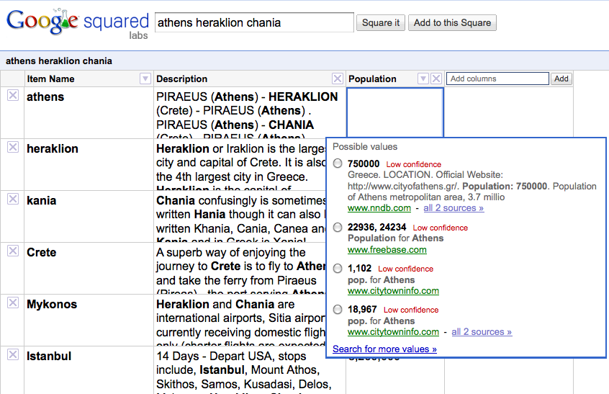
Interpretation of Annotations 1: Attribute Value*
Annotations on values of an attribute (here "population") for
a particular entity (here "Athens")
Argument: Interpreting cell annotations as relevant to the tuple (entity) adds something that is not trivially modeled with normalized tables.
* Interpretation of annotations on entity attribute values favored by us and underlying our model

Slide 10
Interpretation of Annotations 2: Domain Value*
Domain value annotations*
Alternative representation
Input Rª:
Annotation table Sª:
A
B
b
Bob, March 18, 2011
This number is a prime number.
B
annotation
1ª
2^{b}
2
b: Bob, March 18, 2011
This number is a prime number.
1^{c}
3^{d}
f
Fuyumi, March 19, 2011
Two is not a prime number because it is even.
2e
2^{f}
2
f: Fuyumi, March 19, 2011
Two is not a prime number because it is even
Input Sª:
...
Date
b
This is a holiday.
Annotation table Sª:
...
Dec 25
Date
annotation
...
...
f
This is a holiday too !!!
Dec 25
...
Dec 25
This is a holiday.
Argument for default-all: If annotations are on domain values, then retrieving
all annotations are relevant.
Counter-Argument: But then these anno-tations can be modeled in a separate table as normalized tables.
* Alternative interpretation suggested by Wang-Chiew Tan (example created after conversation at Sigmod 2011)

Slide 11
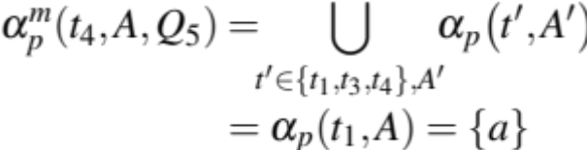
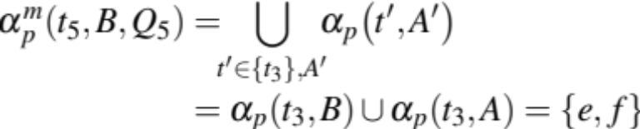
Backup: Detailed Example 2
Rª
Q₅(x,y):-Rª(x,y),Rª(y,_),Rª(x,_)
A
B
A
B
t₁
1ª
2^{b}
t₅
1^{a,c}
2^{b,e,g}
{{t₁,t₃},{t₁,t₂,t₃},{t₁,t₄},{t₁,t₂,t₄}}
{{t₁,t₃}, {t₁,t₄}}
{t₁,t₃,t₄}
t₂
1^{c}
3^{d}
t₆
2^{e,g}
2^{e,f,g}
{{t₃},{t₃,t₄}}
{{t₃}}
{t₃}
t₃
2e
2^{f}
t₄
2^{g}
4^{h}
Why-provenance (α_{w})
α_{w}^{m} (~QRI lineage)
Where-provenance (α_{p})
Minimal witness basis (α_{w}^{m})
Default-all propagation (α_{p}^{d})
Minimal propagation (α_{p}^{m})
A
B
A
B
1^{a,c}
2^{b,e,f,g}
t₄
1ª
2^{b,e,g}
2^{e,g}
2^{b,e,f}
t₅
2e
2^{e,f}
α_{p}^{d}(t₄,B,Q₅) = α_{p}(t₄,B,Q₆) with
Q₆(x,y):-Rª(x,y),Rª(y,_),Rª(x,_) ,Sª(_,y)
Note minimal propagation is not equivalent to just evaluating the where-provenance for the query: Q₇(x,y):-Rª(x,y),Rª(y,_). E.g. α_{p}(t₅,B,Q₇) = {e,f,g}

