Slide 1
HUAWEI
Company Overview

Slide 2
Focusing on Information Transmission, Storage, and
Distribution to Provide ICT Solutions and Services for
Three Business Groups
Serving hundreds of
millions of consumers
Serving global carriers
Focusing on high-value industries
Consumer Business
A brand loved by consumers
Carrier Business
Customers' best strategic partner
Enterprise Business
Enterprises' best innovation partner
A Global Leader of ICT Solutions
Information Distribution and Presentation
Information Transmission
Information Storage
Smartphones
MBB & home devices
Wearable devices
Vehicle telematics
Mobile networks
Fixed networks
Carrier software and core networks
Enterprise networks
M2M connection management platforms
Data center infrastructure
Big Data analytics platforms
Cloud services
Professional services

Slide 3
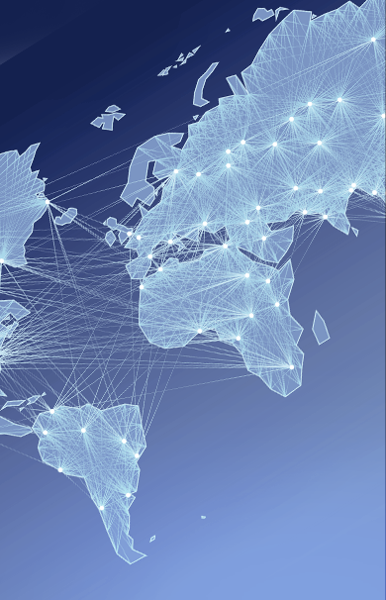





Huawei at a Glance
228
79,000
16
Ranking in
the Fortune
Global 500
R&D employees
R&D centers
170+
176,000
36
Countries
Employees
Joint innovation centers
Notes:
Key Messages:
Huawei is a global leader of ICT solutions. Continuously innovating based on customer needs, we are committed to enhancing customer experiences and creating maximum value for telecom carriers, enterprises, and consumers. Our telecom network equipment, IT products and solutions, and smart devices are used in 170 countries and regions. Huawei ranked 228th on the Global Fortune 500 in 2015 based on its 2014 revenue.
We invest over 10% of our annual sales revenue into R&D and more than 45% of our 176,000 employees engage in R&D. We have built 16 R&D centers worldwide and 36 joint innovation centers with customers.
**********************************
Slide Owner: Wang Jie (00286887), Corporate Marketing Dept
Latest update: Feb, 2015
Recommended target audience: governments, media, partners and customers not so familiar with Huawei
**********************************
More information

Slide 4
Globalized Resource Deployment and Localized Business Operations
Netherlands
Toronto
Germany
Hungary
Ottawa
Romania
Silicon Valley
China
Mexico
Bahrain
India
UAE
Malaysia
Huawei headquarters
Brazil
Accounting shared service center
Bidding center
Mauritius
Supply center & hub
Argentina
R&D center
Training center
Technical support center
Operations in 170+ countries; 176,000+ employees comprising 160+ nationalities worldwide; 72% localization rate.
Huawei's global value chain allows the smooth transfer of capabilities around the world, develops and retains talent in local countries, and creates jobs and economic opportunities.

Slide 5
Continuous Effective Growth
Achieved sustainable and effective growth in core business units through focused strategy
Enterprise business made rapid growth through focused efforts in public safety, finance, transportation and energy
Consumer business established premium brand image and witnessed effective growth
Carrier business achieved steady growth and consolidated technology leadership and competitiveness
Sales Revenue
60.8
USD Billion
46.5
39.5
35.4
32.4
2011
2012
2013
2014
2015
Notes:
讲解要点：
2014年，ICT行业迎来蓬勃发展: 4G建设方兴未艾，云计算、大数据、物联网等技术创新加速，智能终端全面普及。华为抓住机遇，坚持战略聚焦、简化管理、有效增长。2014年, 华为销售收入为2882亿元人民币，同比增长20.6%。主营业务利润为342亿元人民币，主营业务利润率约为12%。
2015年上半年，得益于华为构筑的全球化均衡布局，公司实现销售收入1759亿元人民币，同比增长30%；营业利润率18%。
上半年，企业业务创新的产品和解决方案构建了竞争力的基础，并获得客户广泛认可，开始进入加速发展的轨道。受益于云计算、存储、敏捷网络等主力产品和解决方案在中国及海外智慧城市，金融，教育，ISP等市场的广泛应用，增长开始加速。
消费者业务，体验好、高质量的产品受到消费者的喜爱，中高端的品牌形象已经建立并站稳脚跟。以Mate7、P8为代表的华为中高端手机和荣耀手机双双取得长足进步，消费者业务实现了有质量、可持续的增长。
运营商业务，领先优势持续加强，加大面向未来的牵引力度，以软件定义和云计算为龙头牵引下一代网络技术的发展。以软件定义为核心的SoftCOM战略驱动下一代网络架构和运营模式的变革。受益于中国4G网络建设持续投资和全球数据流量增长驱动提升网络容量的投资，以及运营商数字化转型驱动的ICT产业投资，运营商业务保持持续稳定增长。
**********************************
Slide Owner: Wang Jie (00286887), Corporate Marketing Dept
Latest update: April, 2015
Recommended target audience: all
**********************************
更多信息:
财报的汇报主体为华为控股
人民币是公司的记账本币
华为虽然不是上市公司，但我们一直按上市公司的要求操作，公司财务数据都经过KPMG审计，并且每年都发布年报，保持财务的透明，使客户能更好地了解我们。

Slide 6

Enterprise Business
Focusing on One-stop New ICT Infrastructure Featuring
Cloud Computing Centricity and Cloud-Pipe-Device Synergy
MES
CRM
ERP
PLM
Cloud
Data Centers
Cloud OS
Big Data
Analytics Platforms
Storage
Servers
Pipe
Security
Service
Agile Campuses
Data Center Networks
eLTE
IP Networks
Transport Networks
WLAN
Device
IoT
Agile Gateways
Telepresence
Video Conferences/IVS

Slide 7
Huawei is Committed to Building a Better Connected World
Building a Better Connected World
A Better Connected World is on the horizon. It will have a far-reaching impact on every individual, organization, and industry.
We are committed to building a more efficient and integrated information logistics system that links people to people, people to things, and things to things.
We are connecting systems, businesses, cities, societies, and people around the world, improving efficiency, transforming industries, creating a better experience for everyone, and enabling the free exchange of thoughts and ideas.
Ubiquitous
Connectivity
Agile
Innovation
Inspired
Experience
Everywhere: mobile broadband, fixed broadband, and enterprise networks
Everything: connectivity between people and people, people and things, things and things, and people and services
Everyone: bridging the digital divide to ensure affordable broadband for all
New business models: Big Data analytics, smart industries, and cloud services
New smart ecosystems: device-cloud ecosystems that suit both work- and life-based scenarios
New operating models: Internetized Operations
New technological revolutions: SD-DC2, SDN/NFV, and 5G
Speed: ultra-broadband, zero wait time
Quality: 4K videos and MirrorSys immersive communication
Freedom: Real-time, On-demand, All-online, DIY, Social (ROADS)
Continuous innovation and open cooperation based on customer needs and leading technologies

Slide 8











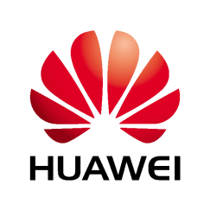
















Global Partners
Analysts
Industry
Academy
Stanford
UIUC
Research Institute

Slide 9
Cloud Service Strategy: Working with Partners to Build an Open Cloud Ecosystem
Business strategy:
    Jointly build the cloud ecosystem by positioning open business cooperation as the core and technology cooperation and talent cultivation as support.
    Focus on IaaS, enable PaaS, and aggregate SaaS; adhere to "Being Integrated".
    Never monetize data in the enterprise market; data belongs to customers.
    Position working with carriers as our first choice when providing enterprise cloud services.
  Unique advantages:
    Technology accumulation based on core technologies developed in-house.
    Open hybrid cloud support using compatible OpenStack architecture.
Internet apps
Industry apps
Universal apps
Games/ video
Enterprise websites/ e-business...
E-government/ smart city
Smart transportation/ media services…
OA/ ERP/CRM
HR/Finance/Enterprise communication…
PaaS
FusionStage
FusionInsight
FusionSphere
IaaS
Servers
Storage
Data center networks

Slide 10

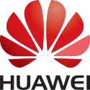
T-Systems and Huawei Work Together to Leverage Strengths from Two Continents
Many years of partnership
+
Huawei
Providing open, converged, and agile enterprise-level public cloud solution with high problem-solving competence and flexibility
Gold member of the OpenStack Foundation
T-Systems
Deutsche Telekom’s ubiquitous network, connectivity, and T-Systems’ understanding of enterprise applications and service advantages 'Made in Germany'
Operates and manages the platform in TWIN-CORE HIHG LEVEL DATA CENTER T3+ ( Biere and Magdeburg ) in Germany with exclusive platform control
Utilizing T-Systems technology and quality leadership in cloud services and Huawei's cutting-edge technology and problem-solving competence, we secure the best prices, services, and quality of our customers' IT transformation into the cloud.

Slide 11
Huawei Big Data Platform Architecture
Application service layer
OpenAPI/SDK
REST/SNMP/Syslog
DataFarm
Data
Porter
Information
Miner
Knowledge
Farmer
Wisdom
Manager
Hadoop API
Plug-in API
System mgmt
MPP DB
Service governance
HIVE
M/R
Spark
Storm
Solr
Hadoop
Yarn/ ZooKeeper
Security mgmt
HDFS/HBase
The Hadoop layer provides Big Data processing environments and delivers enhancements based on open source software.
The DataFarm layer provides end-to-end data insight, builds the data supply chain from data, to information, knowledge, and wisdom. DataFarm includes Porter for data integration, Miner for data mining services, and Farmer for data service frameworks.
FusionInsight Manager is a distributed management framework. The system administrator can control the distributed cluster from a single access point, including system management, data security management, and data governance.

Slide 12


Huawei Builds Up Professional R&D Teams Globally
Key point: Highlight Huawei's global layout, excellent resources, and best practices.
Canada Research Center:
Yarn/large-scale scheduling
Hardware acceleration
Finance Big Data analysis
Xi'an Research Center:
Hadoop products
ELK/MPP DB
Hangzhou Research Center:
Hadoop & Spark
Stream computing
European Research Center:
Distributed memory DB
Distributed computing algorithm
US Research Center:
Spark
ELK/MPP DB
Big Data acceleration
Shenzhen Research Center/Hong Kong:
Big Data insight platform
Big Data solution
Data mining algorithm
India Research Center:
Hadoop
Data visualization
MOLAP
Huawei announces Big Data as one of the four strategic directions into the future and plans to invest thousands of R&D talents in this field.

Slide 13
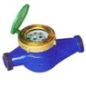





Euler : Core Software Infrastructure of “Device--Pipe--Cloud”
Device
Pipe
Cloud
BaseStation,Controller
transmission network
、PTN, AN
Wireless PS
MCCP
CloudDSL/OLT
Public Cloud
Business & APP
IOT
Enterprise
Family
Personal
CloudBB
CloudEDGE
Telco OS
Key Value
Best
Easy Trusted Experience Ultimate
Performance Availability Efficiency On-Demand Scale-Out
Lite OS
Make IoT hardware more Intelligence(Interconnection, low power consumption, KB)
Security Mobile OS
For the best mobile office security experience
Media OS
fast, high quality, the best experience all format
iCOS
Since the self-research chip build extreme experience together
EulerRTOS
High real-time, high reliability, easy to maintain
EulerOS(ServerOS)
Highly reliable, safe, open, easy to maintain
Programming Technology
Static compiler
Programming Language
SDK/Tools
Performance, high capacity
Business :
Abstract, Decoupling,
Enable
Hardware :
Abstract, Decoupling,
Enable
UVP ( virtualization )
Across different nodes/DC resource pooling and scheduling, high performance (delay & overhead), high efficiency (TTM), high resource utilization (Ondemand)
Linux Kernel
Unified the Linux kernel and the innovation, synchronous community, ARM/x86 enabled, high performance, high reliability, easy to maintain
Hardware
isomorphism / Heterogeneous Integrated Core （Kylin、ARM64、X86…）
……
SIGMA、GAMA、COTS Hardware、network、store
Notes:
1、欧拉主要关注于为华为公司的产品和解决方案提供操作系统相关的技术和解决方案；
2、主要的产品是：面向手机设备的iCOS，面向IoT的LiteOS，面向机顶盒STB的MediaOS，面向电信设备的RTOS和面向服务器的EulerOS，同时也为云上的计算环境提供统一虚拟化平台。

Slide 14
Gauss DB - Multiple database systems covers all industries
Mainframe/
Minicomputer
Embedded
PC Server
Cloud Computing
Data decoupling in DC
Unified data management
between DC
integration
Scale-up
hierarchical
Scale-out
Carrier
DCs as a Computer
Traditional IT
Internet
★
Gauss100 OLTP
Suitable for transactional application scenarios, support high availability cluster, high-performance, scalable to 32 nodes Oracle application compatibility, support alternative changes less than 1%
①
②
③
Distributed database
the goal to support across the unification of the data center data storage and access, provide a uniform data access interface, ms delay support customer global consistent experience, realize high availability across the data center business, and support across the data center disaster data and backup.
OLAP DB
OLTP DB
①
②
③
MPP
Cluster
Distributed
SQL Engine
Toolbox
Interface and Driver
Execution engine
Gauss 200 OLAP
Sophisticated analysis of structured data, up to petabyte level. Based on X86 / Linux open platform, and can be integrated with the Hadoop ecosystem.
Storage engine
Mem engine
Disk engine
FS
OS/Virtualization
Chips

Slide 15

Gauss DB - Multiple database systems covers all industries
Pipe
Device
Cloud
NFV
SmartCare
FusionInsight大数据
DT
Public Cloud
CloudEdge、CloudCore
TLF
Consumer Cloud/vMall
Business Cloud
GMDB V3
Distributed In-Memory DB
Gauss200 OLAP
Analytic Database
NaturalBase
Device data management
RDS、ADS
Cloud-Native Database
Goals：
Support application of NFV/ SDN @SoftCOM to implement app-logic/data separation
Competitive：
Resilient scalability，support agile business
Low Latency， support same UX with traditional Telco apps
Telco grade high reliability，Cross-DC HA， DR
Goals：
Improve FusionInsight Big Data platform Competitiveness
Support ADS, Smart City, Smartcare Solutions
Competitive：
High performance of PB level structured data management；
High reliability and easy to use
CloudNative architecture
Cross-DCs data analytic
Goals：
Provide device user better data management ability
Competitive：
Intelligent adaptive data management
Adaption of heterogeneous data engines, apps transparent switch between different engines
Goals：
Provide better data management ability for enterprise application running on cloud
Competitive：
Enterprise level high reliability
Easy to operate，automation
Management ability of million DB instance
Goals：
Distributed Data Management for Cloudily Data Center
Competitive：
Resilient scalability with distributed architecture
Distributed transaction support global consistency
Global data distribution， globally deployed application can access data locally for better UX
D-Matrix（Technology Prototype Project）
Page 15
Notes:
落脚点：对修改开源的诉求低

Slide 16



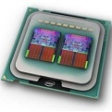

DPC Lab: Distributed parallel computing speed “Large-Scale" business innovation
Distributed parallel computing developing trend:
Network to soften, data centralized, distributed across the data center application extension ability is the key, how to take advantage of IT technology and keep consistent CT experience?
As multi-core, heterogeneous, the sustainable development of the multi-core and heterogeneous hardware oriented thousand thread, the details of how to shield the hardware, give full play to the ability to scale hardware last?
①Large-scale real-time handle
(NFV hardware and software decoupling)
③ Large-scale application innovation (Cloud Computing)
SDDC－SEA
Scalability: →∞,Opex ≈0
The performance of the linear growth rate of 50%
Adaptive Scale Out/In (across different Multi-core, across the chip, across nodes, DC, free to modify, free release)
Scenario/
problem
②Large-scale data computing(SDN integrated routing computing
CloudDSL/OLT
Telco OS
Public cloud
CloudBB
CloudEDGE
Clloud distributed application
DevOps Studio
Cloud Distributed Software
vDCn
Across DC
Multilayer
Multitenant
Massive node
Distributed parallel computing
vEPC
Business awareness of distributed computing framework
Code Mgt.
Efficiency:
TTM≈0
Resource utilization > 70%
Code reuse rate 100%
Across the DC distributed cluster
vDC1
vDC2
high speed tansparent memory communication
vIMS
vEPC
vEPC
vApp
Multi-core heterogeneous
ISV
Distributed store
Distributed store
Cluster management and adaptive scheduling
Virtual network
LXC/Docker
System Monitor
Availability：99999
Business don't interrupt
Business self-healing<1s
OpenStack
DataCenter as a Computer
vDCn
vDC2
Hypervisor/OS
FPGA
Multi-core heterogeneous
Thousand core
vDC1
ARM64
X86＋MIC
modeling
Hardware
DSP
GPU
……
Notes:
1、分布式与并行计算Lab主要关注与分布式和并行计算相关的软件技术和算法实现，以及分布式数据管理；
2、当前的主要研究的场景有：面向异构硬件的分布式并行编程技术，面向容器的微服务编程框架，下一代大数据分析技术，面向跨数据中心场景的分布式数据管理相关技术。

Slide 17






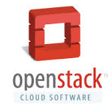
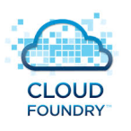

Software Open Source Competency Center of CSI
Open Source
Software Scanning
Early Engagement
In New OSS Projects
  Early Recognition and Participation
  Consumption Management
  Training and Internal Process
  Community Management
OSS Organization | Contribution & Influence
 | Top 20 in kernel
 | Top 5 in Hadoop Top 5 in Spark
 | Core member Sit in Board & TSC
 | Founding member Sit in Board & TSC
 | Founding member Sit in Board & SC
 | Gold Member Top 10 contribution
 | Gold Member Top 10 contribution
 | Silver Member Asia Pacific Laboratory
Component Pedigree
Life Cycle Management
Code Synchronization
Product
Supporting
Open Source Process
Open Source Tools
Open Source Models
Cultivating Talents to Work in Open Source Community
Operation and Promotion of Open Source Community

Slide 18
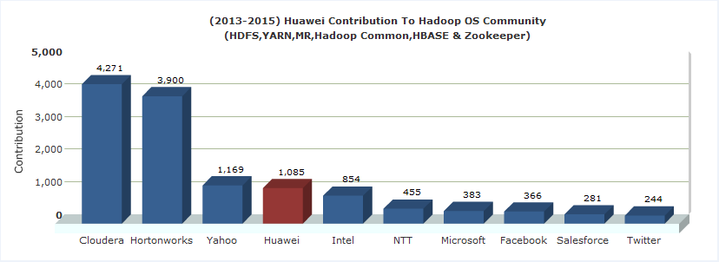
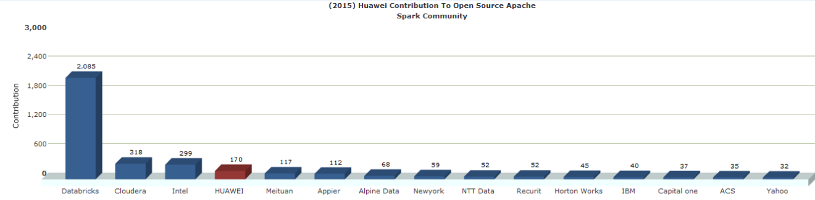


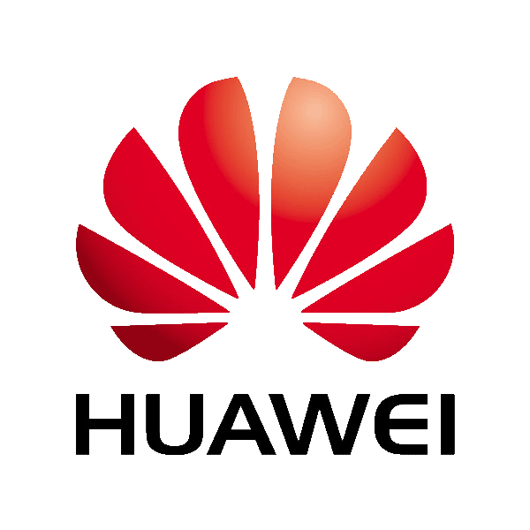
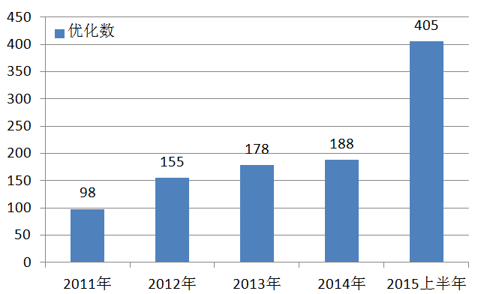
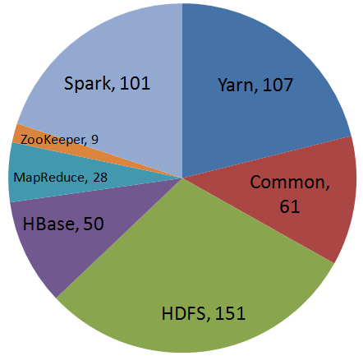
Huawei's Contributions to the Hadoop Community
1
PMC
4
Committer
50+
Contributors
Increasing contributions to the Hadoop community makes Huawei one of top contributors around the world.
Huawei's contributions to components in the Hadoop community in the first half of 2015.

