Slide 1
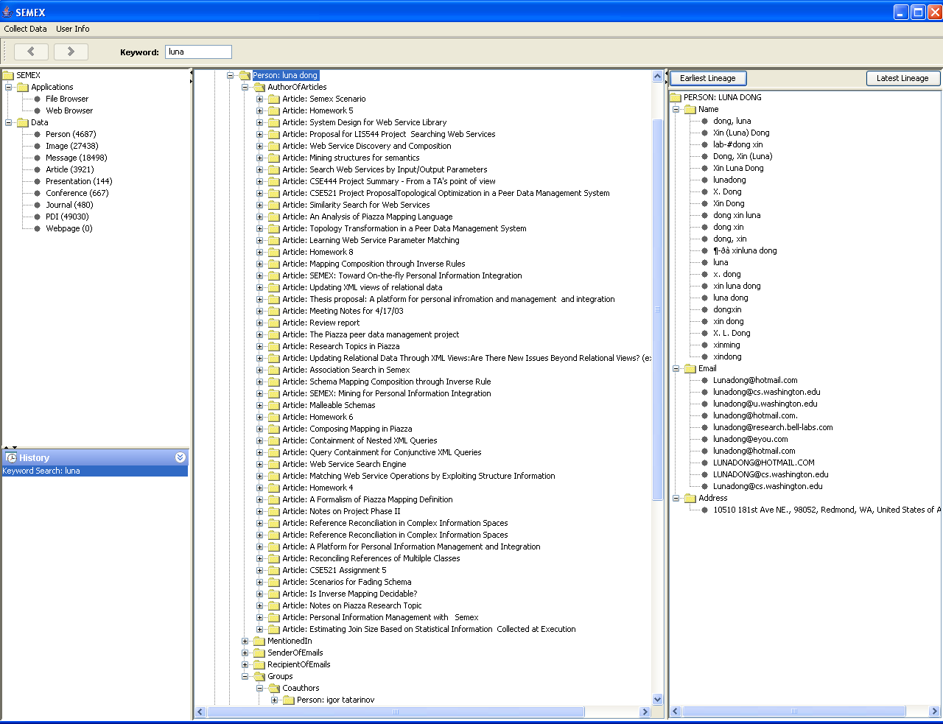
Browsing Associations with Semex
LUNA DONG
Different references to the same person
AuthorOfArticles
MentionedIn
SenderOfEmails
RecipientOfEmails
Reference reconciliation identifies all references to the same real-world object
Coauthors

Slide 2
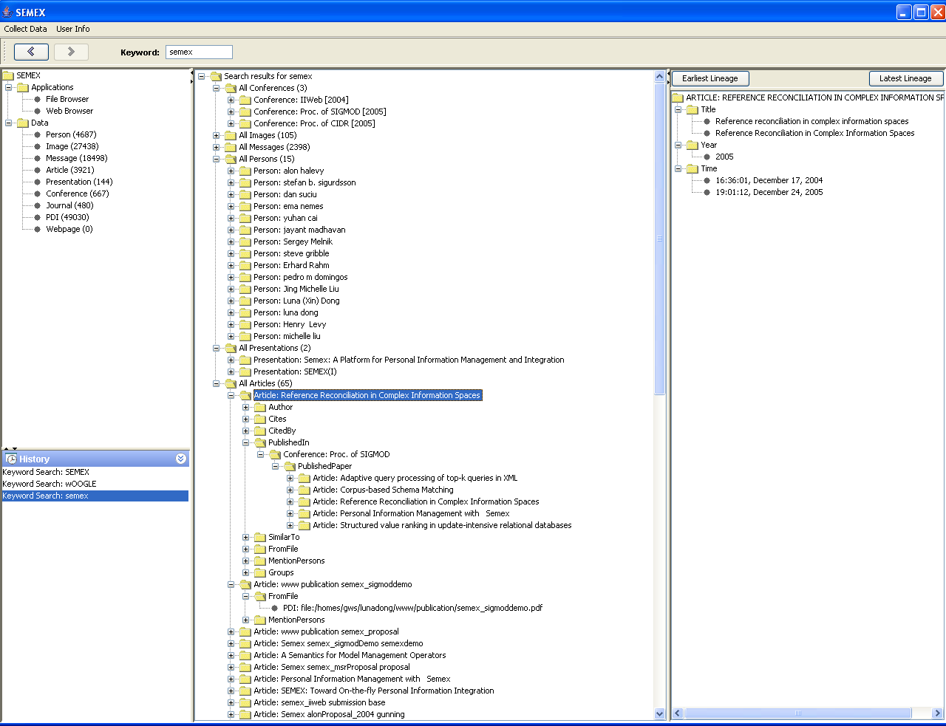
“Who are Working on Semex?”
— Keyword Search Returns Associated Instances
Search Semex
3 Conferences for publishing Semex papers
105 Images in Semex papers
2398 Messages
2 Presentations
65 Articles
15 Persons working on Semex
(though they are not named Semex :)

Slide 3
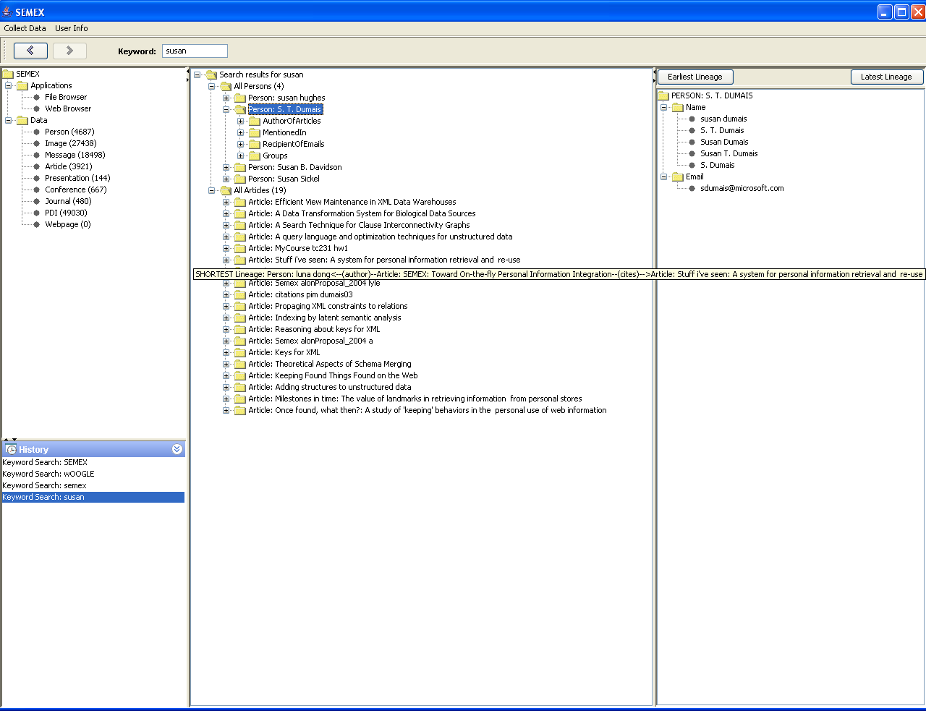
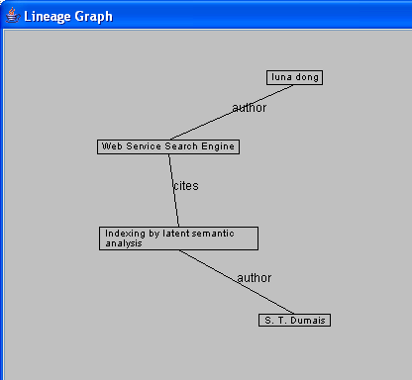
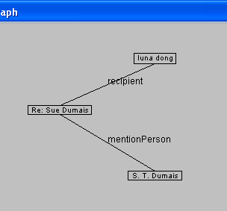
“How do I Get to Know this Person?”
— Semex Provides Lineage Information
Susan Dumais
Shortest Lineage
Latest Lineage
User: Do I know this paper of Susan Dumais?
Semex: Yes, you once cited it.
The last time we mentioned Susan Dumais is in an email
Earliest Lineage
I got to know Susan Dumais by citing her paper

Slide 4
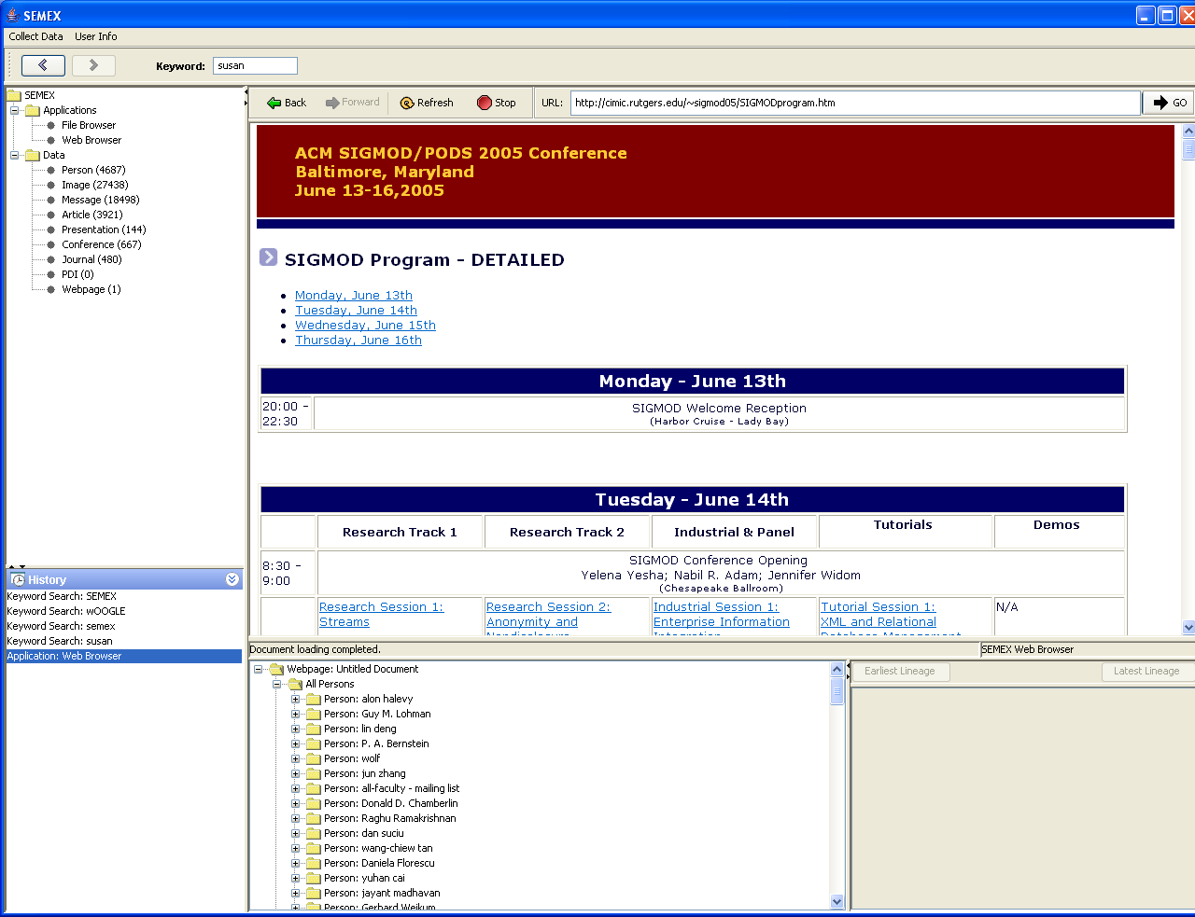
“What’s Interesting in this Webpage?”
— Semex Tells You in Your Own Words
My friends who published papers in Sigmod’05

