Slide 1
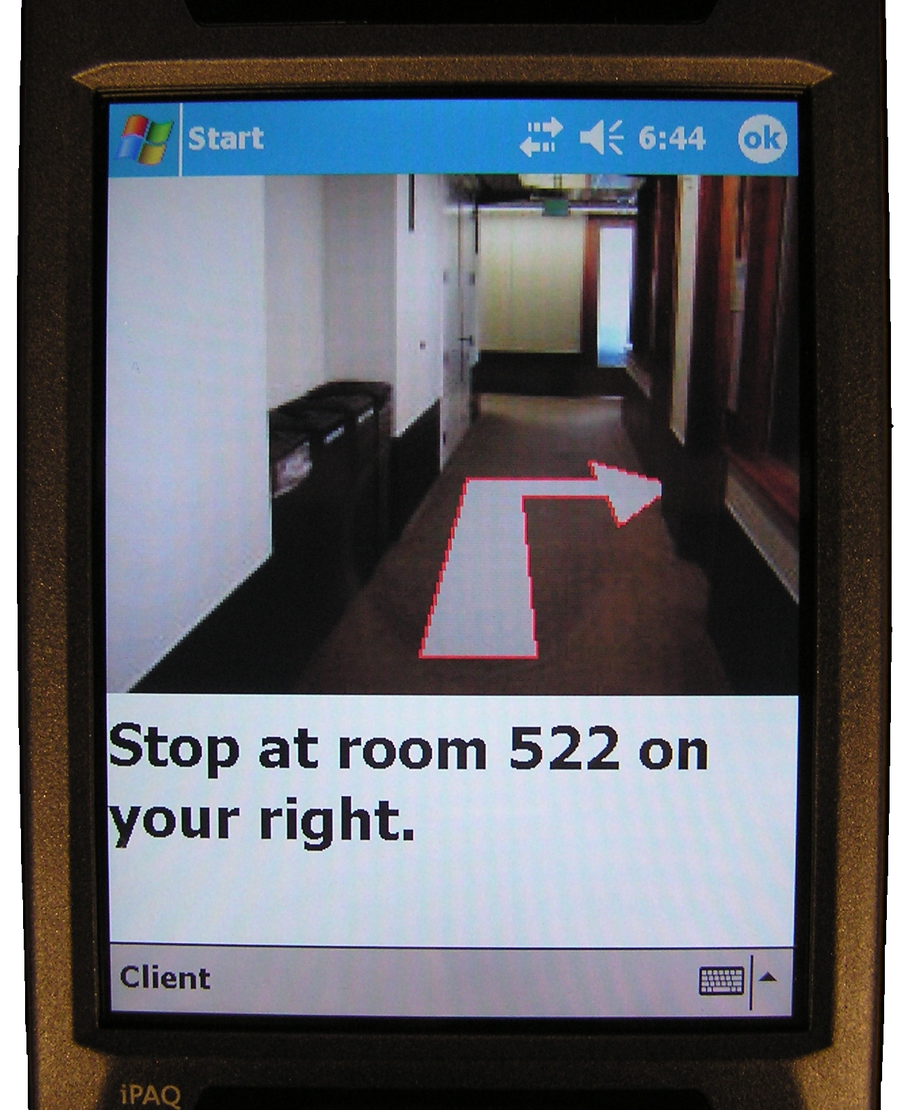
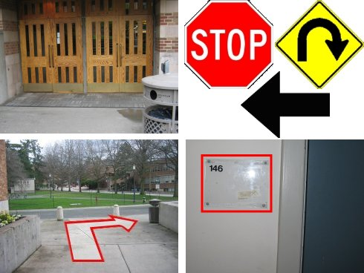
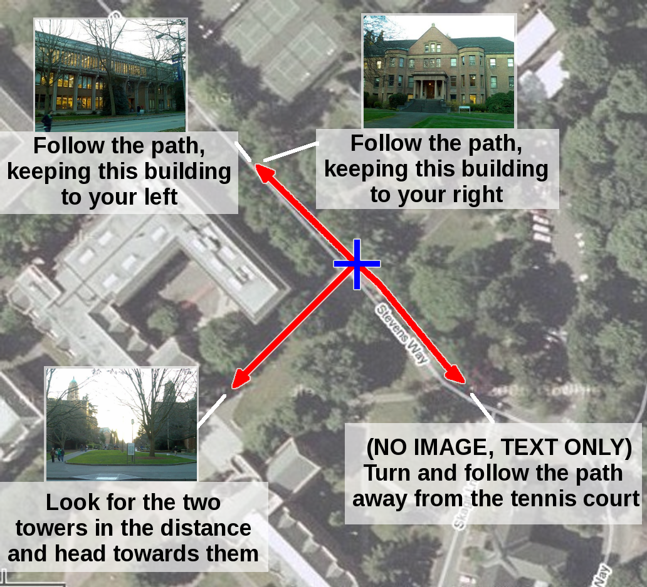
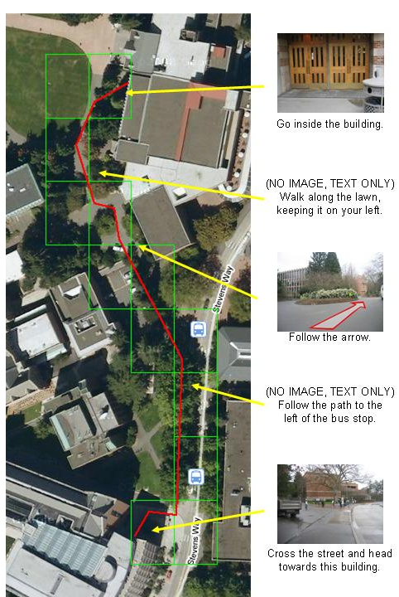


Developing a Wayfinding Application for Individuals with Cognitive Impairments
People with cognitive impairments need assistance in navigating to the places they need to visit throughout their day. We are creating a wayfinding system through a continuing, iterative process involving design, prototyping, and evaluation.
Indoor Study (n=7)
Diverse set of participants used a Wizard of Oz system to navigate 3 indoor routes
Used 3 sets of modalities: image+audio, image+text, and image+text+audio
Results
  All participants successfully followed directions to destinations
  Wide range of preference for modalities and expectation of when directions should be given
Outdoor Study 1 (n=6)
Examine whether outdoor environments alter usability of the different types of directions
Compare against baseline (no system) situation
Results
  5 of 6 participants struggled to navigate in baseline
  Photo visibility was an issue at times, but were still helpful in many cases
  Environment did not distract participants, but at times they focused too much on system
Outdoor Study 2 (n=9)
Examine the use of different types of landmarks for wayfinding and effect of landmark orientation to understandability
Results
  Perspective photos were less likely to be involved in wayfinding difficulties or be misinterpreted (p<0.01)
  Road and sculptures were less error-prone than buildings (p<0.01)
  Walking toward a landmark was less error-prone than keeping it on the side or walking away from it (p<0.05)
Ongoing Work
Developing a system to generate customizable and adaptable wayfinding directions
Model user preference and behavior using Markov decision process (MDP) framework
Include personalized factors when factoring direction costs, e.g., physical effort and safety
Create a route plan that minimizes the cost to navigate to the destination
Observe user behavior to adjust likelihoods and weights
Alan Liu (UW CSE)
Harlan Hile (UW CSE)
Gaetano Borriello (UW CSE)
Henry Kautz (U. of Rochester)
Pat Brown (UW Rehab Med)
Mark Harniss (UW Rehab Med)
Kurt Johnson (UW Rehab Med)

