Slide 1
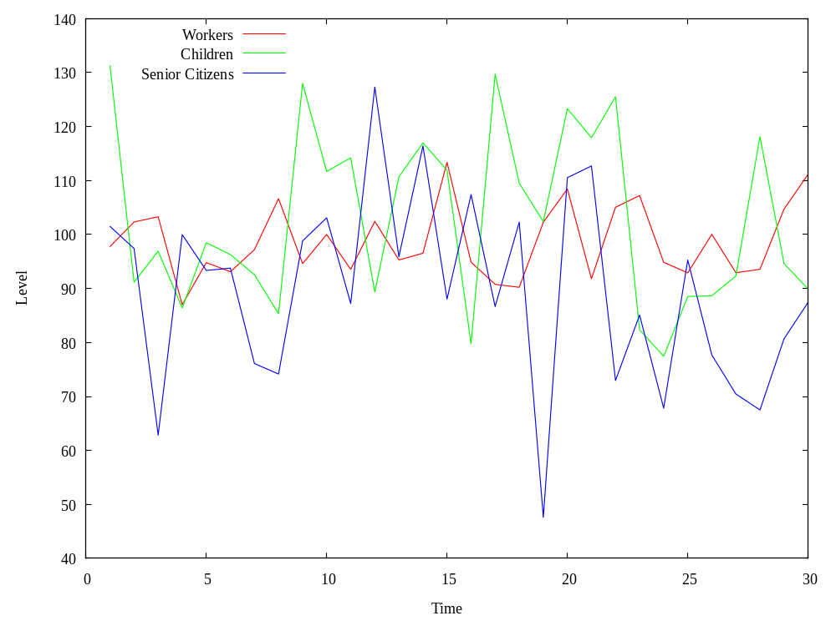
Taxation for Strong Environmental Policy

Slide 2
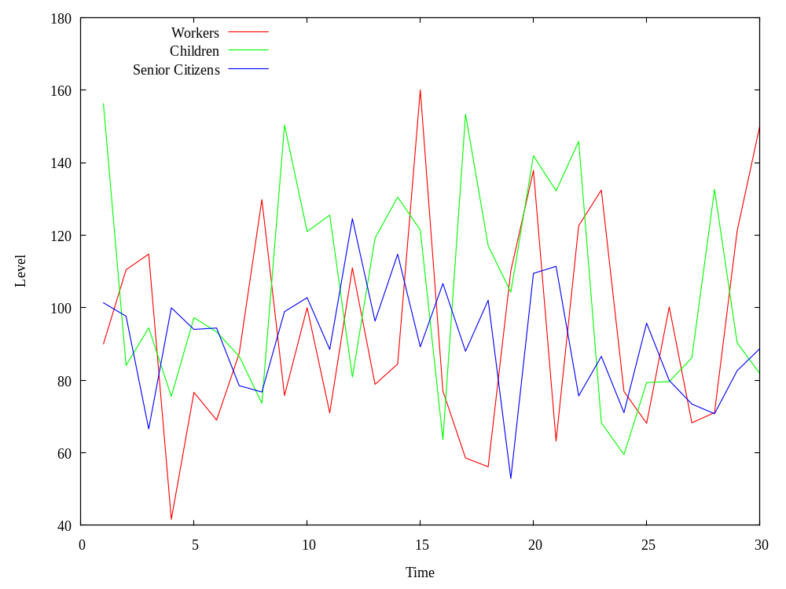
Taxation for High Population Growth

Slide 3
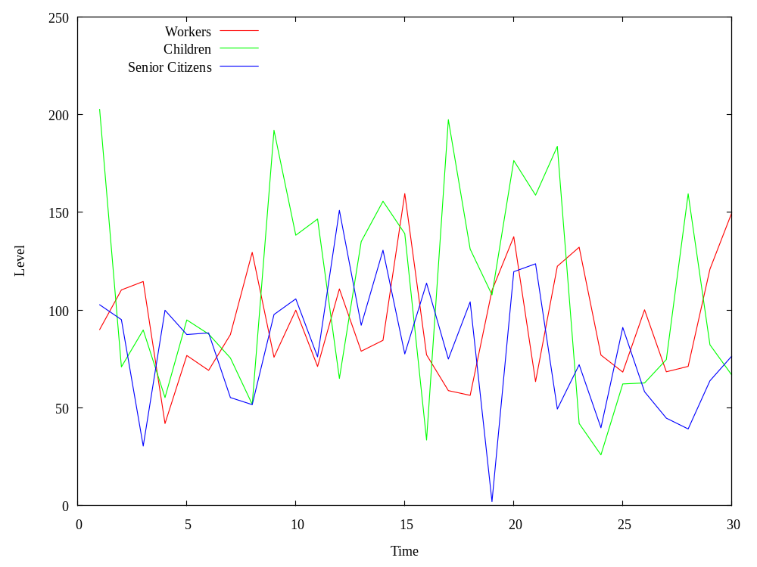
Taxation for Sudden Animal Invasion

Slide 4
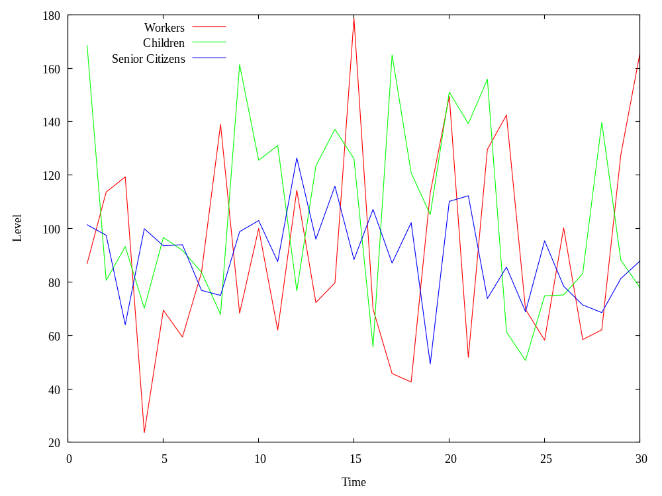
Taxation for Mars People Landing

Slide 5
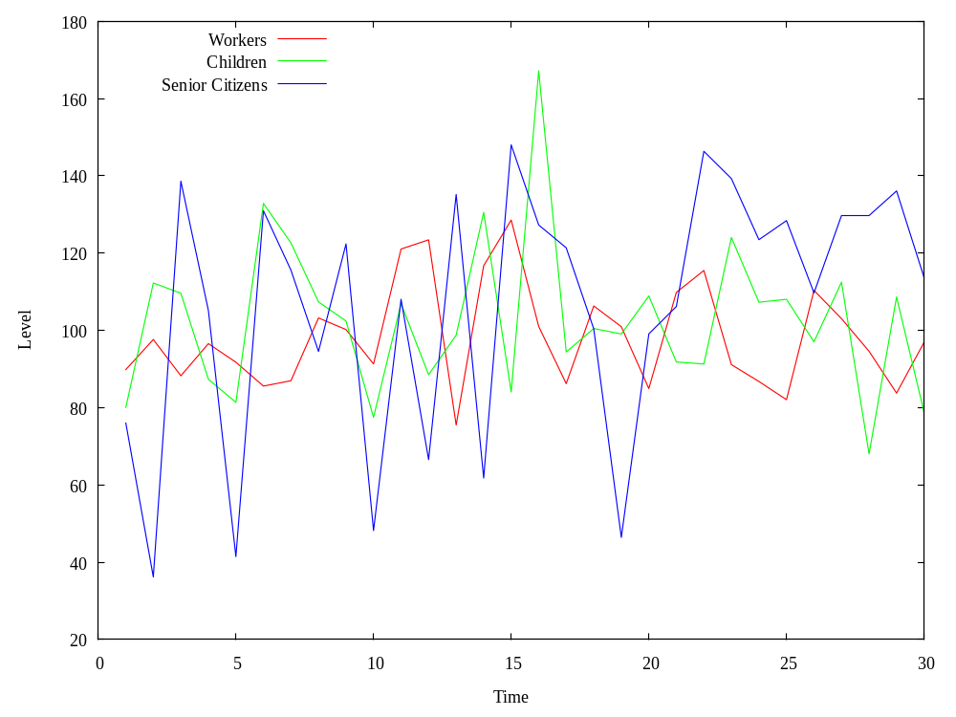
Unemployment for Strong Environmental Policy

Slide 6
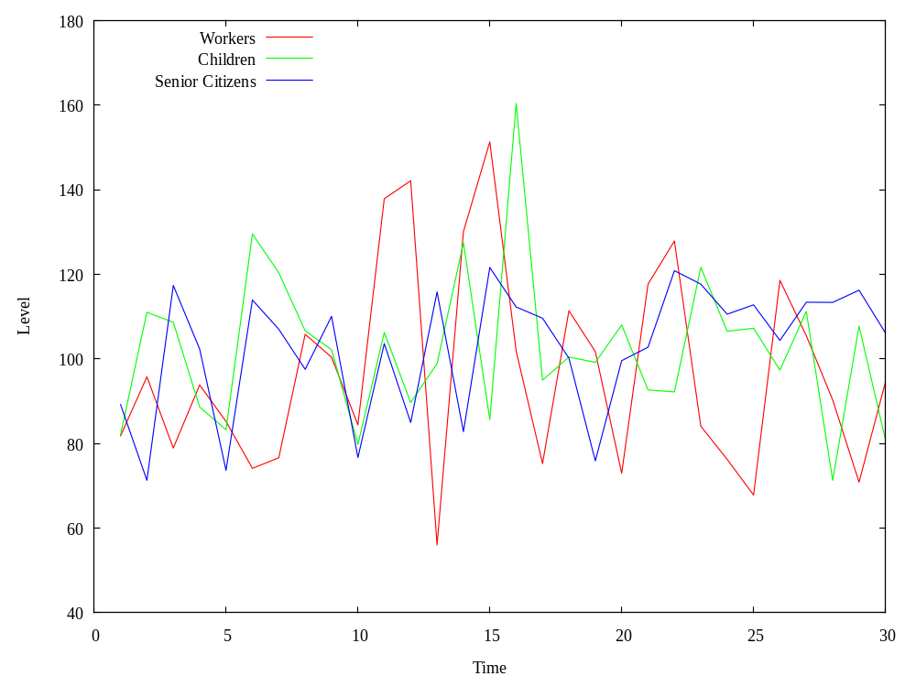
Unemployment for High Population Growth

Slide 7
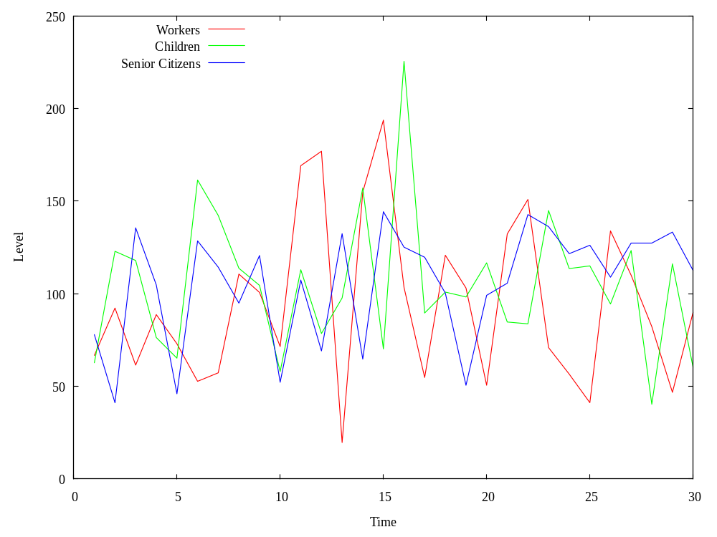
Unemployment for Sudden Animal Invasion

Slide 8
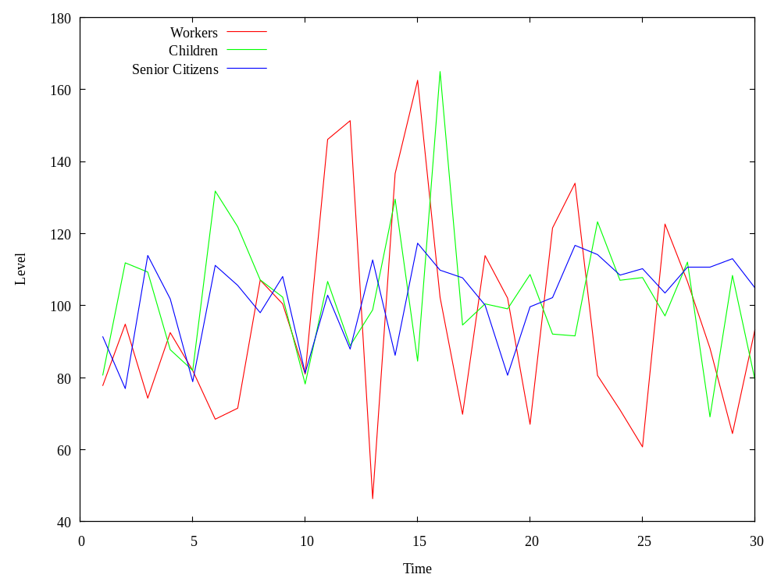
Unemployment for Mars People Landing

Slide 9
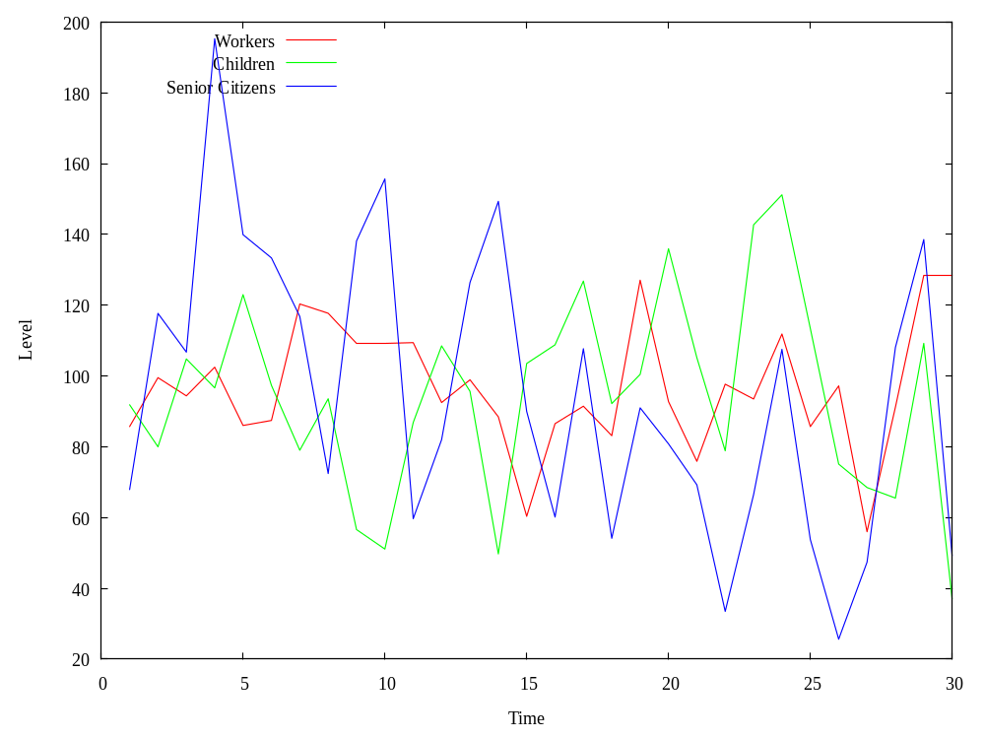
Well being Island for Strong Environmental Policy

Slide 10
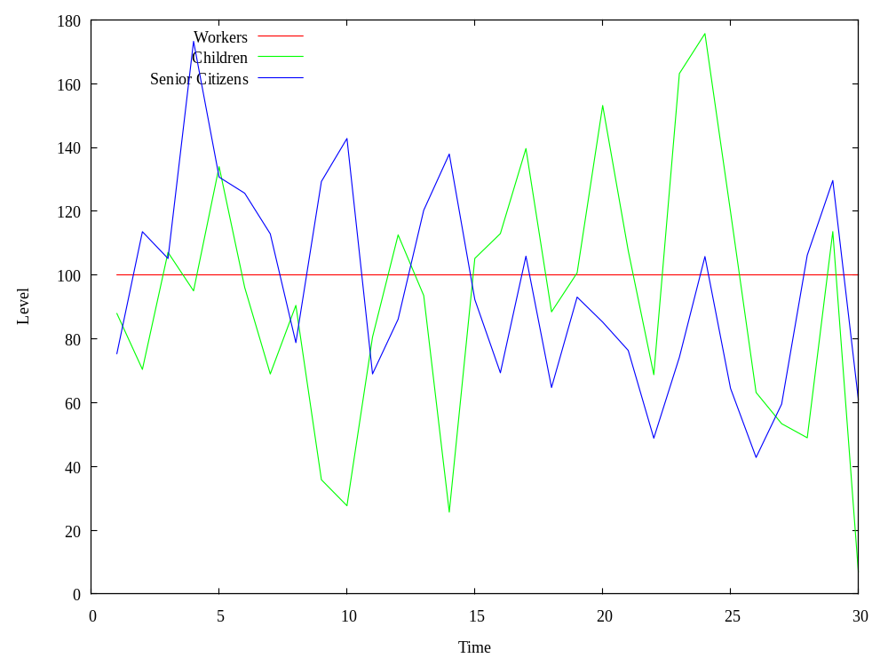
Well being Island for High Population Growth

Slide 11
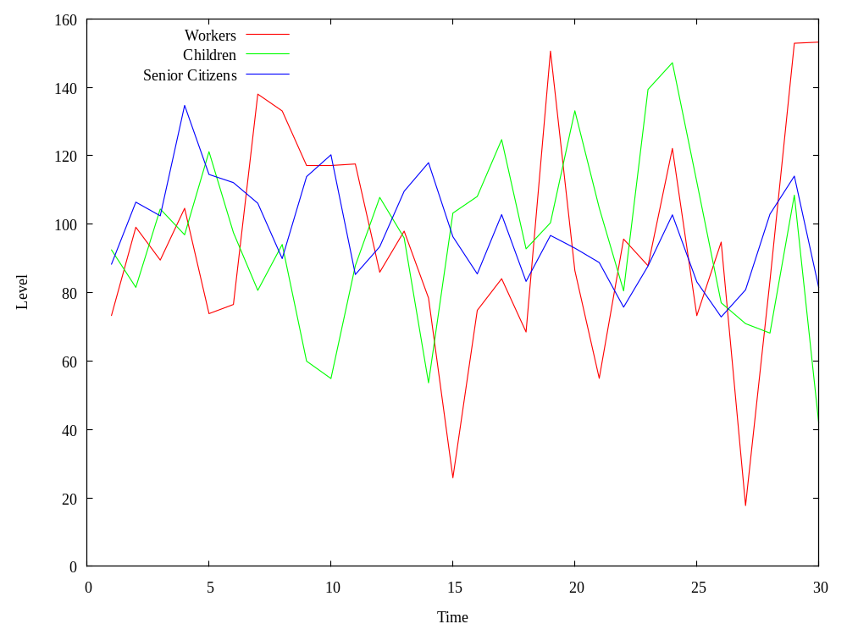
Well being Island for Sudden Animal Invasion

Slide 12
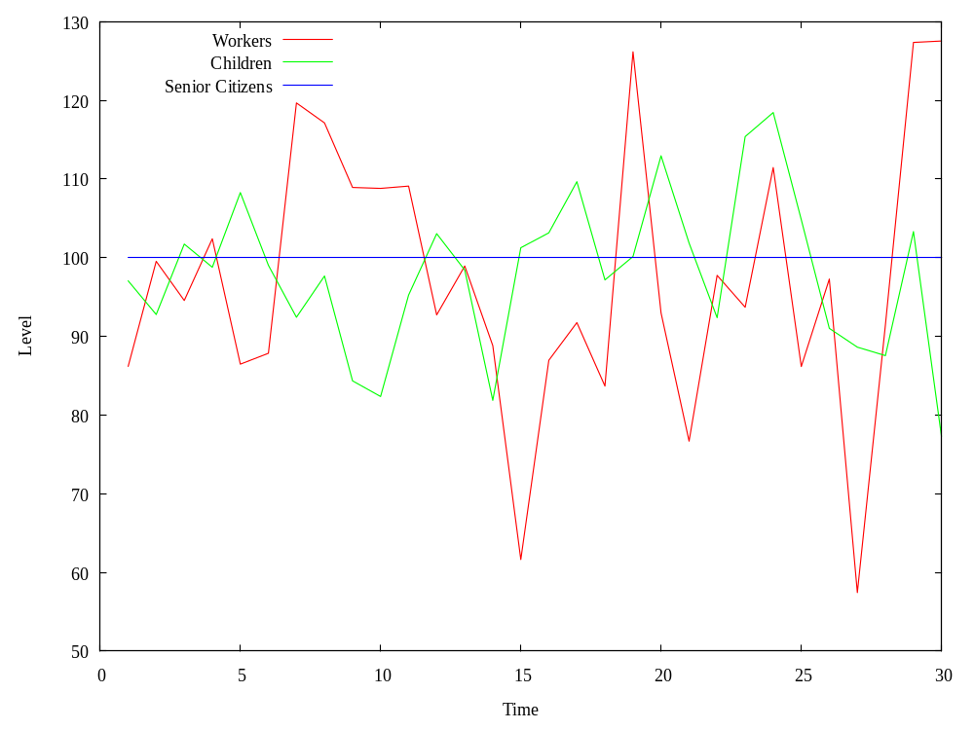
Well being Island for Mars People Landing

Slide 13
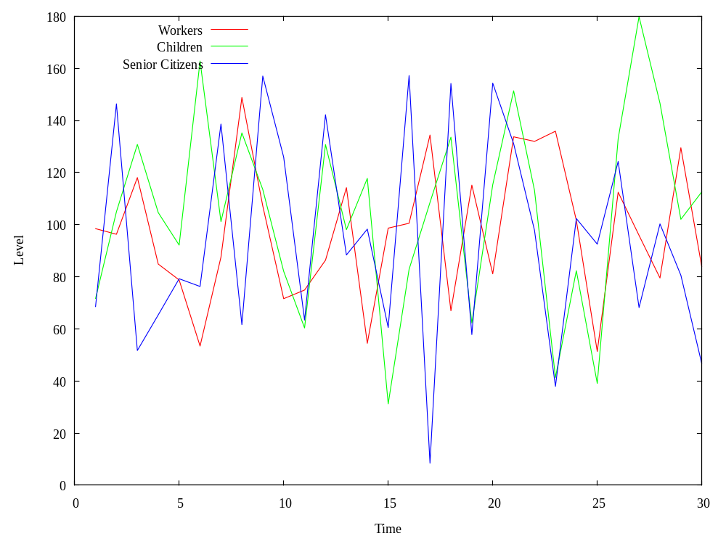
Well being Greenland for Strong Environmental Policy

Slide 14
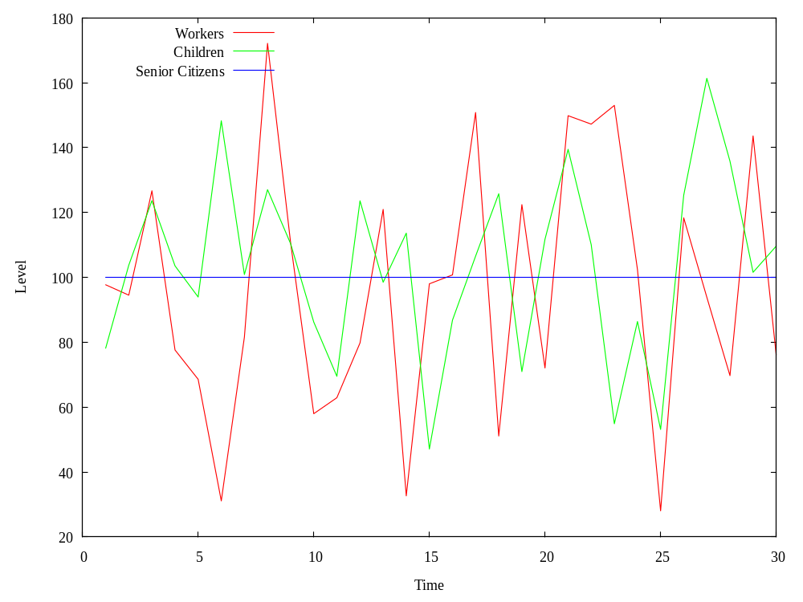
Well being Greenland for High Population Growth

Slide 15
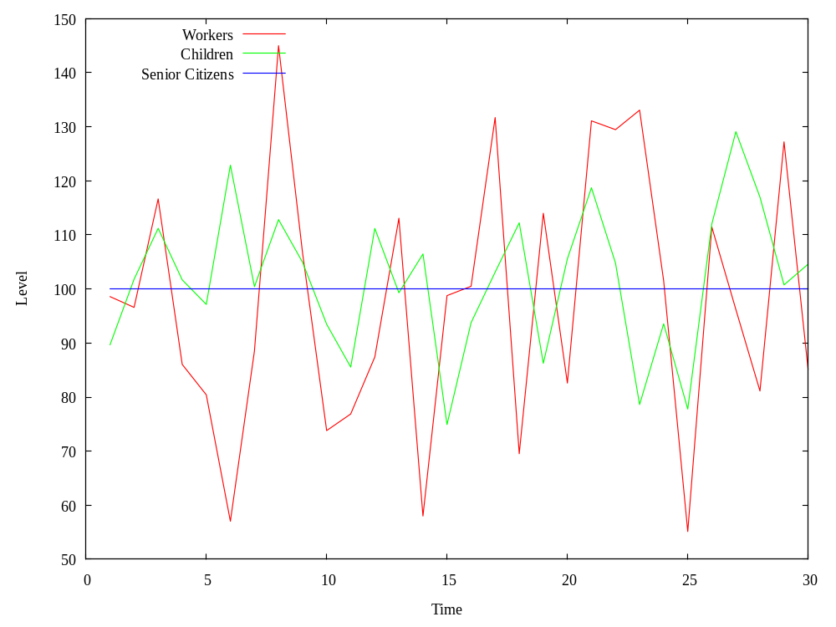
Well being Greenland for Sudden Animal Invasion

Slide 16
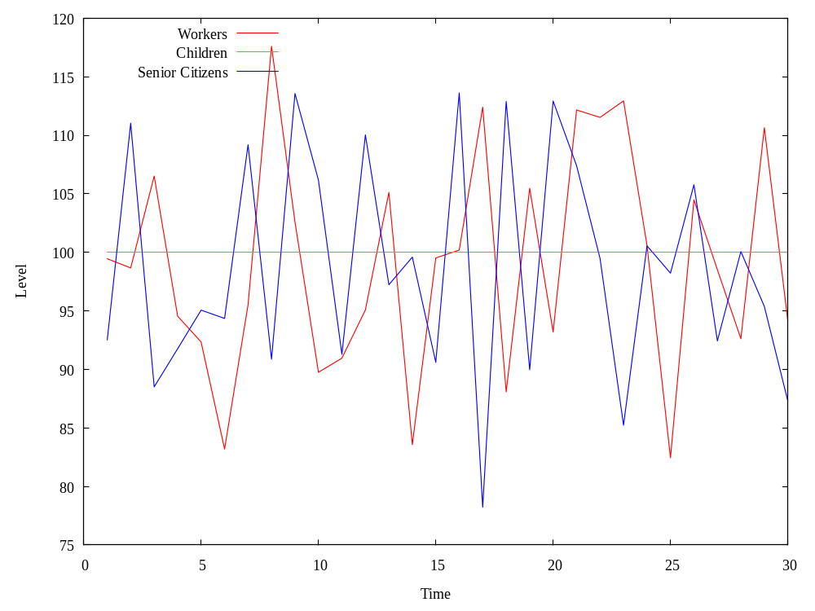
Well being Greenland for Mars People Landing

