Slide 1
Rule Engine: General
Rule Engine – Apply tests/checks to data by using rules: Files, Databases, Streams, any data
Rules/group of rules and actions created through web user interface
Rules and group of rules to define complex rule scenarios
Actions to update/modify data or toher actions after rules are processed
All parts situated in a project and can be exported to a Zip file – one file that can be executed by the ruleengine
Can be used to test data, for quality checks, KPI's, to filter data, to update data

Slide 2
Rule Engine: Usage
Written in Java. Runs everywhere, small footprint
Extendable: additional checks, rules, actions easily created
Universal – any Java Objekt can be evaluated
Use cases:
  Standalone applications
  Embedded in applications ; also web applications
  Runs on a server, in a virtual machine (VM) or as a container (Docker)
  Plugin available for Pentaho Data Integration tool
  Run as a standalone Socket Server, waiting for connections

Slide 3
Rule Engine: Groups and Rules
Groups and Rules connected with and/or conditions
Rules check data against an expected value or against another field
Group of rules can pass the tests/checks although some rules might have failed (when using „or“ conditions)
Results of a test/check can trigger one or multiple actions
Several actions are already pre-defined
Actions can be any Java code – e.g. update of data/datenbases, send messages, calculations, etc.

Slide 4
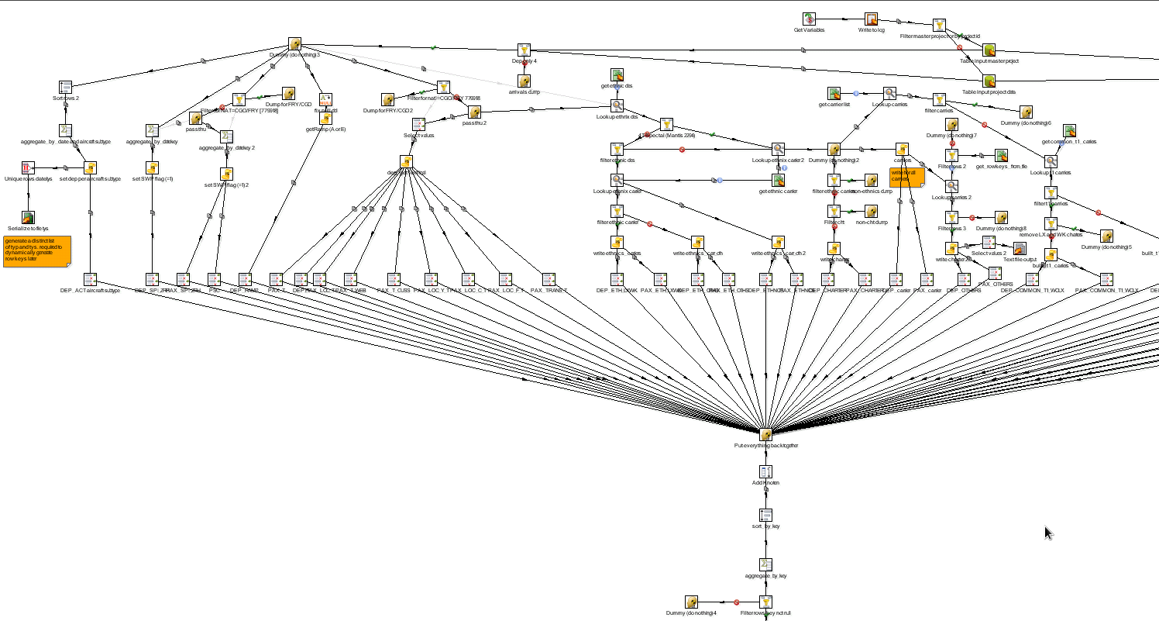
without Rule Engine: ETL example

Slide 5
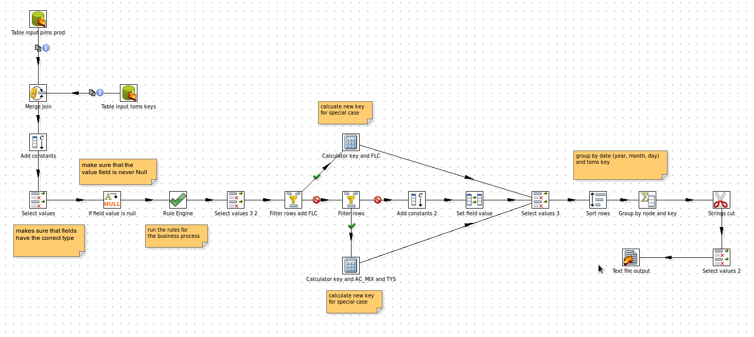
with Rule Engine: same ETL

Slide 6
Rule Engine: Advantages
Any level of complexity for the logic is possible
Rules are external to ETL tool, application code, web code and NOT embedded and mixed with code or IT processes
Maintenance of rules and actions can be done externally: Business user, superuser, developer
Application code, ETL processes and code in general is simplified and easier to overview and maintain; big plus for Quality and reducing Cost
Logic is transparent to the user
Universally usable and extendible
Open Source & free of licence cost

Slide 7
Rule Engine: Status
Rule Engine stand-alone or server: available
Pentaho Data Integration Plugin Step: available
Documentation on core design, checks, actions, web gui: available
Web GUI for the maintenance of rules and actions: available

