Slide 1
WISP 2011
General Program Structure
MAIN MANAGEMENT RECORDS
(The linkage to data records is dynamic across Mgmt. records)
Pick from list
OR
New Record
Pick from list
OR
New Record
Pick from list
OR
New Record
Pick from list
OR
New Record
General Field and Soils Data Records
Primary Field ID:
Secondary Field ID:
Irrigated Area (ac)
SOILS DATA
Field Capacity
Perm. Wilt Point
Crop Data
Records
Managed root
zone depth (in)
ET Records
Field Lat and Long
(degrees and Dec
Degrees)
ET Equation
- A3600 Table
- LAI Based
Irrigation
Equipment
Operation
Records
Data
Records
Web Soil Survey
Insert WSS Link

Slide 2
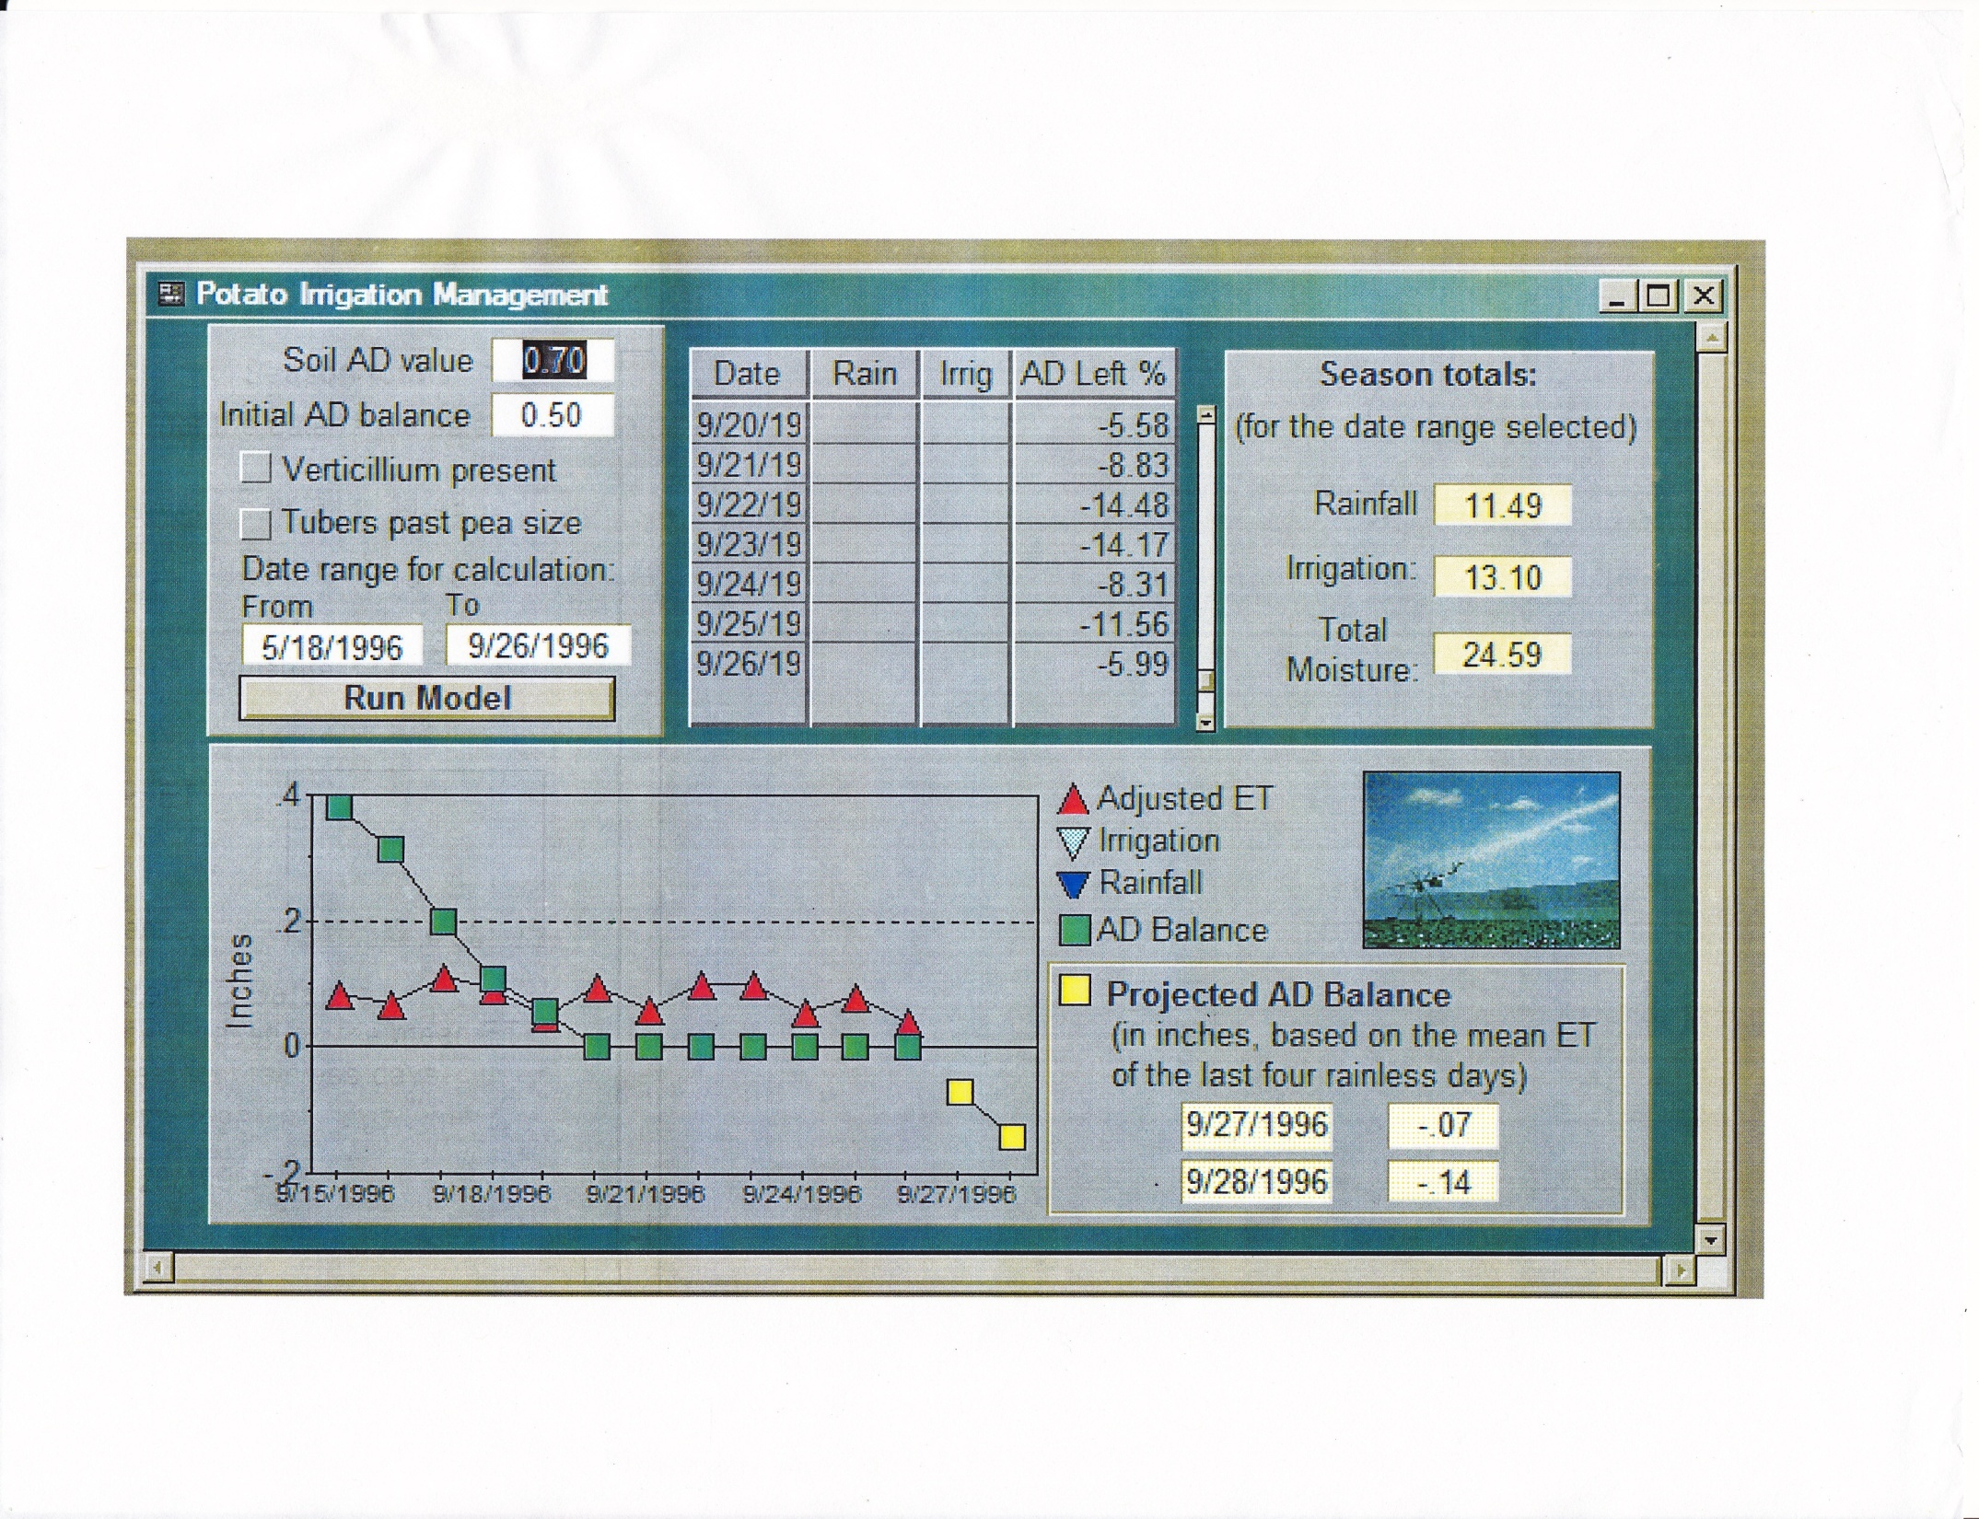

Slide 3
