Slide 1
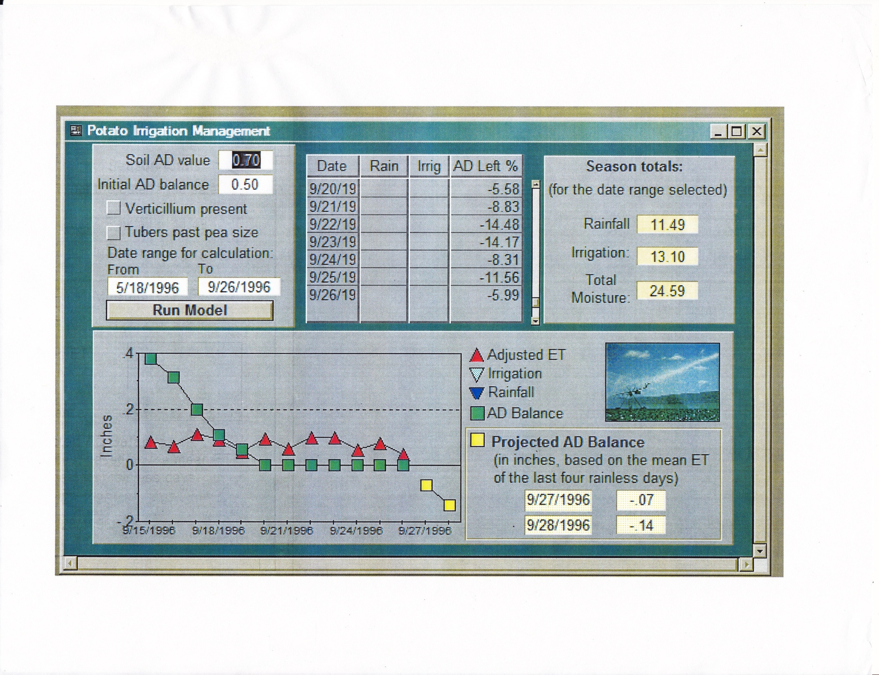

Slide 2
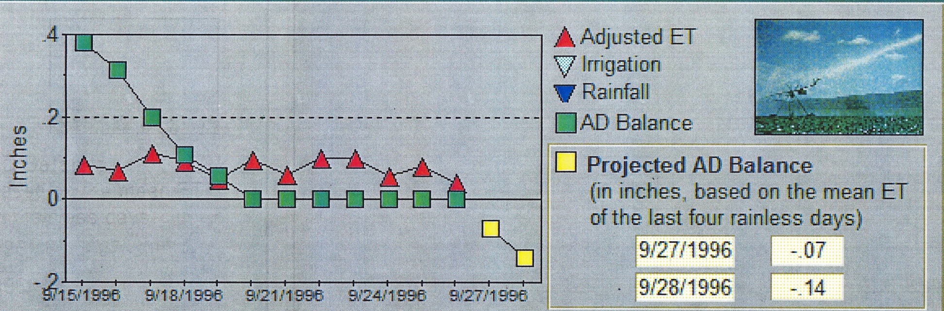
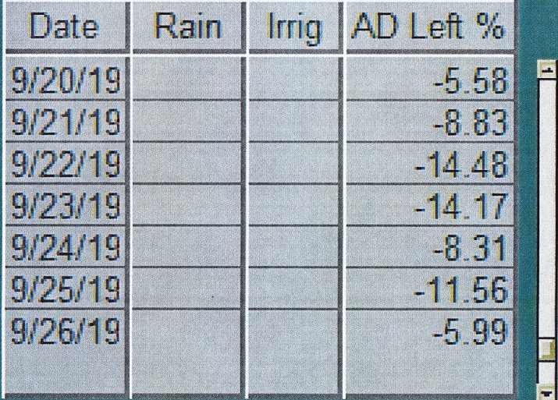
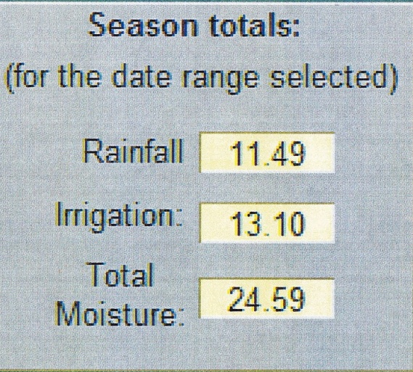
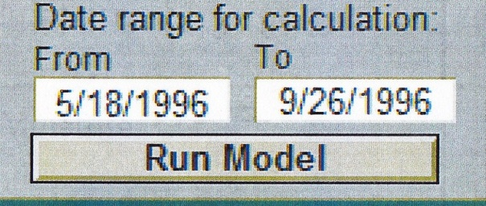
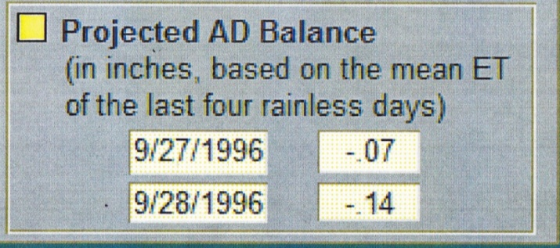
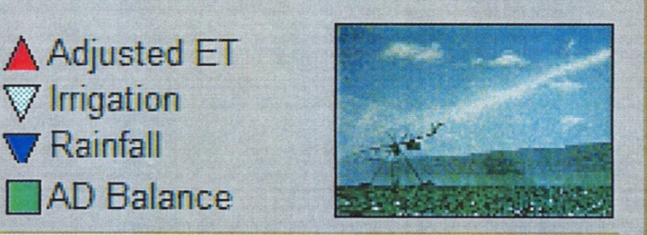

Slide 3
WISP 2011
Program Structure
MAIN MANAGEMENT FORM
General Field and Soils Data.
Primary Field ID:
Secondary Field ID:
Irrigated Area (ac)
SOILS DATA
Field Capacity
Perm. Wilt Point
ET Form
Field Lat and Long
(degrees and Dec
Degrees)
ET Equation
- A3600 Table
- LAI Based
General Field and Soils Data.
Primary Field ID:
Secondary Field ID:
Irrigated Area (ac)
SOILS DATA
Field Capacity
Perm. Wilt Point
General Field and Soils Data.
Primary Field ID:
Secondary Field ID:
Irrigated Area (ac)
SOILS DATA
Field Capacity
Perm. Wilt Point
Crop Data Form
Managed root
zone depth (in)
Crop Data Form
Managed root
zone depth (in)
Crop Data Form
Managed root
zone depth (in)
Crop Data Form
Managed root
zone depth (in)
Crop Data Form
Managed root
zone depth (in)
Irrigation
Equipment
Operation Form
Web Soil Survey
Insert WSS Link
Web Soil Survey
Insert WSS Link
Web Soil Survey
Insert WSS Link
Web Soil Survey
Insert WSS Link

