Slide 1

Welfare Implications of Recent Horizontal Mergers in the U.S. Airline Industry
Carlos A. Manzanares
Department of Economics (Vanderbilt and UW)
UW eScience Institute
Fall 2014 Incubator Program

Slide 2
Introduction
Since 2005, most intense merger activity in U.S. airline history
  US Airways & America West, Delta & Northwest, United & Continental, Southwest & AirTran, American & US Airways
  Four major carriers remain (American, United, Delta, Southwest)
Research question: what would U.S. fares and route structures look like if these mergers had been prevented?
  Market concentration can raise prices
  New entry can offset these gains
Uses newly available dynamic game estimation methods

Slide 3
Data & Estimation Overview
Primary data source: DB1B data, U.S. Department of Transportation
  Contains 10% quarterly sample of all U.S. airline tickets and fares, 2003 to current
  ~11 million tickets per quarter; 44 quarters, 2003q1 to 2013q4
Estimation goal: estimate demand and marginal costs by route (done), entry costs by route (eScience project)
Value Function Simulation / Estimation Approach
  Augment Data (STATA) - Raw DB1B data → Augmented
  Value Function Simulation / Estimation Step (R)
  Counterfactual Simulation Step (R)

Slide 4
Data Augmentation
Raw (6 cols, ~11 M rows/q)
Augmented (STATA; 167 cols, ~88M rows per q)
Currently: Laptop, moving to R, Amazon Cloud
Fare | Origin | Dest | Stop | Carrier | Quarter
180.83 | SEA | DFW | SNA | AA | 2003q3
Farebin | Origin | Dest | Stop | Carrier | Dist_L1 | … | NS_C
$150 to $200 | SEA | DFW | SNA | AA | 1173 |  | 4

Slide 5
Value Function Estimation
One run:
  Augmented Data (20 quarters) → VFE in R → Output 160 csv’s, ~ 11 M rows
Goal: 1000 runs
  “Merge” step: simple average by row
  Return one csv, ~11 M rows for estimation in R (laptop)
Primary limitation: RAM consumption

Slide 6
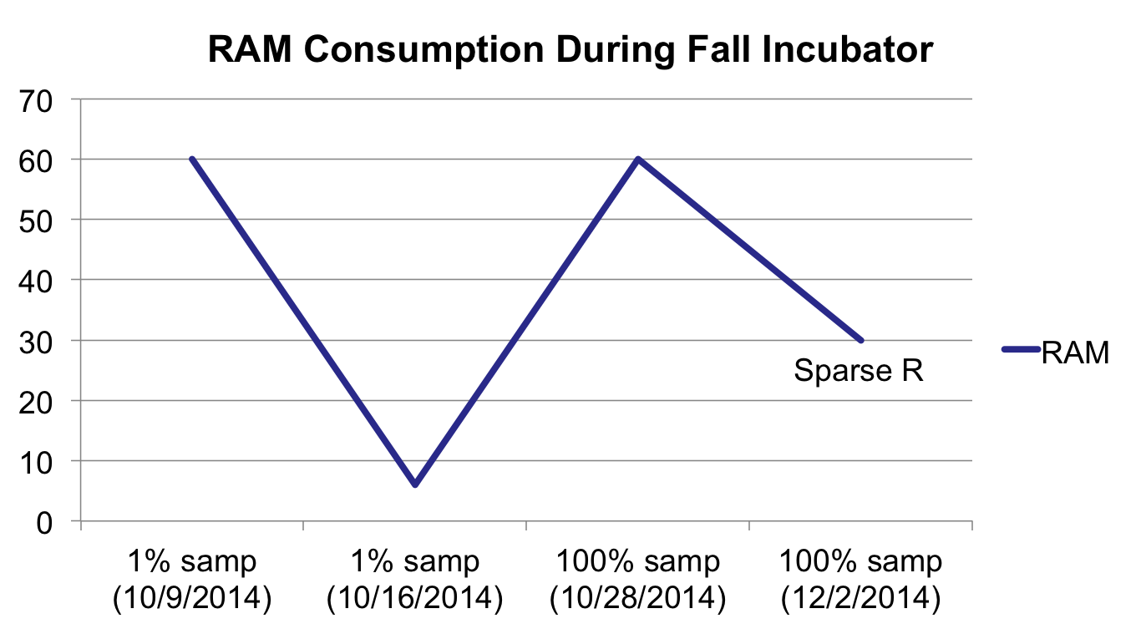
RAM Consumption

Slide 7
Goals & Results Summary
Goal: implement VFE on Amazon cloud on 1% sample
  Result: implement VFE estimation for 2 of 20 quarters on Amazon cloud for 100% sample
  Incubator help: implement on Amazon EC2, sparse package R advice, python code for parallel runs on cloud, python code for calculating averages over all csv’s.
Extra: began converting all STATA data augmentation code to R, to implement on cloud.
To do: complete VFE estimation on all quarters, repeat for Counterfactual step to get first results (expected: December)

Slide 8
Thank You!
UW eScience Institute
  Formal and informal conversations
Special thanks: Andrew Whitaker

