Slide 2

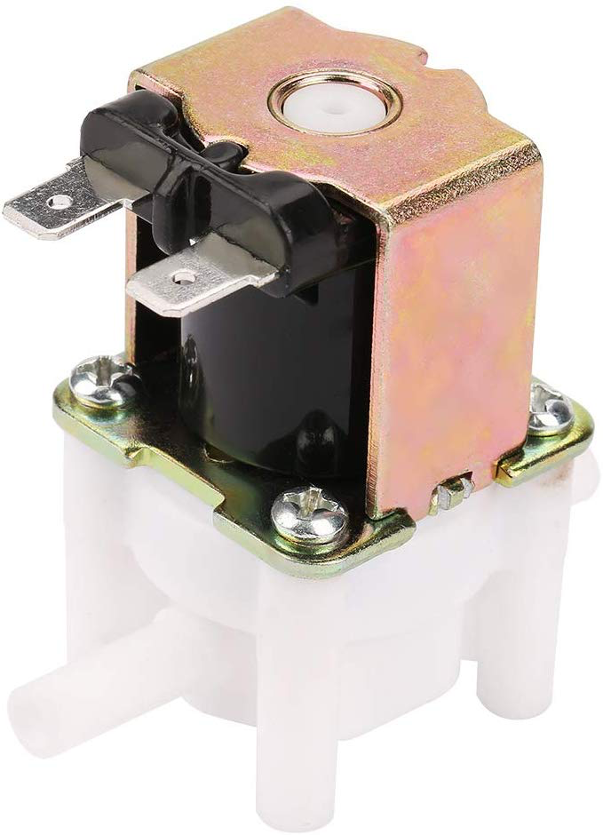
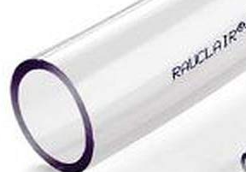



Mechanic part
Electronic part
Supersonic sensor
Arduino
Relais shield

