Slide 1
Biology II
iGEM Drylab

Slide 2
Takeaways from Xavaar’s mini-lesson
Regulation of the Central Dogma is complicated and layered.
Metabolic Pathways are like a input-output system, with multiple ingredients.
Hardware/Software’s role: Find out how we can detect + gather data from these pathways.
Simulation’s Role: Simulate the biological mechanisms + the microfluidic device.

Slide 3
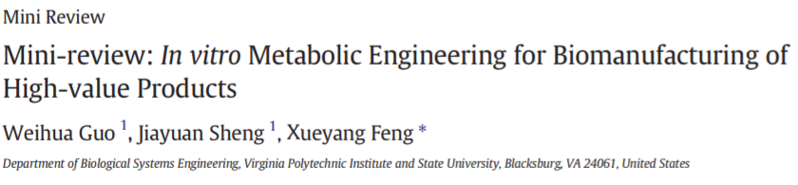
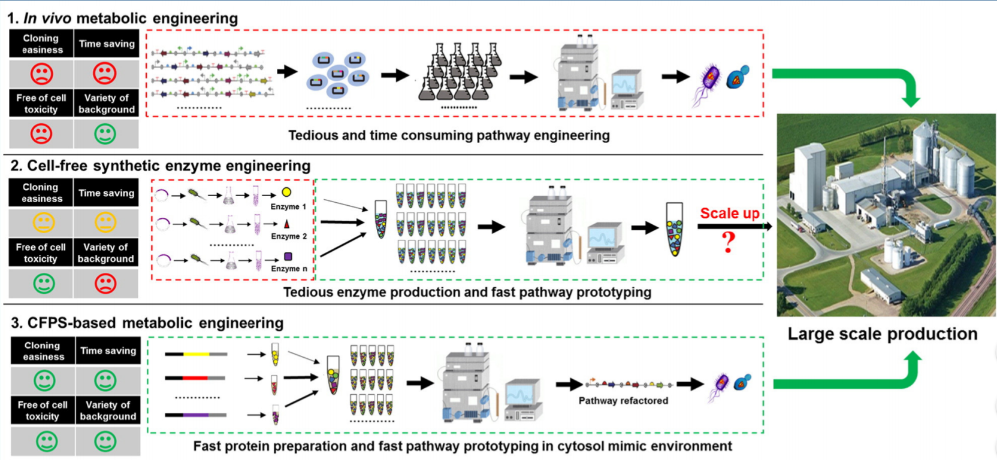
https://www.ncbi.nlm.nih.gov/pmc/articles/PMC5288458/
Notes:
We are trying to do #2. We are trying to make the process more efficient because cell-free synbio is expensive! Microfluidics can make it cheaper by physically having less material. Scaling up is a big issue we have to figure out, but is outside the scope of actual research for our summer.

Slide 4
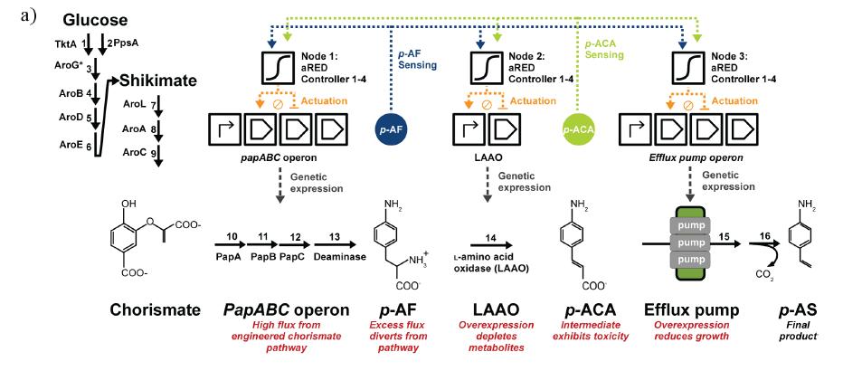
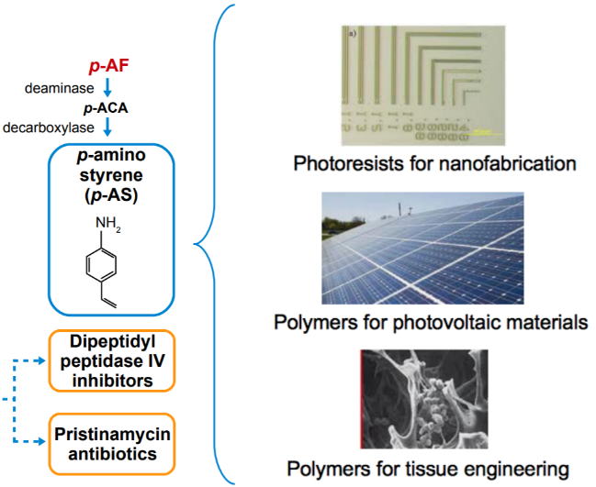
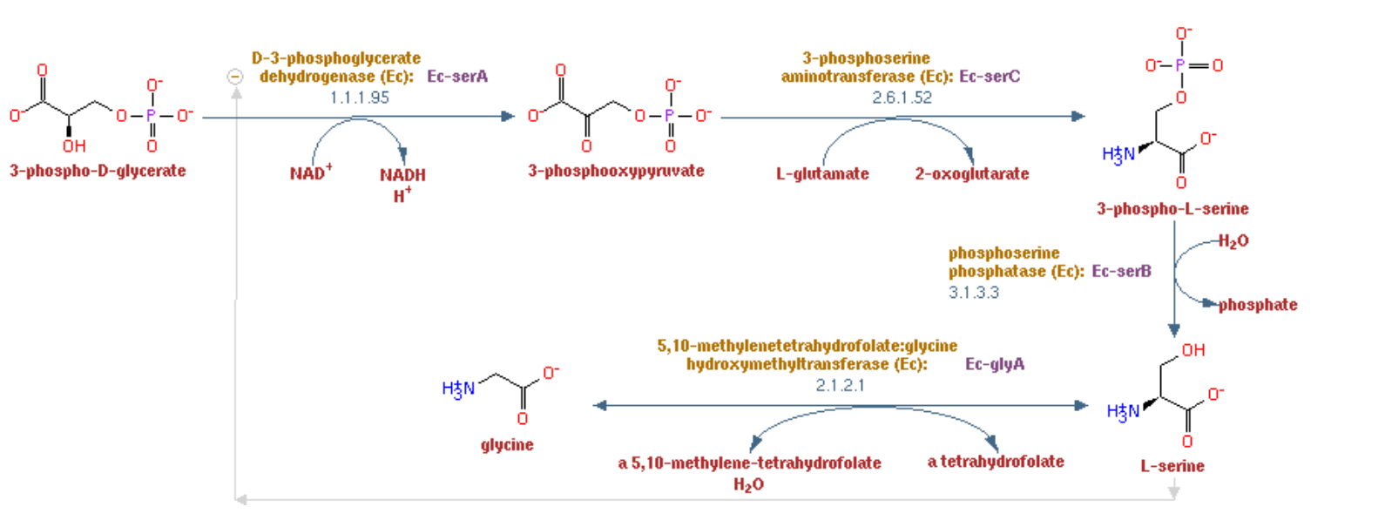
Notes:
We originally started with the p-AS pathway, which can create products that are valuable. But chorismate is insanely expensive, these products are hard to work with, and is not endogenous to E. Coli. We think it’s too hard.
Instead, we want to focus not on what the pathway makes, but the process itself. We are looking for an easy but interesting pathway, such as this. This is one part of Amino Acid production, and makes glycine and serine, which are available anywhere. The amino acid production pathways are much more characterized and known, which makes the products cheap to create as well.

Slide 5
Q + A
Notes:
Summarize your research in three to five points.

