Slide 1
Why do you attend school?
Drylab: Questions
Notes:
To carry on Andrew’s last lesson, today we’re going to be learning about questions.
While I’m the hardware lead, this entire powerpoint isn’t JUST for hardware. It’s for everyone, because it’s a necessary skill to have. Just because I will be using a hardware based example later on, doesn’t mean software oriented people shouldn’t be asking questions as well. I’m not a mechanical engineer– I’m actually going into Informatics as a data scientist, so I’m a software guy, but, I have hardware background from 6 years in robotics, and let me tell you, knowing hardware really helped me with being a better programmer in ways you might learn to see. I consider hardware to be “physical software”. Only differences is that software doesn’t have to follow the laws of physics.

Slide 2
To learn
Why do you attend school?
Notes:
To preface, let me ask you: why do you attend school? Take 10 seconds to talk to the person next to you about the FIRST thing that immediately pops into your head. AAAAAND START. OKAY STOP. Let’s hear some of the answers.

Slide 3
To get a job
To learn
Notes:
Obviously one that probably came up (if it doesn’t then this presentation is ruined) is to learn.

Slide 4
A problem being solved by…
To get a job
Notes:
The other would be to get a job

Slide 5

A problem being solved by…
Notes:
Services
Learning requires you to ask questions to figure an answer out. Jobs normally provide a service: a solution to people’s problems. All these things have roots in question asking, it’s the thing that makes the world go round. In order to become a great asset to your team, a great worker for a future company, a great lab assistant, you must be able work independently to some extent. In order to work independently, you have to be able to ask yourself questions and then derive solutions for those questions on your own.
We want to get you to the point where if we’re busy, you can take a look at what needs to be done, ask one of the leads “should I do this?” and if they say “yeah go for it” then bring it from start to completion by yourself or with a group of people.
Don’t be daunted, you aren’t entirely alone. Look around you, you have a team of individuals who will always be a zulip message away (and give or take a couple of minutes). Not only that, you have a great tool called Google ->

Slide 6
important
Notes:
Knowing how to use Google is imperative to getting hired for a lab position, a job, getting ahead in class, getting good grades, etc. All great bioengineers, biologists, computer scientists, mechanical engineers, electrical engineers, informatics, etc. ALL use google extensively when there is nobody around them who knows the answer.

Slide 7


important
Notes:
Using google is important. In order to first use it, you'll need to learn how to ask the right questions, and how to parse through jargon to find the answers you're looking for.

Slide 8

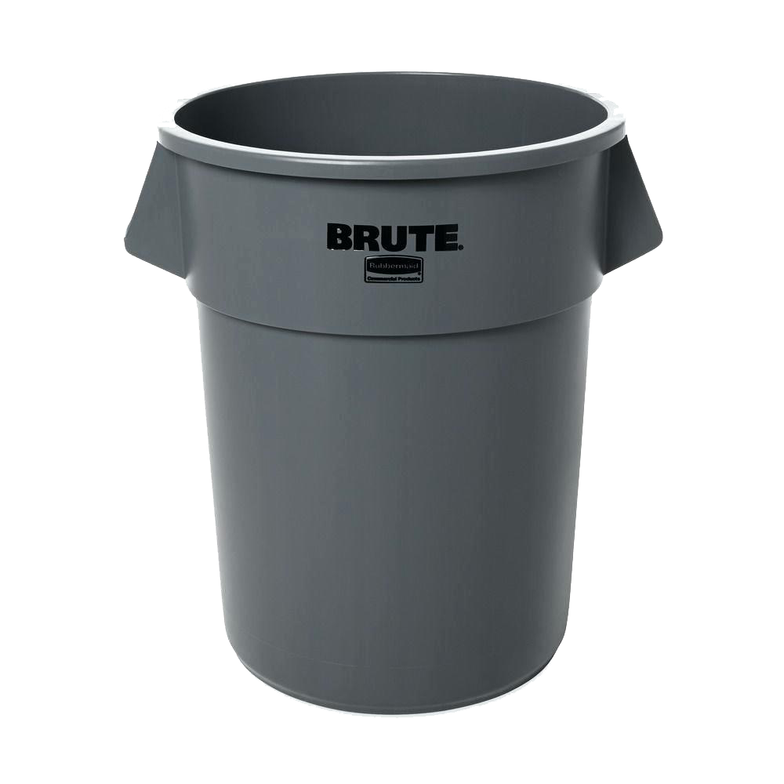
Notes:
Wetlab focuses on the ability to read literature they find using google and finding the answers in that way. Being able to understand all the shit on a research paper is important for them to do their job well, and it also lands them more lab positions.
Drylab... don't think you're scot free either, you need to be able to read literature too in some manner. Labs actually really like having hardware and software people too! Reading literature, again, is a great way to land that position, if you wanted to be more lab oriented. Aside from that, you'll 100% NEED to be able to read DOCUMENTATION. Programmers especially need to be able to read documentation for APIs. If you don't know how to read an API, you better learn how

Slide 9
Notes:
or thorw that dream of getting into CS away. Hardware wise, we need people to be able to read documentation on HOW certain things might be assembled, for example, how to interface the sensors with the hardware correctly.

Slide 10
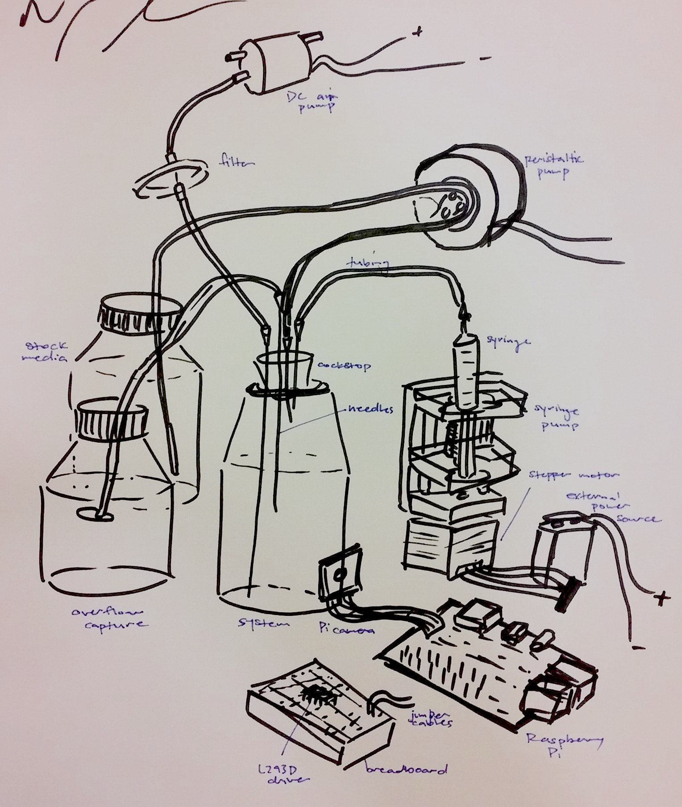
Notes:
Let's take the device from last year. We were given a set of parameters by wetlab that we needed to fulfill that I’ll list out. I want you guys to give me questions to ask to lead me to a theoretical product. I'll be providing answers to these questions along the way.
First, the parameters

Slide 11
Get a liquid from point A to B (from 4 different point As)

Slide 12
Get a liquid from point A to B (from 4 different point As)
Milliliter or microliter accuracy

Slide 13
Get a liquid from point A to B (from 4 different point As)
Milliliter or microliter accuracy

Slide 14

Get a liquid from point A to B (from 4 different point As)
Milliliter or microliter accuracy
Cheap

Slide 15
Get a liquid from point A to B (from 4 different point As)
Milliliter or microliter accuracy
Cheap
Notes:
Now using these criteria, I want you to give me some questions or things to google that will aid in making this. We can chain googles off each other if they’re relevant.
I have no idea if you guys are gonna suggest things along the lines of what I have planned, but I’ll try to pretend I don’t know anything about building what we used last year.
We’ll be doing this exercise until the end of class

