Slide 1
Intro to Linux & Command Line
Based on slides from CSE 391
Edited by Andrew Hu
slides created by Marty Stepp, modified by Jessica Miller & Ruth Anderson
http://www.cs.washington.edu/391/

Slide 2
Lecture summary
Unix and Linux operating system
You will not be tested
Just to help you understand what the environment is
Introduction to Bash shell (command line)

Slide 3
Operating systems
What is an OS? Why have one?
Ever heard any of these words? Linux, Unix, GNU

Slide 4
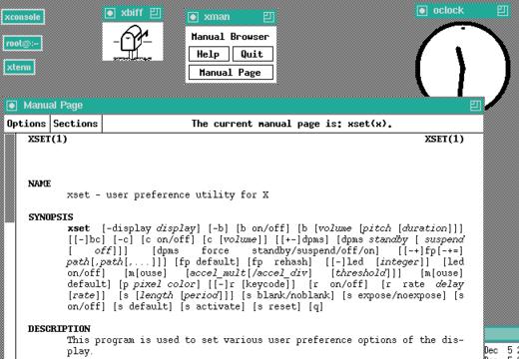
Unix
One of the first operating systems
Key Unix ideas:
hierarchical file system; "everything" is a file
lots of small programs that work together to solve larger problems

Slide 5

Linux
Linux: An OS framework
Almost every server on the internet
Every Android phone
GNU: A bunch of small tools
Distribution (distro): Different Linux types
e.g. Ubuntu, Debian, Raspbian
Key features of Linux:
open source software: source can be downloaded
free to use
constantly being improved/updated by the community

Slide 6
Linux vs Unix
What the heck is a Unix?
Early OS, the progenitor of Linux
Nobody really uses Unix anymore
Many people use them interchangeably
http://unix.stackexchange.com
Don’t worry about it

Slide 7
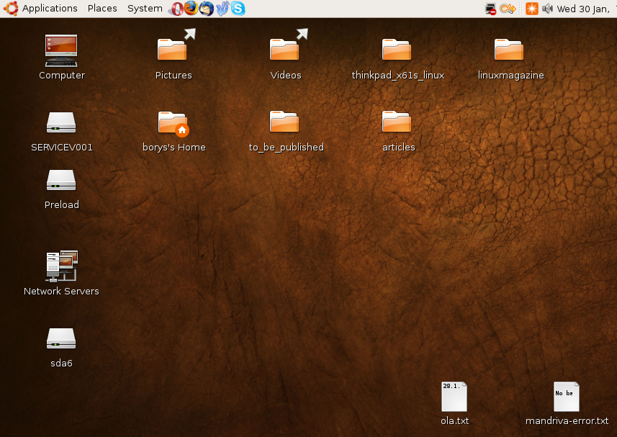
Linux Desktop
Very similar to navigating Windows or OS X

Slide 8
Things you can do in Linux
Browse the internet
Install and play games
Play Music and Videos
IM, Skype
Basically: Everything

Slide 9

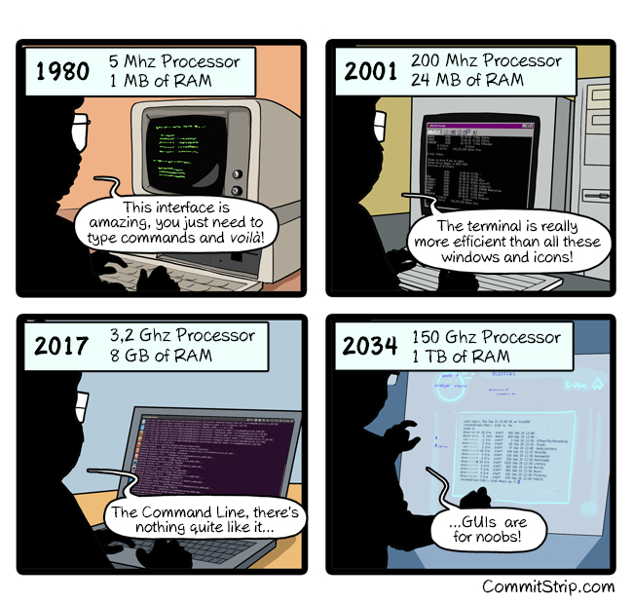
Command Line

Slide 10
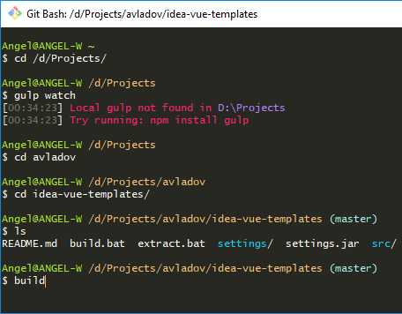
Shell
shell: uses user input to manage the execution of other programs.
Runs in a text window
User types commands, the shell runs the commands
We will use Bash
Most commonly used shell
on Linux
Why should I learn to use
a shell when GUIs exist?

Slide 11
Why use a shell?
Why should I learn to use a shell when GUIs exist?
faster
work remotely
programmable
can handle repeated commands
Notes:
Xavaar was confused what a shell is
GUI is unintuitive for repeated commands –Yoshi
Explain the file grabbing from a specfici date analogy

Slide 12


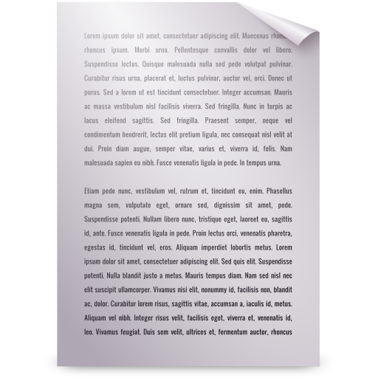
Navigating the file system
ls | lists files in a directory
ls -l | lists all files in directory with details
cd [dir] | changes the working directory
GUI (you don’t see this)
Shell (what you see)
$
l
s
Me
CSE
Docs
Notes

Slide 13
Navigating the file system
command | description
ls | lists files in a directory
ls -l | lists all files in directory with details
cd [dir] | changes the working directory
$
l
s
D
a
n
B
u
n
3
9
1
Notes
Me
CSE
Docs
Notes

Slide 14
Navigating the file system
ls | lists files in a directory
ls -l | lists all files in directory with details
cd [dir] | changes the working directory
GUI (you don’t see this)
Shell (what you see)
stop
$
l
s
Me CSE Docs Notes
Me
CSE
$
Docs
Notes

Slide 15
Navigating the file system
ls | lists files in a directory
ls -l | lists all files in directory with details
cd [dir] | changes the working directory
GUI (you don’t see this)
Shell (what you see)
stop
$
l
s
Me CSE Docs Notes
Me
CSE
$
c
d
CSE
$
Docs
Notes

Slide 16
Navigating the file system
ls | lists files in a directory
ls -l | lists all files in directory with details
cd [dir] | changes the working directory
GUI (you don’t see this)
Shell (what you see)
$
l
s
Me CSE Docs Notes
Dan
142
$
c
d
CSE
$
143
391
391
Notes

Slide 17
Relative directories
directory | description
. | the directory you are in ("working directory")
.. | the parent of the working directory (../.. is grandparent, etc.)
* | Everything in a directory
[string]*[string] | Everything in a directory that starts and ends with the specified strings
~ | your home directory (on many systems, this is /home/username )

Slide 18
Directory commands
some commands (cd, exit) are part of the shell ("builtins")
others (ls, mkdir) are separate programs the shell runs
command | description
ls [-l] | list files in a directory
pwd | print the current working directory
cd [dir] | changes the working directory
mkdir [dir] | create a new directory
rmdir [dir] | delete a directory (must be empty)

Slide 19
File commands
CTRL is often written as ^
CTRL+C would be ^C
command | description
cat [file] | print out the contents of file (named for concatenate)
pico [file] | edit a file in the working directory
(while running) CTRL+C | stops the currently running program
wget [url] | download a file from the internet
alias short=‘long’ | create a short version of a long command

Slide 20
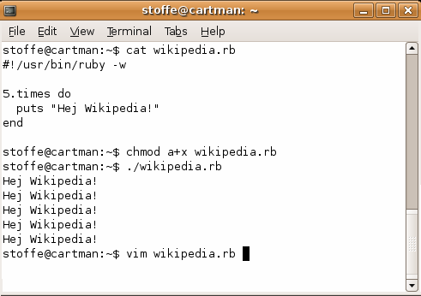
Shell commands
many accept arguments or parameters
example: cp (copy) accepts a source and destination file path
a program uses 3 streams of information
input: comes from user's keyboard
output: goes to console
errors can also be printed (by default, sent to console like output)
parameters vs. input
parameters: before Enter is pressed; sent in by shell
input: after Enter is pressed; sent in by user

Slide 21
Command-line arguments
most options are a - followed by a letter such as -c
some are longer words preceded by two - signs, such as --count
options can be combined: ls -l -a -r can be ls -lar
many programs accept a --help or -help option to give more information about that command (in addition to man pages)
or if you run the program with no arguments, it may print help info
for many commands that accept a file name argument, if you omit the parameter, it will read from standard input (your keyboard)

Slide 22
Shell/system commands
"man pages" are a very important way to learn new commands
man ls
man man
command | description
man or info | get help on a command
clear | clears out the output from the console
exit | exits and logs out of the shell
command | description
date | output the system date
cal | output a text calendar
uname | print information about the current system

Slide 23
File commands
Use “-i” (interactive) to force confirmation
$ rm -r –i *
remove file ‘bitcoinwallet.key’? no
touch prog.java –t 149204010000
-t [[CC]YY]MMDDhhmm
command | description
cp | copy a file
mv | move or rename a file
rm | delete a file
rm –r [DIR] | delete a directory and all of its contents
touch | create a new empty file, or update its last-modified time stamp

Slide 24
Exercise Solutions
caution: the cp, rm, mv commands do not prompt for confirmation
easy to overwrite/delete a file; this setting can be overridden (how?)
Use “-i” with the command, “interactive” to prompt before overwrite
Exercise : Given several albums of .mp3 files all in one folder, move them into separate folders by artist.
mkdir U2
mkdir PSY
mkdir JustinBieber
mv GangnamStyle.mp3 PSY/
mv Pride.mp3 U2/
Exercise : Modify a .java file to make it seem as though you finished writing it on Dec 28 at 4:56am.
touch –t 201612280456 Hello.java

Slide 25
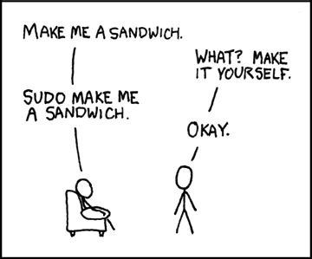
SUDO
super user do
Pronounced like “sue-dough” or “pseudo”
Similar to “execute as Admin” in Windows
sudo apt-get install [package]
sudo apt-get update
sudo rm [someone else’s file]
Notes:
It asks for your password

Slide 26
Basic Emacs Commands
C- = control key M- = meta/alt key
read a file into Emacs: C-x C-f
save a file back to disk: C-x C-s
exit Emacs permanently: C-x C-c
search forward: C-s search backward: C-r
scroll to next screen: C-v scroll to previous screen: M-v
Undo: C-x u
entity to move over | backward | forward
character | C-b | C-f
word | M-b | M-f
line | C-p | C-n
go to line beginning/end | C-a | C-e
go to buffer beginning/end | M-< | M->
https://courses.cs.washington.edu/courses/cse391/17au/handouts/emacs.pdf

Slide 27
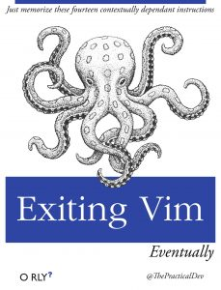
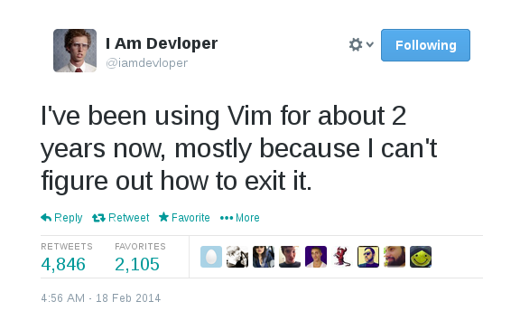
Vi / Vim
Powerful command line text editor
Notoriously infuriating
https://stackoverflow.blog/2017/05/23/stack-overflow-helping-one-million-developers-exit-vim/

Slide 28
Basic Vim Commands
command | description
:w | Write changes to the file
:x | Write and quit
:q! | Quit without saving
i or a | Enter Insert mode (AKA normal typing mode)
v | Enter Visual mode (AKA select mode)
ESC | Exit Insert or Visual mode
https://wiki.gentoo.org/wiki/Vim/Guide and http://tnerual.eriogerg.free.fr/vimqrc.pdf

Slide 29
Mounting cse homedir on VM
https://www.cs.washington.edu/lab/software/homeVMs/linuxVM#install
Create a directory in your home directory, called csehomedir:
cd
mkdir csehomedir
Now to use that directory as a “link” to your CSE files on your VM:
sshfs username@attu: ~/csehomedir OR
sshfs username@attu.cs.washington.edu:/homes/iws/username ~/csehomedir/
It is a good idea to back up your files from your VM regularly.
Actually keep your files on your CSE home directory
Regularly move files from your VM to another location
If you need to get a fresh VM image, you can save the files from your old VM using this procedure: "My VM Seems Broken. How Do I Recover?"
https://www.cs.washington.edu/lab/software/homeVMs/linuxVM#faq

Slide 30
My VM is Broken!
https://www.cs.washington.edu/lab/software/homeVMs/linuxVM#install
If your VM is misbehaving, first try a reboot of the VM and also of your machine. If that doesn’t work, often it is easiest just to get a fresh VM image and start over (maybe you saved the .zip file you downloaded previously?)
BEFORE you delete your current copy of the VM, you can save the files from your current copy of the VM using this procedure:
See "My VM Seems Broken. How Do I Recover?“ here:
https://www.cs.washington.edu/lab/software/homeVMs/linuxVM#faq

Slide 31
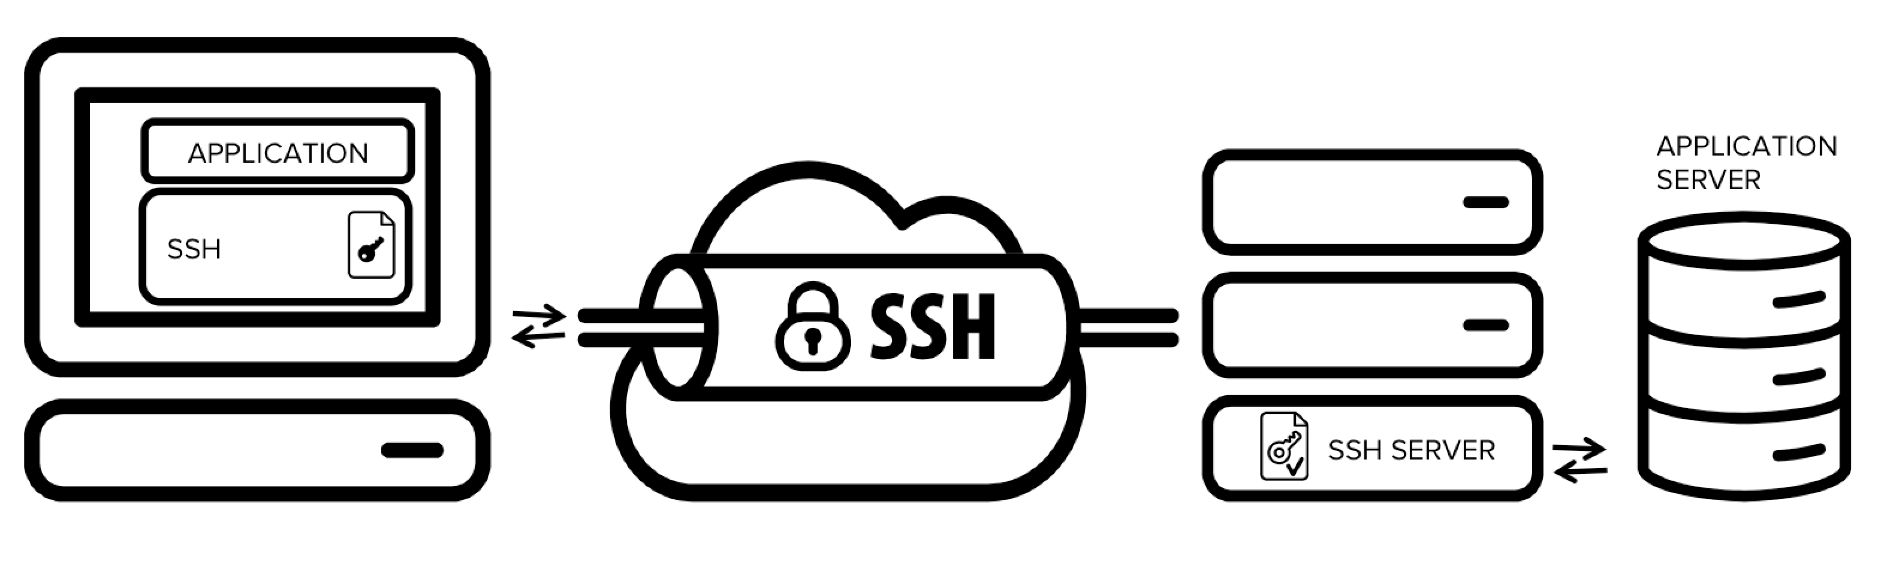
SSH
Secure Shell
Control a computer remotely, through a shell
Do work from the comfort of your personal computer

Slide 32
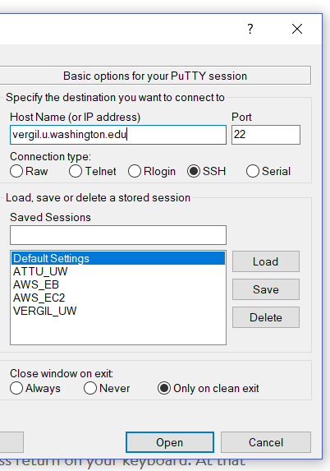
SSH Clients
Windows: PuTTY
type in server URL
Mac: Built in shell client
just type ssh user@example.com
Port should be 22

Slide 33
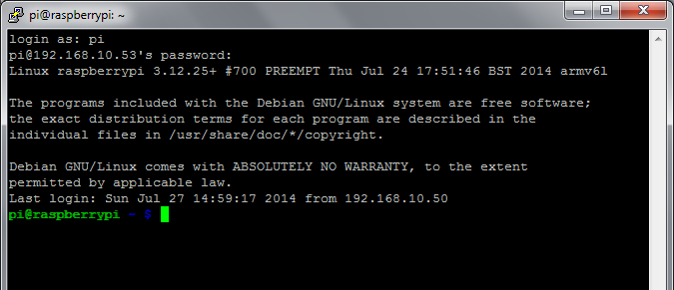
Using SSH
Shell interface
This is why it’s important to know how to use command line!

Slide 34
How to collaborate on code?

Slide 35
Version Control
When you work on a group project, how do you share files?
Google Docs, OneDrive, Dropbox
These are examples of real-time centralized version control
What happens when two people try to edit the same line?
What happens when somebody deletes everything?
How do you know who made what changes?

Slide 36

Real-Time Centralized VC
You’re probably very familiar with using a real-time centralized Version Control System
E.g. Google Docs, OneDrive, Dropbox
Pros
Easy to set up, use, and share
Instant feedback from other editors
Cons
Can’t really resolve conflicts
Other editors “stepping on your toes”
You don’t know who, when, or what
each change was

Slide 37


What is a conflict?
print(“The meaning of life is...”);
print(“The meaning of life is...”);
print(“The meaning of life is 42”);
print(“The meaning of life is...”);
print(“The meaning of life is that it ends”);

Slide 38
What is a conflict?
print(“The meaning of life is 42”);
print(“The meaning of life is...”);
CONFLICT
print(“The meaning of life is...”);
print(“The meaning of life is that it ends”);

Slide 39
What is a conflict?
print(“The meaning of life is 42”);
print(“The meaning of life is...”);
OR
print(“The meaning of life is that it ends”);

Slide 40
What is a conflict?
print(“The meaning of life is 42”);
print(“The meaning of life is...”);
print(“The meaning of life is that it ends”);

Slide 41
What is a conflict?
print(“The meaning of life is that it ends”);
print(“The meaning of life is 42”);

Slide 42
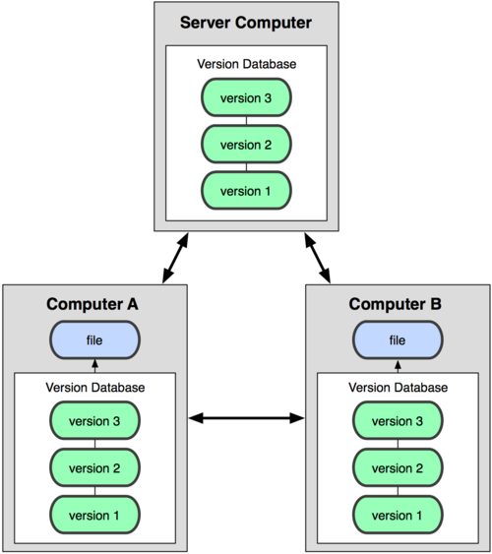
Distributed VCS
Centralized Model
Distributed Model
Notes:
What was the point of this lecture? Supporting the development of our code through the linux environment, managing the linux environment through SSH, and managing versions through Git
Too detailed -Yoshi

Slide 43
Distributed VCS
A distributed VCS lets each user have their own copy of the database
Users can send their versions to each other
If there is a conflict, the sender decides which version to use
Pros
Each user has their own copy
User can choose how to resolve conflicts
Detailed log of every change ever
Cons
More difficult to set up and use

Slide 44
Git
Git is a distributed VCS
Most commonly used VCS
Created by Linus Torvalds to support the development of Linux

Slide 45
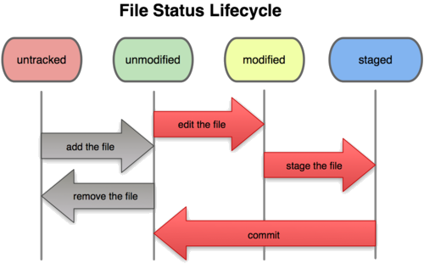
Git on your local machine

Slide 46
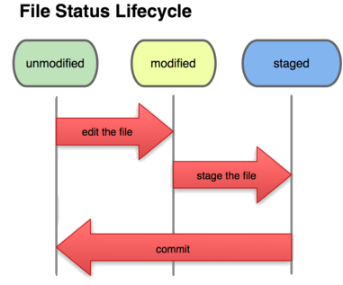
Basic Workflow
Basic Git workflow:
Edit files in your working directory
Stage files, adding snapshots of them to your staging area
Commit, which takes the files as they are in the staging area and stores that snapshot permanently

Slide 47
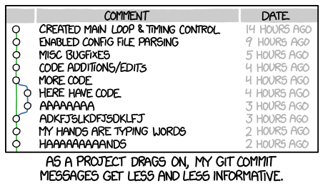
Use Good Commit Messages
http://xkcd.com/1296/
Notes:
http://xkcd.com/1296/

Slide 48
Commit message style
Start your commit message with either +,-,=
+ when functionality was added
- when functionality was taken away
= for small edits that don’t change the functionality
Keep it less than one sentence
Use multiple commits when necessary
If you added two separate features, make two separate commits!

Slide 49
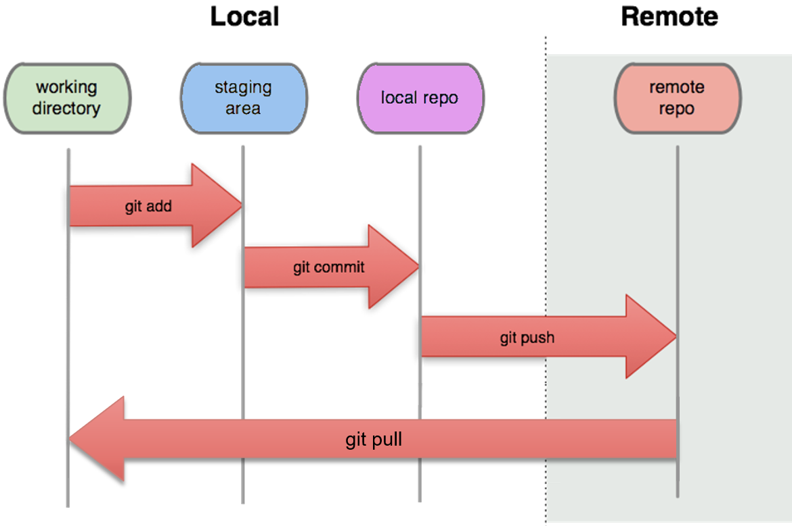
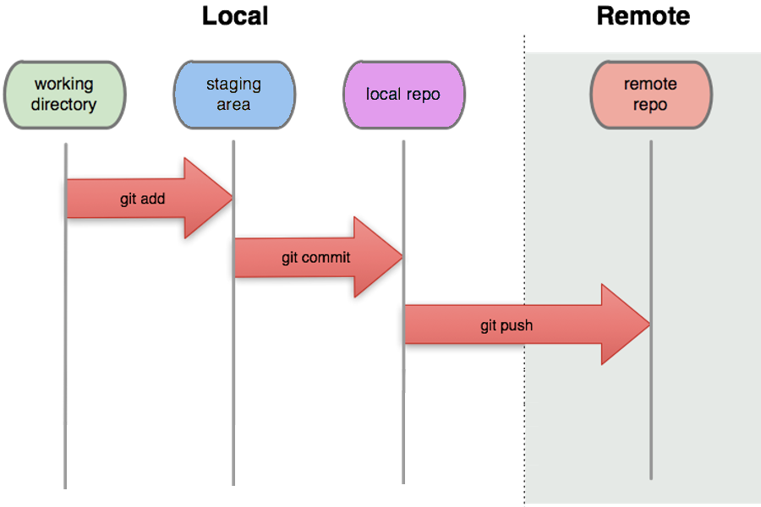
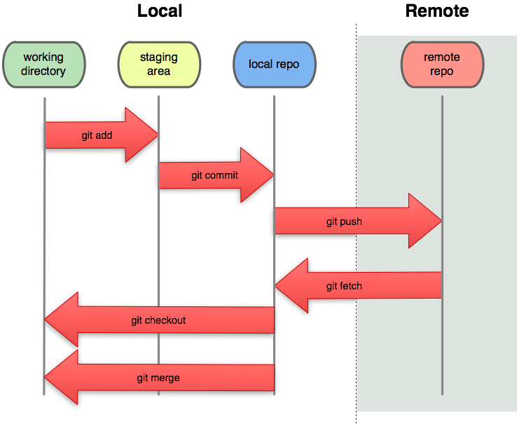
Git with a remote server
git pull

Slide 50
Basic Workflow
Push commits to the server to publish your commits
Pull from the server to get other users’ commits

Slide 51
Git commands
command | description
git status | See which files are/need to be staged
git add [-a] [file] | Add [file] to the staging area
git commit –m [mssg] | Commit these changes and label [mssg]
git push origin master | Send your commits to the server
git pull | Download updates from the server

