Slide 1

Wonderful Wines of the World: Customer Segmentation
Business Cases - Group AA

Slide 2
Customers
Moderate Diversity
Customer-Centric Marketing

Slide 3
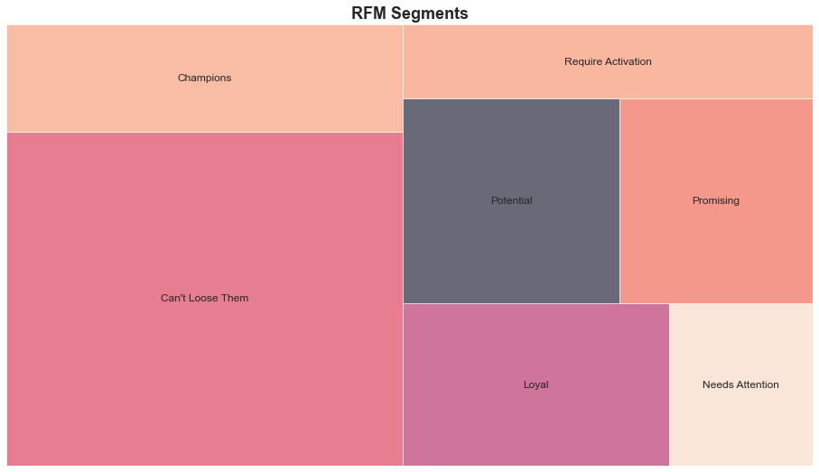
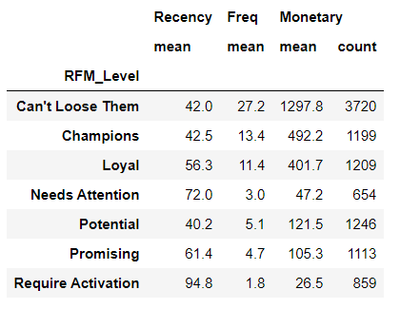
RFM Analysis

Slide 4
Segmentation Approach
Demographic
Behavioral

Slide 5
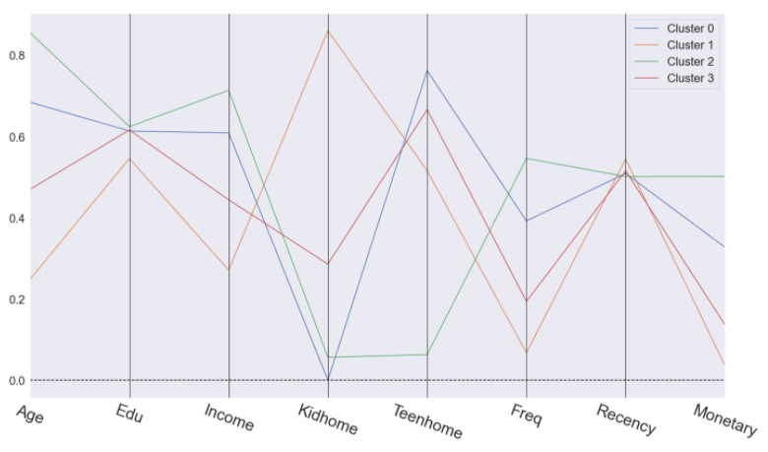

Slide 6
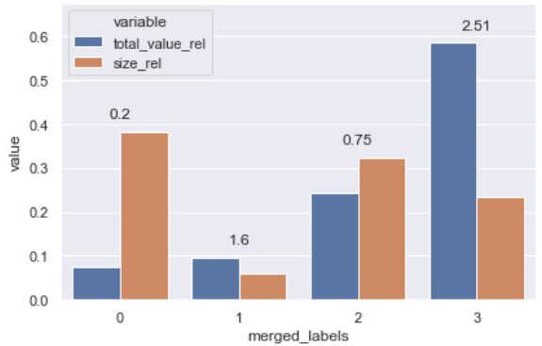
Leverage Analysis

Slide 7
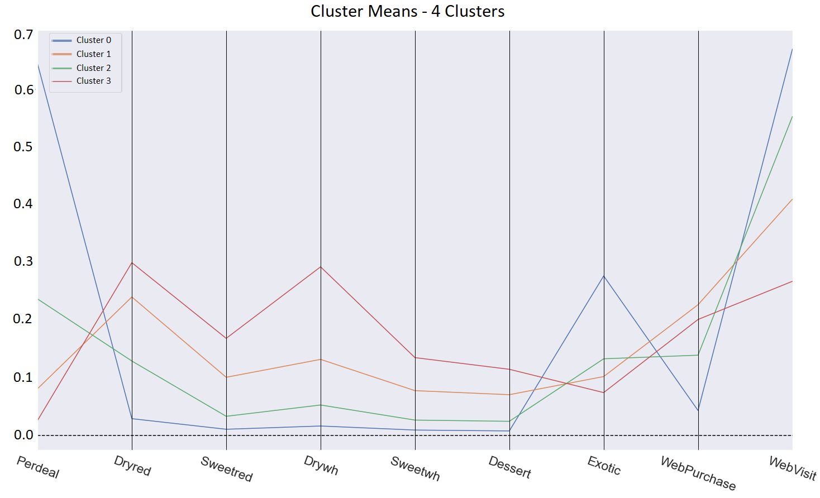
Cluster Profiling

Slide 8
Deployment
Timeline
Continuous Evaluation
Re-clustering
6 to 12 months
Employee Training

Slide 9
Marketing Mix
 | Cluster 0 | Cluster 1 | Cluster 2 | Cluster 3
Product | Exotic | Dry red, dry white | Exotic, dry red | Dry read, dry white, sweet red
Price | Low price | High price | Avg price | High price
Place | Email, mail | Online | Online | Store
Promotion | Promotions and special offers | Free accessorize with the purchase more than avg sum | Wishlist items and a limited-time offer discount | Special events and individual subsription

Slide 10
Thank you.

