Slide 1
Pharmacy Management System
Database Development with PL/SQL
Lecturer: Eric Maniraguha
Academic Year: 2025-2026
Adventist University of Central Africa
Uwitonze Pacific | Student ID: 26983

Slide 2

Introduction
Modern pharmacies continue to experience operational challenges caused by manual and fragmented processes. These issues frequently result in prescription errors, inventory mismatches, delayed patient services, and inconsistencies in patient and medicine records.
This project introduces a Pharmacy Management System developed using Oracle Database and PL/SQL to improve accuracy, automate workflows, and enhance service delivery through:
Automated prescription processing
Real-time inventory monitoring
Secure management of prescriptions, inventory, and payments
Increased operational efficiency
Problem Statement
Despite their critical role in healthcare, many pharmacies still rely on manual procedures that lead to:
Frequent prescription errors
Outdated or inaccurate inventory tracking
Slow service delivery to patients
Poorly structured or inconsistent patient records

Slide 3

Proposed Solution
Automated prescription processing
Real-time inventory management
Patient data management
Analytics & reporting

Slide 4
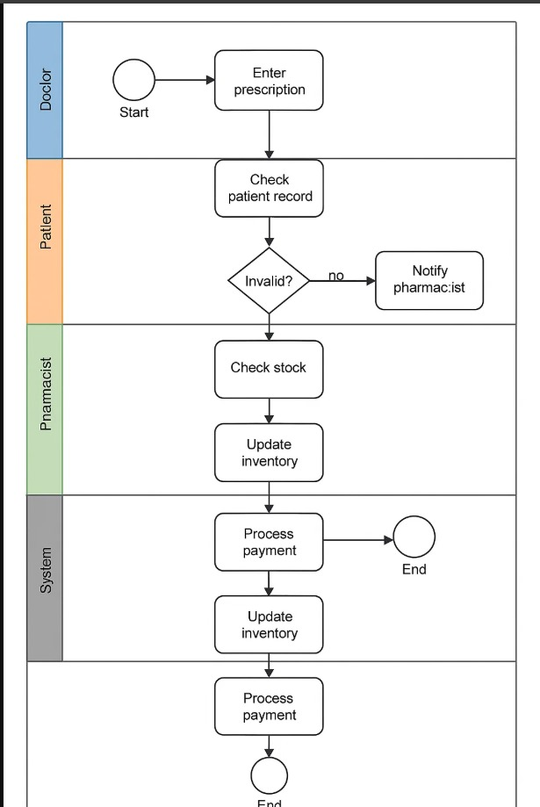
Business Process Overview
Actors: Doctor, Patient, Pharmacist, System
Prescription → Validation → Stock Check
Dispensing → Billing → Inventory Update

Slide 5
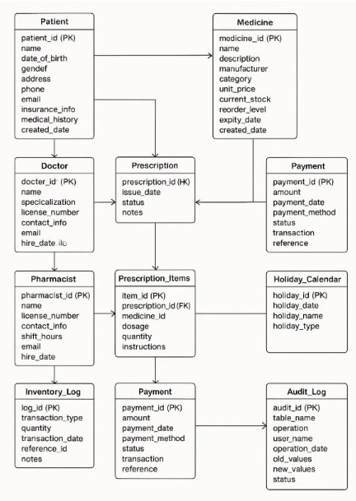
Logical Database Design
9 main entities: Doctor, Patient, Medicine,
Prescription, Prescription_Items,Pharmacist,
Dispensed_Medicines, Payment,Inventory_Log
Fully normalized (3NF)
ERD implemented with relationships

Slide 6
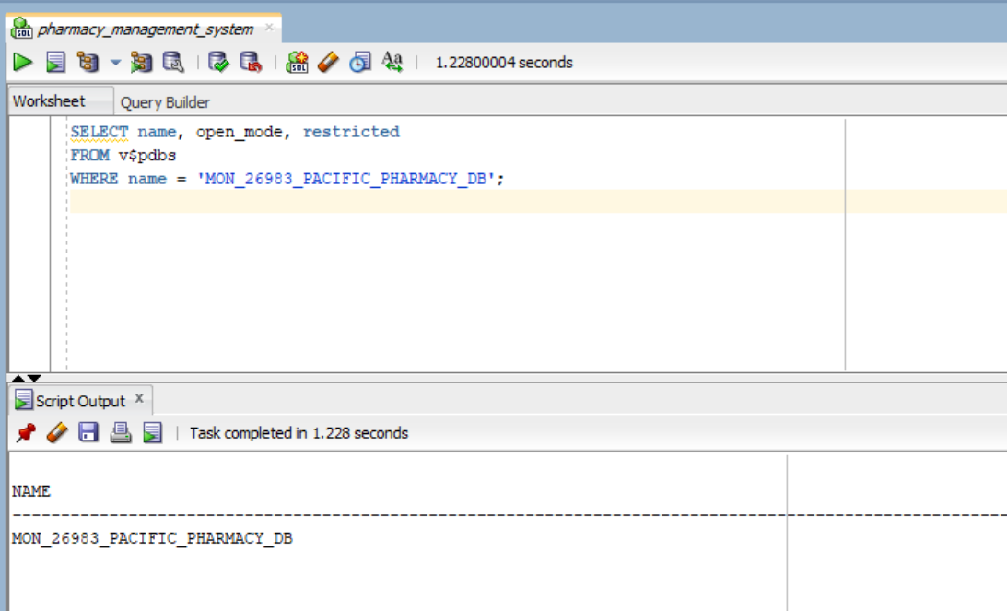
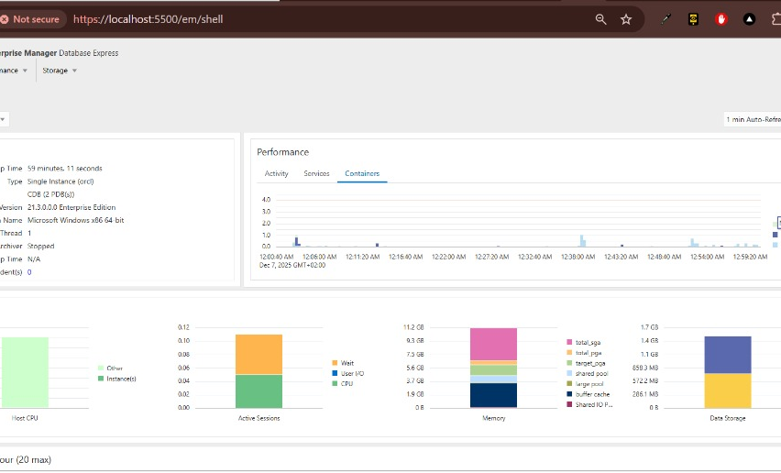
DatabaseImplementation
9 main entities: Doctor, Patient, Medicine,
Prescription, Prescription_Items, Pharmacist,
Dispensed_Medicines, Payment, Inventory_Log
Fully normalized (3NF)
ERD implemented with relationships

Slide 7
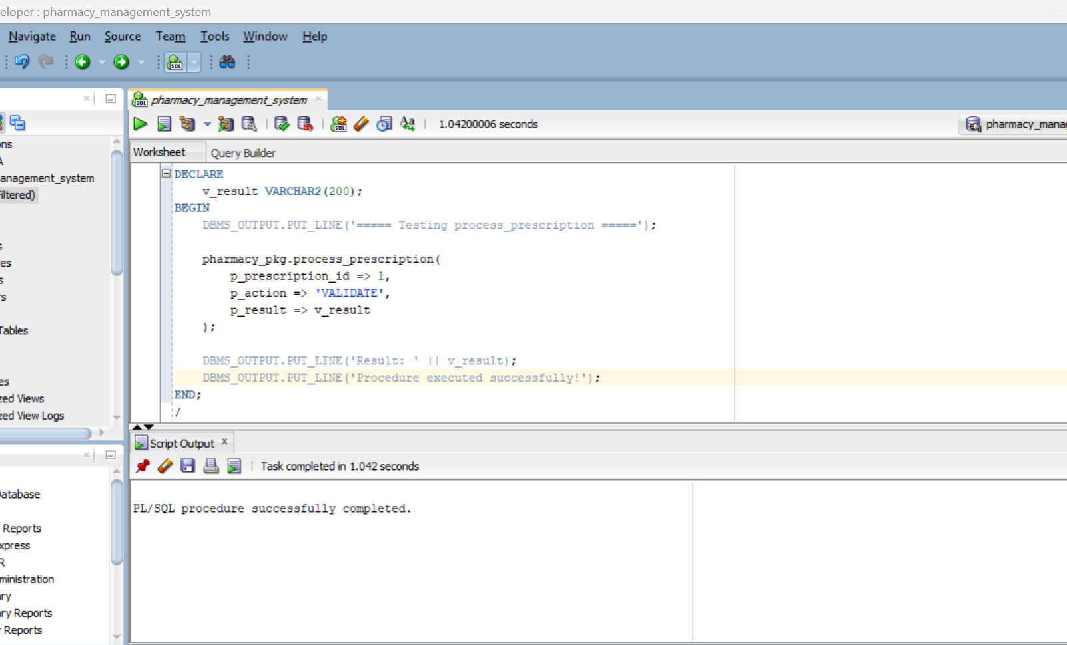
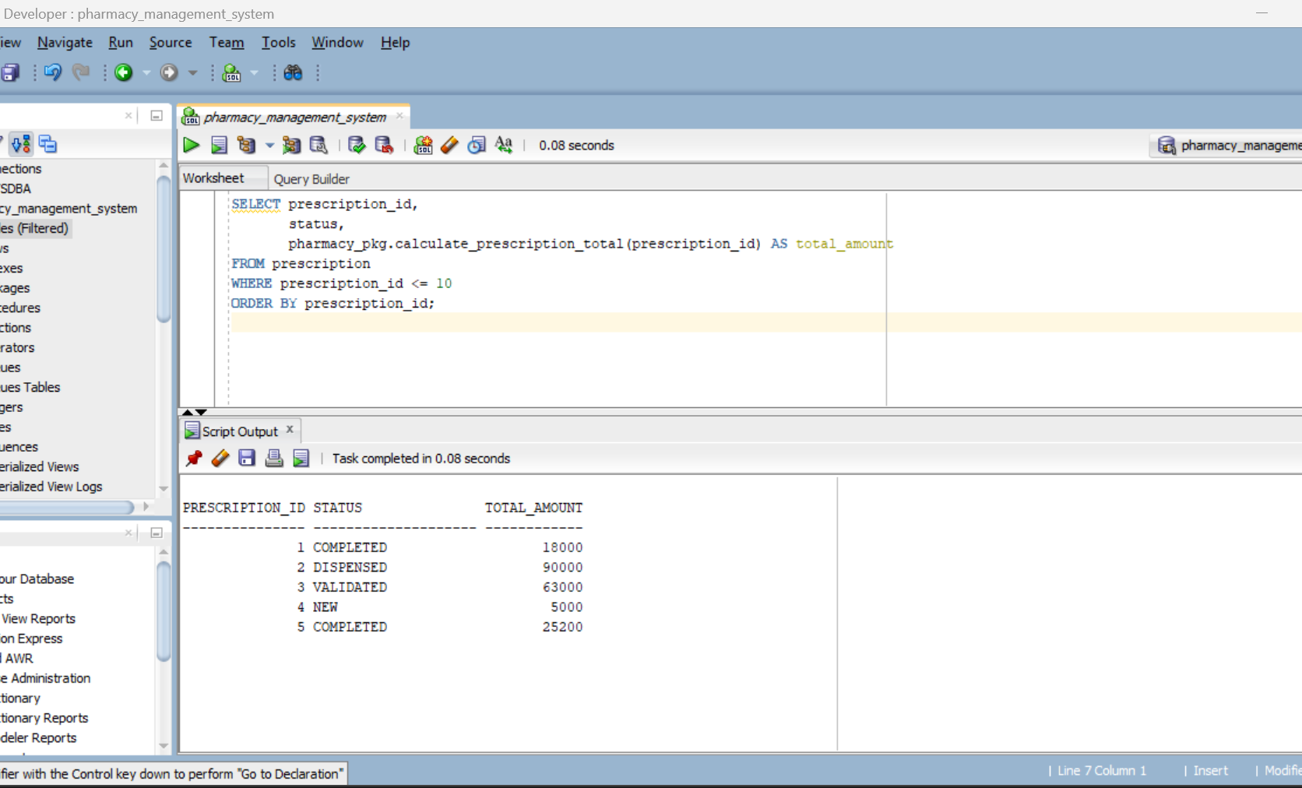
PL/SQL Development
Procedures:process_prescription, inventoryreport
Functions: calculate totals,patient history
Cursors for active prescriptions& low stock
Window functions:ROW_NUMBER, RANK, LAG, LEAD

Slide 8

Security & Auditing
Trigger: weekday/holiday restriction
Audit logging: ALLOWED/DENIED actions
Auto stock updates & validation triggers
Holiday management system

Slide 9

Reporting & BI Features
Low stock alerts
Daily revenue summary
Sales by doctor
Inventory movement analysis

Slide 10
Conclusion
The Pharmacy Management System successfully automates key pharmaceutical operations, resulting in faster workflows and reduced manual errors. By integrating a fully PL/SQL-based backend, the system enhances accuracy in prescription processing and ensures reliable stock control through real-time inventory updates. Comprehensive auditing mechanisms strengthen data security and compliance, while analytical reports support informed decision-making for managers and pharmacists. Overall, the project demonstrates a robust, efficient, and modern solution for improving pharmacy service delivery.

