Slide 1
Pharmacy Management System
Database Development with PL/SQL
Lecturer: Eric Maniraguha
Academic Year: 2025-2026
Uwitonze Pacific | Student ID: 26983

Slide 2

Introduction
Modern pharmacies face increasing challenges due to manual processes that often result in prescription errors, inventory mismatches, delayed patient services, and data inconsistencies.
This project introduces a Pharmacy Management System built using Oracle Database and PL/SQL programming. The system provides:
Automation of prescription workflows
Real-time inventory tracking
-Secure data management for prescriptions, inventory, and payments
-Enhanced service delivery and operational efficiency

Slide 3

Problem Statement
Manual prescriptions lead to errors
Outdated inventory tracking
Slow service delivery
Unstructured patient records

Slide 4

Proposed Solution
Automated prescription processing
Real-time inventory management
Patient data management
Analytics & reporting

Slide 5
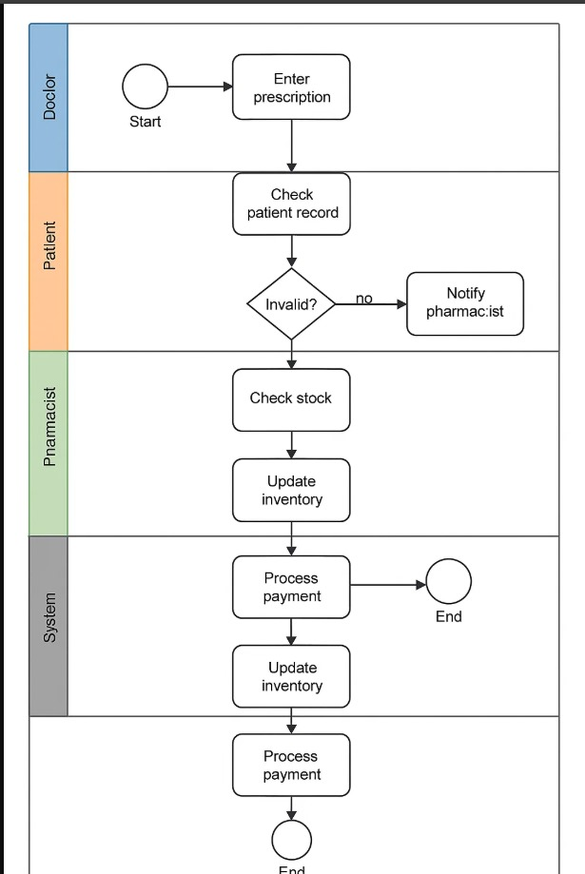
Business Process Overview
Actors: Doctor, Patient, Pharmacist, System
Prescription → Validation → Stock Check
Dispensing → Billing → Inventory Update

Slide 6
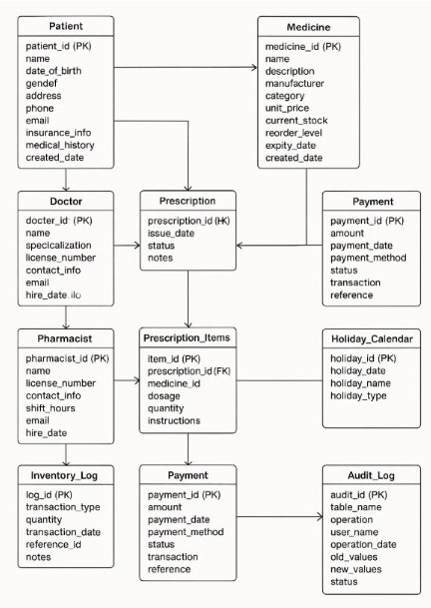
Logical Database Design
9 main entities: Doctor, Patient, Medicine,
Prescription, Prescription_Items,Pharmacist,
Dispensed_Medicines, Payment,Inventory_Log
Fully normalized (3NF)
ERD implemented with relationships

Slide 7
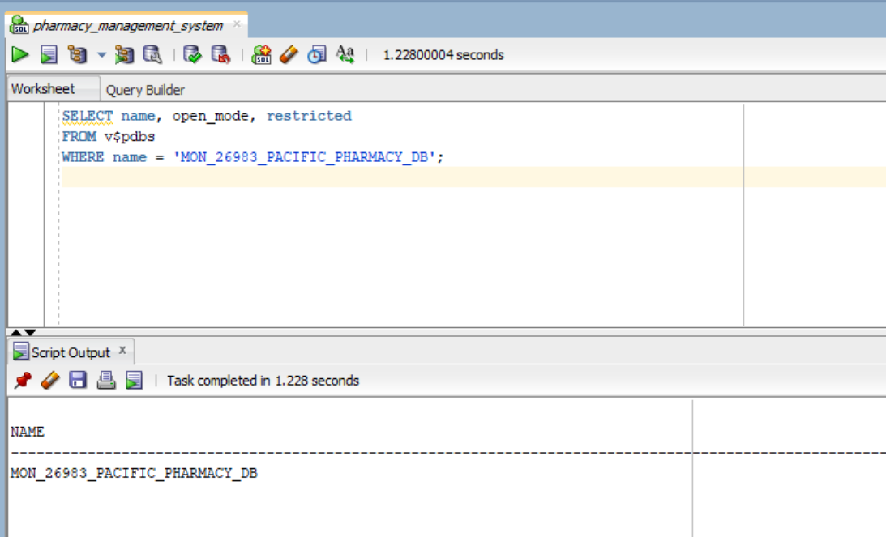
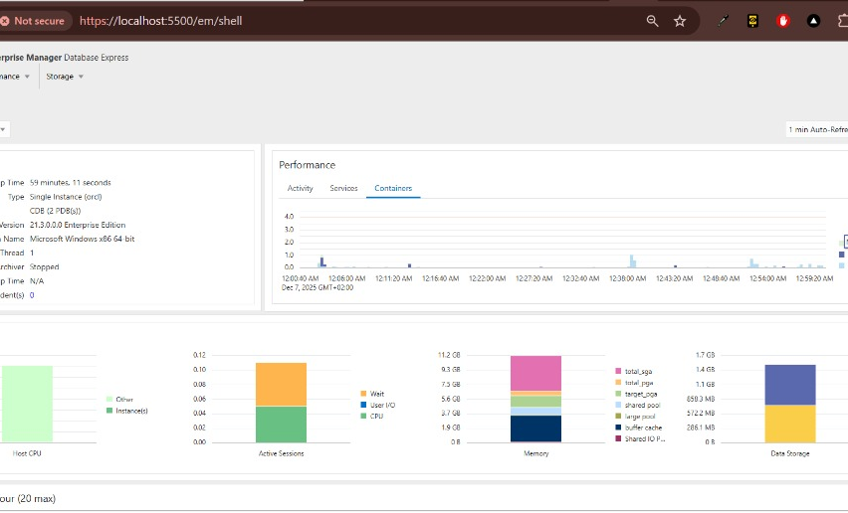
DatabaseImplementation
9 main entities: Doctor, Patient, Medicine,
Prescription, Prescription_Items, Pharmacist,
Dispensed_Medicines, Payment, Inventory_Log
Fully normalized (3NF)
ERD implemented with relationships

Slide 8
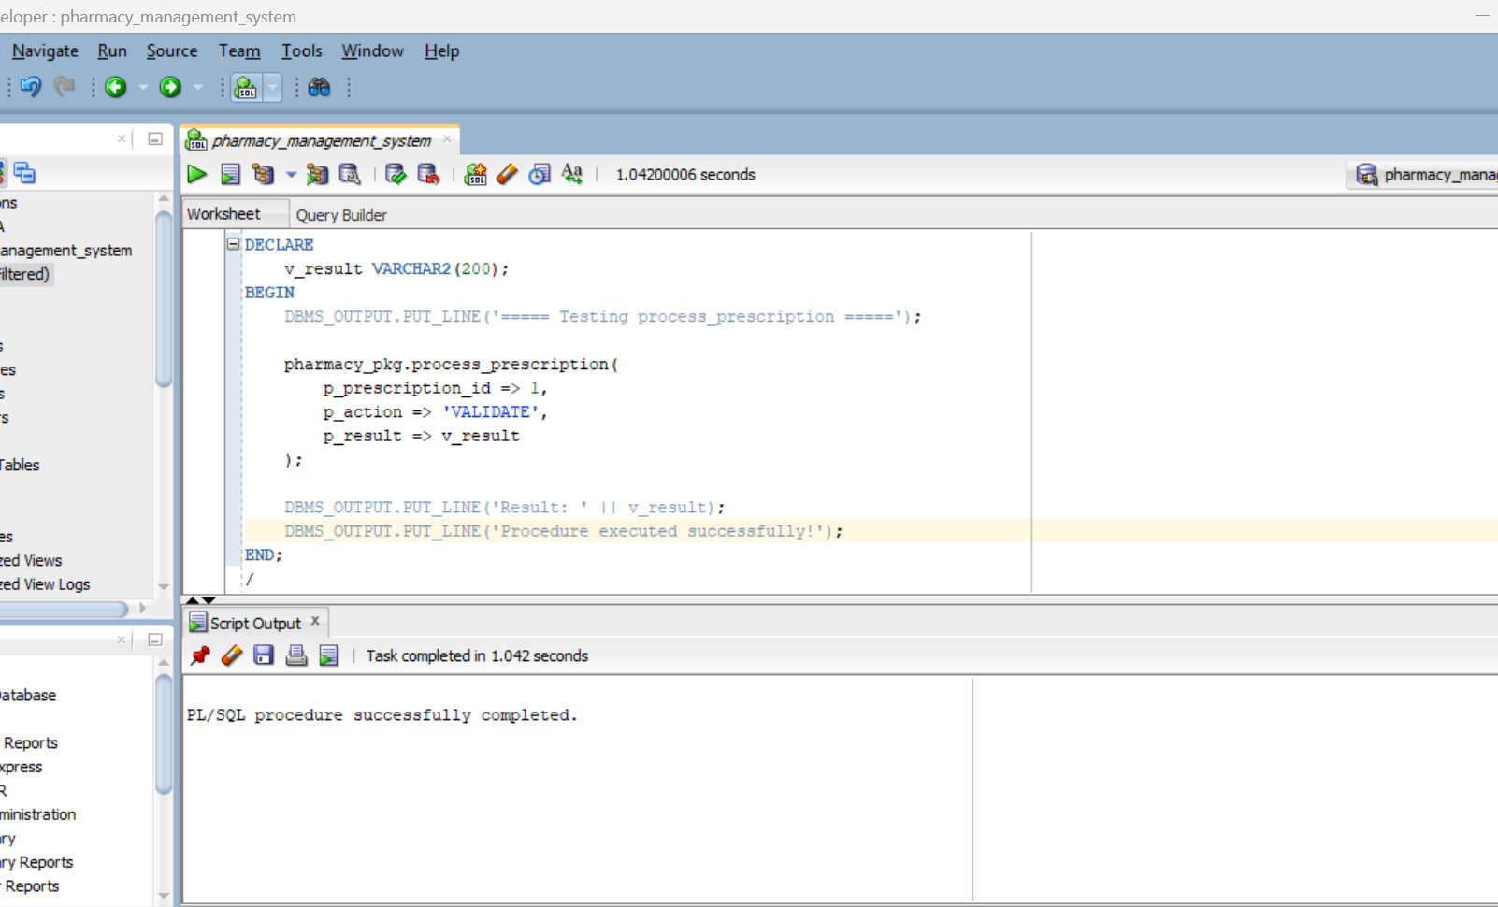
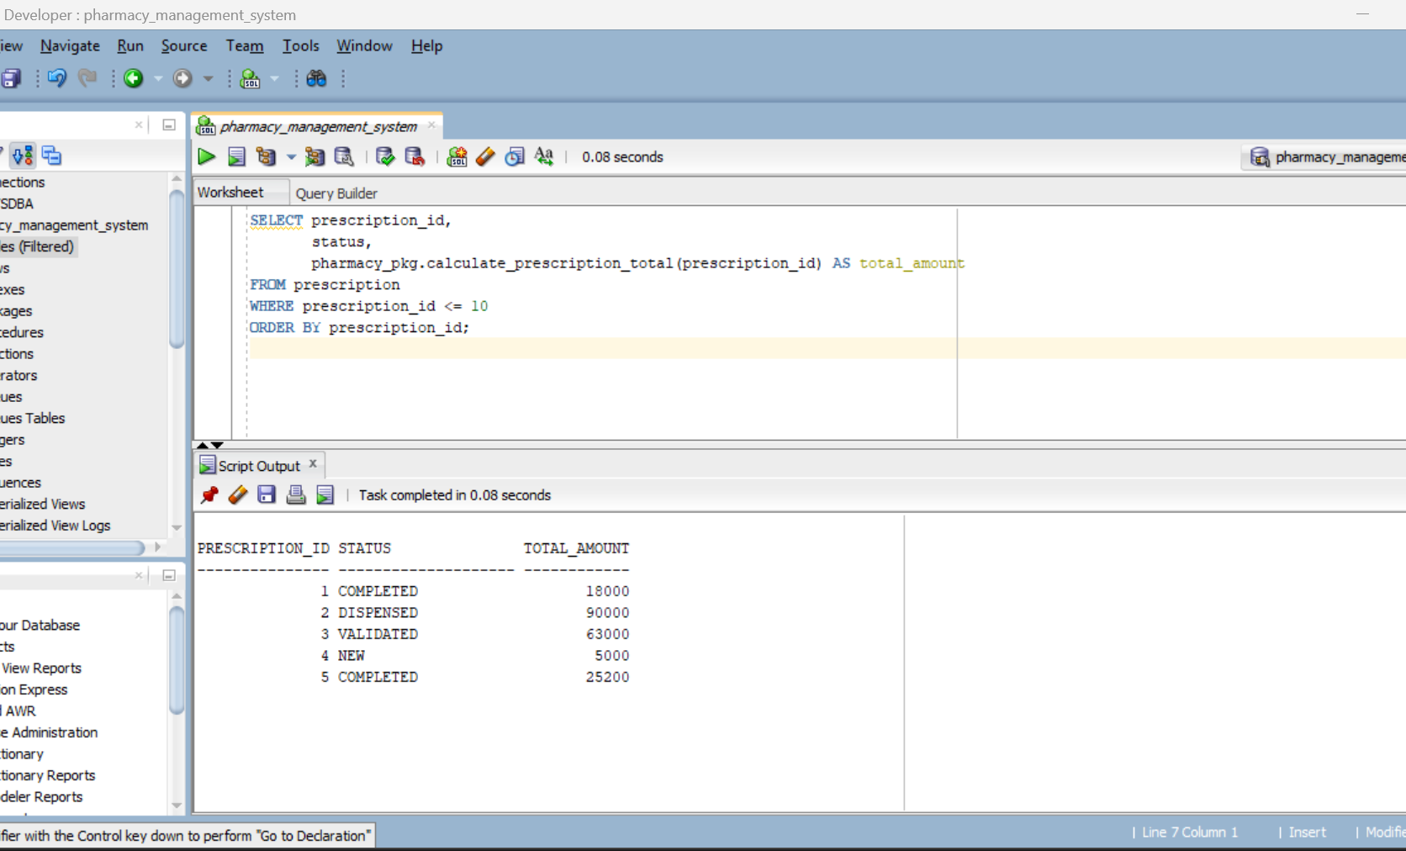
PL/SQL Development
Procedures:process_prescription, inventoryreport
Functions: calculate totals,patient history
Cursors for active prescriptions& low stock
Window functions:ROW_NUMBER, RANK, LAG, LEAD

Slide 9

Security & Auditing
Trigger: weekday/holiday restriction
Audit logging: ALLOWED/DENIED actions
Auto stock updates & validation triggers
Holiday management system

Slide 10

Reporting & BI Features
Low stock alerts
Daily revenue summary
Sales by doctor
Inventory movement analysis

Slide 11
Conclusion
The Pharmacy Management System successfully automates key pharmaceutical operations, resulting in faster workflows and reduced manual errors. By integrating a fully PL/SQL-based backend, the system enhances accuracy in prescription processing and ensures reliable stock control through real-time inventory updates. Comprehensive auditing mechanisms strengthen data security and compliance, while analytical reports support informed decision-making for managers and pharmacists. Overall, the project demonstrates a robust, efficient, and modern solution for improving pharmacy service delivery.

