Slide 1
E-Commerce Big Data Analytics
MongoDB, HBase and Apache Spark for an integrated analytics platform
Uwizeye Christelle |ID: 101465 | Big Data Analytics | AUCA

Slide 2
1. Business problem and project goal
An e-commerce company needs to understand customers, purchases and browsing behaviour.
Goal: build an analytics solution that supports product, customer and conversion decisions.
The project generated realistic e-commerce data and used the right technology for each data-access pattern.
  Questions answered: What sells? Who purchases? What happens between browsing and purchase?
AUCA Big Data Analytics Final Project | Uwizeye Christelle | 2

Slide 3
2. Dataset and project scope
10,000
users
5,000
products
50,000
transactions
200,000
sessions
25 product categories; product attributes, pricing and category hierarchy.
Transactions contain embedded line items, quantities, prices and recognised purchase status.
Session data contains product views, cart contents, device details, location and referral source.
A 10,000-session representative HBase sample was used for the cross-system analysis.
AUCA Big Data Analytics Final Project | Uwizeye Christelle | 3

Slide 4
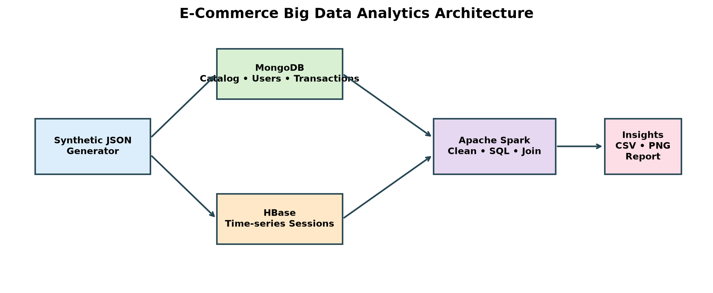
3. System architecture
Raw JSON is modelled in MongoDB and HBase; Spark performs batch, SQL and cross-system analytics.
AUCA Big Data Analytics Final Project | Uwizeye Christelle | 4

Slide 5
4. MongoDB: document model and analytics
MongoDB stores flexible e-commerce business entities as documents.
  Products: product details with category information and pricing data.
  Users: profiles with frequently accessed purchase summaries and preferences.
  Transactions: one document per order with embedded line items.
Loaded 25 categories, 5,000 products, 10,000 users and 50,000 transaction documents.
Aggregation pipelines: top products by recognised revenue and customer purchase-frequency segmentation.
AUCA Big Data Analytics Final Project | Uwizeye Christelle | 5

Slide 6
5. HBase: time-series browsing storage
HBase is designed for fast row-key access to a user’s browsing activity.
Row key: user_id | ISO start time | session_id — sessions for the same user are stored together in time order.
Column families: meta, device, geo and activity.
A 10,000-session representative sample was loaded and queried successfully for individual users.
A second table design, product_daily_metrics, supports product performance measurements over time.
AUCA Big Data Analytics Final Project | Uwizeye Christelle | 6

Slide 7
6. Spark batch processing and SQL
PySpark cleaned and normalized JSON records, standardized fields and wrote analytical Parquet datasets.
Generated 109,863 transaction items and 92,216 recognised transaction items.
Recommendation indicator: product pairs purchased in the same transaction (68,565 unique pairs).
Spark SQL demonstrated complex joins across MongoDB-like transaction data and HBase-like browsing data.
Example analyses: customer engagement/purchase value and category view-to-purchase funnel.
AUCA Big Data Analytics Final Project | Uwizeye Christelle | 7

Slide 8
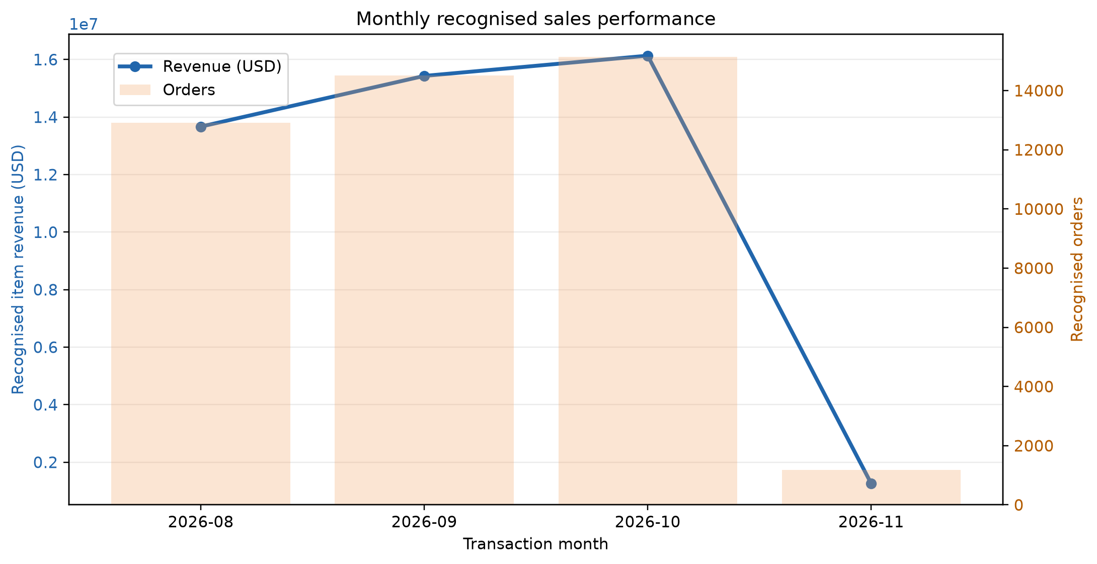
7. Sales performance over time
Monthly recognised sales provide a time-based view of revenue and purchasing activity.
AUCA Big Data Analytics Final Project | Uwizeye Christelle | 8

Slide 9
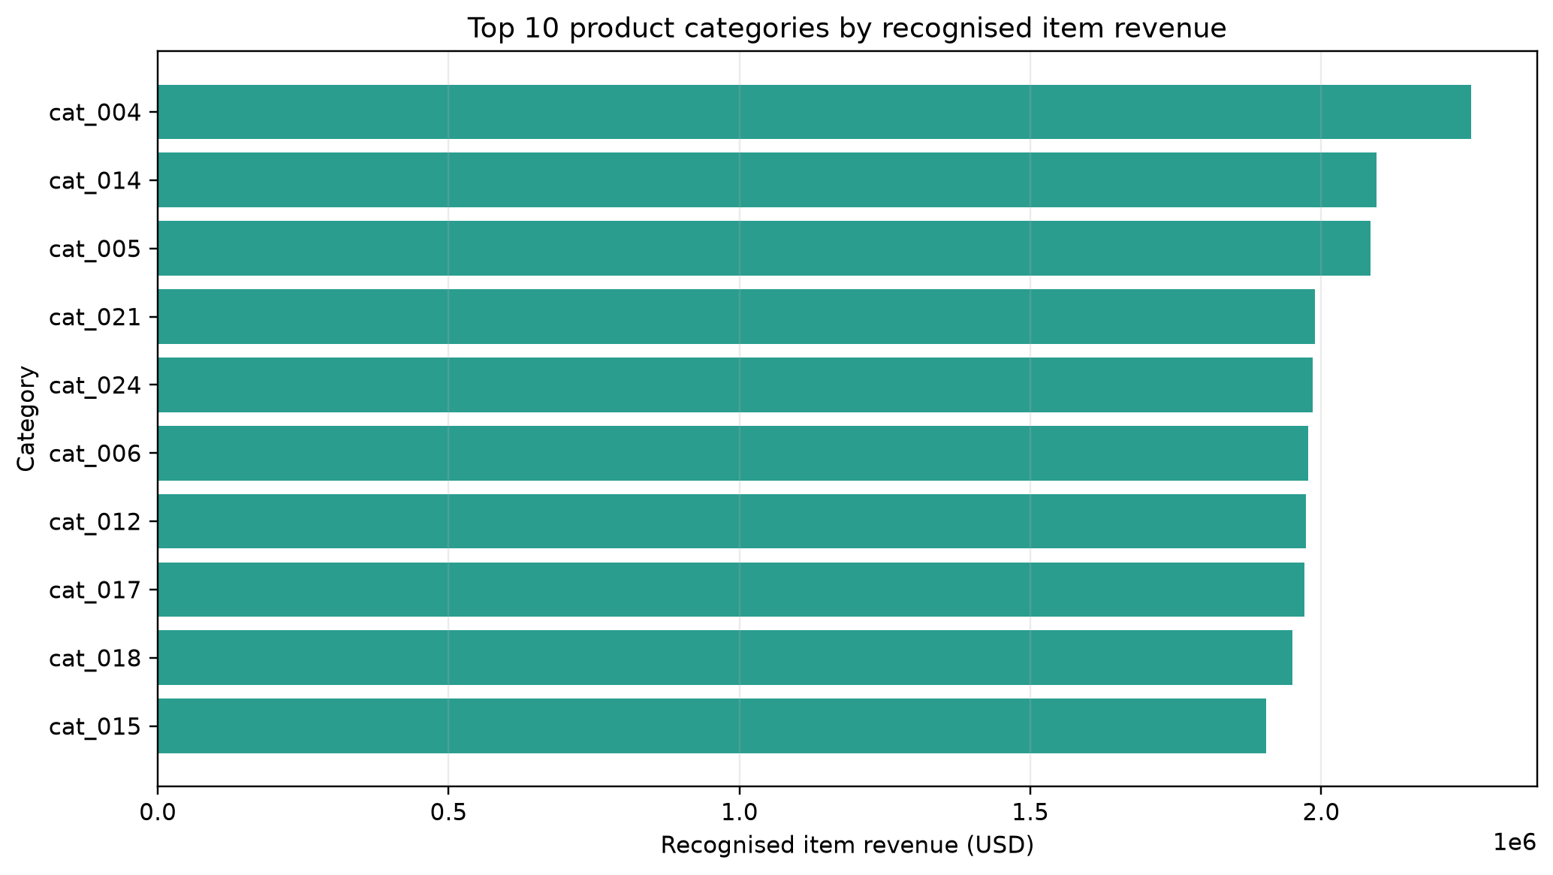
8. Product category revenue
Category performance identifies product groups that contribute the highest recognised item revenue.
AUCA Big Data Analytics Final Project | Uwizeye Christelle | 9

Slide 10
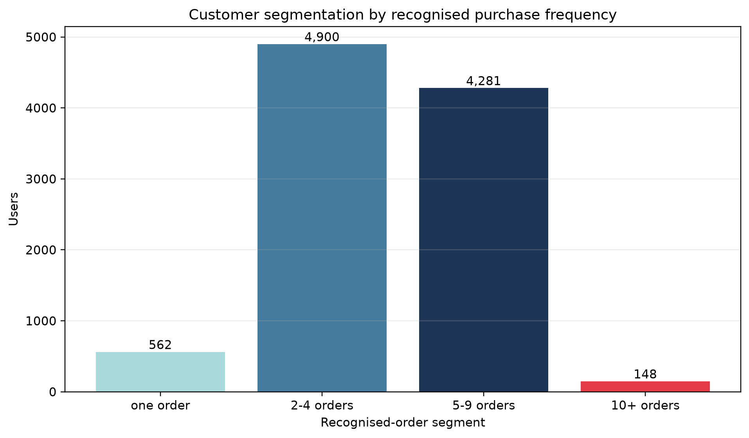
9. Customer purchase segments
Most customers are regular purchasers; the high-frequency group is smaller but strategically important.
AUCA Big Data Analytics Final Project | Uwizeye Christelle | 10

Slide 11
10. Integrated analytics: conversion funnel
Business question: Which browsing journeys become recognised purchases?
HBase contributes session activity: product views, cart behaviour, device type and referrer.
MongoDB contributes recognised transaction and revenue information.
Spark joins both sources by session_id, calculates funnel stages and groups results by device and referrer.
This produces evidence for marketing and user-experience decisions that neither system can provide alone.
AUCA Big Data Analytics Final Project | Uwizeye Christelle | 11

Slide 12
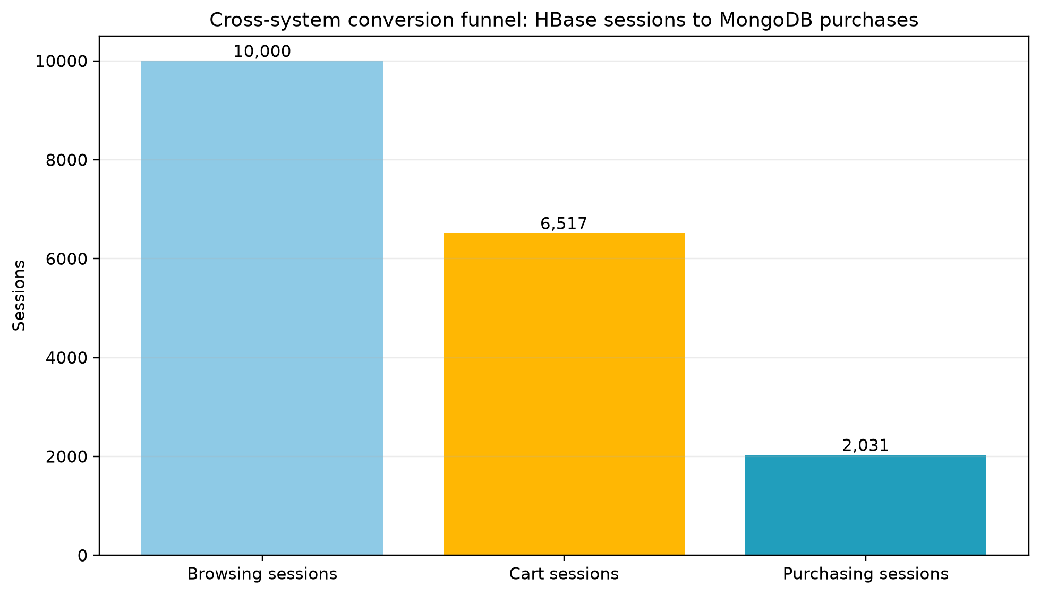
11. Cross-system conversion funnel
Results: 10,000 browsing sessions → 6,517 cart sessions → 2,031 recognised purchases.
AUCA Big Data Analytics Final Project | Uwizeye Christelle | 12

Slide 13
12. Key findings and business insights
The data pipeline supports product popularity, purchase segments, revenue analysis and conversion analysis.
The browsing-to-cart rate is high enough to justify studying checkout abandonment and cart recovery.
Product recommendations should be treated as indicators, not final recommendations, because random synthetic data produces weak co-purchase counts.
MongoDB suits document-centric business data; HBase suits high-volume, user-keyed event retrieval; Spark suits transformation and cross-source computation.
AUCA Big Data Analytics Final Project | Uwizeye Christelle | 13

Slide 14
13. Scalability, limitations and conclusion
Scalability: partitioned Parquet, Spark DataFrame operations, MongoDB indexes and HBase row-key locality support future scale-out.
Limitations: synthetic data, a representative HBase sample, and no real-time streaming component.
Future work: deploy on a multi-node cluster, add stronger recommendation ranking, and monitor the funnel continuously.
Conclusion: the project demonstrates a practical multi-system architecture where each technology is used for the workload it handles best.
Thank you — questions?
AUCA Big Data Analytics Final Project | Uwizeye Christelle | 14

