Slide 1
Distributed Multi-Model Analytics
for E-Commerce Data
Final Project Defence
Uwizeye Christelle | Student ID: 101465 | AUCA Big Data Analytics

Slide 2
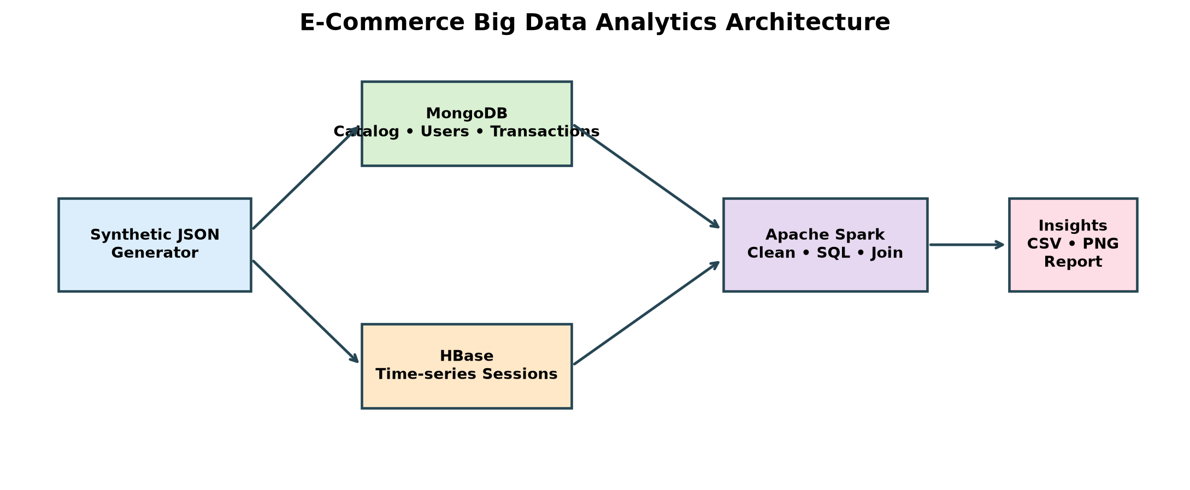
1. Architecture and dataset
0:00–1:00
Generated JSON data is stored according to the strongest access pattern, then analysed using Spark.
AUCA Big Data Analytics Final Project | Uwizeye Christelle | ID: 101465 | 2

Slide 3
2. Data modelling decisions
1:00–2:30
MongoDB transaction document (simplified)
HBase browsing-session row key
{
"transaction_id": "txn_...",
"user_id": "user_005955",
"status": "recognised",
"items": [{"product_id": "prod_01748",
"quantity": 2, "price": 111.33}]
}
Row key
user_005955|2026-09-25T00:48:37|sess_e69952bc68
Column families
meta → session ID, times, status
device → type, browser, OS
geo → country, city, IP
activity → views, cart, products
Why: sessions for one user are stored together.
MongoDB supports flexible business documents; HBase supports fast time-ordered retrieval of one user’s events.
AUCA Big Data Analytics Final Project | Uwizeye Christelle | ID: 101465 | 3

Slide 4
3. Query demonstration: MongoDB and HBase
2:30–5:30
MongoDB aggregation — product popularity
HBase query — one user’s session activity
transactions.aggregate([
{$match: {status: "recognised"}},
{$unwind: "$items"},
{$group: {_id: "$items.product_id",
units: {$sum: "$items.quantity"},
revenue: {$sum: {$multiply:
["$items.quantity", "$items.price"]}}}},
{$sort: {revenue: -1}}, {$limit: 10}
])
Returns: top products by recognised
item revenue and units sold.
# user prefix scan
scan 'user_sessions', {
STARTROW => 'user_005955|',
STOPROW => 'user_005955}',
LIMIT => 20
}
Returns session metadata, device,
view counts and cart behaviour.
Efficient because the row key starts
with user_id.
Live-demo preparation: have MongoDB analytics and the HBase shell query result already open.
AUCA Big Data Analytics Final Project | Uwizeye Christelle | ID: 101465 | 4

Slide 5
4. Spark cleaning and recommendation indicator
5:30–6:40
PySpark processing logic
Batch output
# normalize records and explode transaction line items
clean_items = transactions.filter("status = 'recognised'") \
.select('transaction_id', 'user_id',
explode('items').alias('item'))
# products bought in the same transaction
pairs = clean_items.alias('a').join(clean_items.alias('b'),
(col('a.transaction_id') == col('b.transaction_id')) &
(col('a.item.product_id') < col('b.item.product_id')))
# count co-purchases as recommendation indicators
10,000 users cleaned
5,000 products cleaned
109,863 transaction items
92,216 recognised items
68,565 unique product pairs
Interpretation:
Pairs indicate possible
recommendations; counts are
weak in synthetic random data.
AUCA Big Data Analytics Final Project | Uwizeye Christelle | ID: 101465 | 5

Slide 6
5. Spark SQL analytics
6:40–7:30
Category view-to-purchase funnel (simplified Spark SQL)
SELECT p.category_id,
COUNT(*) AS product_detail_views,
COUNT(DISTINCT t.transaction_id) AS purchasing_transactions,
ROUND(100.0 * COUNT(DISTINCT t.transaction_id) / COUNT(*), 2)
AS purchases_per_100_product_views
FROM hbase_page_views v
JOIN mongo_products p ON v.product_id = p.product_id
LEFT JOIN mongo_transaction_items t ON v.session_id = t.session_id
WHERE t.status = 'recognised'
GROUP BY p.category_id
ORDER BY purchases_per_100_product_views DESC;
This demonstrates SQL logic over DataFrames representing data that could reside in HBase and MongoDB.
AUCA Big Data Analytics Final Project | Uwizeye Christelle | ID: 101465 | 6

Slide 7
6. Integrated business question and workflow
7:30–8:15
Business question: Which browsing journeys turn into recognised purchases?
HBase
Browsing sessions
views, carts, device, referrer
Spark
Join and aggregate
using session_id
MongoDB
Recognised orders
items and revenue
→
→
Outcome: conversion rates and revenue can be compared by device type and referral source.
AUCA Big Data Analytics Final Project | Uwizeye Christelle | ID: 101465 | 7

Slide 8
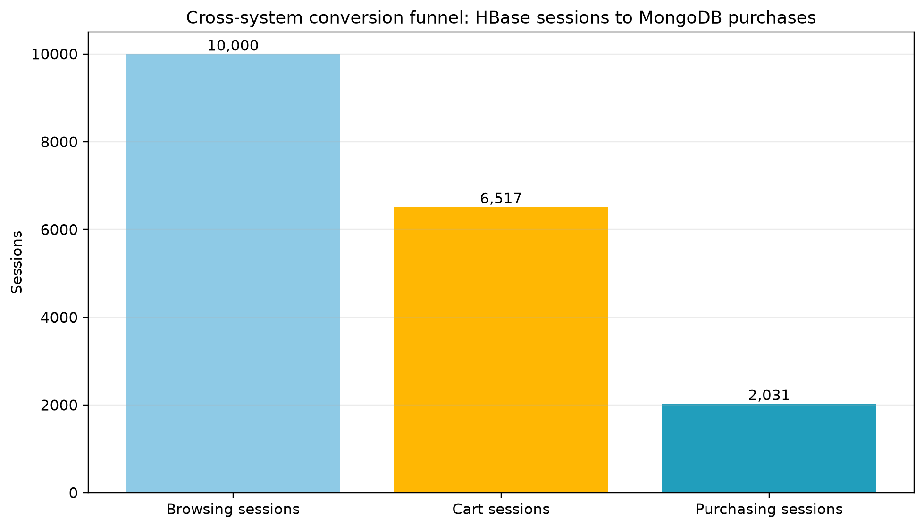
7. Integrated funnel result
8:15–9:00
Result: 10,000 browsing sessions → 6,517 cart sessions → 2,031 recognised purchases.
AUCA Big Data Analytics Final Project | Uwizeye Christelle | ID: 101465 | 8

Slide 9
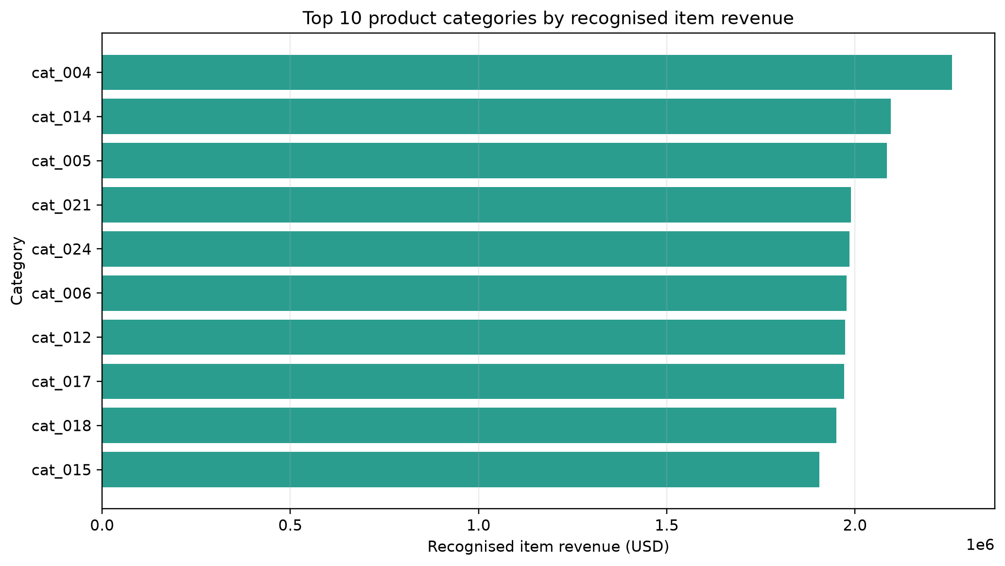
8. Visual insight: category revenue
9:00–9:30
The chart helps prioritize product categories for merchandising and marketing analysis.
AUCA Big Data Analytics Final Project | Uwizeye Christelle | ID: 101465 | 9

Slide 10
9. Reflection, scalability and conclusion
9:30–10:00
MongoDB: indexes support document and aggregation queries; embed line items to retrieve an order in one read.
HBase: user-prefixed row keys provide locality for session-history retrieval.
Spark: Parquet and distributed DataFrame operations support larger-scale transformations and joins.
Honest limitation: data is synthetic and only a representative 10,000-session HBase sample was loaded.
Conclusion: each technology was selected for the workload it performs best.
AUCA Big Data Analytics Final Project | Uwizeye Christelle | ID: 101465 | 10

Slide 11
Thank you — Questions?
Be ready to explain: data-model trade-offs, row-key design, Spark joins, scalability, and the limitation of synthetic data.

