Slide 1

Working with Git/Github
Matthew Fallon

Slide 2

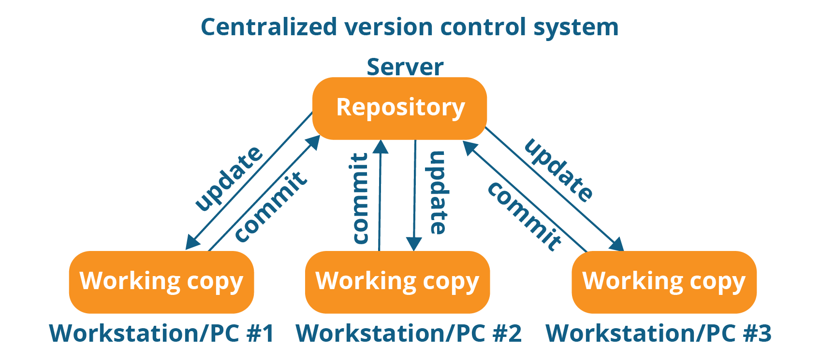

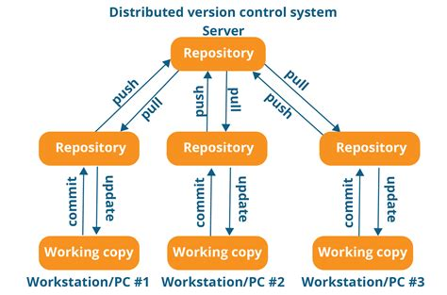
Version Control
Two software developers, one project

Slide 3
Group projects suck
You do not code in isolation
Save to google drive?
Two people one file, what happens?
Version control
Allow “rollback”
Track “blame”
Coordinate “merging”

Slide 4
Centralized VCS
Checkouts
Only work with what you need
Mark what you are working on
Online all the time
Never get out of sync with the server (Hopefully)

Slide 5
Distributed VCS
Local repo copy
No need for internet all the time
Bring local inline with remote
More complex, more control

Slide 6
Git
What we use, why we use it

Slide 7
Git
Made by Linus Torvalds (the Linux person)
Distributed
Wanted to let anyone anywhere help with Linux, no central server to upkeep
Handmade to be good for Linux and for open source projects
No server needed, just storage

Slide 8
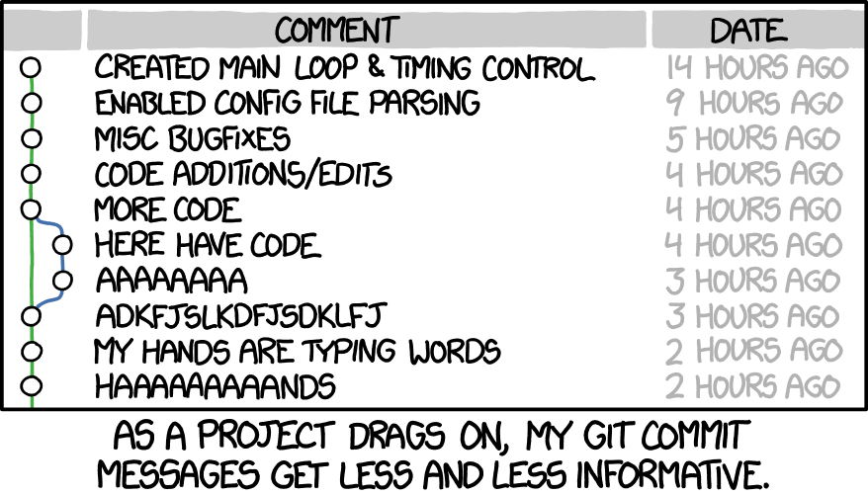
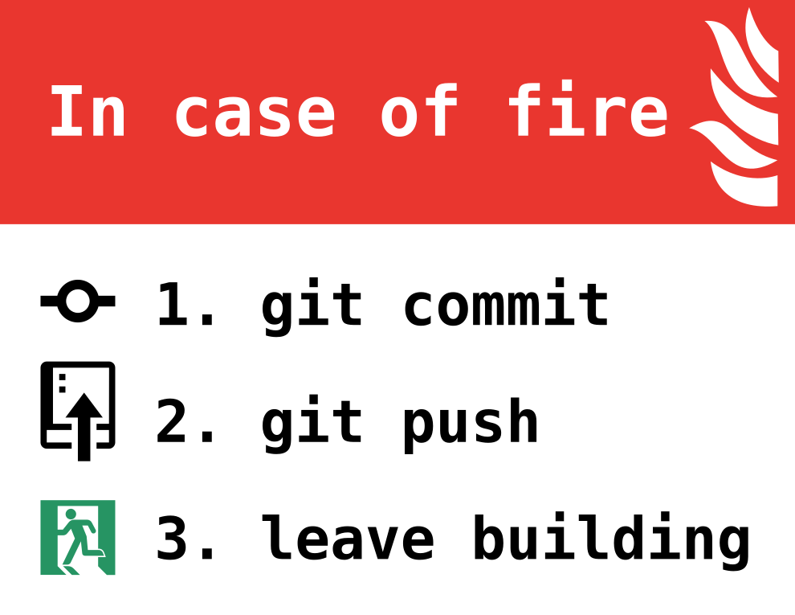
Git Actions
How we use it

Slide 9
Get started
git init
Run this only once! (server may run it for you)
git clone [repo-url]
Grab from server (if already up there)
git status
What files can git see?

Slide 10
Add changes
git branch
Section off your changes (merge them back later)
Branch early branch often
git add [file-name | .]
Tell git what files you want to “save changes” for
git commit [-a] [-m “message”]
Tell git to save those changes as a grouping “staple them together”

Slide 11
Merge with others
git merge
Bring back in your branch’s changes
Fast forward if possible
git rebase
Update your branch with other’s changes
Only do on your own branches or local branches
Merge conflicts are scary
Don’t panic, sometimes hard sometimes easy

Slide 12
Ahhh! Somethings up!
git reset [--hard | --soft]
Run `git add .` first.
Hard resets “tracked” files themselves
Soft resets just the commit

Slide 13
Notable Mentions
git log –graph
Show the history in the cli with “graph” of how changes relate

Slide 14
Learn Git Branching
https://learngitbranching.js.org/

Slide 15
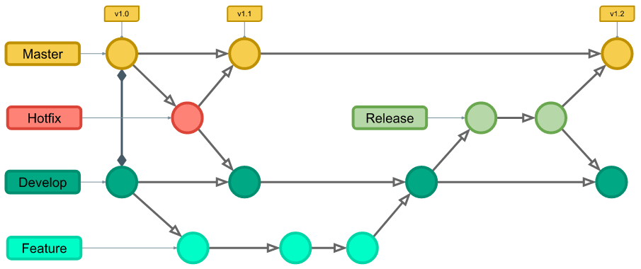
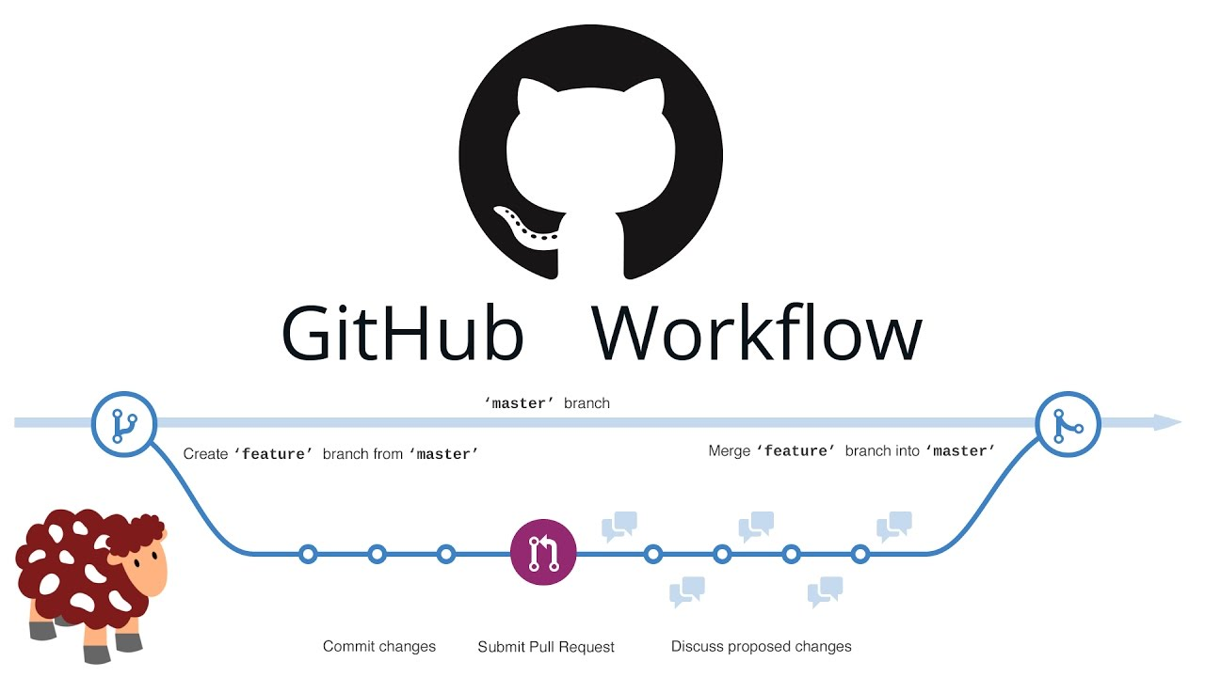
Workflows in Git
How we scale it

Slide 16
Git flow
Fully fleshed out
Ongoing development on one project
Complicated

Slide 17
Github Flow
Muuuuch simpler
Uses github or other repo to coordinate merges online
Not as complex, not as much control

Slide 18

Github and alternates
Where we use it

Slide 19
Online Repos
Manage storage
Help make small edits
Pull requests

Slide 20
Why github account is needed
Industry common
Very common for opensource
Share your “profile” on your resume.

Slide 21

Thank You
someone@example.com

