Slide 1
Node.js Development
By: Zoli Nahoczki

Slide 2
Overview
Final Product Preview
Client Server Architecture
HTTP
REST
Data
JSON
XML
Javascript Basics
Node.js
What is it
NPM

Slide 3
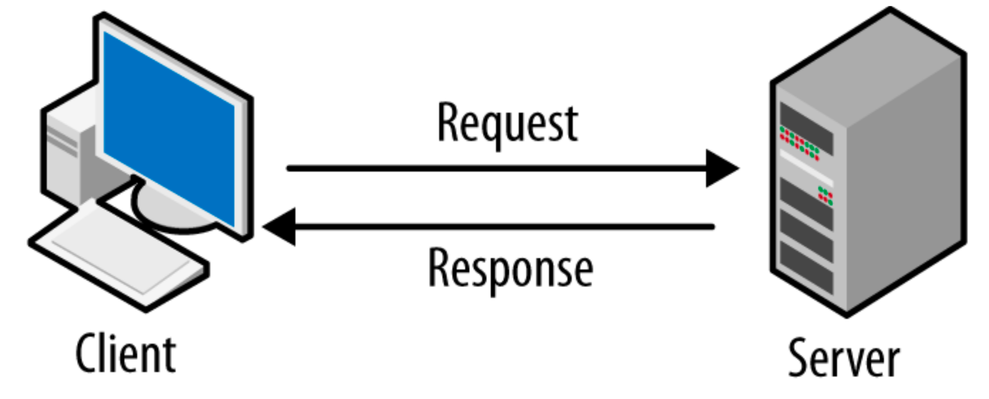
Client Server Architecture

Slide 4
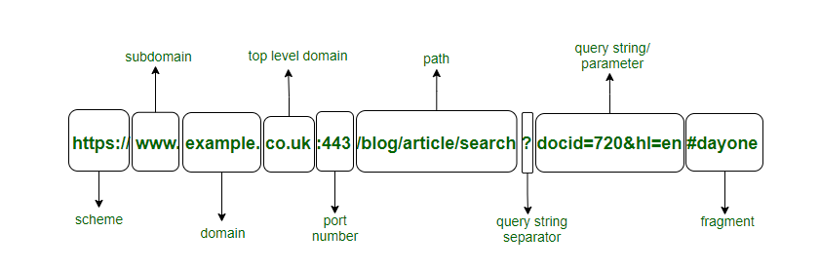
HTTP
HyperText Transfer Protocol
Used for transmitting documents or data between systems/servers

Slide 5
REST (RESTful API)
Representational State Transfer
Application Programming Interface
“Grabbing the state of the server at that certain time”

Slide 6
Data
Modern day data is portrayed in JSON (JavaScript Object Notation) “Easy for humans to read and easy for machines to parse and generate”
Older method - XML (Extensible Markup Language)
EXAMPLE

Slide 7
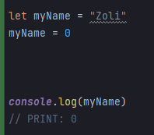
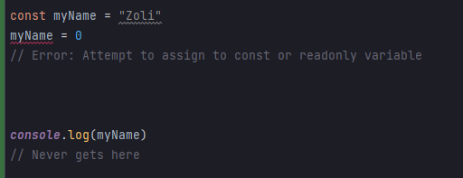
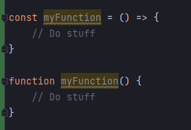
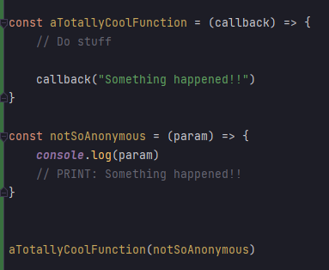
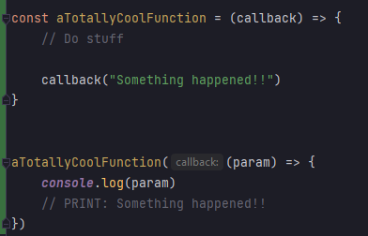
Javascript Basics
Weakly Typed (Unlike Java :-) )
Variables
let
const
Arrow functions
Anonymous functions

Slide 8
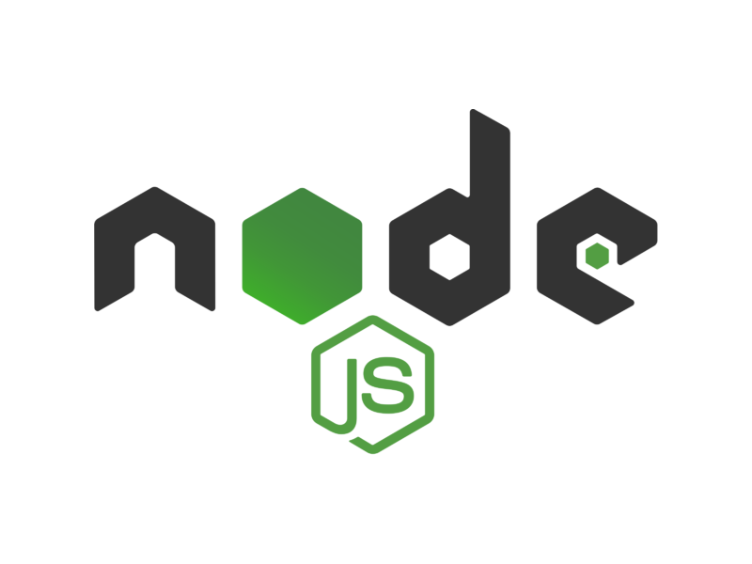
Node.js
Designed to build scalable network applications
Async and Event driven
Fast
Highly Scalable

Slide 9

Node Package Manager (NPM)
“Use other people’s stuff in our code”
ExpressJS
Used to create our API
Mongoose
Object Data Modeling (ODM) library for MongoDB
Morgan
Logging requests coming to our server

