Slide 1




Crunching large graphs with commodity processors
Jacob Nelson, Brandon Myers, A. H. Hunter, Preston Briggs, Luis Ceze, Carl Ebeling, Dan Grossman, Simon Kahan*, Mark Oskin
University of Washington
*also Pacific Northwest National Laboratory
http://sampa.cs.washington.edu
HotPar 2011 Berkeley, CA
Notes:
system to speed up large graph processing on clusters

Slide 2
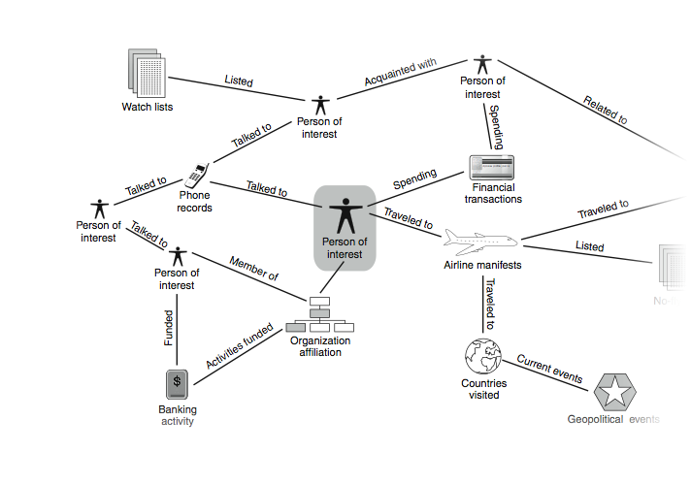
Introduction
Graphs important for emerging applications: social networks, bioinformatics, sensor networks, semantic databases
These graphs are big! Today, billions of vertices, edges In the future, trillions of vertices, edges

Slide 3
Some graphs have challenging structure
Some social network metrics:
An Experimental Study of the Small World Problem, Travers and Milgram, 1969 “6 degrees of separation”
Planetary-Scale Views on an Instant-Messaging Network Leskovec and Horvitz, 2008 Microsoft Messenger network: 180 M vertices, 1.3 B edges: Effective diameter: 7.8
Six Degrees of Separation, Twitter Style Alex Cheng, Sysomos Inc., 2009 Twitter network: > 100 M vertices, 5.2 B edges Effective diameter: ~6

Slide 4
Why are these graphs hard?
Too big for one machine’s memory => Distribute across cluster
Many interesting graphs have challenging structure => Difficult to partition in a balanced way => Difficult to find locality
Bottom line: Frequent high-latency inter-node communication
For some problems, partitioning and replication help

Slide 5
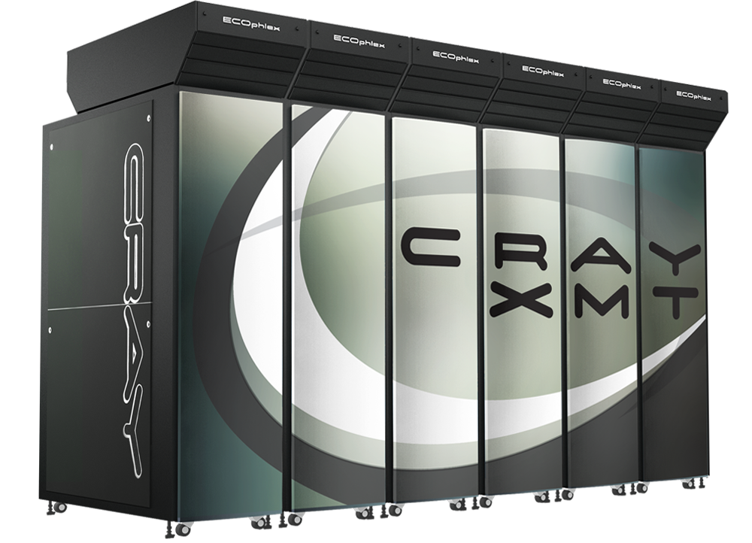
One approach: Cray XMT
Large shared memory up to 128TB across 8192 processors
Latency tolerance via concurrency: Each processor supports 1024 outstanding memory requests 128 hardware threads
Simple programming model “lots of 1MHz processors”
Application sweet spot: irregular problems with little locality slow at everything else
Notes:
the only downside,
beside the price,
is performance

Slide 6
Our position
We can beat the Cray XMT
using commodity processors
at price and performance
on all problems

Slide 7
Our goal
SoftXMT: Lightweight multithreading in software
XMT-like Performance Programming model
Commodity Processors Interconnect
(possibly including an FPGA)

Slide 8
Outline
The SoftXMT system
Implementation
Evaluation of SoftXMT coroutine overhead
Next steps

Slide 9
How can we beat the XMT?
XMT one 500MHz core
Intel Xeon six 2.66GHz cores
Memops 500 Mref/s 1024 in flight
Memops 15.6 Bref/s ~32 in flight
core
core
. . .
core
Contexts 128
Contexts 12
66 Mref/s
275 Mref/s
mem
mem
140 Mref/s
175 Mref/s
network
network
nic
nic
30 Mref/s to 110 Mref/s
26 Mref/s to 90 Mref/s

Slide 10
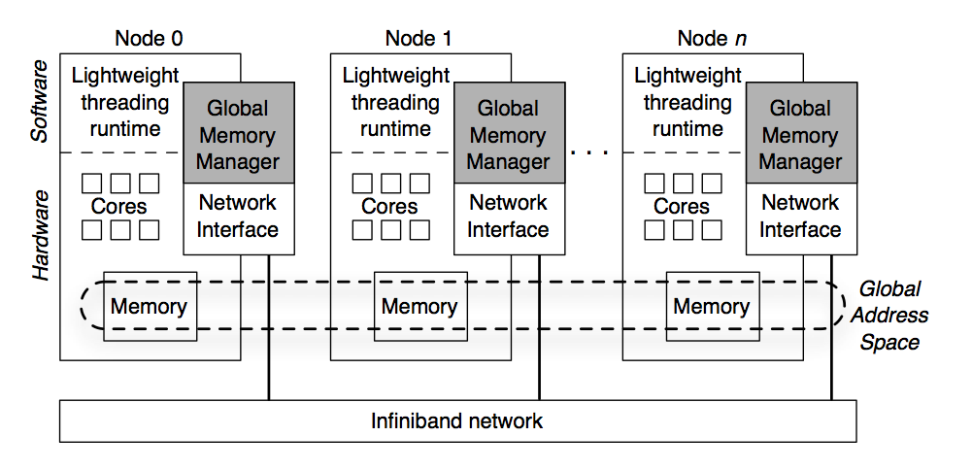
SoftXMT system overview
Support more contexts
Support more memory concurrency

Slide 11
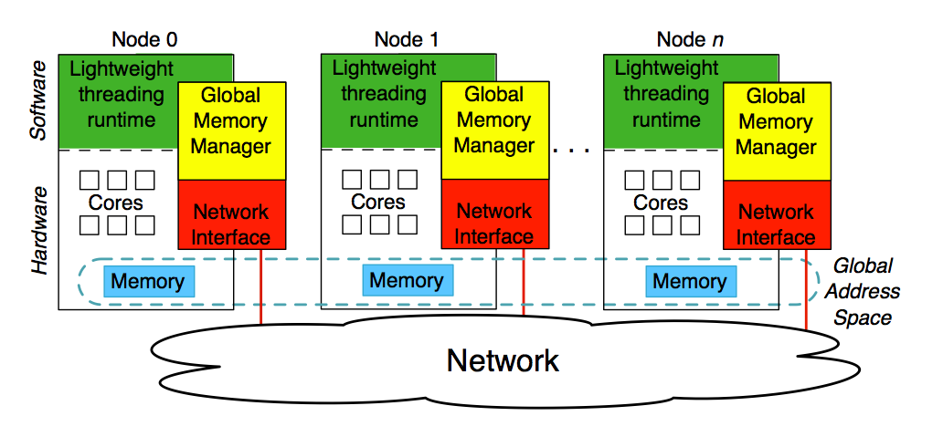
SoftXMT system overview
Support more contexts
Support more memory concurrency

Slide 12
SoftXMT programming model
Key features: - Shared global address space - Explicit concurrency with many threads - Lightweight synchronization
Address space partitioned into - Node-private - Shared global (no caching)
Concurrency exploited via cooperative multitasking - Threads yield on long latency operations
This is infrastructure for compilers to leverage

Slide 13
Outline
The SoftXMT system
Implementation
Evaluation of SoftXMT coroutine overhead
Conclusion

Slide 14
Implementation: Key features
Lightweight multithreading - overhead must be low enough to allow enough threads to cover network latency
Concurrency in global memory references - must support enough outstanding references to cover network latency
Low-overhead synchronization - must avoid blocking other threads

Slide 15
Cooperative multithreading with coroutines
issue
prefetch a
yield load a
load a
complete
Core
Coroutine 1
Coroutine 2
Coroutine 3
Coroutine 4
prefetch a
yield load a
prefetch b
yield load b
prefetch c
yield load c
prefetch d
yield load d

Slide 16
Minimizing context switch overhead
Treat context switches as function calls; save minimal state
Switch and schedule in user space - current: round-robin - future: reactivate on operation completion
Work: generate remote reference
Context switch
. . .
Lower context switch overhead => more ref/s
. . .
Time

Slide 17
Global memory concurrency
We need hundreds of outstanding requests per processor to cover network latency
XMT: 1024 requests per processor Xeon: ~32 requests per processor
We must manage memory concurrency ourselves

Slide 18
Exposing local memory concurrency
Break reads and writes into two operations issue: start data moving complete: block until complete
Local latency tolerance
issue
prefetch a
yield load a
load a
complete
issue
prefetch a
yield store d -> a
store a
complete

Slide 19
The Global Memory Manager
Tracks outstanding memory requests
On requester side: - issues request over network - waits for response - wakes thread when ready
On responder side: - performs memory request - also, synchronization operations

Slide 20
Exposing remote memory concurrency
Break reads and writes into two operations issue: start data moving complete: block until complete
Local latency tolerance
Remote latency tolerance
issue
prefetch a
yield load a
async_send( a )
yield blocking_recv( a )
load a
complete
issue
prefetch a
yield store d -> a
async_send( d, a )
yield blocking_recv( a )
store a
complete

Slide 21
The Global Memory Manager
Tracks outstanding memory requests
On requester side: - issues request over network - waits for response - wakes thread when ready
On responder side: - performs memory request - also, synchronization operations
Worker thread
Local GMM
Remote GMM
issue
async_send(a)
recv(a)
load a -> d
send(d, a)
issue_read(a)
yield complete_read(a)
load a
on recv(a): wakeup thread
complete

Slide 22
Software or hardware?
Software: - dedicate core(s) to managing memory - global memory operations are function calls
Hardware: - Add FPGA accelerator on coherence bus low complexity, no computation - Encode commands in address space
Notes:
communicate with it using memory operations, design the protocol to ensure that these operations complete quickly

Slide 23
Low-overhead synchronization
For the XMT’s application sweet spot, we need - atomic increment - producer-consumer
Treat all synchronization as remote reference - separate into issue and complete - run through global memory manager - GMM owns sync variable => no atomic instructions!

Slide 24
Outline
The SoftXMT system
Implementation
Evaluation of SoftXMT coroutine overhead
Conclusion

Slide 25
Evaluation of SoftXMT coroutine overhead
Evaluate one piece of design: Coroutine context switch overhead
Evaluate on single node Round-robin scheduling Access local DRAM Use prefetch instructions to expose memory concurrency
Is context switch overhead low enough for - single node latencies? - multi-node latencies?

Slide 27
Experimental Setup
Dell PowerEdge R410 dual 6-core Xeon X5650 chips (Nehalem μarchitecture) 24GB of RAM
NUMA memory architecture each chip has its own integrated memory controller Memory references to other chip’s memory go over the cache-coherent QPI
Used 1GB huge pages to reduce TLB misses
Hyperthreading disabled

Slide 28
Can we reach hardware’s max random reference rate using coroutines?
parallel for (i in 1..n) { while (not done) { list[i] = list[i]->next
}
}
ILP
Coroutines
parallel for (c in 1..num_cores) { while (not done) { list[1] = list[1]->next
list[2] = list[2]->next
...
list[n] = list[n]->next
} }
parallel for (i in 1..n) { while (not done) { readIssue(&list[i]->next) yield() list[i] = readComplete(&list[i]->next)
} }

Slide 29
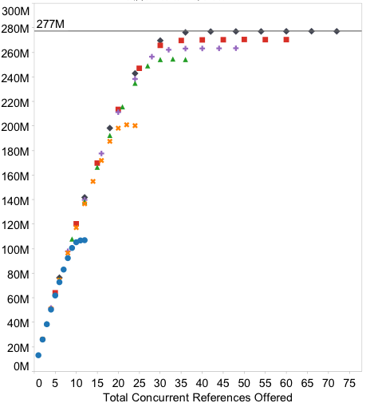
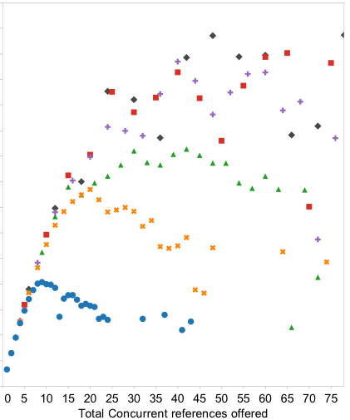

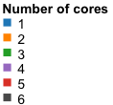
Coroutines saturate memory bandwidth with low overhead
Notes:
XMT 100 Mref/s

Slide 30
What overhead should we expect for a multi-node system?
Questions: Can we support enough concurrency to saturate a network link? Does coroutine context storage hurt us?
Force memory operations off chip: Allocate lists in second chip’s memory, access from first chip’s cores
Emulate network latency in scheduler - Assume 3µs round-trip network latency, 100M references per second - Delay rescheduling of a coroutine for that long
No actual network communication, memory concurrency still limited by hardware

Slide 31
What overhead should we expect for a multi-node system?
Questions: Can we support enough concurrency to saturate a network link? Does coroutine context storage hurt us?
Emulate network with 3µs round-trip latency, 100M references per second - Bandwidth: reference memory in other socket - Latency: scheduler delays memory operation
(still single node: no actual network, same memory concurrency limits)

Slide 32
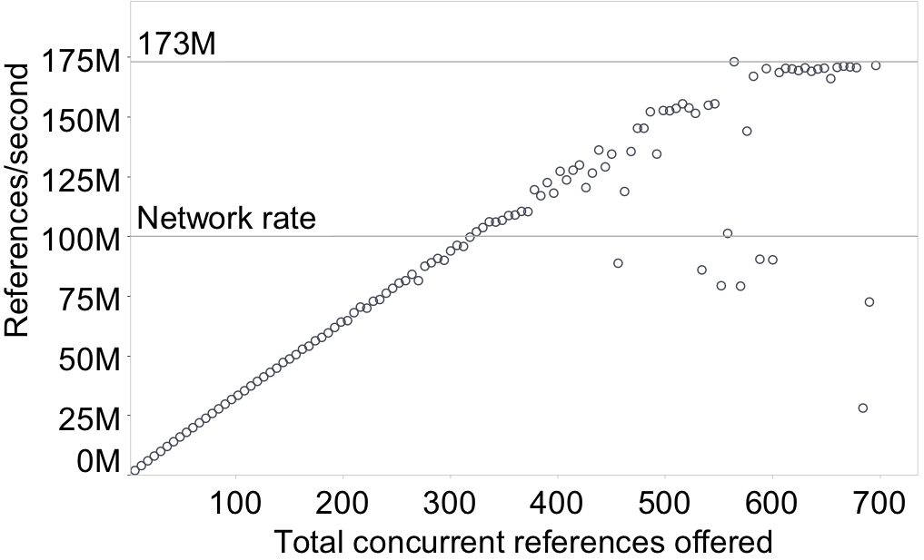
Coroutines support enough concurrency to saturate network link
32
Notes:
XMT 100 Mref/s

Slide 33
When do we blow out the cache?
Extend pointer chasing benchmark to include local working set Now, for each global reference, do n local references to b bytes of data
parallel for (i in 1..n) { while (not done) { readIssue(&remoteList[i]->next) yield() remoteList[i] = readComplete(&remoteList[i]->next) for ( i in 1 to num_local_updates ) { localList->data++; localList = localList->next; }
} }

Slide 34
When do we blow out the cache?
Extend pointer chasing benchmark to include local working set Now, for each global reference, do n local updates to b bytes of data
Global memory
1’s Local Memory
2’s Local Memory
3’s Local Memory
b bytes
n updates
1
2
3
. . .
Time

Slide 35
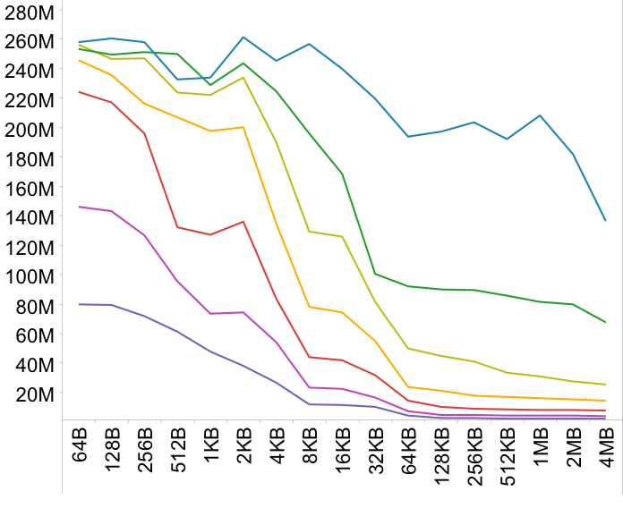


We can saturate network bandwidth even with a modest working set
local updates per remote
Network rate
Working set size per coroutine
Working set size per coroutine
Notes:
op point from last experiment: ~300 coroutines
We’re run this out to absurd levels
Operating point for our applications: upper left Past 32KB: blowing out L3 cache

Slide 36
Outline
The SoftXMT system
Implementation
Evaluation of SoftXMT coroutine overhead
Conclusion

Slide 37
Next steps
Build software Global Memory Manager
Explore commodity network limits
Investigate synchronization

Slide 38
Related work
Multithreading to tolerate latency Hardware: Cray XMT, SMT, Alewife, Cyclops, GPUs Software: SCM, Qthreads, MAESTRO, Charm
User-level multithreading First-class User Level Threading, Capriccio
Shared memory abstraction on distributed memory Partitioned Global Address Space Languages: UPC, CAF, Chapel, X10
Graph processing on distributed memory machines Pregel, Parallel BGL, CGMLib

Slide 39
Also in the paper
Ideas for synchronization
More details on memory manager interface
More details on evaluation

Slide 40
Conclusion
We think we can beat Cray XMT using commodity processors at price and performance on all problems
Vision for SoftXMT project: lots of memory concurrency + lightweight multithreading + lightweight synchronization
Our multithreading library has low enough overhead to tolerate long latencies of large high-bandwidth global memory

Slide 41
Text
Questions?
http://sampa.cs.washington.edu
1

Slide 43
What about commodity clusters?
Map-Reduce - not a good fit for graph problems: communication is expensive
Pregel - limited programming model - for similar performance, 10x resources compared to XMT
Top entry on Graph500: BlueGene: 8192 node machine 64x nodes for 6x performance (but on a larger problem)

Slide 44
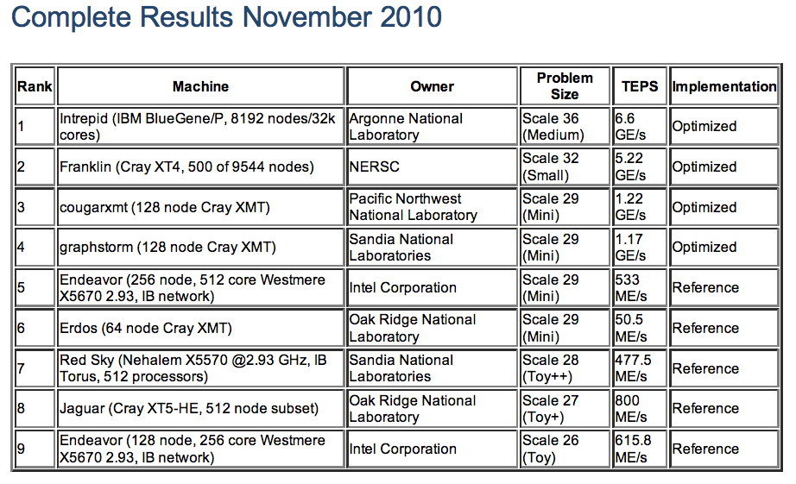
Graph500

Slide 45
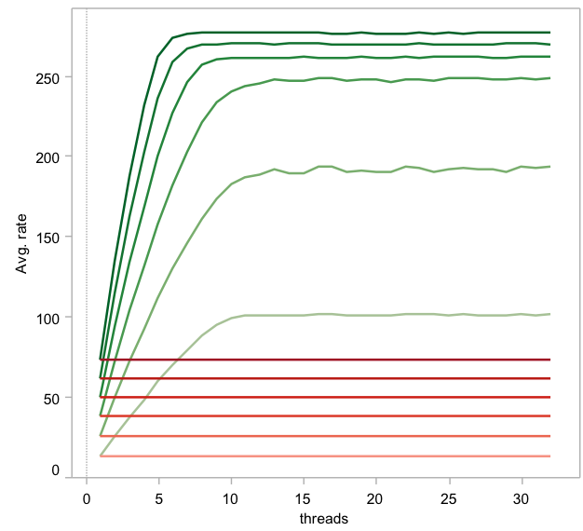
New coroutine approach

