Slide 1
Task 15: SoftXMT
Towards a scalable multi-node system
Simon Kahan Jacob Nelson
simon.kahan@pnnl.gov nelson@cs.washington.edu

Slide 2
Outline
Intro and SoftXMT Vision – Simon
2011Q3 Progress and Plans -- Jacob

Slide 3
Team
UW – started 9/30/2010 – softxmt.cs.washington.edu
Graduate Students:
Andrew Hunter – on leave at Google [coroutine library (“green threads”)]
Brandon Myers – architecture, FPGAs
Jacob Nelson – systems, FPGAs
Faculty:
Luis Ceze – programming & reliability of multicore systems
Carl Ebeling – FPGA technologies
Dan Grossman – programming language implementation
Mark Oskin – parallel architecture
Independent
Preston Briggs (preston@cs.washington.edu)

Slide 4


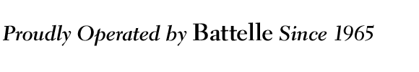

Project Shaping Activities
Weekly meeting at UW – notes: softxmt.cs.washington.edu
Cray’s Task 15 report: Multi-node exploration
Preliminary XE (Gemini) performance
Validates our continued exploration into multi-node
Blue Waters
Have NCSA account; waiting for access this fall
Tilera
Recruiting a postdoc to study latency tolerance
“Crunching Large Graphs with Commodity Processors”
Students’ paper presented in HotPar May, 2011
“Jumpthreads: software multithreading for latency tolerance”
Andrew Hunter’s Quals, in prep for PPoPP 2012
3x speedup on graph search & treap operations; 1.4x on sqrts
4

Slide 5
SoftXMT Vision
Scale up irregular apps using mass market components
What characterizes irregular apps?
Task flow “interrupted” by unpredictable remote references and dependencies
What are their special needs?
Sustained task throughput in the presence of synchronization and random access latencies
5

Slide 6
How can we compete with the XMT?
XMT one 500MHz core
Intel Xeon six 2.66GHz cores
Memops 500 Mref/s 1024 in flight
Memops 15.6 Bref/s ~32 in flight
core
core
. . .
core
Contexts 128
Contexts 12
66 Mref/s
275 Mref/s
mem
mem
140 Mref/s
175 Mref/s
network
network
nic
nic
30 Mref/s to 110 Mref/s
26 Mref/s to 90 Mref/s
6

Slide 7
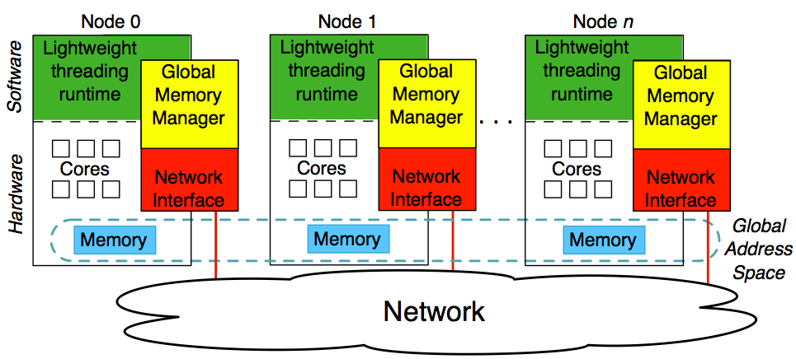
SoftXMT system overview
Support more contexts
Support more memory concurrency
7

Slide 8
Review: Lightweight threading runtime
Why multiple contexts?
Little’s Law: 100Mref/s bandwidth * 1us latency = 100 ops in flight
Why context switch?
100 cores idly waiting wastes power
Why a fast sequential processor?
Amdahl’s law: 99% parallel => at most 100x speedup
Latency tolerance necessary on multiple levels
local memory latency is still ~100ns
8

Slide 9
Review: Lightweight threading runtime
Built coroutine library
Low overhead context switching (“green threads”)
Compiler transformation (“jump threads”)
Overhead is low
Supports hundreds of threads
Can even tolerate local memory latency
9

Slide 10
This review: initial experiments with multi-node
UW
Approach for software acceleration of aggregation, atomics
Cray
Initial multi-node experiments
Result: ~23 Mref/s per node on HPCC Random Access
10

Slide 11
SoftXMT system overview
Support more memory concurrency
11

Slide 12
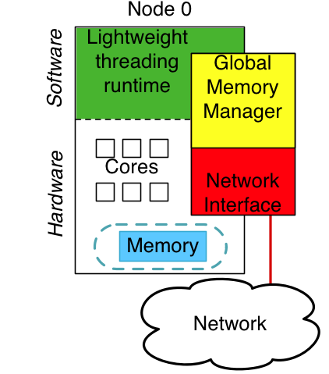
Global memory manager
Responsibilities
track outstanding global requests
aggregate requests
perform atomic operations
assist with thread scheduling
Three stages of implementation
Software-only: “idealized” NIC
Software + NIC hardware
FPGA accelerator?
12

Slide 13
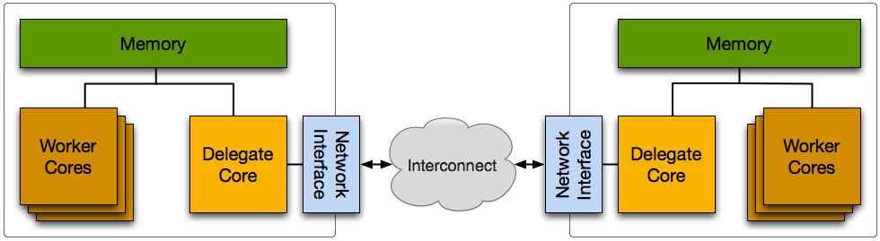
Delegate cores
Abstraction of ideal RDMA-capable network interface
Manage concurrent references, assist with scheduling
13

Slide 14
Delegate cores help with aggregation
Group references by node destinations amortize network overhead
Combine atomic operations
14

Slide 15
Delegate cores help with atomic operations
Problems
Atomic operations introduce unnecessary fences on x86
Network interfaces support only basic atomic operations
Alternative
Run local atomic operations on delegate core
Analogous to an MTA memory controller
atomic_mark_node( &node1 );
atomic_mark_node( &node2 );
atomic_mark_node( &node3 );
Implied fences
15

Slide 16
Delegate cores help with atomic operations
Programmer marks synchronization variables
All synchronization variables accessed through delegate Local non-sync variables accessed by workers directly
No atomic operations necessary
Caching improves hotspot performance
No atomic operations necessary
16

Slide 17
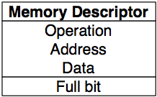
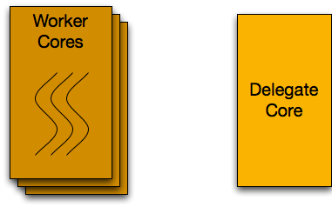

Delegate mechanism
State: Memory descriptor
Communication: Delegate queues Single-reader Single-writer Cacheline
Behavior:
Coroutine
Worker core
Delegate core
17

Slide 18
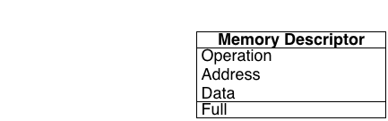

Delegate protocol
No synchronizing operations!
Tradeoffs
Send pointer? Entire descriptor?
Receive data? Thread Id?
18

Slide 19
Why not depend on the network interface?
Network card
Basic atomic operations
Atomic operations cause unnecessary serialization
Message aggregation must be done in NIC
NIC-to-local-memory bandwidth may be limited
Delegate core
Extended atomic operations
Atomic operations can be done without synchronization
Software can also aggregate messages
Memory bandwidth scales with multiple delegates and memory partitioning
19

Slide 20
Let’s look at some numbers
What do we have now?
Our proof-of-implementation
Where do we think we can get?
Our GUPS-specialized delegate
Cray benchmarks
What will Blue Waters contribute?
Estimates based on documentation
20

Slide 21
Current delegate results
Benchmark: Parallel list chasing
Two single-socket Xeon "nodes"
Delegate core manages remote communication
Network simulated through shared memory
Goal: demonstrate that delegate data flow works
Currently zero optimization: Experiments with individual components suggest 10x more
21

Slide 22
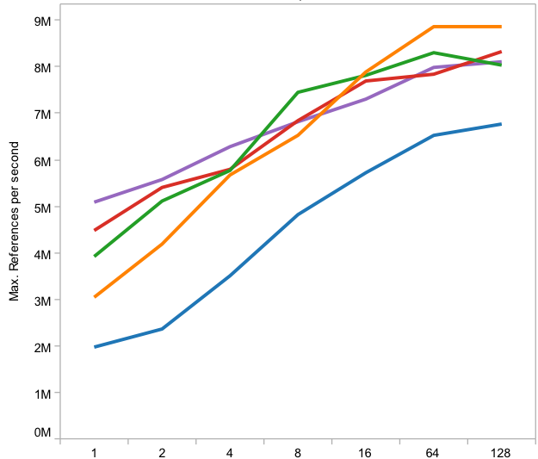
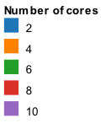
Delegate infrastructure works
4 Mref/s per “node”
22

Slide 23
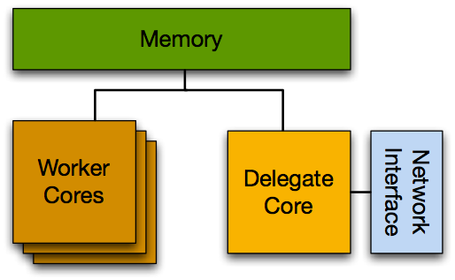
Delegate performance will improve
> 100 Mref/s
23 Mref/s ?
> 100 Mref/s
23

Slide 24
Specialized delegate performance
Single-node GUPS:
Delegate specialized for doing local atomic increments
You saw this last review
for i in 1..field_width { a[ b[i] ]++
}
Delegated
24

Slide 25
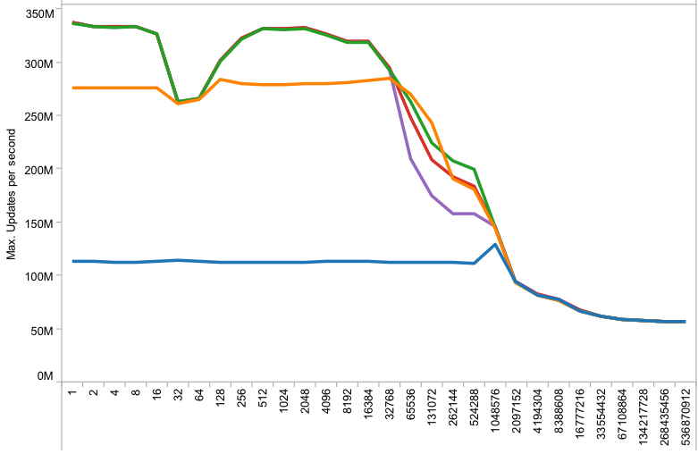
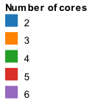
Specialized delegate performance
Up to 330 Mref/s
25

Slide 26
Another data point: Cray’s multi-node experiments
Cray took our code and implemented
their own lightweight context switching library
global memory library using Gemini network interface
Benchmarks show promise
~23 Mref/s per node for 8-node HPCC Random Access
65% of XMT1 performance on same benchmark, even though XMT aggregates messages and XE6 doesn’t
We believe the delegate approach can compete with this
26

Slide 27
What about Blue Waters?
XMT one 500 MHz core
IBM Power7 eight 4 GHz cores
Memops 500 Mref/s 1024 in flight
Memops 64 Gref/s ~64 in flight
core
core
. . .
core
Contexts 128
Contexts 32
66 Mref/s
~1 Gref/s
mem
mem
140 Mref/s
~188 Mref/s to ~1.5 Gref/s?
network
network
nic
nic
30 Mref/s to 110 Mref/s
3.5 Gref/s ?
For 32-core node
27

Slide 28
Next steps
This summer: throughput
Improve delegate performance
Get network working with delegate
Explore aggregation
Fall
Synchronization
Initial Blue Waters exploration
28

Slide 29
Summary
We have a plan for multi-node
Now we’re executing that plan
Software delegate offers advantages over NIC
Opportunity for aggregation
Accelerate more general synchronization
Initial performance results are promising
29

