Slide 1
Task 15: Grappa supporting irregular applications on mass market clusters
Simon KAHAN & JACOB NELSON
Pacific Northwest National Laboratory & University of Washington
Seattle, WA

Slide 2
A rose is a rose…
SoftXMT => Grappa
SoftXMT was intended…
to emulate CrayXMT, providing an economical alternative for those addressing its sweetspot in parallel graph algorithms.
Grappa restates our intention more broadly:
to address the needs of all irregular in-core applications, scaling on mass market systems to the limit of expressed parallelism.
Includes scientific, engineering, and machine learning applications.
All Applications
CrayXMT Sweetspot: +high injection rate network
+latency tolerant processors
-no caches
-low instruction / flop rate
=> parallel graph algorithms
Irregular Applications

Slide 3
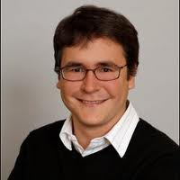
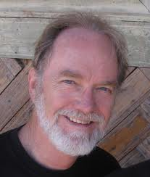





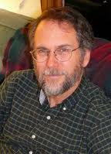


Team Grappa
UW Faculty
Luis Ceze (UW co-PI)
Carl Ebeling
Mark Oskin
Students
Brandon Holt
Brandon Myers
Jacob Nelson
Staff Programmer
UW hire TBD to manage software test & release
Others
Preston Briggs (UW Affiliate)
Simon Kahan (PNNL co-PI, UW Affiliate)
Still searching for a postdoc… … inquire within.

Slide 4

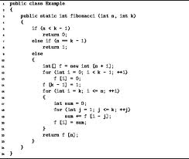
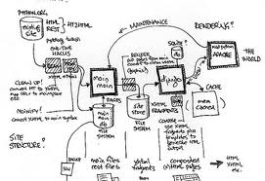
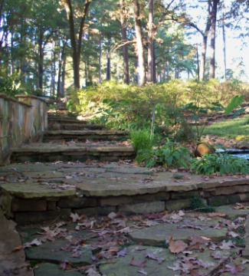
Talk Outline
What makes us believers:
early multi-node performance
How Grappa is shaping up:
a programming example
How Grappa works:
a whole system description
Next steps:
where we are going and what we wish for

Slide 5
Q: What makes us believers?
In a task-based worldview, parallel computing:
Breaks computation into tasks
Executes the tasks
Combines the results
(and possibly does this recursively)
Every computation is in this simple sense tree-structured
Task B may depend on a
result produced by Task H; or they may conflict at a critical section.
B
H

Slide 6
… the two factors
Computational throughput of tree-computation is product of:
processor throughput
Keep pipelines busy doing useful work
Tolerate memory and synchronization latency
Multiplex many threads to each core efficiently
Avoid fences
Delegate synchronization operations
concurrency moving through the tree (current focus)
Expressing concurrency
Parallel loops
expressed as recursive subdivision of iteration range
A la Cilk and TBB
Asynchronous (often recursive) function calls
Eg, spawning, futures, etc
Exploiting concurrency
Work stealing
Alternatively, work pushing

Slide 7

… concurrency through tree
As we mentioned last review, we have been looking at UTS
Measures the time to explore a random tree recursively
Tree is implicit, as in a game tree: the tree is not constructed in memory.
Measures only second factor: maintaining concurrency
(T1L) Geometric degree distribution, 102M nodes, depth 13, 80% leaves
Small enough to solve on one compute node; large enough to scale up a bit
CrayXMT to 32 processors at 30 K/s ( tree nodes per second per processor )
Authors had parallelized loops in the RNG that had small trip count
Massive overheads
Used loop future construct to parallelize every node
Loop future bogs down at large processor count

Slide 8
An aside…
We found that Cilk style binary decomposition of loops is faster and more reliable on the CrayXMT than its built-in loop future.
void parallel_loop(int start_index, int iters, int min_chunk, void (*loop_body)(int i, void *sargs), void * shared_args) { switch (iters) { case 0: return; case 1: loop_body(start_index, shared_args); break; default: if (iters >= min_chunk) { future void d$; future d$ (start_index, iters, loop_body, min_chunk, shared_args) { parallel_loop(start_index + (iters+1)/2, iters/2, min_chunk, loop_body, shared_args); } parallel_loop (start_index, (iters+1)/2, min_chunk, loop_body, shared_args); touch(&d$); } else { for (int i = start_index; i < start_index + iters; i++) loop_body(i,shared_args); } } }

Slide 9
… aside
Take any loop-future loop…
#pragma mta loop future
#pragma mta assert parallel for (int i = start; i < end; i++) { int j = int_fetch_add(startBin + String[Sorted[i] + bit], 1); SortedTemp[j] = Sorted[i]; }
… and transform it to something like:
typedef struct { int *startBin; int *String; int *Sorted; int *SortedTemp; int bit; } shared_args2;
void loop_body2(int i, void *pv,void *sv) { shared_args2 * s = (shared_args2 *) sv; int index = int_fetch_add(s->startBin + s->String[s->Sorted[i] + s->bit], 1); s->SortedTemp[index] = s->Sorted[i]; }
shared_args2 s2 = {startBin, String, Sorted, SortedTemp, bit}; parallel_loop(start, end-start, 100, loop_body2, &s2);

Slide 10
…
We applied our implementation to John’s dnaSort code
3 parallel loops in one routine, the 3rd loop recursively calls the routine
One more reason we believe that tree performance is what matters:
dnaSort is not about trees, but the decomposition of work is
Next review we will have this running on Grappa

Slide 11
… Back to UTS
CrayXMT reached 140K tree nodes per second per processor node
The UTS MPI distribution runs 1.2M/sec per 12 core cluster node
We want to give the CrayXMT a better shot, so we modify UTS:
We precompute and store the tree so that the CrayXMT is not penalized for slow computational throughput generating random numbers.
We then traverse the memory-resident tree using that same optimization that replaces loop future.
(for CrayXMT, but not for their MPI distribution)
The CrayXMT now peaks at almost 860k tree nodes per second per processor.
Cf: results shown two reviews ago for binary trees at about 1.1M

Slide 12
UTS on Grappa
We now do the same on Grappa:
Run this modified UTS that precomputes and stores the tree randomly throughout memory (we take care not to store it where we build it)
Where the CrayXMT uses a global queue of futures, Grappa uses work-stealing akin to Cilk and TBB.
Grappa gets neither the advantage of local computation via RNG nor that of loading tree data residing on the local node: it has to do the same application-level work that the CrayXMT does.
Results on 12 node mass market system…

Slide 13
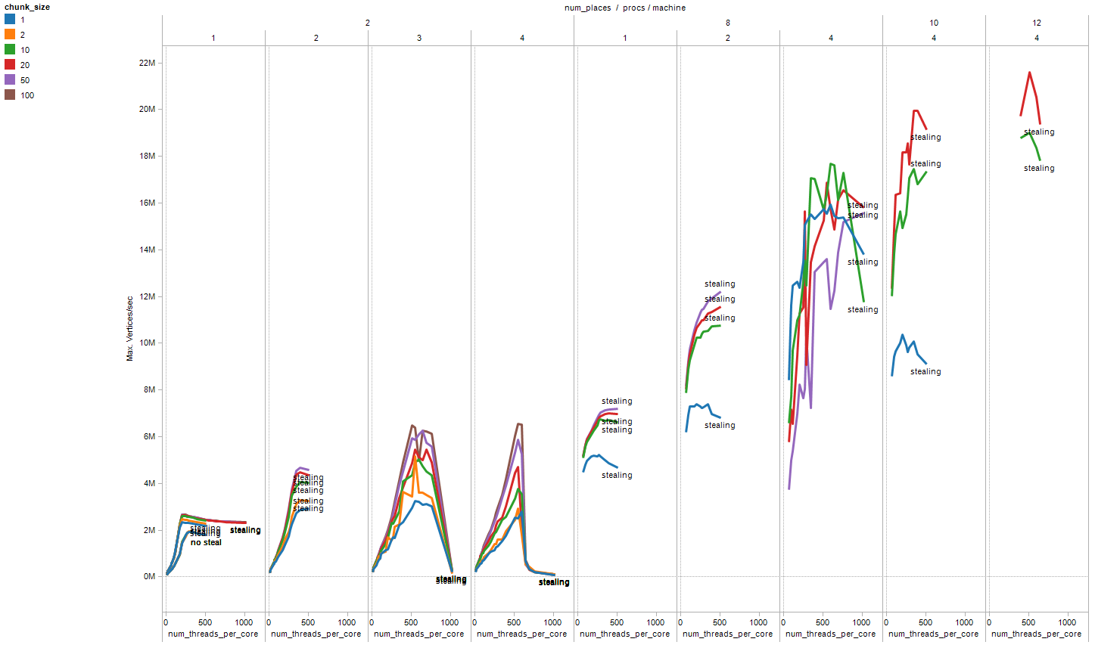
Early data: 2, 4, 8, 10, 12 cluster nodes
Performance generally rises with #nodes & #cores
200-500 coroutines per core needed to reach peak, then crashes
We will need a feedback mechanism
Work stealing strategy affects performance

Slide 14
UTS throughput for T1L tree (100M nodes)
XMT is largely bandwidth bound;
weak scaling to 400M nodes on 64 gets to 35M
Grappa & XMT are both traversing a tree dispersed randomly through memory using parallel_loop.
The MPI execution is out-of-box UTS & traverses the tree implicitly, so there are rng calls and work-stealing, but not remote references at every node.
8
12
4
10

Slide 15
Using Grappa V0

Slide 16
Code example: UTS
Remember:
Long-term goal: be a compiler backend
Short-term goal: demonstrate speedup coding directly against library
The following shows the spirit of the UTS code we wrote
Watch out for key ideas:
Spawning tasks
Global memory
Cache objects
Parallel loop decomposition

Slide 17
UTS: main task
Pointer to global memory
struct Vertex;
typedef GlobalPointer< Vertex > Edge;
void create_graph( GlobalPointer< Vertex > vertices,
GlobalPointer< Edge > edges );
void user_main() {
GlobalPointer< Vertex > vertices = global_malloc< Vertex >( VERTEX_COUNT );
GlobalPointer< Edge > edges = global_malloc< Edge >( EDGE_COUNT );
create_graph( vertices, edges );
spawn( &uts, &vertices[0] );
}
Malloc from global heap
Task spawn

Slide 18
UTS: visiting a vertex
parallel_loop( start, num_iterations, function_ptr, arg_ptr );
void uts_loop_body( int i, Edge * edges ) {
uts( edges[i] );
}
void uts( GlobalAddress< Vertex > vertex_pointer ) {
Incoherent< Vertex >::RO vertex( vertex_pointer );
Incoherent< Edge >::RO edges( vertex->edge_pointer, vertex->edge_count );
parallel_loop( 0, vertex->edge_count, &uts_loop_body, &edges[0] );
}
Parallel loop body (implicitly spawned)
Cache object
Implicit context switch; block until acquired on first use
Parallel loop decomposition

Slide 19
How does Grappa V0 work?

Slide 20
Execution flow
Core 0
Core 1
Core 2
runtime_main()
runtime_main()
runtime_main()
user_main()
spawn()
task()
task()
task()
task()
task()
task()
task()
task()
task()
steal
join()

Slide 21
Tasks
Only 16 bytes: { function_pointer, argument_pointer }
Three states:
Unstarted
Sitting in a queue somewhere, may be stolen
Started
Matched with a coroutine and stack
No longer stealable; bound to a particular core
Done
We support public and private tasks
Public tasks can be stolen while unstarted
Private tasks are bound to a core when spawned

Slide 22
Scheduler
Goals:
Balance load across cluster
Allow programmer to exploit locality
Each core has its own scheduler
Each scheduler has four queues
Public unstarted task queue
Other cores may steal from here
Private unstarted task queue
These tasks may run only on this scheduler’s core
Run queue
These tasks are ready to execute, bound to coroutines and stacks
Periodic queue
Mostly maintenance tasks: aggregator, profiler, etc.

Slide 23
Communication and aggregation
All communication is based on asynchronous active messages
This is the basic construct: call_on( core_id, &function, args_pointer, args_size, payload_pointer, payload_size );
No registration of handlers or memory is necessary
Messages to a common destination are queued until
we can form a packet of reasonable size
messages have been waiting too long
flush( core_id ) is called

Slide 24
Memory layout
Two pointer types:
Two-dimensional pointers
Standard PGAS ( Node, LocalAddress ) tuple
Used to publish local data to remote nodes
Linear pointers
Block-cyclic distributed across cluster
Used for large, low-locality global data
Block Cyclic Global Memory pool
Core 1 mem
Core 2 mem
Core 3 mem
int B[2];
B[0]
B[1]
B[2]
2D Global Pointer
Linear Global Pointer
Local memory
int A[2];
&A[1]
&B[1]

Slide 25
The shared heap
Large, low-locality data is stored in the Grappa heap
This is built out of chunks allocated on each node
Data is striped in a block-cyclic way across the chunks
Allocation is done with global_malloc( byte_count ); global_malloc< T >( count ); global_free( GlobalPointer<> );

Slide 26
Delegate operations
Used for synchronization
Memory is modified at its home node
Context switches are implicit; split-phase operation also possible GlobalPointer< Vertex > address; int increment = 1; int previous_value = fetch_and_increment_word( address, increment ); if( 0 == previous_value ) { succeeded(); }
Implicit context switch

Slide 27
Cache operations
Used for data with spatial or temporal locality
Interface similar to C++ smart pointers
Cache object “localizes” global data, returning a local pointer to a buffer
Two modes:
Incoherent, for known-non-interfering reads/writes
Coherent, which synchronizes through the directory
Example: Coherent< int64_t >::RW buf( pointer, count ); buf.block_until_acquired(); local_modify( buf ); buf.block_until_released();

Slide 28
Conclusions and Next Steps

Slide 29
Conclusion
Grappa now runs on multiple nodes
Design is behaving as expected
Grappa’s programming model is maturing
Enabling application development by non-implementors
Grappa searches the T1L tree twice as fast as XMT per node, up to 12 nodes
Promises efficient and general parallel loop execution

Slide 30
Next steps: Immediate
Run on larger system
Optimize
Tune aggregator to ensure good network bandwidth utilization
Improve memory latency tolerance through batching
Short-circuit core-to-core communications within a node
Reduce overhead of common active messages
Bring up more benchmarks
Betweenness centrality
Path isomorphism
Connected components
Triangles
BFS
Submit paper

Slide 31
On the horizon
Dynamic control of runtime parameters
Improve network layer
Work with Intel/QLogic
Work with LBL
Compiler
Goal: write code oblivious to Grappa
Better parallelization though dependence analysis
Batched global memory operations
Explore non-stack-based (continuation-based) execution models
Chapel
Scale to larger systems
Hierarchical work-stealing
Hierarchical aggregation

