Slide 1

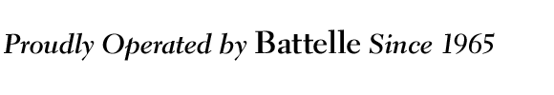
Task 15: SoftXMT
Runtime progress
Simon Kahan simon.kahan@pnnl.gov
Jacob Nelson nelson@cs.washington.edu
Mark Oskin oskin@cs.washington.edu
1

Slide 2
Team
UW – started 9/30/2010 – softxmt.cs.washington.edu
Graduate Students:
Brandon Holt – languages, Chapel
Andrew Hunter – on leave at Google [coroutine library (“green threads”)]
Brandon Myers – architecture, FPGAs
Jacob Nelson – systems, FPGAs
Postdocs:
<TBD> -- Tilera Runtime
Faculty:
Luis Ceze – programming & reliability of multicore systems
Carl Ebeling – FPGA technologies
Dan Grossman – programming language implementation
Mark Oskin – parallel architecture
Independent
Preston Briggs (preston@cs.washington.edu)

Slide 3
Project Shaping Activities
Blue Waters
Tilera
Still recruiting a postdoc to study latency tolerance
"Jumpthreads: software multithreading for latency tolerance”
Andrew Hunter submitted to PPoPP 2012
Cascadia 2011 SoftXMT Presentation (Brandon Myers)
FPGA related workshop
Attended by Microsoft, NVIDIA, Pico, Xilinx, UW, UWisc, UBC, U Toronto, …
Chapel
Held an all day Task 2/8/15 meeting with PNNL, UW, Cray (Brad)
Ongoing discussions per Task 2/8 report
Lightfleet
Contacted & met with regarding their freespace interconnect

Slide 4


Outline
Vision
Benchmarks
Components
Delegate performance
Network performance with aggregation
Collaboration
Chapel
4

Slide 5
Vision
5

Slide 6
SoftXMT Vision
Scale up irregular apps using mass market components
Key features:
Lots of concurrency
High random access rate to global memory
Fine-grained synchronization
Simple programming model
6

Slide 7
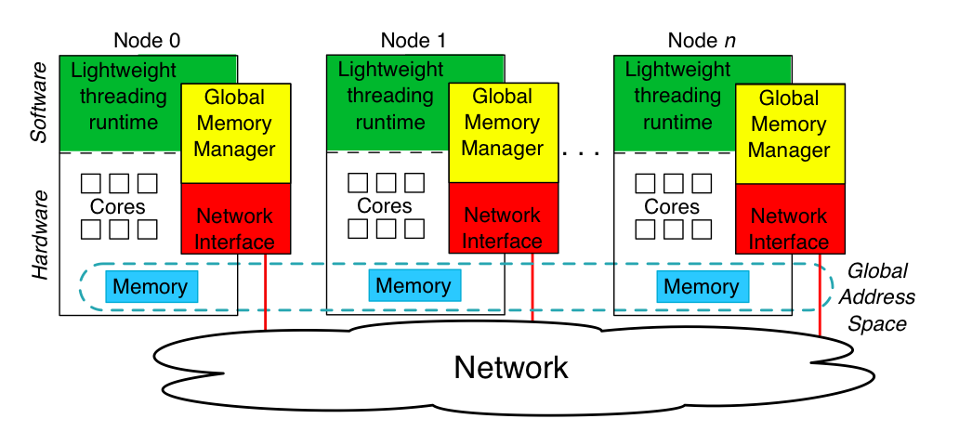
System overview
Support more contexts
Support more memory concurrency
7

Slide 8
List chasing pseudocode
typedef struct element { global struct element * next; global data_t data; } element_t;
global element_t lists[] = allocate_lists();
Mark global data
Mark global data
Mark data accessed atomically
multi_task_queue( NUMBER_OF_LISTS, &loop_body ); run_tasks();
sync global int count;
parallel for( int i = 0; i < NUMBER_OF_LISTS; ++i ) {
global element_t * current = get_list_head( i ); while( ! current->visited ) {
if( predicate( current->data ) )
++count;
current = current->next;
}
}
Mark potential concurrency
issue( ATOMIC_INC, &current->visited );
_handle = issue( READ, &current->next );
yield();
current = complete( _handle );
8

Slide 9
Challenges
Concurrency
Minimize context switching time
Support lots of contexts without blowing out cache
Global Memory
Increase effective message rate of commodity networks
Support languages’ memory consistency models
Synchronization
High-throughput, avoid unnecessary serialization
Support extended memory semantics
9

Slide 10
Benchmarks
10

Slide 11
What drives design
Metrics clarify what we care about:
“if you can measure it, you can manage it”™
We care about scaling irregular threaded applications
each concurrent subtask makes random dependent references to global memory
metric: throughput chasing linked-lists
work per subtask is unpredictable
metric: throughput traversing imbalanced binary tree

Slide 12
Imbalanced Binary Tree recursive definition for size S > 1, fixed imbalance D > 1
D==2 => balanced binary tree.
larger D => tree more imbalanced.
Choose blue or red based on result of a fair coin toss.
1
S - (((S-1)/D) | 0x1) - 1
((S-1)/D) | 0x1

Slide 13
Example: S=14, D=3

Slide 14
Tree Traverse: what it measures…
void Traverse(TreeNode * root) {
if (root) { future void done$; future done$ (root) { Traverse (root -> left); } Traverse (root -> right); touch (& done$); }
}
Fine-grained task expression: Making parallel work available
Fine-grained task instantiation: Finding, claiming, and beginning work
Producer-consumer synchronization:
Blocking, unblocking, and restarting

Slide 15
Tree Traverse: … and why we care.
Captures the foundations for implementing most forms of irregular parallelism:
Recursion
Every irregular divide & conquer algorithm
Loops
On a large, non-uniform system we need dynamic scheduling to get good load balance
divide and conquer the iteration space, ideally respecting locality where possible a la Cilk or loop future.
Nested parallelism
Nested loops or function calls also require dynamic scheduling
Dataflow
Producer-consumer synchronization

Slide 16
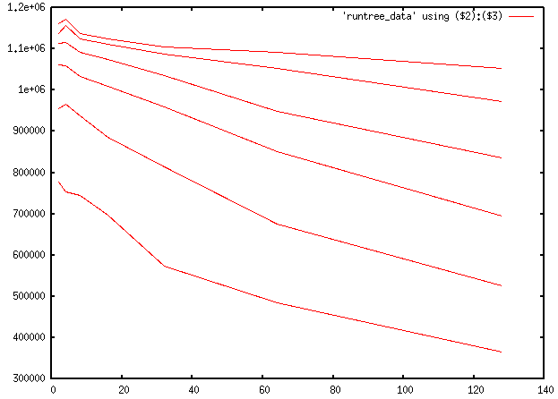
Cray XMT Performance Nodes per second vs Imbalance for S=200M, D=2..128 on 4-128 processors
4
8
16
32
64
128

Slide 17
Our goal
Beat the per node performance on Tree Traverse of Cray XMT as we scale up.
This will indicate we have a runtime system that is at least as capable and scalable across all forms of irregular parallelism.

Slide 18

Benchmark Zoo
Microbenchmarks (worst case performance)
List chasing
Imbalanced tree traversal
Applications (common case performance)
Betweenness centrality (Brandes’ algorithm)
Multiple nodes with aggregation
Coarse- and fine-grained tasks
Block transfers as well as word requests
More to come
18

Slide 19
Components
19

Slide 20
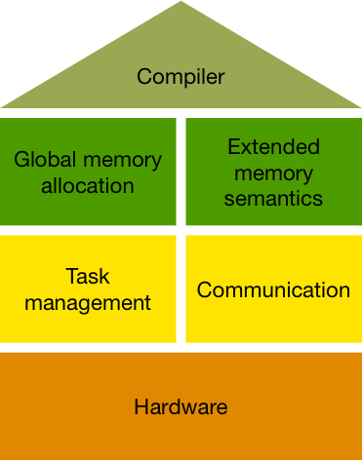
SoftXMT runtime components

Slide 21
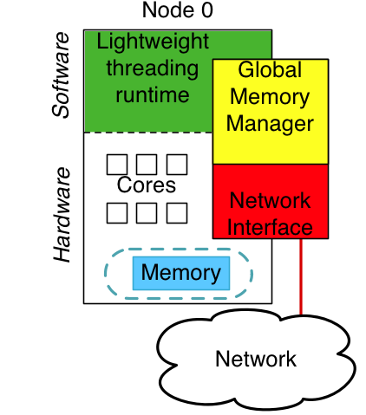
Global memory manager
Responsibilities
track outstanding global requests
aggregate requests
perform atomic operations
assist with thread scheduling
Three stages of implementation
Software-only: “idealized” NIC
Software + NIC hardware
FPGA accelerator?

Slide 22
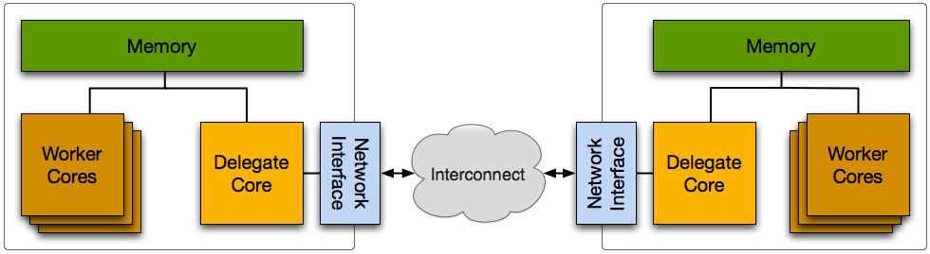
Delegate cores
Abstraction of ideal RDMA-capable network interface
Accelerates atomic accesses, allows for aggregation

Slide 23
Delegate performance experiments
Experiment setup:
List chasing on 5 cores
All requests go through delegate on 6th core
Requests sent to delegate in batches
Previous results
~5 million requests per second through delegate
Goals
More than network card’s limit of 20 Mreq/s
Near single-core DRAM limit of ~100 Mreq/s

Slide 24
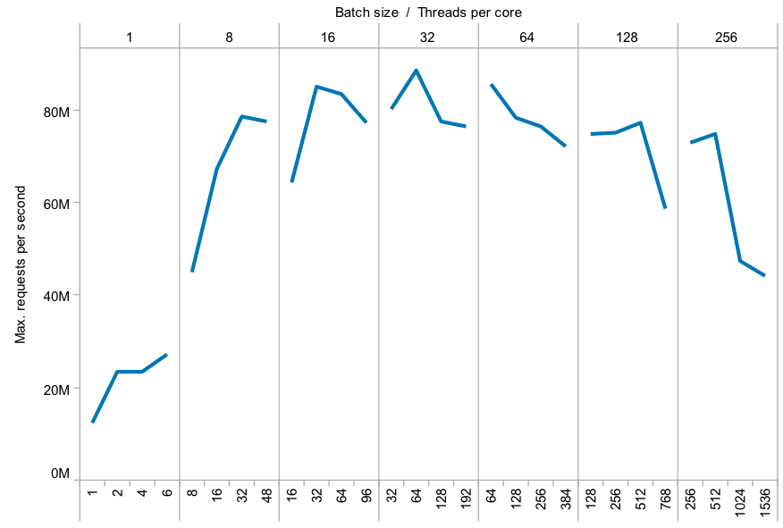
Delegate performance is no longer a bottleneck
Faster than network interface

Slide 25
Exploring network performance
Two hardware vendors
Mellanox ConnectX-2 40Gbit Infiniband
Thanks to HPC Advisory Council for access
“off-load” architecture
“Verbs” API
QLogic TrueScale 40Gbit Infiniband
“on-load” architecture
“PSM” API
GASNet for job setup/teardown

Slide 26
Measuring raw network performance
Experiment setup:
List chasing on two nodes
One node chases lists in other node’s memory
Goal
Approach peak network card performance: ~20 Mreq/s per node

Slide 27
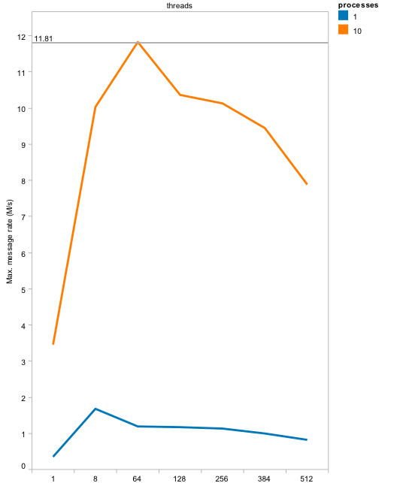
Raw message rate

Slide 28
Measuring aggregation performance
Experiment setup:
List chasing on two nodes
One node chases lists in other node’s memory
Requests are delayed to form an aggregate message
Goal
Approach bandwidth-saturating message rate: ~250 Mreq/s per node

Slide 29
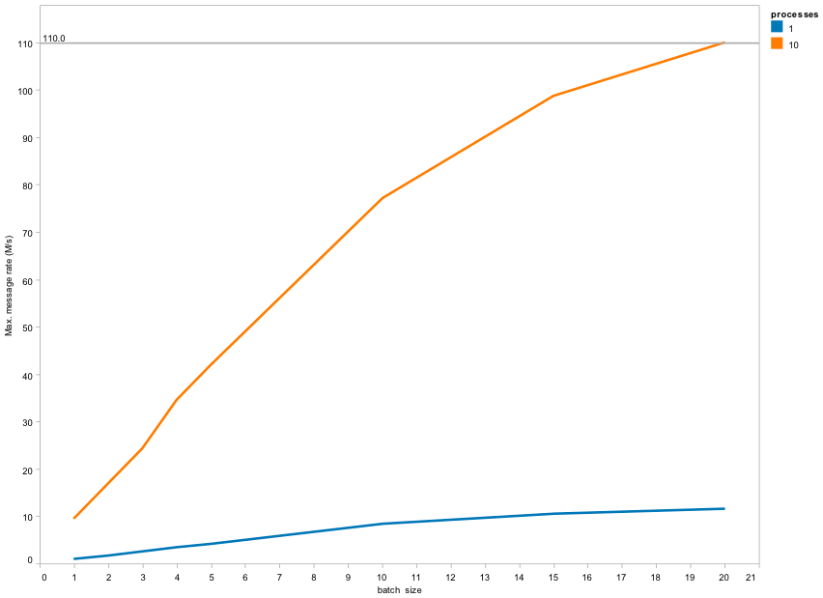
Aggregate message rate

Slide 30
Next steps
Lots of challenges in getting good performance with these cards
Multi-threaded performance is unsupported/unreliable; Multi-process nodes complicate language support
All these rates are lower than the wire-level rate
Working with vendors to understand where the bottlenecks are

Slide 31
Collaboration with other tasks
31

Slide 32
Interfacing with our collaborators
Discussions with
Task 2: Compiler
Task 8: Chapel
Task 11: Hardware
Chapel’s runtime interface is close to ours

Slide 33
Chapel’s runtime interface: tasks

Slide 34
Chapel’s runtime interface: tasks

Slide 35
Questions around integrating with Chapel
How big is a locale?
“Chapel native”: SMP node within cluster
XMT: entire machine
Locale per core?
How should latency tolerance be integrated?
“Chapel native”: User-level domain map
Extended types, for compiler-level code generation
Context switch on all memory operations?

Slide 36
Conclusions
36

Slide 37
Conclusions and next steps
Developing benchmarks to drive runtime design
Delegate performance is no longer the bottleneck
Aggregation improves effective message rate
Work on common runtime interface is progressing
Next review period
Multi-threaded network performance?
Explore extended memory semantics using delegation
Imbalanced tree benchmark on SoftXMT runtime

