Slide 1
Task 15: SoftXMT Mitigation for Limited Injection Rate, Part I
Brandon Holt, Simon Kahan, Brandon myers, Jacob nelson
PNNL and University of Washington, Seattle
CASS-MT January 2012 Review, BWI, Maryland

Slide 2
Introduction
The original three dark sides of SoftXMT are… less dark
Latency – tolerable via split phase requests and fast software context switching
Synchronization – can avoid built-in atomic operations and still synchronize efficiently via delegates
Global view memory – can ensure consistency via delegates
But, we need to address network performance limitations
~10Mref/s per network interface on random access is too slow
~100Mref/s with aggregation is better
Can we do even better?

Slide 3
Outline
Introduction – Simon Kahan
Work Stealing Status – Brandon Myers
Data Locality: Task Migration versus Caching – Brandon Holt
Software Controlled Caching – Jacob Nelson

Slide 4
Name Dropping
Intel: Roger Golliver
LBL: Costin Iancu
Rice: Vivek Sarkar
Cray: Brad Chamberlain
Sandia: Kyle Wheeler

Slide 5
Unbalanced Tree Search Status
Brandon Myers

Slide 6
Tree Traverse: why we care
Captures a general form of irregular parallelism
tasks spawn a dynamic number of parallel fine-grained work items
creates an imbalance of work
Has irregular access pattern we expect from applications
dependent random accesses to a large shared address space
Producer-consumer synchronization
Notes:
load distribution is input dependent

Slide 7
Unbalanced Tree Search (UTS)
Unbalanced Tree Search (UTS)¹ is a benchmark suite for evaluating the dynamic load balancing ability of a system
Each vertex in the implicit tree traversal produces some number of children by sampling from a probability distribution
Standard implementations of UTS use work stealing (in chunks) for distributing and balancing work
Augment the benchmark with:
random access by generating the tree before the traversal and permuting vertices throughout the global address space
per-thread payload that is accessed on each vertex traversal
¹Olivier et al, 2007, 2008
Notes:
perhaps show a picture

Slide 8
SoftXMT load balancing
XMT imbalanced binary tree micro-benchmark—seen last quarter—uses futures to spawn parallel work
SoftXMT will depend on locality in the work queue to get the best performance
worker first processes work it created before that of others
We assume that local (within a node) work stealing is the best choice for applications that have dynamic imbalance of work
For distributing work across nodes, we explore different methods, including remote work stealing

Slide 9
SoftXMT work stealing
How is it different from classic Cilk-style work stealing?
parallelism not restricted to spawn/sync (i.e. “fully strict”)
distinction between work queues that are local or remote
a core needs multiple work items for latency tolerance
SoftXMT needs multiple work units per core to keep the core busy
so, when should a core steal to minimize its idleness?
steal too late:
too many coroutines will be idle and so core will be idle
steal too often:
too much core time used on stealing instead of real work
might take work that is not required to stay busy

Slide 10
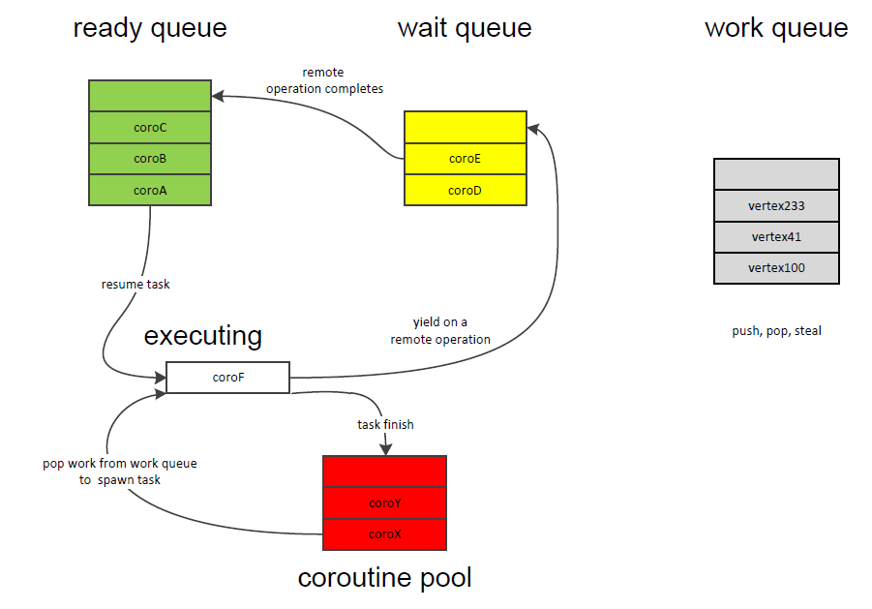
Coroutine scheduling
(readyQ empty) ➔ pop new work from work queue
(readyQ empty && workQ empty) ➔ steal from a local worker

Slide 11
Distributed work stealing
balancing work within a node:
steal from neighboring process’ work queue using a lock and shared memory operations
balancing work across nodes:
When a worker fails to find visible work at neighbors, can steal across network
steal from work queues on another node by sending an Active Message that performs the steal and replies with the stolen work
Recent work has explored distributed work stealing [Olivier ’08, Dinan ‘09], including hierarchical schemes [Quintin ‘10, Wang ‘11] and scalable termination detection [Saraswat ‘11]
Notes:
separate thread handles active messages or the victim worker polls for serialized steal requests
put some ‘stake in the ground’ about current progress and results

Slide 12
Status
Augmented unbalanced tree search microbenchmark tests dynamic load imbalance, dependent random access pattern, and space stress of per-thread payload
Scheduling scheme must take into account the amount of work a core requires to stay latency-tolerant
Initial single-node work stealing results with coroutines shows a rate of 60Mvertices/sec
Working on multi-node implementation
shared memory local steals
active message remote steals to other nodes when no local work is available

Slide 13
Exploring Data Locality
Brandon Holt, Brandon Myers

Slide 14
Motivation
The picture for us:
Many small, short-lived tasks operating on a large shared data set
In order to do its work, a task must access data spread across nodes
Communication over the network is our bottleneck
Specifically, message injection rate is the problem
Previously we discussed aggregation
Group independent accesses from concurrent tasks into single message
Leverage locality to minimize network traffic further
Buffering/caching: keep a local copy for repeated accesses
Migration: move execution context to where data is
e.g. do computation locally on data at a particular vertex

Slide 15
Migration Simulation
When is it better to move a task to the data rather than bringing data to the task?
Develop intuition about the potential gain from moving data and computation around through migration and caching
Collect memory traces on benchmark applications
SSCA2 (graph kernels), Fluidanimate (PARSEC), IntSort (NPB)
Simulate running them using a highly simplified model
PGAS-style data distribution across nodes
Option to fetch a remote piece of data (cache line) or migrate task to where the data resides
Find and measure the optimal task migration schedule for our model
Essentially an extended back-of-the-envelope calculation

Slide 16
Simple Model
Primary performance measure:
Number of messages across the network.
Track references to shared memory only
PGAS-style data distribution across nodes
Simple network model
Flat topology, same cost for anything on a different node
Count number of messages
No timing information
So computation is “free” as well
Tasks execute independently
Simple cache model
Independent caches for each thread
No coherence
Cache is discarded on migration

Slide 17
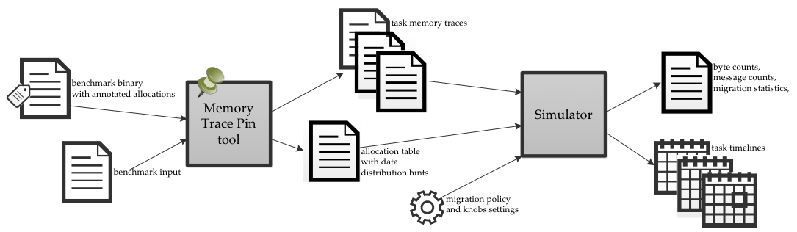
Simulation Framework
Application source with allocations annotated with distribution hints
Collect memory trace from instrumented binary
Policy specifying under which conditions to migrate
Simulate “executing” the traces
Map addresses across “nodes” using distribution hints for each allocation
Current node determines which accesses are remote
Track cache hits/misses
Make migration decisions based on policy

Slide 18
Optimal Policy
Use knowledge of entire trace to find best possible migration schedule for each thread
Dynamic programming solution, O(traceLength * numNodes)

Slide 19
Application Comparison

Slide 20
Conclusions and Next Steps
Migration showed some promise
Most beneficial with a large amount of spatial locality
However, with reuse and accesses to several nodes, caching wins
Very simple network cost
While injection rate is the bottleneck, number of messages is the most important cost, so this is acceptable
Idealized cache model
Results show good spatial and temporal locality to take advantage of
Model is overly optimistic: need a real cache implementation to get more useful results
Look into implementing caching first
However, keep migration in mind, as it may be more profitable when compared with real coherent, finite-size caches

Slide 21
SoftXMT runtime design: Caching
Jacob Nelson
University of Washington Computer Science and Engineering
Seattle, WA

Slide 22
Why Cache Now?
Some locality exists even in irregular applications
We were at a decision point in the design:
XMT-style word-only accesses?
GASNet/GA/SHMEM-style block accesses?
Is there a benefit to moving multiple words per request?
Block transfer study: List chasing, with payloads of 0 to 8 words per vertex

Slide 23
Block fetches: More network bandwidth for user data
Pointer chasing with 2 nodes,
10 cores/node,
256 threads/core,
40 request aggregation

Slide 24
Why Cache?
Migration study: Caching helps us reduce our network use
Block transfer study: ~2x more efficient even for small amounts of spatial locality
Goal: sane memory consistency model for programmer Unsynchronized block gets and puts make this hard
Mechanism is the same as we need for fine-grained synchronization

Slide 25

SoftXMT’s pseudo-cache
We’re really just stealing ideas from the cache literature to build a system for synchronized buffering
Traditional caches:
Capacity-constrained
Granularity may interact badly with problem
Complicated, costly invalidation mechanism
SoftXMT’s pseudo-cache:
No capacity constraints
Multiple, configurable granularities
Explicit releases instead of invalidation
Tightly coupled with scheduler to minimize latency
Play well delegate operations for no-locality modifications

Slide 26
Block Transfers versus SoftXMT Caching
char local_buffer[ 1024 ]; gasnet_get( &local_buffer[0], home_node, global_address, 1024 ); modify( local_buffer ); gasnet_put( home_node, global_address,
&local_buffer[0],
1024 );
SoftXMT_CacheRW< char > local_cache( global_address, 1024 ); local_cache.block_until_ready(); modify( local_cache ); local_cache.release();
Memory:
Thread A: get
Thread B: put

Slide 27
Cache System Components
Local storage for cache lines
Core
Cache Buffer
Cache Buffer
Allocator
Malloc for cached memory
Directory
Directory
Per-node chunk of global address space, for both cached and uncached data
Executes delegate operations
Serializes access, tracks ownership for cache lines
Memory Server
Memory Server
Memory Server
Global Memory

Slide 28
Cached Memory Pools
struct Vertex {
Data d;
Edge * edge_list;
};
Vertex-granularity pool
Cache line size = 1 * sizeof( Vertex )
Edge-list-granularity pool
Cache line size = 4 * sizeof( Edge)
Allocator
Allocator
Directory
Directory
Directory
Directory
Block cyclic
memory block distribution
Memory Server
Memory Server
Memory Server

Slide 29
Problem: Invalidation
Node A reads a line. Node B writes it. How does node A know its value is stale?
Traditional solutions:
System-wide invalidation broadcast
Maintain sharers list; restricted broadcast
Our solution:
No invalidations: instead, explicit releases
We assume most tasks are small
overhead is waiting for tasks to end instead of invalidating
Check out / check in instead of copy/invalidate
Design must avoid deadlock; programmer is responsible for ensuring progress

Slide 30
Controlling access to a line
How can we ensure writers wait until all readers have released their copy?
Borrow ideas from Token Coherence [Martin et al. 2003]
Each cache line has a fixed number of tokens
A thread must hold at least one token to read a line
A thread must hold all the tokens to write a line
Coherence messages with data must contain tokens
Directory stores two things for each line:
Token count
Wait lists

Slide 31
Reading with tokens
Directory
Core
Token count | Wait list
Cache Buffer
Address, Request type
Cache Buffer
10
9
Token count
Data, Token count
Address, Token count, Requesting node
Memory Server
Memory Server
Memory Server

Slide 32
Writing with tokens
Directory
Core
Token count | Wait list
Cache Buffer
Address, Request type
Cache Buffer
10
0
Token count, Updated data
Data, Token count
Token count
Address, Token count, Requesting node
Memory Server
Memory Server
Memory Server

Slide 33
Blocking
Token count
Directory
Core
Token count | Wait list
Cache Buffer
Address, Request type
Cache Buffer
0
Thread id
Data, Token count
Address, Token count, Requesting node
Memory Server
Memory Server
Memory Server

Slide 34
Other supported operations
Multi-line blocks, Multiple blocks
Deadlock is a possibility; We have a strategy for avoiding it
Interacting with delegate operations
When Directory and Memory Server are colocated, delegate operations require just a few extra instructions
Arbitrary full-bit operations
Reuse Directory’s storage and blocking mechanisms, with different operations

Slide 35
Comparing with traditional caches
Core
Core
Cache Buffer
Cache Buffer
Cache
Directory
Directory
Directory
Memory Server
Memory Server
Memory Server
Memory Server
Notes:
trad: all addresses through cache
us: only cached addresses
trad: entire address space covered (directory: large)
us: only cached pools
trad: invalidation (overhead)
us: releases

Slide 36
Implementation
Caching layer implementation is progressing
Communication layer:
Request aggregation
On top of active messages
On top of GASNet
Threading layer:
Our own threading layer
Self-yield time ~10 ns versus QThreads >100ns

Slide 37
Conclusion
Next steps
Finish caching implementation
Integrate work-stealing scheduler
Explore UTS performance
Explore hierarchical aggregation

Slide 38
System overview
Network
Node
Node
Network Interface
Network Interface
Socket
Socket
Socket
Socket
HW Cache
HW Cache
HW Cache
HW Cache
Core
Core
Core
Core
. . .
Core
Core
Core
Core
Core
Core
Core
Core
Core
Core
Core
Core

Slide 39
Software structure
Network
One process per core
User thread
User thread
Node
Network Interface
Message aggregation
Socket
Socket
HW Cache
HW Cache
Delegate operations
Core
Core
Core
Core
Directory
Core
Core
Core
Core
Memory server

Slide 40
Communication
Network
Global Address-to-node translation: simple computation
Operations to Global Addresses handled by active messages to allow for aggregation
Active messages
Node
Network Interface
Communication between cores: active messages (may short-circuit to memory in some cases)
Socket
Socket
HW Cache
HW Cache
Core
Core
Core
Core
Queues through POSIX shared memory
Core
Core
Core
Core

Slide 41
Programmer’s view
We are here
Vertex vertices[ N ];
Vertex * v;
parallel for( v in Vertices ) {
process( v->data );
}
Compiler
Hardware
SoftXMT Runtime

