Slide 1
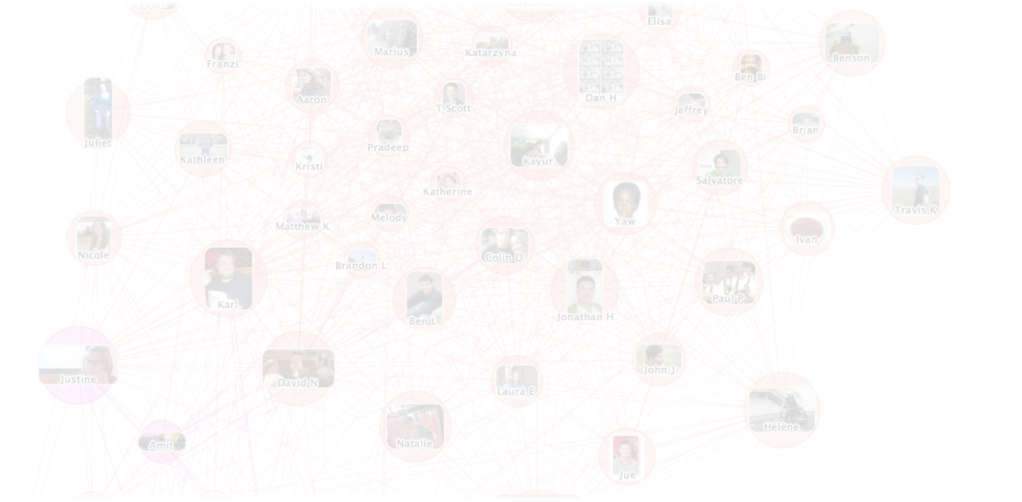



Grappa: faster graph processing on mass-market clusters
Runtime system for global-view task parallelism
Tolerate latency with lightweight threads
Trade latency for:
Random access bandwidth
Fine-grained synchronization throughput
  Jacob Nelson, Brandon Myers, Brandon Holt,
  Preston Briggs, Luis Ceze, Carl Ebeling, Mark Oskin
  University of Washington
  Simon Kahan
  Pacific Northwest National Laboratory

