Slide 1
ONLINE PORTAL BETWEEN STUDENTS AND FACULTY
ABSTRACT:
This Project is Online portal between Students and Faculty. This innovating system can capture the lecture videos of the faculty and can be stored database permanently. If the students were enable to attend the classes or having any classification. Regarding subjects they can recall it by using this system. For Accessing this system login redentials are created students and the faculties. Only the authorized personalities can able to access the videos.

Slide 2
ONLINE PORTAL BETWEEN STUDENTS AND FACULTY
INTRODUCTION:
“Portal” is a web system that provides the functions and features to authenticate and identify the users and provide them with an easy, intuitive, personalized and user-customizable web-interface for facilitating access to information and services that are of primary relevance and interests to the users. Student portal is nothing but a portal which thinks students as the main target users and provides so many useful services to students at a single place and through a single .

Slide 3
ONLINE PORTAL BETWEEN STUDENTS AND FACULTY
interface but in customized form. This project touches all the related boundaries of Online student portal. Two types of user are identified in this project student and an administrator. A student can add or modify self-details, can check the subject videos and query response. Whereas an administrator can login, design events and upload videos. In last check the user query response the query

Slide 4
ONLINE PORTAL BETWEEN STUDENTS AND FACULTY
OBJECTIVES:
The portal will provide teachers with a platform to connect and interact with their students. This would mean that the teacher can group his or her students in their web page as profiles.
This capability addresses the pain point of keeping track of students before, during and after a class. This capability serves as an efficient way for teachers to keep in touch with students.

Slide 5
ONLINE PORTAL BETWEEN STUDENTS AND FACULTY
The portal, in its most basic form, will serve as an individual web page for a teacher. The link to the web page can be used for sharing with others.
It provide “ better and efficient ” service
Reduce the workload of an student.
Faster way to get information about the students. Provide facility for proper monitoring, reduce paper work and provide data security.

Slide 6
ONLINE PORTAL BETWEEN STUDENTS AND FACULTY
SCOPE:
This project is an online portal between students and faculty. This innovative system allows college faculty to share subject videos students. It consists of a faculty login along with student login. Since college faculty operates through pc and videos uploading are simpler through a pc, the faculty login is to be performed through a computer. Faculty may upload videos. The videos are uploaded by faculty to different corresponding departments. We propose to build this system on an online server that allows faculty to upload videos and students may view search and view.

Slide 7
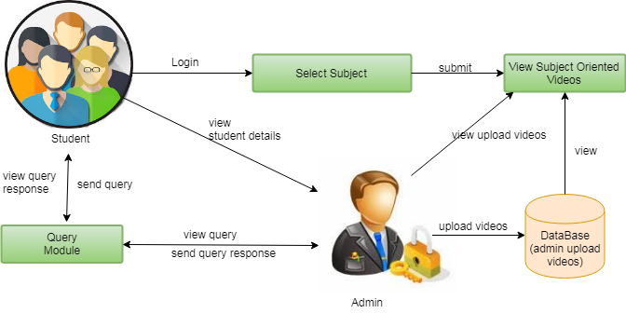
ONLINE PORTAL BETWEEN STUDENTS AND FACULTY
ARCHITECTURE:

Slide 8
ONLINE PORTAL BETWEEN STUDENTS AND FACULTY
1. STUDENTS MODULE
Every Student creates a userid and password in registration page. For details in first name, last name, userid, password, emailed, gender fill the data after submit store the database. After that login the web portal any subjects clarifications, view the upload videos and after that any doubt ask the query in the module. A student can add or modify self-details, can check the subject videos and query response. Student portal is nothing but a portal which thinks students as the main target users and provides so many useful services to students at a single place and through a single interface but in customized form.

Slide 9
ONLINE PORTAL BETWEEN STUDENTS AND FACULTY
2. FAULLTY(ADMIN) MODULE
Two types of user are identified in this project student and an administrator. The portal will provide teachers with a platform to connect and interact with their students. This would mean that the teacher can group his or her students in their web page as profiles. This capability addresses the pain point of keeping track of students before, during and after a class. This capability serves as an efficient way for teachers to keep in touch with students. Faculty create the account in the admin module after that login the admin module open web portal view the student details. Maintaining the database process and easily access the database. This module use for faculty updates details.

Slide 10
ONLINE PORTAL BETWEEN STUDENTS AND FACULTY
3. VIDEO UPLOAD MODULE:
Faculty login the portal and upload the related subject videos. This module only accesses the faculty same times edit, delete, and modify the any process only faculty. Since college faculty operates through pc and videos uploading are simpler through a pc, the faculty login is to be performed through a computer. Faculty may upload videos. The videos are uploaded by faculty to different corresponding departments. Whereas an administrator can login, design events and upload videos.

Slide 11
ONLINE PORTAL BETWEEN STUDENTS AND FACULTY
4. QUERY MODULE
The Student Portal is aimed at active students at Chalmers. ... In addition to regular web pages, the Student Portal serves as an interface to a range of services in different systems. Links between systems can sometimes make the Student Portal slow. Student send the response the query. In this module very important for the student and faculty improve that any type knowledge get the answer for this module.

Slide 12
ONLINE PORTAL BETWEEN STUDENTS AND FACULTY
SYSTEM SPECIFICATION:
HARDWARE REQUIREMENTS:
System : Pentium IV 2.4 GHz.
Hard Disk : 40 GB.
Floppy Drive : 1.44 Mb.
Monitor : 14’ Colour Monitor.
Mouse : Optical Mouse.
Ram : 512 Mb.

Slide 13
ONLINE PORTAL BETWEEN STUDENTS AND FACULTY
SOFTWARE REQUIREMENTS:
Operating system : Windows.
Coding Language : Python.
Front-End : Python.
Back-End : Django-ORM
Designing : Html, css, javascript.
Data Base : MySQL (WAMP Server).

Slide 14
ONLINE PORTAL BETWEEN STUDENTS AND FACULTY
CONCLUSION:
Developing an online student portal to promote count of students to splurge into the field of education. It will provide ease to the student in getting whole information regarding studies. It will provide flexibility and sophistication to students. It provide mean of collaborative learning to the students. It was a wonderful and learning experience for us while working on this project. This software is very easy to use so all educational institute can use this frequently. So, we can hope that our software will be very popular and get sponsors to develop in future.

Slide 15
THANKING YOU

