Slide 1
COMP6124
Chapter 0
Transmission Fundamentals
- a quick refresher

Slide 2
Electromagnetic Signal
Function of time
Can also be expressed as a function of frequency
Signal consists of components of different frequencies

Slide 3
Time-Domain Concepts
Analog signal - signal intensity varies in a smooth fashion over time
No breaks or discontinuities in the signal
Digital signal - signal intensity maintains a constant level for some period of time and then changes to another constant level
Periodic signal - analog or digital signal pattern that repeats over time
s(t +T ) = s(t )
where T is the period of the signal
Aperiodic signal - analog or digital signal pattern that doesn't repeat over time

Slide 4
Time-Domain Concepts
Peak amplitude (A) - maximum value or strength of the signal over time; typically measured in volts
Frequency (f )
Rate, in cycles per second, or Hertz (Hz) at which the signal repeats
Period (T ) - amount of time it takes for one repetition of the signal
T = 1/f
Phase (φ) - measure of the relative position in time within a single period of a signal
Wavelength (λ) - distance occupied by a single cycle of the signal
Or, the distance between two points of corresponding phase of two consecutive cycles

Slide 5
Sine Wave Parameters
General sine wave
s(t ) = A sin(2πft + φ)
Figure 2.3 shows the effect of varying each of the three parameters
(a) A = 1, f = 1 Hz, φ = 0; thus T = 1s
(b) Reduced peak amplitude; A=0.5
(c) Increased frequency; f = 2, thus T = ½
(d) Phase shift; φ = π/4 radians (45 degrees)
note: 2π radians = 360° = 1 period

Slide 6
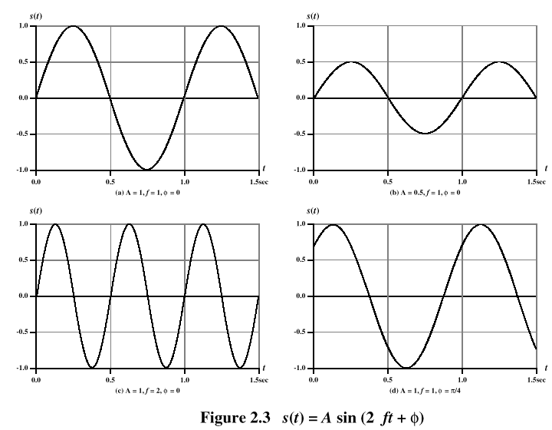
Sine Wave Parameters

Slide 7
Frequency-Domain Concepts
Fundamental frequency - when all frequency components of a signal are integer multiples of one frequency, it’s referred to as the fundamental frequency
Spectrum - range of frequencies that a signal contains
Absolute bandwidth - width of the spectrum of a signal
Effective bandwidth (or just bandwidth) - narrow band of frequencies that most of the signal’s energy is contained in

Slide 8
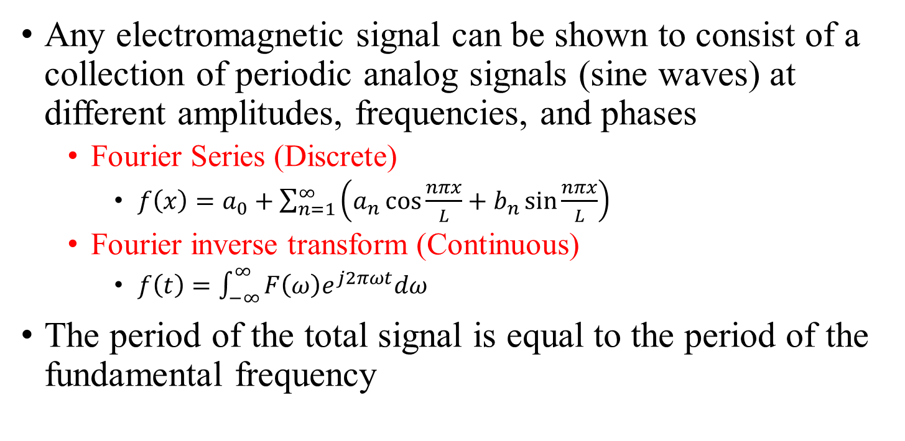
Frequency-Domain Concepts
Any electromagnetic signal can be shown to consist of a collection of periodic analog signals (sine waves) at different amplitudes, frequencies, and phases
Fourier Series (Discrete)
$f\left(x\right)=a_{0}+\sum_{n=1}^{∞}{\left(a_{n}\cos{\frac{nπx}{L}}+b_{n}\sin{\frac{nπx}{L}}\right)}$
Fourier inverse transform (Continuous)
$f\left(t\right)=\int_{−∞}^{∞}{F\left(ω\right)e^{j2πωt}dω}$
The period of the total signal is equal to the period of the fundamental frequency

Slide 9
Relationship between Data Rate and Bandwidth
The greater the bandwidth, the higher the information-carrying capacity
Conclusions
Any digital waveform will have infinite bandwidth
BUT the transmission system will limit the bandwidth that can be transmitted
AND, for any given medium, the greater the bandwidth transmitted, the greater the cost
HOWEVER, limiting the bandwidth creates distortions

Slide 10
Data Communication Terms
Data - entities that convey meaning, or information
Signals - electric or electromagnetic representations of data
Transmission - communication of data by the propagation and processing of signals

Slide 11
Analog Signals
A continuously varying electromagnetic wave that may be propagated over a variety of media, depending on frequency
Examples of media:
Copper wire media (twisted pair and coaxial cable)
Fiber optic cable
Atmosphere or space propagation
Analog signals can propagate analog and digital data

Slide 12
Digital Signals
A sequence of voltage pulses that may be transmitted over a copper wire medium
Generally cheaper than analog signaling
Less susceptible to noise interference
Suffer more from attenuation
Digital signals can propagate analog and digital data

Slide 13
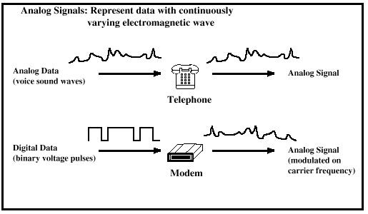
Examples of Analog and Digital Data

Slide 14
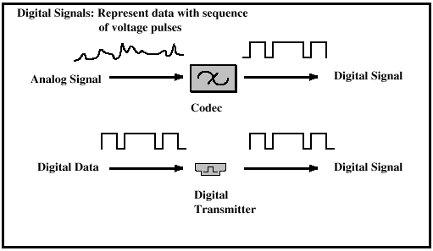
Examples of Analog and Digital Data

Slide 15
About Channel Capacity
Impairments, such as noise, limit data rate that can be achieved
For digital data, to what extent do impairments limit data rate?
Channel Capacity – the maximum rate at which data can be transmitted over a given communication path, or channel, under given conditions

Slide 16
Concepts Related to Channel Capacity
Data rate - rate at which data can be communicated (bps)
Bandwidth - the bandwidth of the transmitted signal as constrained by the transmitter and the nature of the transmission medium (Hertz)
Noise - average level of noise over the communications path
Error rate - rate at which errors occur
Error = transmit 1 and receive 0; transmit 0 and receive 1

Slide 17
Signal-to-Noise Ratio
Ratio of the power in a signal to the power contained in the noise that’s present at a particular point in the transmission
Typically measured at a receiver
Signal-to-noise ratio (SNR, or S/N)
A high SNR means a high-quality signal, low number of required intermediate repeaters
SNR sets upper bound on achievable data rate

Slide 18
Shannon Capacity Formula
Equation:
Represents theoretical maximum that can be achieved
In practice, only much lower rates achieved
Formula assumes white noise (thermal noise)
Impulse noise is not accounted for
Attenuation distortion or delay distortion not accounted for

Slide 19
Example of Shannon Formulation
Spectrum of a channel between 3 MHz and 4 MHz ; SNR_{dB} = 24 dB
Using Shannon’s formula

Slide 20
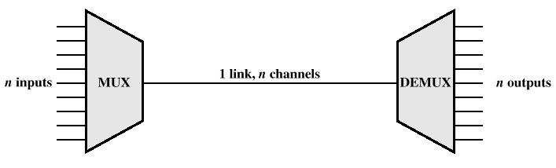
Multiplexing
Capacity of transmission medium usually exceeds capacity required for transmission of a single signal
Multiplexing - carrying multiple signals on a single medium
More efficient use of transmission medium

Slide 21
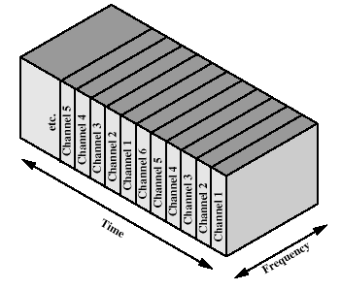
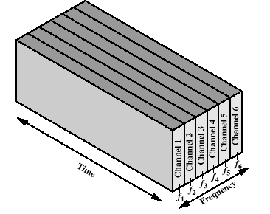
Multiplexing
Frequency-division multiplexing (FDM)
Takes advantage of the fact that the useful bandwidth of the medium exceeds the required bandwidth of a given signal
Time-division multiplexing (TDM)
Takes advantage of the fact that the achievable bit rate of the medium exceeds the required data rate of a digital signal

