Slide 1
COMP6124
Chapter 1
Fundamentals of Wireless Communications (I)

Slide 2
Protocol Stack for
Wireless and IoT networks

Slide 3
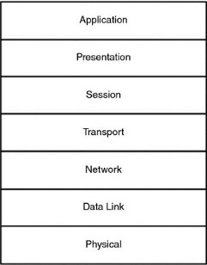
Open Systems Interconnection (OSI) Reference Model
Application: This is the process that is ultimately producing and consuming data.
Presentation: Provides independence to application processes by structuring the data.
Session: Provides control and synchronization between application processes communicating across the network.
Transport: Packetizes the data, sequences the data, and handles connection-oriented or connectionless delivery.
Network: Routes the data across the network.
Data Link: Controls access to the physical medium. Corrects for errors in received data.
Physical: Transmits and receives data acrosst he physical medium.
Notes:
Most communication systems, including the protocols for the wireless IoT, are organized into a protocol stack. Such a layered architecture provides a natural means to decompose the various functions within a communications system

Slide 4
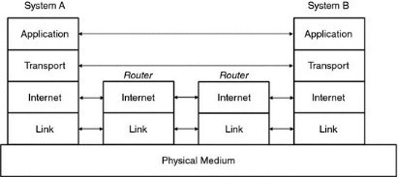
TCP/IP reference model
Application: This is the process that is ultimately producing and consuming data.
Transport: Packetizes the data, sequences the data, and handles connection-oriented or connectionless delivery.
Internet: Routes the data across the network.
Link: Controls access to the physical medium. Corrects for errors in received data. Transmits and receives data across the physical medium.

Slide 5
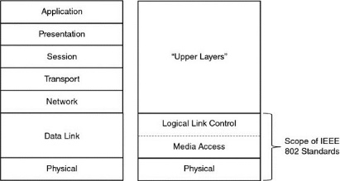
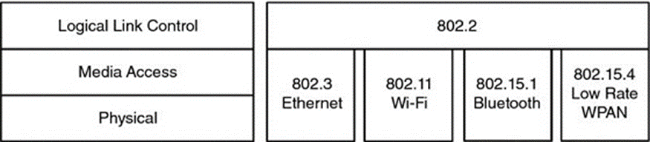
Mapping IEEE802 to OSI
IEEE 802 is a family of standards for personal, local , and metropolitan area networks.
PHY and MAC are defined
for each different IEEE standard.

Slide 6
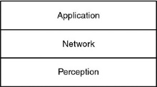
Layered model for IoT
The “Perception” layer is the layer where information is gathered. This layer handles any sensor that is attached to the wireless IoT links.
The “Network” layer handles all transportation of data. The operation of the wireless links between sensors and network coordinators are encapsulated here. Routing between the network nodes is encapsulated here. Funneling information to a gateway and sending that information to remote servers is encapsulated here.
The “Application” layer represents the desired application. This layer handles the user interface and decisions made at the top of the stack.
Our focus in this course:
PHY and MAC layers
Notes:
-- The application is the layer that might exist in “the cloud.”
-- The sensors could be any number of things from vibration sensors for a security system to sensors used to gather data on soil conditions for agricultural applications

Slide 7
Physical Medium: Propagation Channels

Slide 8
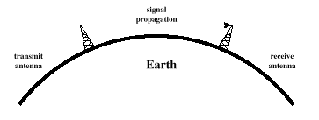
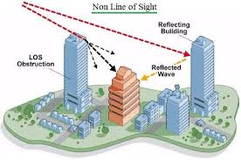
Propagation Channels

Slide 9
Wireless Transmission Impairments
Attenuation and attenuation distortion
Free space loss
Noise
Atmospheric absorption
Shadowing
Multipath
Refraction
Thermal noise

Slide 10
Attenuation
Strength of signal falls off with distance over transmission medium
Free space loss
P_{t} = signal power at transmitting antenna
P_{r} = signal power at receiving antenna
λ = carrier wavelength
d = propagation distance between antennas
c = speed of light ( 3× 10^8 m/s), where d and λ are in the same units (e.g., meters)
Gr, Gt are the transmit and receive antenna gain, respectively

Slide 11
Free Space Loss
Free space loss equation can be recast (without antenna gain):

Slide 12
Single-slope Path Loss
Another common model to account for attenuation due to path (space) loss:
where P_{Ta} is the apparent transmit power (typically measured as the power at 1 m away from the transmitter) (the carrier frequency is implicitly included), and n is the path loss coefficient.
It can be recast as:

Slide 13
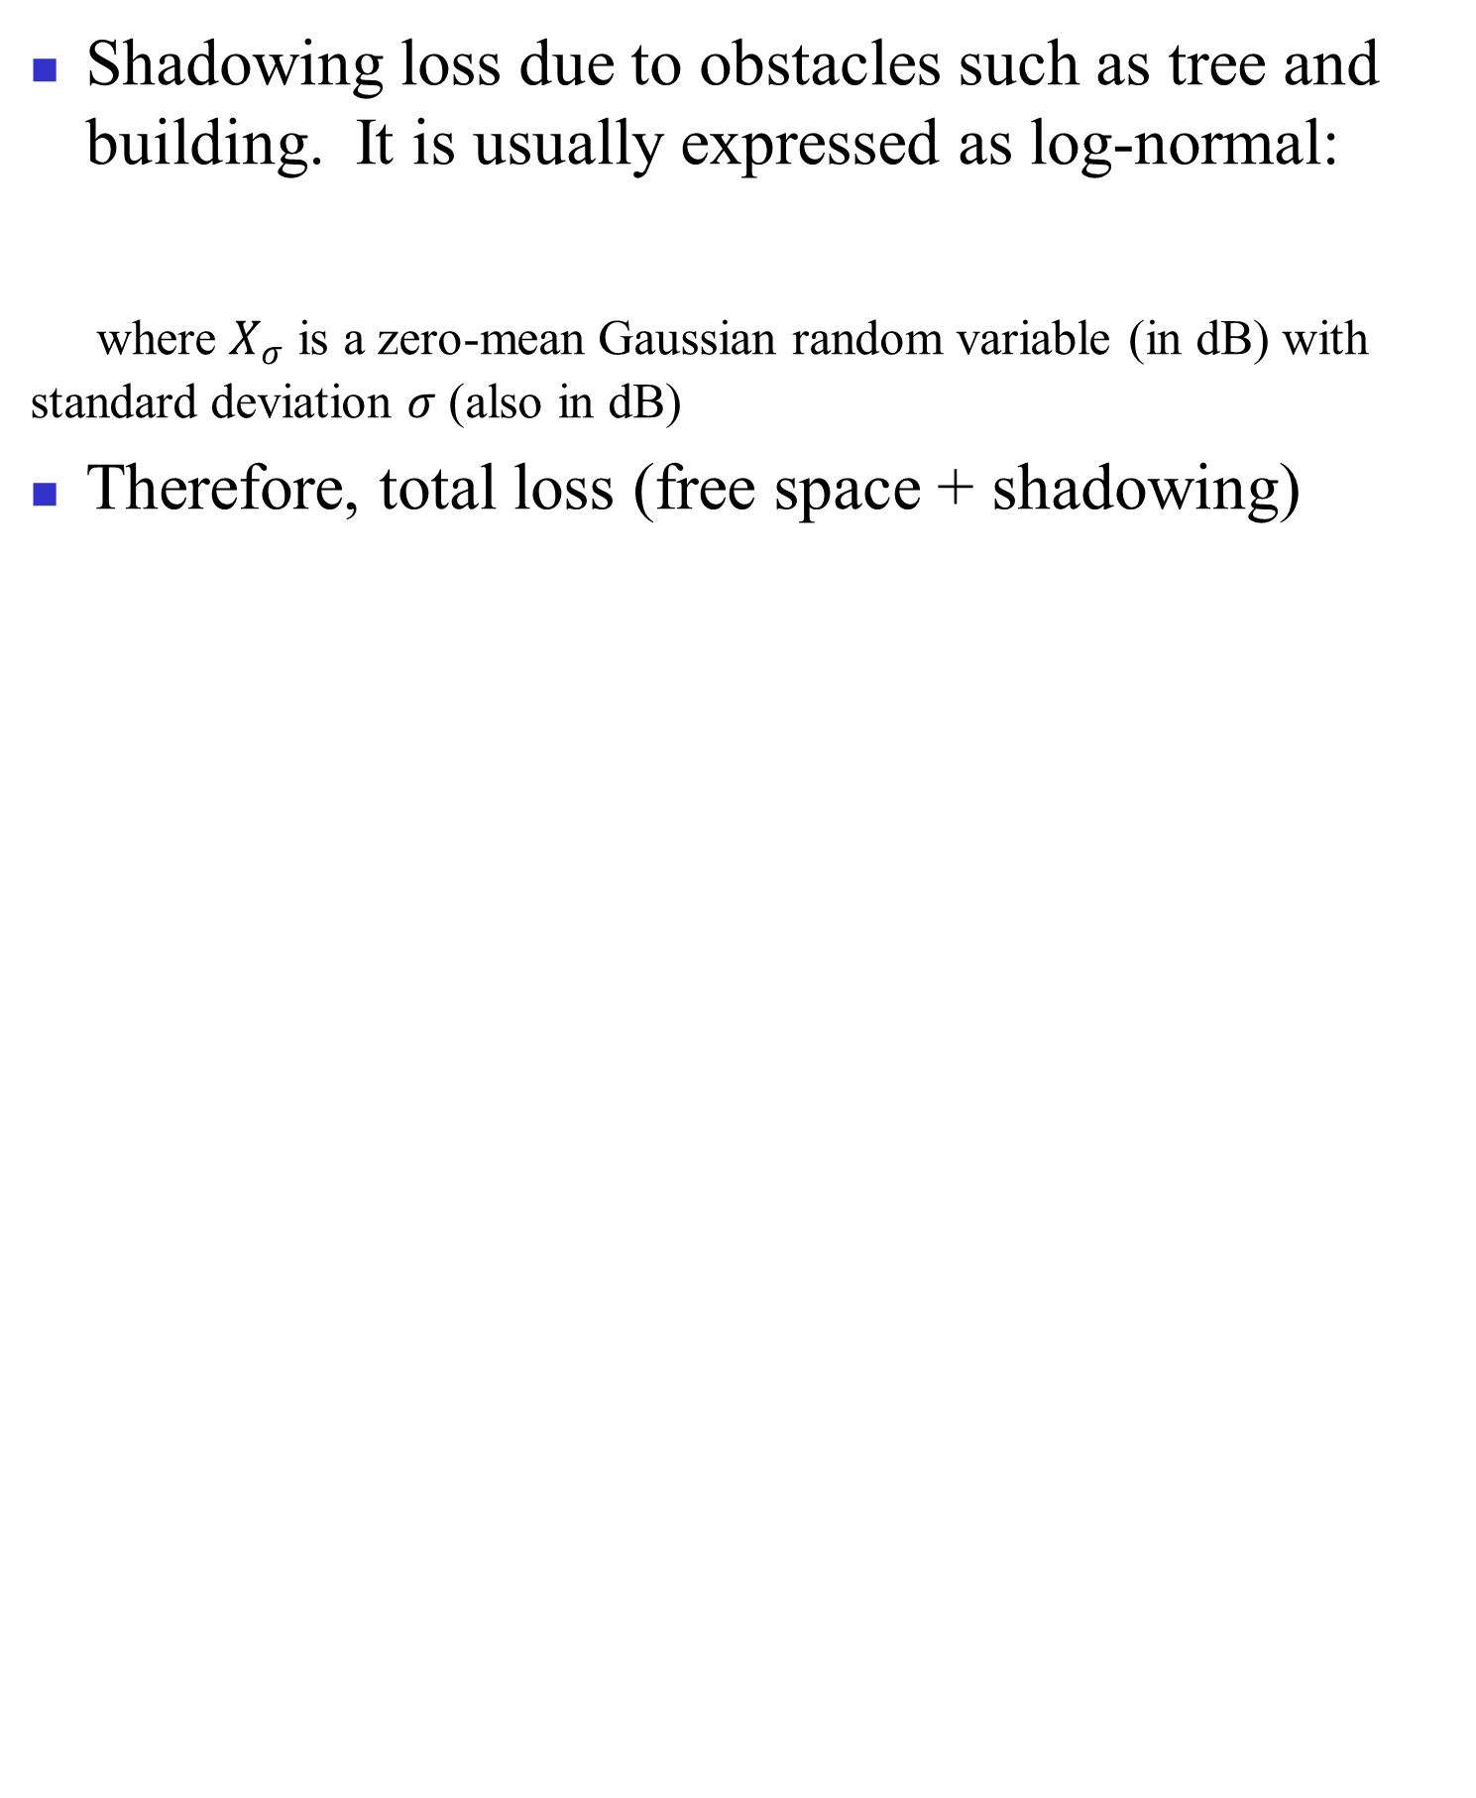

Shadowing Loss

Slide 14
Multipath Propagation
Reflection - occurs when signal encounters a surface that is large relative to the wavelength of the signal
Diffraction - occurs at the edge of an impenetrable body that is large compared to wavelength of radio wave
Scattering – occurs when incoming signal hits an object whose size in the order of the wavelength of the signal or less

Slide 15
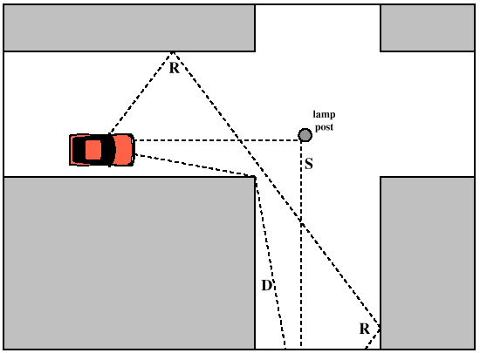
Multipath Propagation

Slide 16
The Effects of Multipath Propagation
Multiple copies of a signal may arrive at different phases
If phases add destructively, the signal level relative to noise declines, making detection more difficult
Intersymbol interference (ISI)
One or more delayed copies of a pulse may arrive at the same time as the primary pulse for a subsequent bit

Slide 17
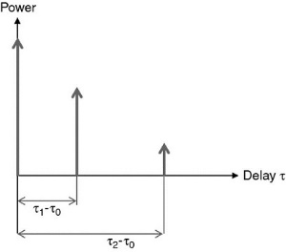
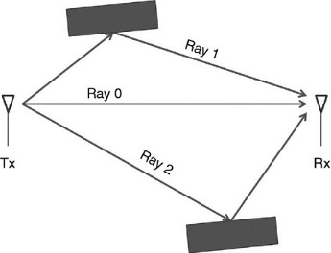

The Effects of Multipath Propagation
Power-delay profile P$\left(τ\right)$
Impulse response$h\left(τ\right)$
Max. Delay spread = time between the first and the last version of signal.
The signal amplitude can change by moving a few inches
→ small-scale fading

Slide 18
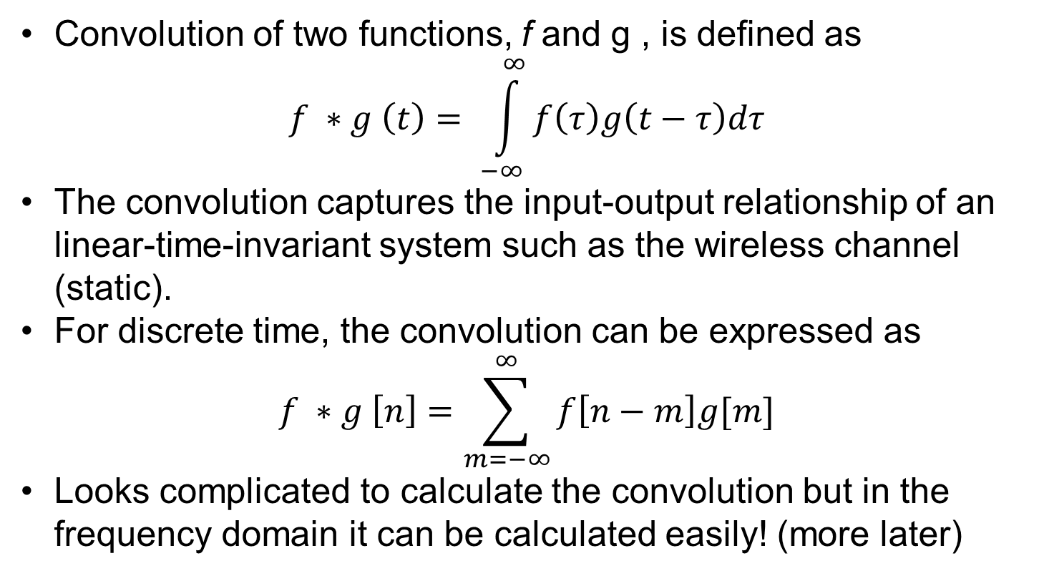
Mathematical Preliminaries
Convolution of two functions, f and g , is defined as
$$f ∗g \left(t\right)= \int_{−∞}^{∞}{f\left(τ\right)g\left(t−τ\right)dτ}$$
The convolution captures the input-output relationship of an linear-time-invariant system such as the wireless channel (static).
For discrete time, the convolution can be expressed as
$$f ∗g \left[n\right]=\sum_{m=−∞}^{∞}{f\left[n−m\right]g[m]}$$
Looks complicated to calculate the convolution but in the frequency domain it can be calculated easily! (more later)

Slide 19
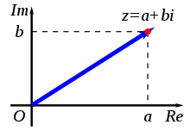

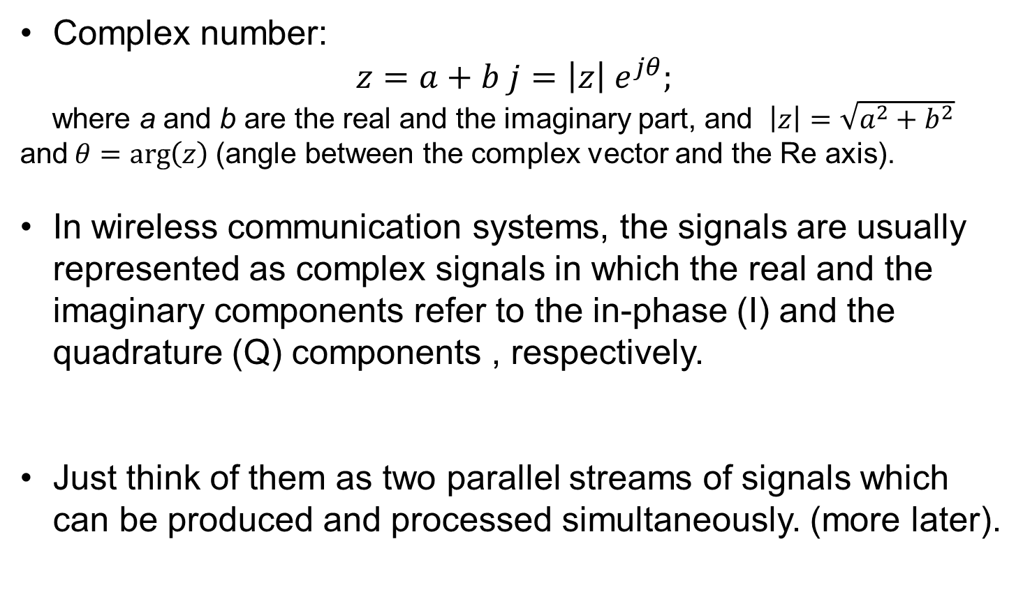
Mathematical Preliminaries
Complex number:
$$z=a+b j=\left|z\right| e^{jθ};$$
where a and b are the real and the imaginary part, and $\left|z\right|=\sqrt{a^{2}+b^{2}}$ and$θ=\arg\left(z\right)$(angle between the complex vector and the Re axis).
In wireless communication systems, the signals are usually represented as complex signals in which the real and the imaginary components refer to the in-phase (I) and the quadrature (Q) components , respectively.
Just think of them as two parallel streams of signals which can be produced and processed simultaneously. (more later).

Slide 20

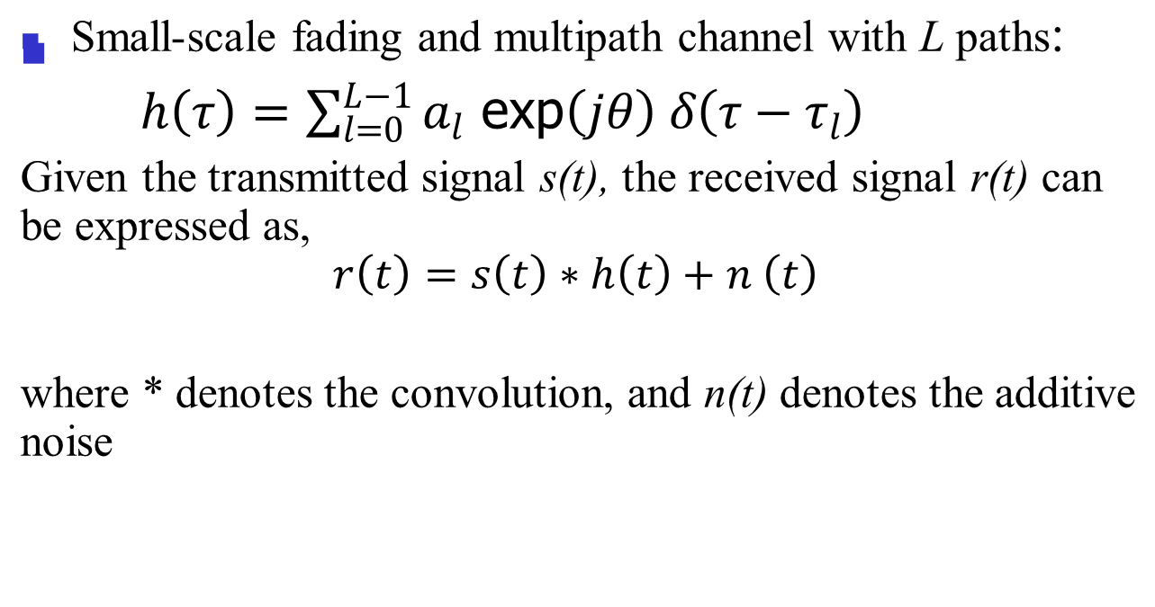
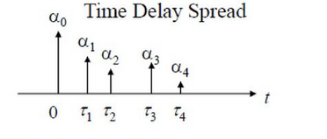

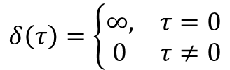
Mathematical Model
h( τ) is called the channel impulse response
$$δ\left(τ\right)=\left\{\begin{matrix}∞, & τ=0 \\ 0 & τ≠0\end{matrix}\right.$$
$$\int_{−∞}^{∞}{δ\left(τ\right)dτ=1}$$
Notes:
Convolution between a signal s(t) and delta function with center tau_l is equal to the original s(t) shifted by the same tau_l

Slide 21
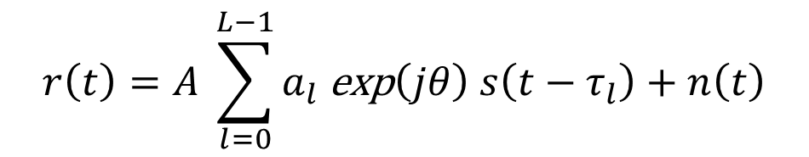
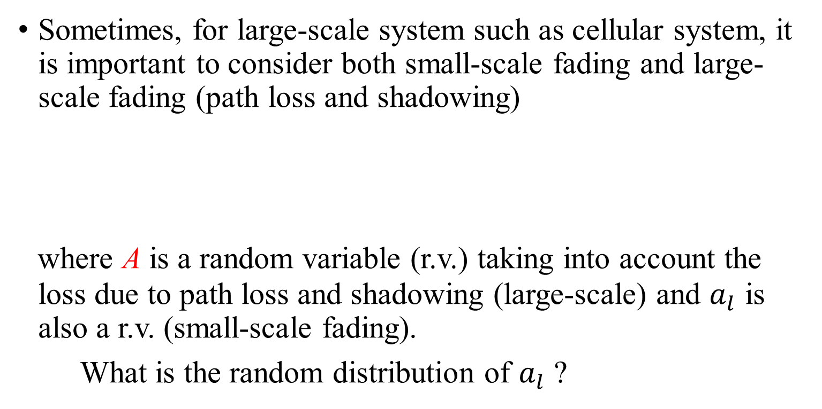
Mathematical Model
Sometimes, for large-scale system such as cellular system, it is important to consider both small-scale fading and large-scale fading (path loss and shadowing)
where A is a random variable (r.v.) taking into account the loss due to path loss and shadowing (large-scale) and $a_{l}$ is also a r.v. (small-scale fading).
What is the random distribution of $a_{l}$ ?

Slide 22
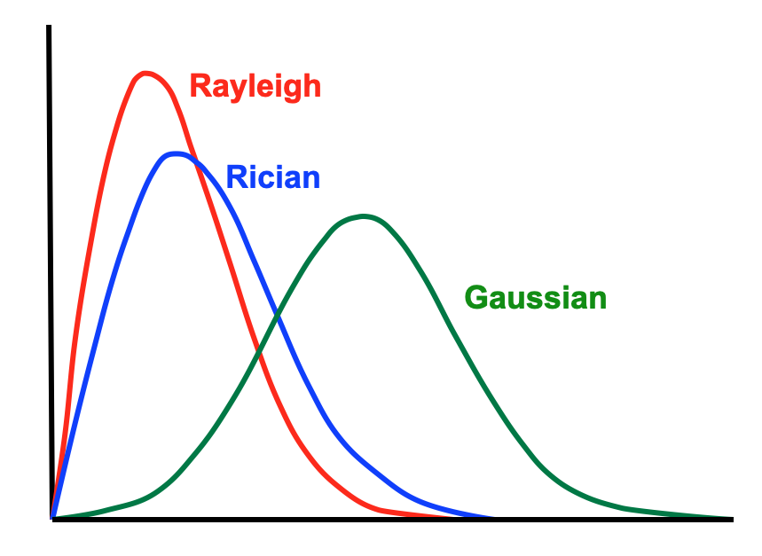
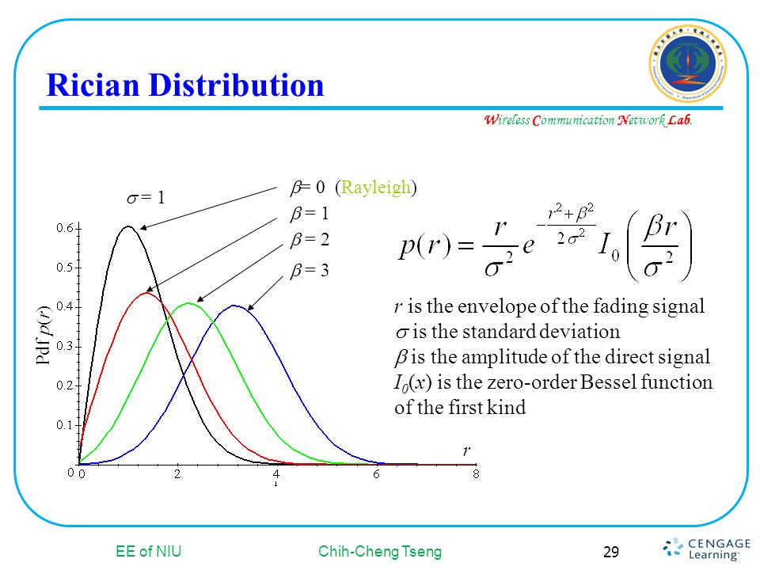
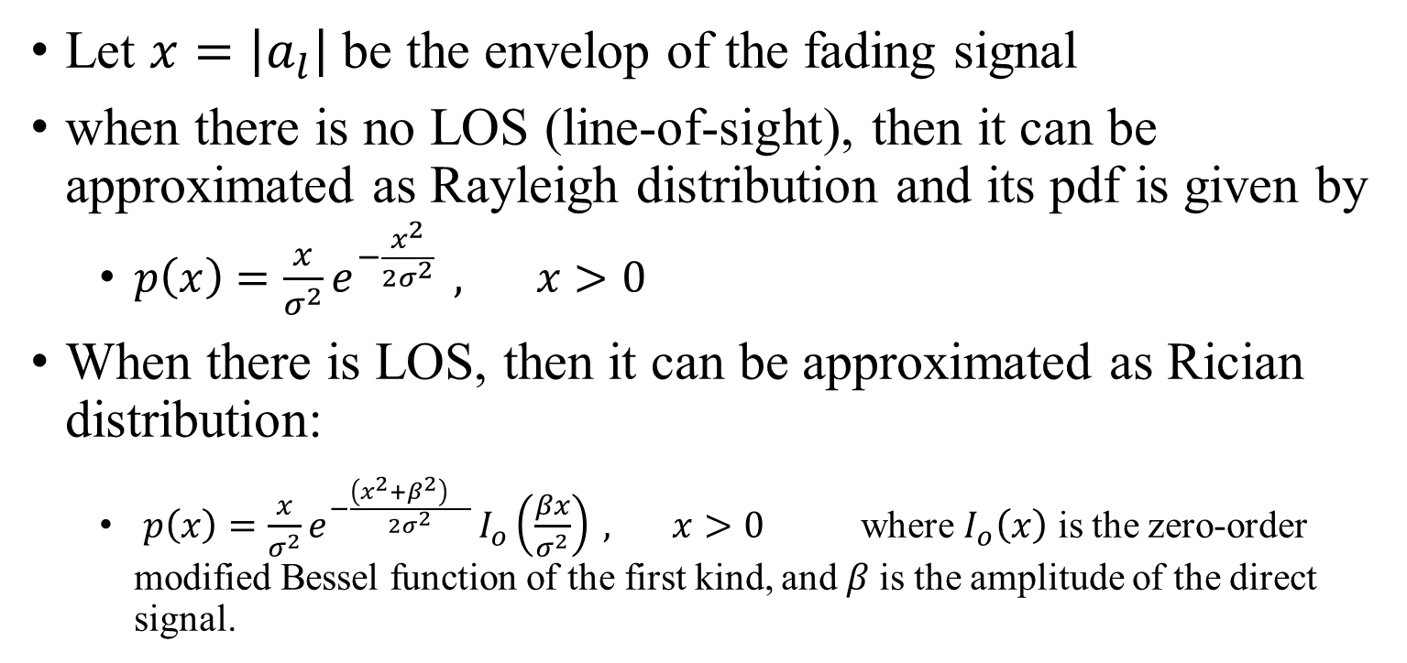
Fading Distribution
Let $x=\left|a_{l}\right|$be the envelop of the fading signal
when there is no LOS (line-of-sight), then it can be approximated as Rayleigh distribution and its pdf is given by
$p\left(x\right)=\frac{x}{σ^{2}}e^{−\frac{x^{2}}{2σ^{2}} } , x>0$
When there is LOS, then it can be approximated as Rician distribution:
$p\left(x\right)=\frac{x}{σ^{2}}e^{−\frac{{\left(x^{2}+β^{2}\right)}^{}}{2σ^{2}} }I_{o}\left(\frac{βx}{σ^{2}}\right) , x>0$ where $I_{o}\left(x\right)$ is the zero-order modified Bessel function of the first kind, and$β$ is the amplitude of the direct signal.

Slide 23
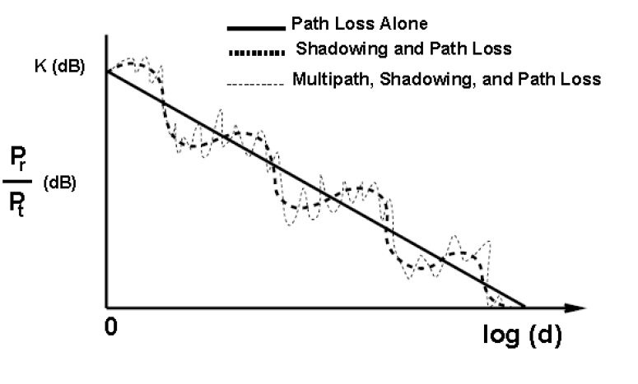



Putting all the channel effects together
$$r\left(t\right)= \underset{A}{\underbrace{A_{L}{ A}_{s}}}(h \left(t\right)∗ s\left(t\right))$$
$A_{L}$-- path loss (large scale)
$A_{s}$ --shadowing loss (large scale)
It’s a random process over space and time! To understand more, we need to examine its statistical properties, such as first-order (expected value), second-order (correlation) and so on.
All fading coefficients are random, questions abut the degree of dependency between them:
Does the loss/gain remain relatively the same for all frequency components (frequency – correlation) ?
How fast does the loss vary (time- correlation)?

Slide 24
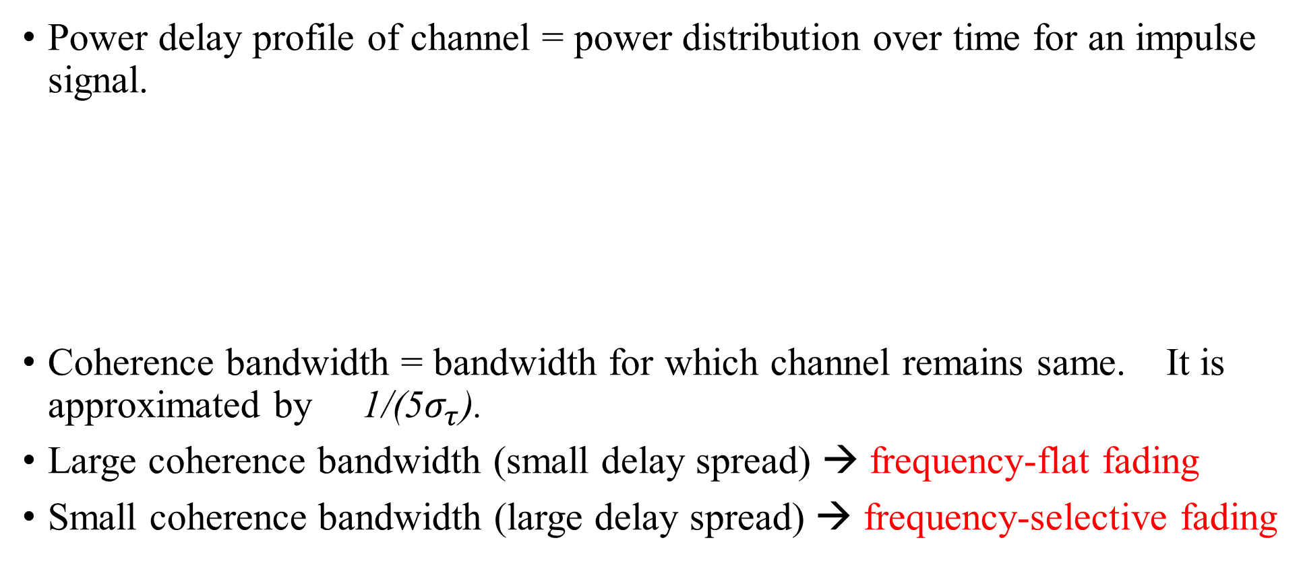

Statistical characterization of fading channels (I)
Q1. Does the loss remain the same for all frequency components?
Power delay profile of channel = power distribution over time for an impulse signal.
Coherence bandwidth = bandwidth for which channel remains same. It is approximated by 1/(5$σ_{τ}$).
Large coherence bandwidth (small delay spread) → frequency-flat fading
Small coherence bandwidth (large delay spread) → frequency-selective fading
r.m.s delay spread = $σ_{τ}$
=$\sqrt{\frac{\sum_{k}{P\left(τ_{k}\right){τ_{k}}^{2}}}{\sum_{k}{P\left(τ_{k}\right)}}−{\left(\frac{\sum_{k}{P\left(τ_{k}\right){τ_{k}}^{}}}{\sum_{k}{P\left(τ_{k}\right)}}\right)}^{2}}$

Slide 25
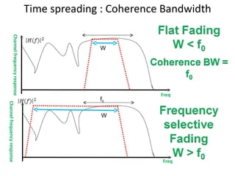
Statistical characterization of fading channels (I)
Q1. Does the loss remain the same for all frequency components?
W is the signal bandwidth

Slide 26
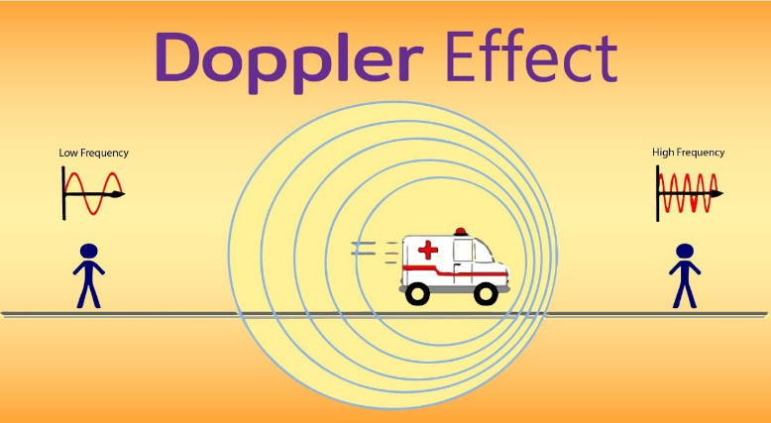
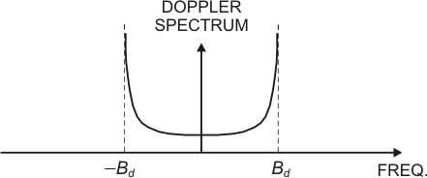
Statistical characterization of fading channels (II)
Q2. How fast does the loss vary?
The Doppler effect is the change in frequency of a wave, caused by the relative motion between the wave’s source and the observer.
Doppler Power Spectrum = Power Distribution over frequency for a signal transmitted at one frequency
It depends on the velocities of the source and observer

Slide 27
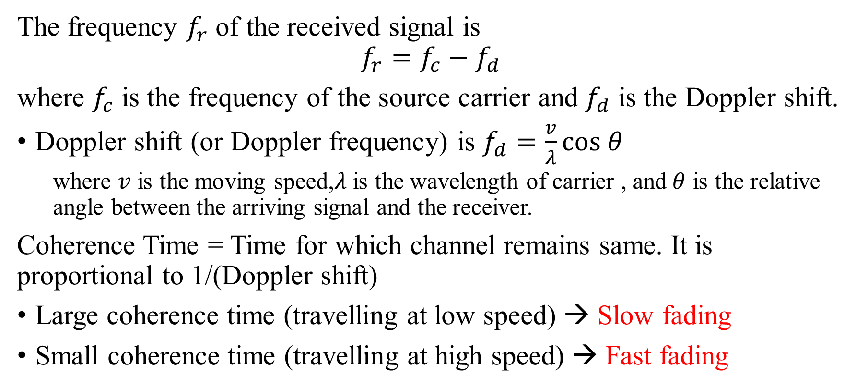
Statistical characterization of fading channels (II)
The frequency $f_{r}$ of the received signal is
$$f_{r}=f_{c}−f_{d}$$
where $f_{c}$ is the frequency of the source carrier and $f_{d}$ is the Doppler shift.
Doppler shift (or Doppler frequency) is $f_{d}=\frac{v}{λ}\text{cos} θ$
where $v$ is the moving speed,$λ$is the wavelength of carrier , and$θ$ is the relative angle between the arriving signal and the receiver.
Coherence Time = Time for which channel remains same. It is proportional to 1/(Doppler shift)
Large coherence time (travelling at low speed) → Slow fading
Small coherence time (travelling at high speed) → Fast fading

Slide 28
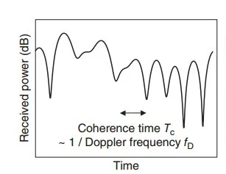
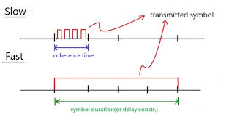
Statistical characterization of fading channels (II)
It’s generally better to have the symbol duration less than the coherence time! (less distortion)

Slide 29
Thermal Noise
Amount of thermal noise to be found in a bandwidth of 1Hz in any device or conductor is:
N₀ = noise power density in watts per 1 Hz of bandwidth
k = Boltzmann's constant = 1.3803 × 10⁻²³ J/K
T = temperature, in kelvins (absolute temperature)

Slide 30
Expression E_{b}/N₀
Ratio of signal energy per bit to noise power density per Hertz
The bit error rate for digital data is a function of E_{b}/N₀
Given a value for E_{b}/N₀ to achieve a desired error rate, parameters of this formula can be selected
As bit rate R increases, transmitted signal power must increase to maintain required E_{b}/N₀

