Slide 1

oneDNN Generic GPU Vendor
Denis Samoilov
09/12/2024

Slide 2
oneDNN GPU Support
oneDNN GPU support is implemented via OpenCL and SYCL runtimes
oneDNN with OpenCL GPU runtime supports only Intel vendor (though it’s technically possible to enable others)
oneDNN with SYCL GPU runtime supports Intel, NVIDIA, AMD and Generic vendors
oneDNN with SYCL GPU runtime is the main configuration to support multiple vendors
oneDNN has reference and optimized implementations for Intel, NVIDIA and AMD vendors
oneDNN with SYCL GPU runtime requires oneAPI DPC++ compiler that supports the target vendor
There are Intel oneAPI DPC++ compiler that is distributed as part of oneAPI toolkit and Open Source oneAPI DPC++ compiler that can be built from source
The Intel oneAPI DPC++ compiler can be used with plugins to enable additional vendors: NVIDIA, AMD
oneDNN is allowed to have different additional dependencies for different vendors such as cuDNN for NVIDIA or MIOpen for AMD
How to build oneDNN with GPU support for different vendors:
cmake .. -DDNNL_CPU_RUNTIME=SYCL -DDNNL_GPU_RUNTIME=SYCL -DNNL_GPU_VENDOR=NVIDIA
Supported values for the vendor are Intel (default), NVIDIA, AMD and Generic
Documentation for the supported vendors can be found here

Slide 3
Generic GPU Vendor
The generic GPU vendor was introduced to provide initial support for different vendors
The initial support means providing reference implementations that are generic by nature and not optimized for any vendor
The generic kernels are implemented in generic SYCL (no vendor specific extensions are used)
The generic GPU vendor is ready to be extended to support accelerators as well. There is no support for accelerators yet
The generic vendor requires the oneAPI DPC++ compiler to support the target device (GPU or accelerator)
If there are multiple GPUs and/or accelerators in the system, it is the user's responsibility to ensure that the correct SYCL device representing the target device is selected at runtime
The list of supported oneDNN primitives for the generic vendor can be found here

Slide 4
Vendor Specific Optimizations
The generic vendor is meant to provide the initial support for new vendors and therefore the performance of the generic kernels can be suboptimal
There are three options to optimize oneDNN for the target vendor:
Implement SYCL kernels using vendor specific extensions
Use vendor performance libraries
Use backend kernel language when applicable. For example, if backend is OpenCL then the OpenCL kernels can be compiled and used with SYCL with the interoperability API
In all cases a new GPU vendor must be added (“DNNL_GPU_VENDOR=NEW_VENDOR”)
The GPU specific code is organized around vendors. Each vendor has a dedicated and isolated space for development:
gpu
├── intel/ # Intel vendor-specific code
├── nvidia/ # NVIDIA vendor-specific code
├── amd/ # AMD vendor-specific code
├── new_vendor/ # A new vendor-specific code
└── generic/ # Generic (vendor agnostic)code
├── sycl/ # Generic SYCL kernels (no vendor specific extensions)
├── ref_concat.hpp # Kernel language agnostic implementations (concat via reorders)

Slide 5
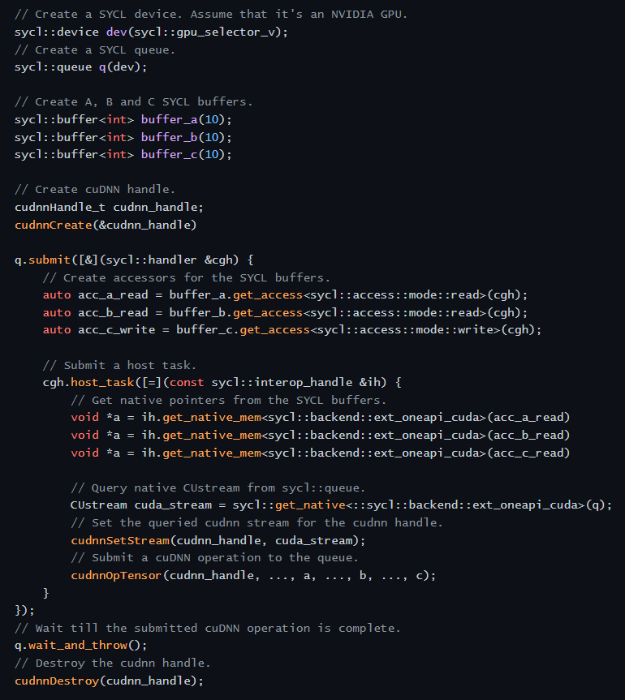
Use Vendor Performance Libraries
oneAPI DPC++ compiler backend has to be compatible with the performance library. For example, oneAPI DPC++ compiler with CUDA backend can be used with cuDNN
SYCL specification defines a way to interoperate with the backend
SYCL objects can be queried for backend native objects. For example, “sycl::queue” for “Custream”, “sycl::contex” for “Cucontext”, “sycl::device” for “Cudevice” and “sycl::buffer” for a memory pointer
The pointer returned by “malloc_shared” or “malloc_device” can be used as is
Using the interoperability API the vendor performance libraries can be embedded into the SYCL programming model

Slide 6
How To Contribute
oneDNN is an open-source project that has contribution guidelines and defines an RFC process. Please make yourself familiar with them
When it comes to contributions that impact some aspects of the library's architecture a formal proposal (RFC) is required. Adding a new vendor will requires a formal proposal
The first step to enable a new vendor is to make sure that the oneAPI DPC++ compiler supports it
The second step is to build oneDNN for a generic vendor and try to run it on the target device
Warning: while the vendor is generic the oneAPI DPC++ compiler may require some additional flags to compile generic SYCL kernels for the target device. See here for more details
The third step is to add support for the new vendor to add optimized kernels. The generic kernels are allowed to be enabled in a combination with the optimized ones so the coverage will not be impacted
Do no hesitate to ask questions on the public github. We try to answer them within a few days

Slide 7
Thank you!

