Slide 1
UXL FOUNDATION
UXL Skills Evaluator
Project-maintained operational knowledge for coding agents
Maintainer overview · August 2026
Notes:
[Sources]
- https://github.com/uxlfoundation/skills/blob/main/skills.yaml
- https://github.com/uxlfoundation/skills/blob/main/evaluation/harbor/suites.json
- https://github.com/uxlfoundation/skills/blob/main/evaluation/harbor/EVALUATOR_POLICY.md
- https://uxlfoundation.github.io/skills/
- https://github.com/uxlfoundation/skills/blob/main/docs/evaluator-operator-guide.md
- https://github.com/uxlfoundation/skills/blob/main/docs/forward-testing.md
- https://github.com/uxlfoundation/skills/blob/main/docs/release-and-promotion-policy.md
[/Sources]
Speaker cue: UXL Skills Evaluator

Slide 2
Why project maintainers should care
Fewer repeat explanations — Capture the review comments, setup choices, and failure triage your team repeats today.
Safer agent contributions — Guide agents toward project-owned APIs, tests, evidence, and honest limitations before they open a PR.
Reviewable change control — Skills are small repository files; guidance changes arrive through normal GitHub review.
Measured usefulness — Executable evaluations check whether the guidance improves verified outcomes — not just whether it sounds plausible.
2
Notes:
[Sources]
- https://github.com/uxlfoundation/skills/blob/main/skills.yaml
- https://github.com/uxlfoundation/skills/blob/main/evaluation/harbor/suites.json
- https://github.com/uxlfoundation/skills/blob/main/evaluation/harbor/EVALUATOR_POLICY.md
- https://uxlfoundation.github.io/skills/
- https://github.com/uxlfoundation/skills/blob/main/docs/evaluator-operator-guide.md
- https://github.com/uxlfoundation/skills/blob/main/docs/forward-testing.md
- https://github.com/uxlfoundation/skills/blob/main/docs/release-and-promotion-policy.md
[/Sources]
Speaker cue: Why project maintainers should care

Slide 3
What exists today
8 skills — Six library portfolios plus shared SYCL build/debug and performance-validation guidance.
52 scoped evaluation tasks — 41 implemented and 11 left visible as planned gaps; this is inventory, not a pass-rate claim.
A public control room — Skills, evaluations, platforms, methodology, maturity, source freshness, and ownership status.
A portable execution model — GitHub-hosted checks by default; opt-in specialized machines only when a task contract requires them.
3
Notes:
[Sources]
- https://github.com/uxlfoundation/skills/blob/main/skills.yaml
- https://github.com/uxlfoundation/skills/blob/main/evaluation/harbor/suites.json
- https://github.com/uxlfoundation/skills/blob/main/evaluation/harbor/EVALUATOR_POLICY.md
- https://uxlfoundation.github.io/skills/
- https://github.com/uxlfoundation/skills/blob/main/docs/evaluator-operator-guide.md
- https://github.com/uxlfoundation/skills/blob/main/docs/forward-testing.md
- https://github.com/uxlfoundation/skills/blob/main/docs/release-and-promotion-policy.md
[/Sources]
Speaker cue: What exists today

Slide 4
The current skill catalog — at a glance
oneDNN — Primitives, layouts/reorders, fusion, numerics, benchdnn.
oneMath — Domains, dispatch modes, queues, backends, linking.
oneDAL — Python/native paths, modes, tables, metric parity, conversion cost.
oneTBB — Patterns, shared state, flow graphs, arenas, grainsize/affinity.
oneDPL — Host/device policies, iterators, lifetime, synchronization, ordering.
oneCCL — Collectives, ranks, launch symmetry, waits, plugins, hangs.
Cross-project — SYCL build/runtime triage and correctness-first performance evidence.
4
Notes:
[Sources]
- https://github.com/uxlfoundation/skills/blob/main/skills.yaml
- https://github.com/uxlfoundation/skills/blob/main/evaluation/harbor/suites.json
- https://github.com/uxlfoundation/skills/blob/main/evaluation/harbor/EVALUATOR_POLICY.md
- https://uxlfoundation.github.io/skills/
- https://github.com/uxlfoundation/skills/blob/main/docs/evaluator-operator-guide.md
- https://github.com/uxlfoundation/skills/blob/main/docs/forward-testing.md
- https://github.com/uxlfoundation/skills/blob/main/docs/release-and-promotion-policy.md
[/Sources]
Speaker cue: The current skill catalog — at a glance

Slide 5
Architecture: project knowledge becomes measured evidence
One repository carries guidance, task contracts, policy, and the public portfolio view.
Project docs
examples · tests
maintainer incidents
Skill guidance
source ledger
prompt evals
Harbor tasks
instruction · environment
verifier
GitHub-hosted
or specialized
execution lane
Evidence +
public dashboard
maintainer decision
Specialized machines change the environment, not the evidence contract.
5
Notes:
[Sources]
- https://github.com/uxlfoundation/skills/blob/main/skills.yaml
- https://github.com/uxlfoundation/skills/blob/main/evaluation/harbor/suites.json
- https://github.com/uxlfoundation/skills/blob/main/evaluation/harbor/EVALUATOR_POLICY.md
- https://uxlfoundation.github.io/skills/
- https://github.com/uxlfoundation/skills/blob/main/docs/evaluator-operator-guide.md
- https://github.com/uxlfoundation/skills/blob/main/docs/forward-testing.md
- https://github.com/uxlfoundation/skills/blob/main/docs/release-and-promotion-policy.md
[/Sources]
Speaker cue: Architecture: project knowledge becomes measured evidence

Slide 6
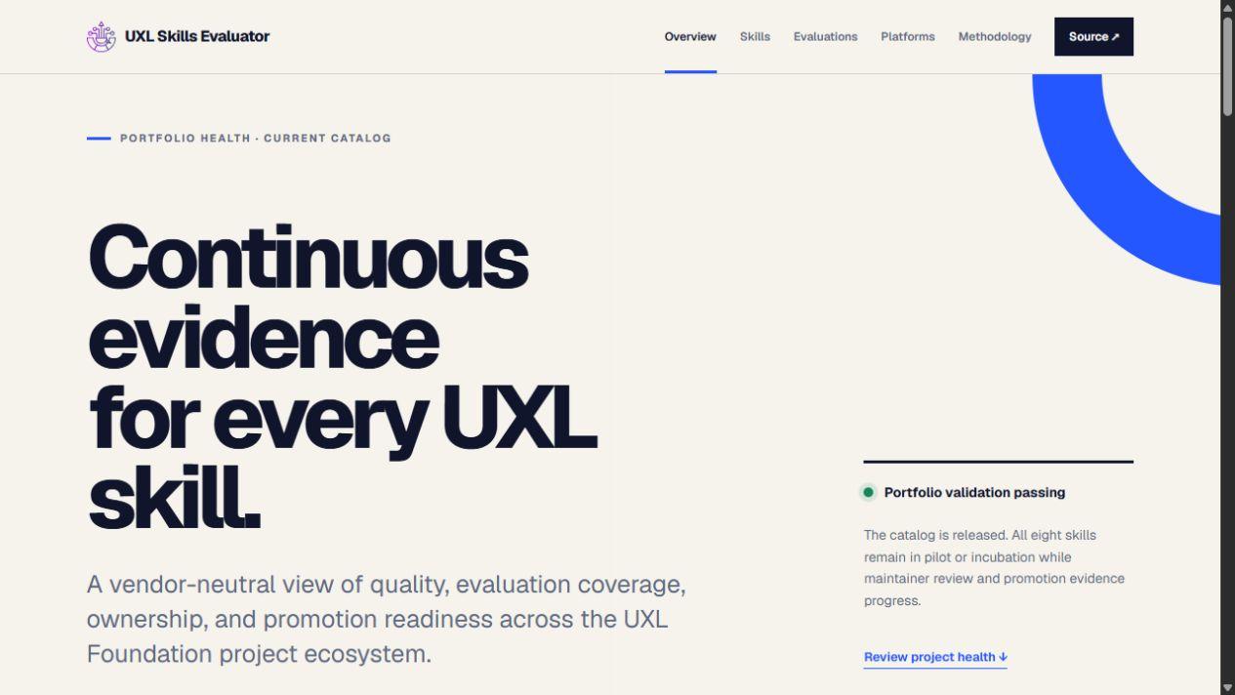
The public control room answers: are the skills healthy?
6
Notes:
[Sources]
- https://github.com/uxlfoundation/skills/blob/main/skills.yaml
- https://github.com/uxlfoundation/skills/blob/main/evaluation/harbor/suites.json
- https://github.com/uxlfoundation/skills/blob/main/evaluation/harbor/EVALUATOR_POLICY.md
- https://uxlfoundation.github.io/skills/
- https://github.com/uxlfoundation/skills/blob/main/docs/evaluator-operator-guide.md
- https://github.com/uxlfoundation/skills/blob/main/docs/forward-testing.md
- https://github.com/uxlfoundation/skills/blob/main/docs/release-and-promotion-policy.md
[/Sources]
Speaker cue: The public control room answers: are the skills healthy?

Slide 7
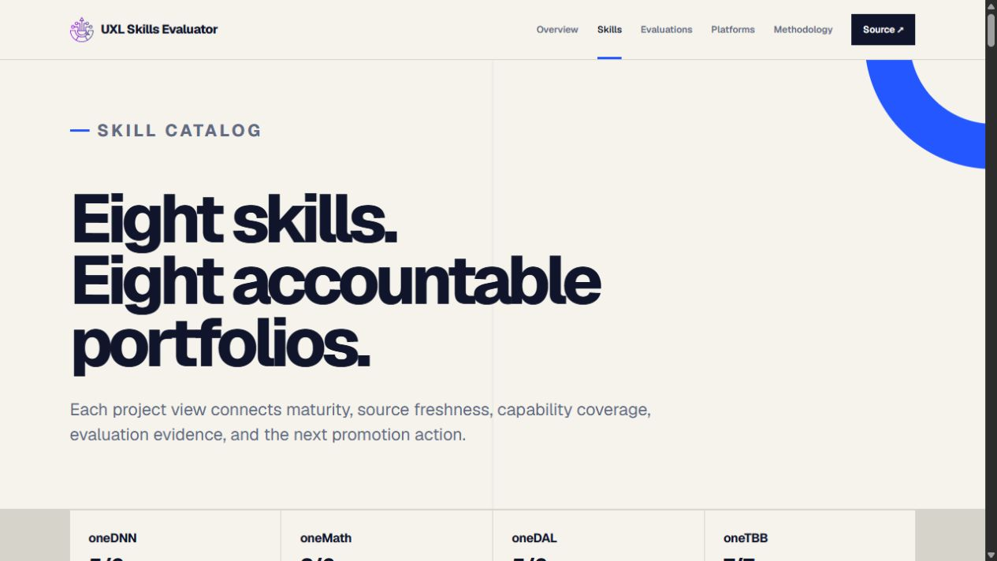
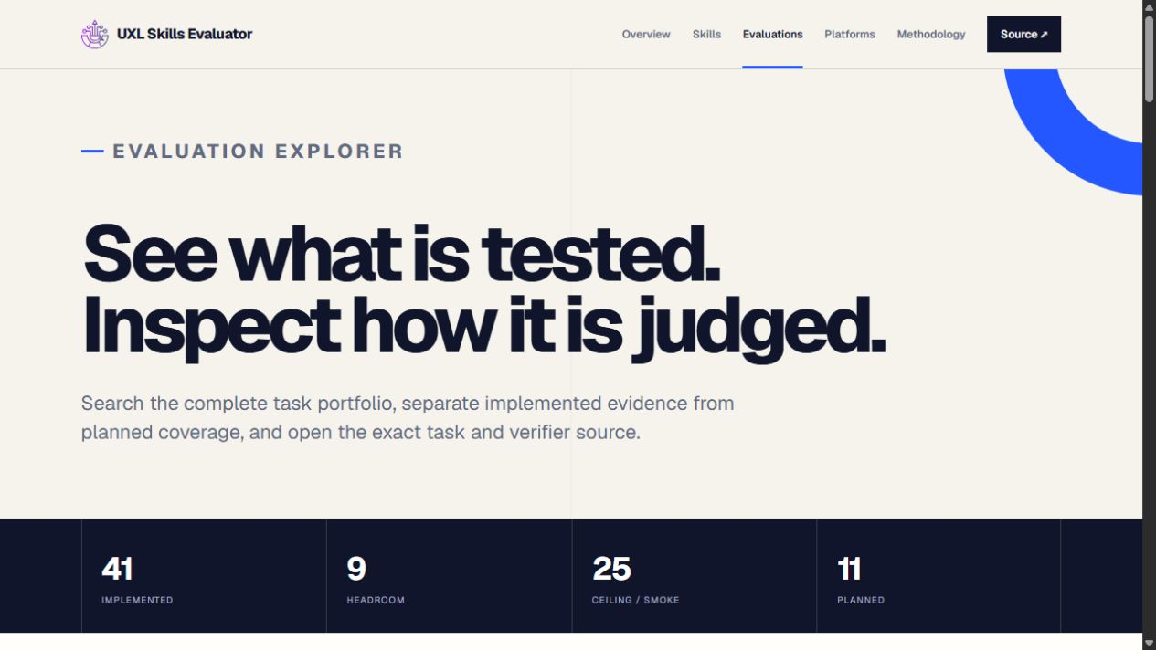
Maintainers can drill from portfolio to exact task contracts
Skills: scope, maturity, sources, limitations
Evaluations: exact tasks, states, environments
7
Notes:
[Sources]
- https://github.com/uxlfoundation/skills/blob/main/skills.yaml
- https://github.com/uxlfoundation/skills/blob/main/evaluation/harbor/suites.json
- https://github.com/uxlfoundation/skills/blob/main/evaluation/harbor/EVALUATOR_POLICY.md
- https://uxlfoundation.github.io/skills/
- https://github.com/uxlfoundation/skills/blob/main/docs/evaluator-operator-guide.md
- https://github.com/uxlfoundation/skills/blob/main/docs/forward-testing.md
- https://github.com/uxlfoundation/skills/blob/main/docs/release-and-promotion-policy.md
[/Sources]
Speaker cue: Maintainers can drill from portfolio to exact task contracts

Slide 8
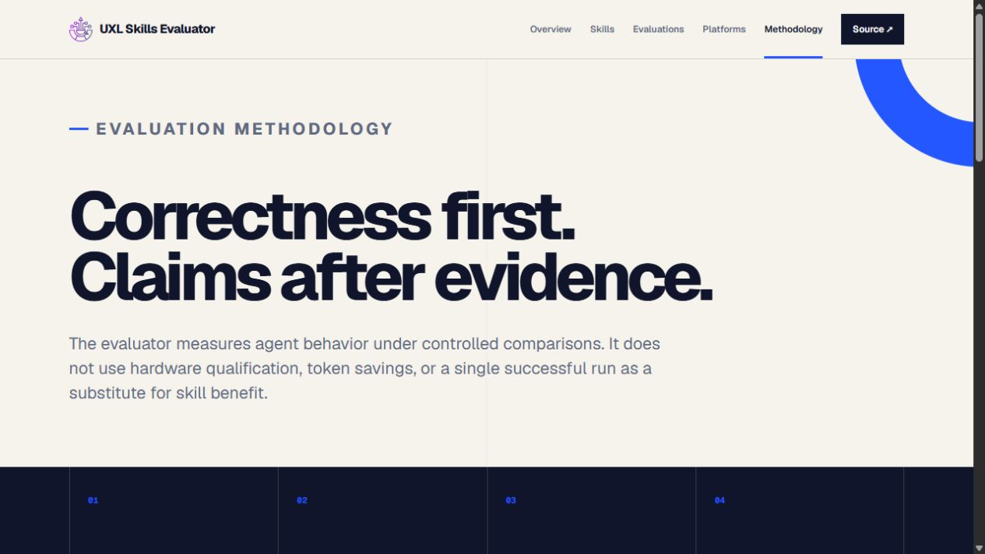
The methodology is deliberately claim-resistant
8
Notes:
[Sources]
- https://github.com/uxlfoundation/skills/blob/main/skills.yaml
- https://github.com/uxlfoundation/skills/blob/main/evaluation/harbor/suites.json
- https://github.com/uxlfoundation/skills/blob/main/evaluation/harbor/EVALUATOR_POLICY.md
- https://uxlfoundation.github.io/skills/
- https://github.com/uxlfoundation/skills/blob/main/docs/evaluator-operator-guide.md
- https://github.com/uxlfoundation/skills/blob/main/docs/forward-testing.md
- https://github.com/uxlfoundation/skills/blob/main/docs/release-and-promotion-policy.md
[/Sources]
Speaker cue: The methodology is deliberately claim-resistant

Slide 9
Every claim lives inside a matched evaluation cell
Inside one cell, change only the skill treatment.
Task + verifier
revision
Agent + harness
model + reasoning
Image + toolchain
OS + hardware
Attempts + timeouts
concurrency
Matched arms
no skill · previous
candidate
Repeat across representative cells; report differences. Never average incompatible contexts into a universal score.
9
Notes:
[Sources]
- https://github.com/uxlfoundation/skills/blob/main/skills.yaml
- https://github.com/uxlfoundation/skills/blob/main/evaluation/harbor/suites.json
- https://github.com/uxlfoundation/skills/blob/main/evaluation/harbor/EVALUATOR_POLICY.md
- https://uxlfoundation.github.io/skills/
- https://github.com/uxlfoundation/skills/blob/main/docs/evaluator-operator-guide.md
- https://github.com/uxlfoundation/skills/blob/main/docs/forward-testing.md
- https://github.com/uxlfoundation/skills/blob/main/docs/release-and-promotion-policy.md
[/Sources]
Speaker cue: Every claim lives inside a matched evaluation cell

Slide 10
Maintainer pushback is expected — and the answer is scoped evidence
Do you test every model, harness, and version? — No. We select representative, risk-based cells and publish the untested gaps.
What happens when a model, harness, or toolchain changes? — Re-run the affected cells; older results remain historical evidence, not current proof.
Could a skill overfit the evaluator? — Use maintainer incidents, hidden implementation-neutral checks, negative controls, multiple tasks, and trajectory review.
What if every arm passes? — Classify the task as ceiling/smoke; do not claim quality lift and seek a harder task.
Does a hardware oracle prove the skill helps? — No. It qualifies the execution lane; matched model trials are a separate experiment.
Can we compare scores across cells? — Look for consistent conclusions and report exceptions; never pool incompatible models or environments into one universal score.
10
Notes:
[Sources]
- https://github.com/uxlfoundation/skills/blob/main/skills.yaml
- https://github.com/uxlfoundation/skills/blob/main/evaluation/harbor/suites.json
- https://github.com/uxlfoundation/skills/blob/main/evaluation/harbor/EVALUATOR_POLICY.md
- https://uxlfoundation.github.io/skills/
- https://github.com/uxlfoundation/skills/blob/main/docs/evaluator-operator-guide.md
- https://github.com/uxlfoundation/skills/blob/main/docs/forward-testing.md
- https://github.com/uxlfoundation/skills/blob/main/docs/release-and-promotion-policy.md
[/Sources]
Speaker cue: Maintainer pushback is expected — and the answer is scoped evidence

Slide 11
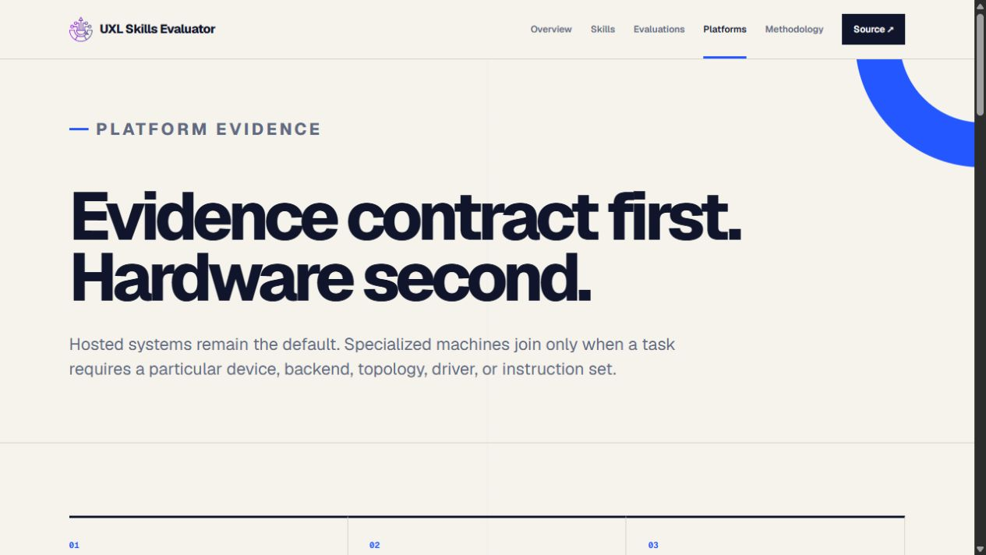
Hardware is a pluggable evidence lane — never the product
11
Notes:
[Sources]
- https://github.com/uxlfoundation/skills/blob/main/skills.yaml
- https://github.com/uxlfoundation/skills/blob/main/evaluation/harbor/suites.json
- https://github.com/uxlfoundation/skills/blob/main/evaluation/harbor/EVALUATOR_POLICY.md
- https://uxlfoundation.github.io/skills/
- https://github.com/uxlfoundation/skills/blob/main/docs/evaluator-operator-guide.md
- https://github.com/uxlfoundation/skills/blob/main/docs/forward-testing.md
- https://github.com/uxlfoundation/skills/blob/main/docs/release-and-promotion-policy.md
[/Sources]
Speaker cue: Hardware is a pluggable evidence lane — never the product

Slide 12
The ongoing maintainer workflow fits normal GitHub practice
A maintainer’s recurring action is a small review — the shared evaluator does the rest.
1 Review
trigger · guidance
sources · limits
2 Edit via PR
skill + eval +
source ledger
3 CI validates
catalog · tasks
site · smoke
4 Compare
no-skill · previous
candidate
5 Decide
keep · revise
promote
Quality is the gate; lower token use never compensates for fewer verified successes.
12
Notes:
[Sources]
- https://github.com/uxlfoundation/skills/blob/main/skills.yaml
- https://github.com/uxlfoundation/skills/blob/main/evaluation/harbor/suites.json
- https://github.com/uxlfoundation/skills/blob/main/evaluation/harbor/EVALUATOR_POLICY.md
- https://uxlfoundation.github.io/skills/
- https://github.com/uxlfoundation/skills/blob/main/docs/evaluator-operator-guide.md
- https://github.com/uxlfoundation/skills/blob/main/docs/forward-testing.md
- https://github.com/uxlfoundation/skills/blob/main/docs/release-and-promotion-policy.md
[/Sources]
Speaker cue: The ongoing maintainer workflow fits normal GitHub practice

Slide 13
Ownership is intentionally split
Project maintainers own — Triggers, technical guidance, official sources, limitations, and whether task scenarios are authentic.
UXL shared infrastructure owns — Catalog validation, Harbor harnesses, comparison policy, dashboards, hosted CI, and runner contracts.
Hardware owners opt in — They qualify a declared environment, run only reviewed immutable evaluator revisions, and return evidence artifacts.
No silent promotion — Project approval, source verification, realistic eval prompts, matched trials when feasible, and explicit limitations remain gates.
13
Notes:
[Sources]
- https://github.com/uxlfoundation/skills/blob/main/skills.yaml
- https://github.com/uxlfoundation/skills/blob/main/evaluation/harbor/suites.json
- https://github.com/uxlfoundation/skills/blob/main/evaluation/harbor/EVALUATOR_POLICY.md
- https://uxlfoundation.github.io/skills/
- https://github.com/uxlfoundation/skills/blob/main/docs/evaluator-operator-guide.md
- https://github.com/uxlfoundation/skills/blob/main/docs/forward-testing.md
- https://github.com/uxlfoundation/skills/blob/main/docs/release-and-promotion-policy.md
[/Sources]
Speaker cue: Ownership is intentionally split

Slide 14
The decision we need from each project
Name one owner — A maintainer or small reviewer group for scope and source freshness.
Approve or correct the first-pass guidance — Especially triggers, gotchas, unsupported paths, and terminology.
Validate the task inventory — Keep, rewrite, or delete scenarios; nominate one real support issue or regression.
Adopt a light cadence — Review skill-affecting PRs and recheck sources at releases or quarterly.
Start small — A 30-minute review is enough to turn this from UXL-authored draft into project-backed guidance.
14
Notes:
[Sources]
- https://github.com/uxlfoundation/skills/blob/main/skills.yaml
- https://github.com/uxlfoundation/skills/blob/main/evaluation/harbor/suites.json
- https://github.com/uxlfoundation/skills/blob/main/evaluation/harbor/EVALUATOR_POLICY.md
- https://uxlfoundation.github.io/skills/
- https://github.com/uxlfoundation/skills/blob/main/docs/evaluator-operator-guide.md
- https://github.com/uxlfoundation/skills/blob/main/docs/forward-testing.md
- https://github.com/uxlfoundation/skills/blob/main/docs/release-and-promotion-policy.md
[/Sources]
Speaker cue: The decision we need from each project

