Slide 1
UXL FOUNDATION
UXL Skills Evaluator
Project-maintained operational knowledge for coding agents
Maintainer overview · September 2026
Notes:
[Sources]
- https://github.com/uxlfoundation/skills
- https://uxlfoundation.github.io/skills/
- https://github.com/uxlfoundation/skills/blob/main/skills.yaml
- https://github.com/uxlfoundation/skills/blob/main/evaluation/harbor/EVALUATOR_POLICY.md
[/Sources]
Presenter guidance
Purpose: Frame the UXL Skills Evaluator for project maintainers and working-group leads.
Explain: It is an incubating, open project that pairs maintainable agent guidance with reproducible evaluations and a public health dashboard.
Emphasize: The deck explains what exists now and how maintainers can shape it; it is not a claim that the current drafts are project-approved.

Slide 2
What exists today
8 skills — Six library portfolios plus shared SYCL build/debug and performance-validation guidance.
52 scoped evaluation tasks — 41 implemented and 11 left visible as planned gaps; this is inventory, not a pass-rate claim.
A public control room — Skills, evaluations, platforms, methodology, maturity, source freshness, and ownership status.
A portable execution model — GitHub-hosted checks by default; opt-in specialized machines only when a task contract requires them.
2
Notes:
[Sources]
- https://github.com/uxlfoundation/skills
- https://uxlfoundation.github.io/skills/
- https://github.com/uxlfoundation/skills/blob/main/skills.yaml
- https://github.com/uxlfoundation/skills/blob/main/evaluation/harbor/EVALUATOR_POLICY.md
[/Sources]
Presenter guidance
Purpose: Give a factual snapshot of the current catalog and evaluation inventory.
Explain: There are eight skills, 52 defined tasks, 41 implemented tasks, a public dashboard, Harbor-based execution, and a portable target-lane contract.
Emphasize: These numbers describe inventory and maturity, not an aggregate pass rate or quality score.

Slide 3
The current skill catalog — at a glance
oneDNN — Primitives, layouts/reorders, fusion, numerics, benchdnn.
oneMath — Domains, dispatch modes, queues, backends, linking.
oneDAL — Python/native paths, modes, tables, metric parity, conversion cost.
oneTBB — Patterns, shared state, flow graphs, arenas, grainsize/affinity.
oneDPL — Host/device policies, iterators, lifetime, synchronization, ordering.
oneCCL — Collectives, ranks, launch symmetry, waits, plugins, hangs.
Cross-project — SYCL build/runtime triage and correctness-first performance evidence.
3
Notes:
[Sources]
- https://github.com/uxlfoundation/skills
- https://uxlfoundation.github.io/skills/
- https://github.com/uxlfoundation/skills/blob/main/skills.yaml
- https://github.com/uxlfoundation/skills/blob/main/evaluation/harbor/EVALUATOR_POLICY.md
[/Sources]
Presenter guidance
Purpose: Orient the audience to the catalog structure.
Explain: Six skills are specific to oneAPI library projects and two cover shared SYCL troubleshooting and performance-validation practices.
Emphasize: Each catalog card links to the skill, its sources, its task inventory, current evidence, and a maintainer briefing.

Slide 4
Architecture: project knowledge becomes measured evidence
One repository carries guidance, task contracts, policy, and the public portfolio view.
Project docs
examples · tests
maintainer incidents
Skill guidance
source ledger
prompt evals
Harbor tasks
instruction · environment
verifier
GitHub-hosted
or specialized
execution lane
Evidence +
public dashboard
maintainer decision
Specialized machines change the environment, not the evidence contract.
4
Notes:
[Sources]
- https://github.com/uxlfoundation/skills
- https://uxlfoundation.github.io/skills/
- https://github.com/uxlfoundation/skills/blob/main/skills.yaml
- https://github.com/uxlfoundation/skills/blob/main/evaluation/harbor/EVALUATOR_POLICY.md
[/Sources]
Presenter guidance
Purpose: Explain the software architecture from source material to public evidence.
Explain: Maintainer-owned docs inform a versioned skill; Harbor runs task cells through hosted or qualified target lanes; artifacts feed the static dashboard.
Emphasize: A specialized machine changes the execution adapter and environment evidence, not the task or verification contract.

Slide 5
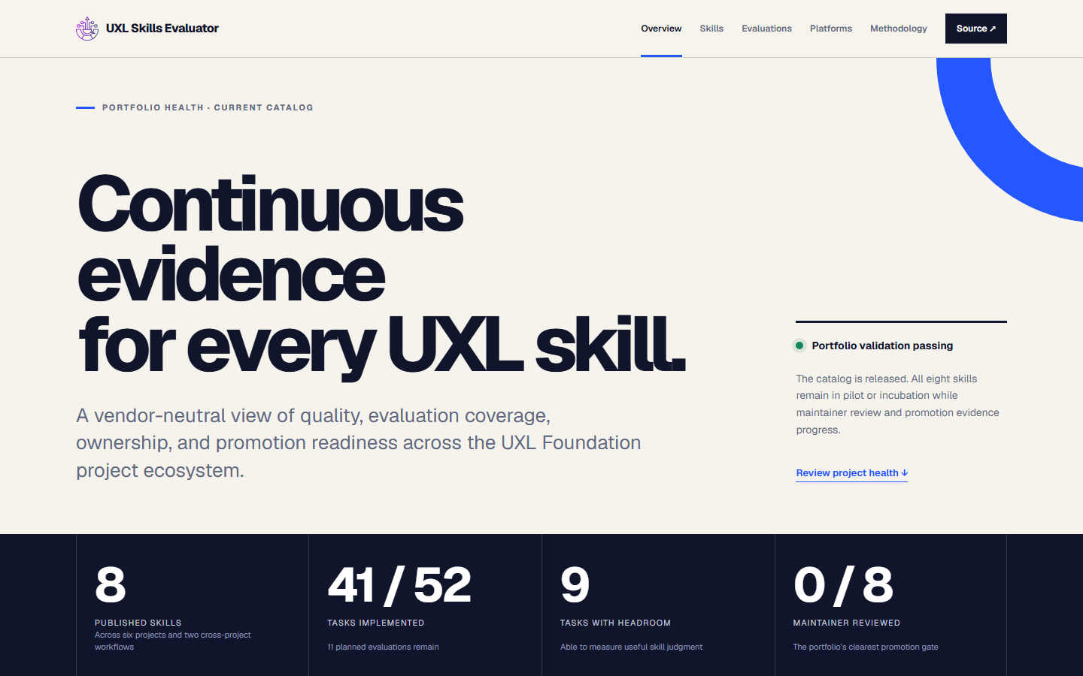
The public control room answers: are the skills healthy?
5
Notes:
[Sources]
- https://github.com/uxlfoundation/skills
- https://uxlfoundation.github.io/skills/
- https://github.com/uxlfoundation/skills/blob/main/skills.yaml
- https://github.com/uxlfoundation/skills/blob/main/evaluation/harbor/EVALUATOR_POLICY.md
[/Sources]
Presenter guidance
Purpose: Show what a manager can learn from the dashboard's top-level view.
Explain: The overview highlights maturity, coverage, freshness, ownership, platform evidence, and visible gaps across the catalog.
Emphasize: Health is intentionally multidimensional; the dashboard avoids compressing unlike environments into one universal score.

Slide 6
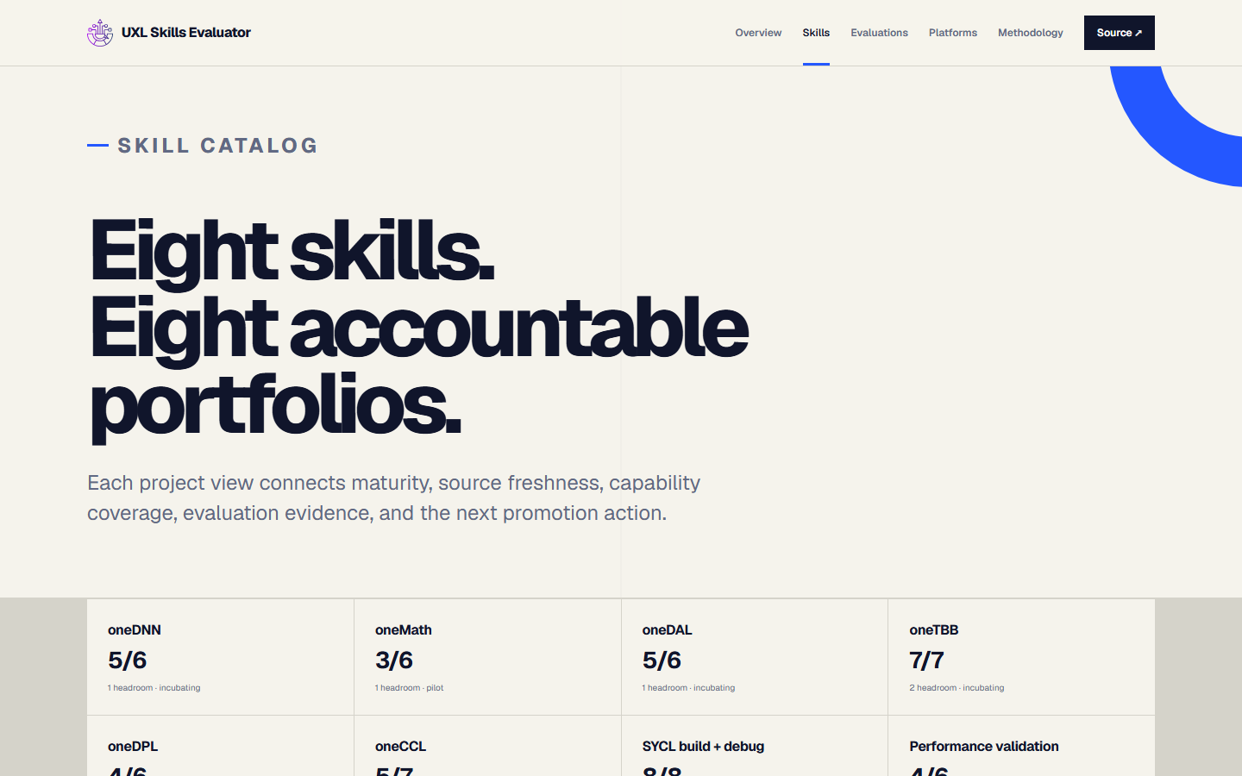
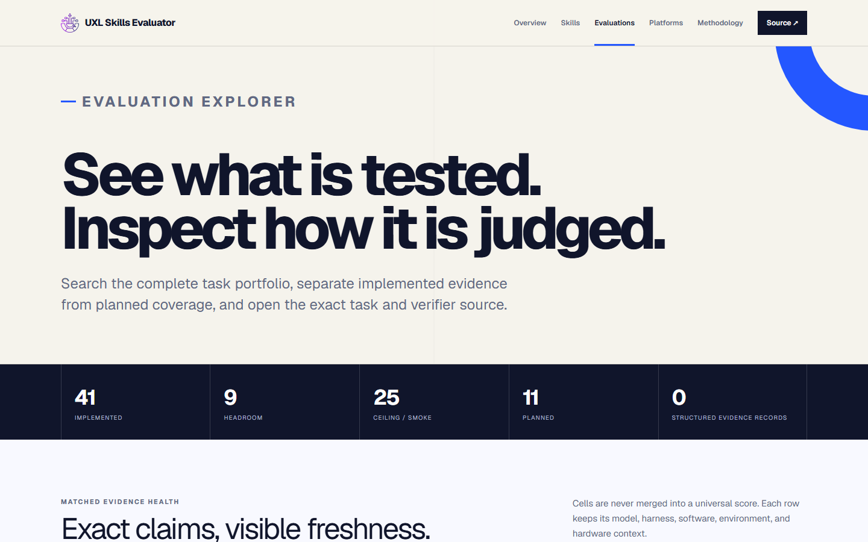
Maintainers can drill from portfolio to exact task contracts
Skills: scope, maturity, sources, limitations
Evaluations: exact tasks, states, environments
6
Notes:
[Sources]
- https://github.com/uxlfoundation/skills
- https://uxlfoundation.github.io/skills/
- https://github.com/uxlfoundation/skills/blob/main/skills.yaml
- https://github.com/uxlfoundation/skills/blob/main/evaluation/harbor/EVALUATOR_POLICY.md
[/Sources]
Presenter guidance
Purpose: Demonstrate how maintainers drill from a skill card into evaluation details.
Explain: The skill and evaluation views expose triggers, guidance, tasks, verifiers, treatments, results, artifacts, and known limitations.
Emphasize: The dashboard is a navigation and evidence layer over repository data, so every claim remains reviewable in GitHub.

Slide 7
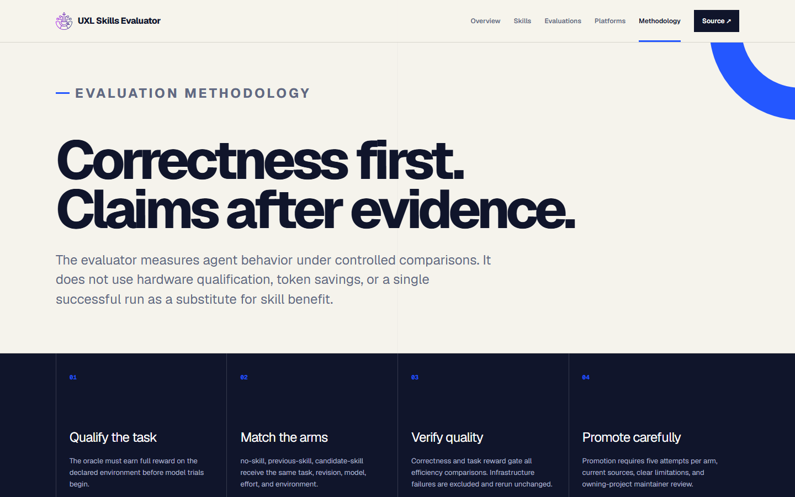
The methodology is deliberately claim-resistant
7
Notes:
[Sources]
- https://github.com/uxlfoundation/skills
- https://uxlfoundation.github.io/skills/
- https://github.com/uxlfoundation/skills/blob/main/skills.yaml
- https://github.com/uxlfoundation/skills/blob/main/evaluation/harbor/EVALUATOR_POLICY.md
[/Sources]
Presenter guidance
Purpose: State the guiding evaluation philosophy.
Explain: Verify correctness and task completion first, test claims separately, preserve provenance, and keep smoke coverage distinct from discriminating evidence.
Emphasize: Passing an environment qualification or a task does not by itself prove that a skill improved an agent's behavior.

Slide 8
Every claim lives inside a matched evaluation cell
Inside one cell, change only the skill treatment.
Task + verifier
revision
Agent + harness
model + reasoning
Image + toolchain
OS + hardware
Attempts + timeouts
concurrency
Matched arms
no skill · previous
candidate
Repeat across representative cells; report differences. Never average incompatible contexts into a universal score.
8
Notes:
[Sources]
- https://github.com/uxlfoundation/skills
- https://uxlfoundation.github.io/skills/
- https://github.com/uxlfoundation/skills/blob/main/skills.yaml
- https://github.com/uxlfoundation/skills/blob/main/evaluation/harbor/EVALUATOR_POLICY.md
[/Sources]
Presenter guidance
Purpose: Explain how comparisons remain meaningful across changing models and tools.
Explain: A matched evaluation cell fixes the task, model, harness, toolchain, software, environment, and verifier; only the skill treatment changes.
Emphasize: Results from incompatible cells are reported side by side rather than pooled into a universal benchmark number.

Slide 9
Maintainer pushback is expected — and the answer is scoped evidence
Do you test every combination? — No. We publish representative, risk-based cells and the gaps.
What changes invalidate evidence? — Re-run affected cells; older results remain history, not current proof.
How do you limit overfitting? — Maintainer incidents, hidden checks, negative controls, multiple tasks, and trajectory review.
What if every arm passes? — Keep it as smoke coverage; claim no lift and seek a harder task.
Does hardware qualification prove skill value? — No. Qualification and matched skill trials are separate gates.
Can scores be pooled? — No universal score; report conclusions within each model, harness, software, and environment cell.
9
Notes:
[Sources]
- https://github.com/uxlfoundation/skills
- https://uxlfoundation.github.io/skills/
- https://github.com/uxlfoundation/skills/blob/main/skills.yaml
- https://github.com/uxlfoundation/skills/blob/main/evaluation/harbor/EVALUATOR_POLICY.md
[/Sources]
Presenter guidance
Purpose: Address expected questions about model, harness, and version coverage.
Explain: The project uses representative risk-based cells, publishes untested gaps, re-runs affected cells after material changes, and uses hidden checks and negative controls to limit overfitting.
Emphasize: When every treatment passes, the task remains smoke coverage and supports no claim of skill lift.

Slide 10
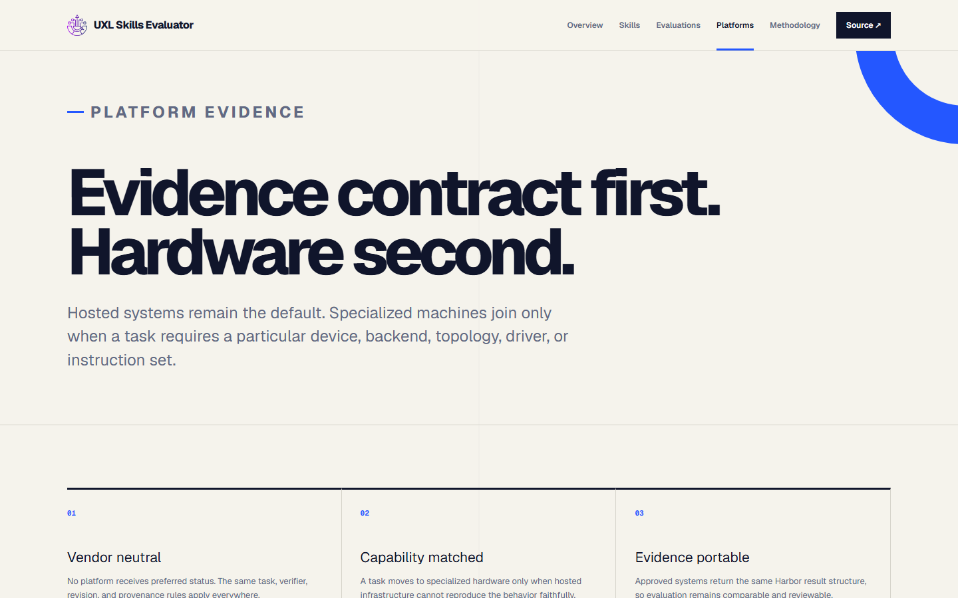
Hardware is a pluggable evidence lane — never the product
10
Notes:
[Sources]
- https://github.com/uxlfoundation/skills
- https://uxlfoundation.github.io/skills/
- https://github.com/uxlfoundation/skills/blob/main/skills.yaml
- https://github.com/uxlfoundation/skills/blob/main/evaluation/harbor/EVALUATOR_POLICY.md
[/Sources]
Presenter guidance
Purpose: Describe the hardware-neutral execution model.
Explain: GitHub-hosted runners handle portable work; qualified machines add GPUs, multi-node systems, or other specialized targets through the same task and artifact contract.
Emphasize: No hardware vendor receives priority from the dashboard, and qualification is separate from matched skill evaluation.

Slide 11
The ongoing maintainer workflow fits normal GitHub practice
A maintainer’s recurring action is a small review — the shared evaluator does the rest.
1 Review
trigger · guidance
sources · limits
2 Edit via PR
skill + eval +
source ledger
3 CI validates
catalog · tasks
site · smoke
4 Compare
no-skill · previous
candidate
5 Decide
keep · revise
promote
Quality is the gate; lower token use never compensates for fewer verified successes.
11
Notes:
[Sources]
- https://github.com/uxlfoundation/skills
- https://uxlfoundation.github.io/skills/
- https://github.com/uxlfoundation/skills/blob/main/skills.yaml
- https://github.com/uxlfoundation/skills/blob/main/evaluation/harbor/EVALUATOR_POLICY.md
[/Sources]
Presenter guidance
Purpose: Make the ongoing maintainer workflow concrete.
Explain: A typical change updates guidance or sources, adds or revises a task, runs validation, reviews evidence, and lands through a normal pull request.
Emphasize: The intended maintenance burden is small and periodic, with automation handling catalog checks and dashboard publication.

Slide 12
Ownership is intentionally split
Project maintainers own — Triggers, technical guidance, official sources, limitations, and whether task scenarios are authentic.
UXL shared infrastructure owns — Catalog validation, Harbor harnesses, comparison policy, dashboards, hosted CI, and runner contracts.
Hardware owners opt in — They qualify a declared environment, run only reviewed immutable evaluator revisions, and return evidence artifacts.
No silent promotion — Project approval, source verification, realistic eval prompts, matched trials when feasible, and explicit limitations remain gates.
12
Notes:
[Sources]
- https://github.com/uxlfoundation/skills
- https://uxlfoundation.github.io/skills/
- https://github.com/uxlfoundation/skills/blob/main/skills.yaml
- https://github.com/uxlfoundation/skills/blob/main/evaluation/harbor/EVALUATOR_POLICY.md
[/Sources]
Presenter guidance
Purpose: Clarify which responsibilities stay with projects and which stay with UXL infrastructure.
Explain: Project maintainers own technical truth, triggers, limitations, and authentic cases; UXL owns schemas, validators, Harbor integration, comparison discipline, and presentation of evidence.
Emphasize: Named project ownership is required before an incubating skill can be treated as maintained guidance.

Slide 13
The decision we need from each project
Name one owner — A maintainer or small reviewer group for scope and source freshness.
Approve or correct the first-pass guidance — Especially triggers, gotchas, unsupported paths, and terminology.
Validate the task inventory — Keep, rewrite, or delete scenarios; nominate one real support issue or regression.
Adopt a light cadence — Review skill-affecting PRs and recheck sources at releases or quarterly.
Start small — A 30-minute review is enough to turn this from UXL-authored draft into project-backed guidance.
13
Notes:
[Sources]
- https://github.com/uxlfoundation/skills
- https://uxlfoundation.github.io/skills/
- https://github.com/uxlfoundation/skills/blob/main/skills.yaml
- https://github.com/uxlfoundation/skills/blob/main/evaluation/harbor/EVALUATOR_POLICY.md
[/Sources]
Presenter guidance
Purpose: Close with the smallest useful maintainer commitment.
Explain: Ask each project to correct its draft skill, validate or replace its task inventory, and identify a reviewer or owner for future changes.
Emphasize: A concrete correction or realistic issue is more valuable at this stage than broad approval of the whole system.

