Slide 1

Team Name: Prometheus
Idea: Create my own workflows around my own money (IFTTT integration)
Team Members(6): Daniel, Marlene, Paul Palmer, Ben Hugo, Roger Kingaby, Marc Danneels,

Slide 2
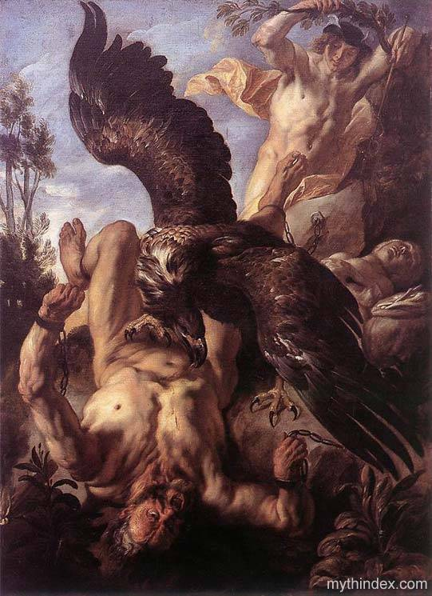

Slide 3








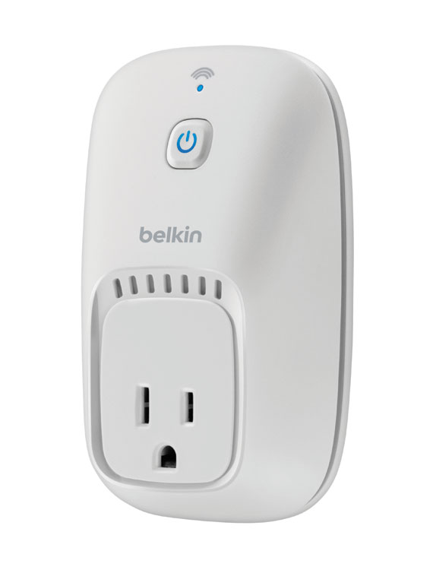
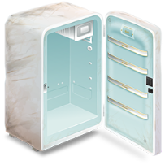
Apps
Workflows
Devices

Slide 4







Channels
…
Recipes
Atlas APIs

Slide 5


Real-World Recipe Examples
Balances
Forex
FCA Transfer
Balances

Slide 6


DEMO
Recipe 1
Recipe 2
TRANSFER
BALANCES

Slide 7

Azure
RSS
Recipe 1
Recipe 2
Please
Transfer
Do Transfer
Instruction
Eeek !
Balance Low
accounts
transfer
Atlas APIs
Balances Reader
Twitter Reader

Slide 8


Business Return
One Million Dollars

Slide 9
Business Return
Kudos at being first NZ bank to join The Internet of Things
Limited by current immaturity of the IFTTT ecosystem

