Slide 1
Flask/ESP32 Concept Demo

Slide 2
Demo #2 Setup
http://github.com/uyechi23/FlaskESP32ConceptDemo
Upload the .ino file to your ESP32
(ESP32 → esp32potdemo → esp32potdemo.ino)

Slide 3
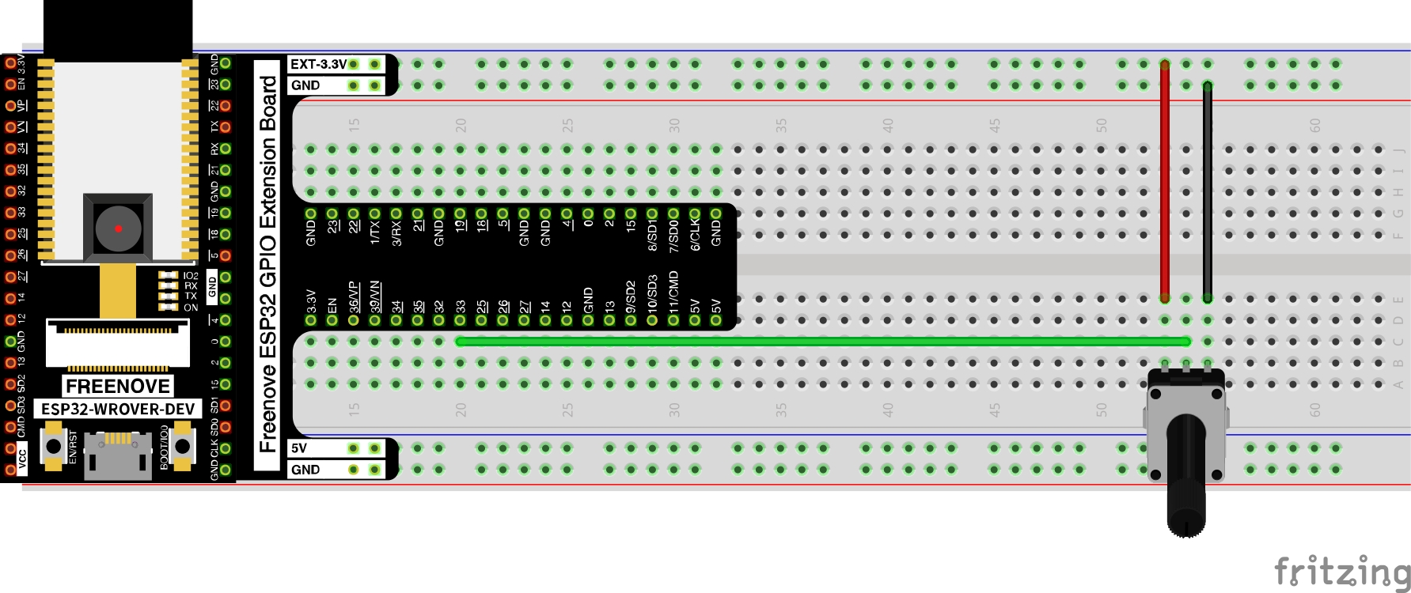
Potentiometer connected to 3.3V, middle pin to ESP32 pin 33

Slide 4
Data Flow

Slide 5
Data Flow from ESP32 to Flask Application
ESP32
HTTP GET Request (with sensor data)
Flask
http://10.13.135.141:5000/potentiometer/esp32/10.0
HTTP Response Header/Body (with processed data)
[Response data, date/time, server data, etc.]
Read Sensors
Activate Actuators
Visit URLs over Wi-Fi
Receive Data
Database Reading/Writing
Process and Return Data
Notes:
ESP32 “visits” a URL associated with a Flask application
The URL contains data; i.e., http://10.13.154.216:5000/inputdata/24.6
Flask receives the request (along with the data in the URL) and does some processing
Any calculations, advanced processing, etc. SHOULD BE DONE SERVER-SIDE (in Flask). The ESP32 is a relatively weak computer and can’t handle advanced operations. On the other hand, the “host” has more computational resources, so it can do things like AI/ML and other advanced calculations.
Flask sends a response back to the client (along with processed data)
For the ESP32, the response can be printed in the Serial Monitor
For a human using a computer, the response can be rendered with HTML on a web browser

Slide 6
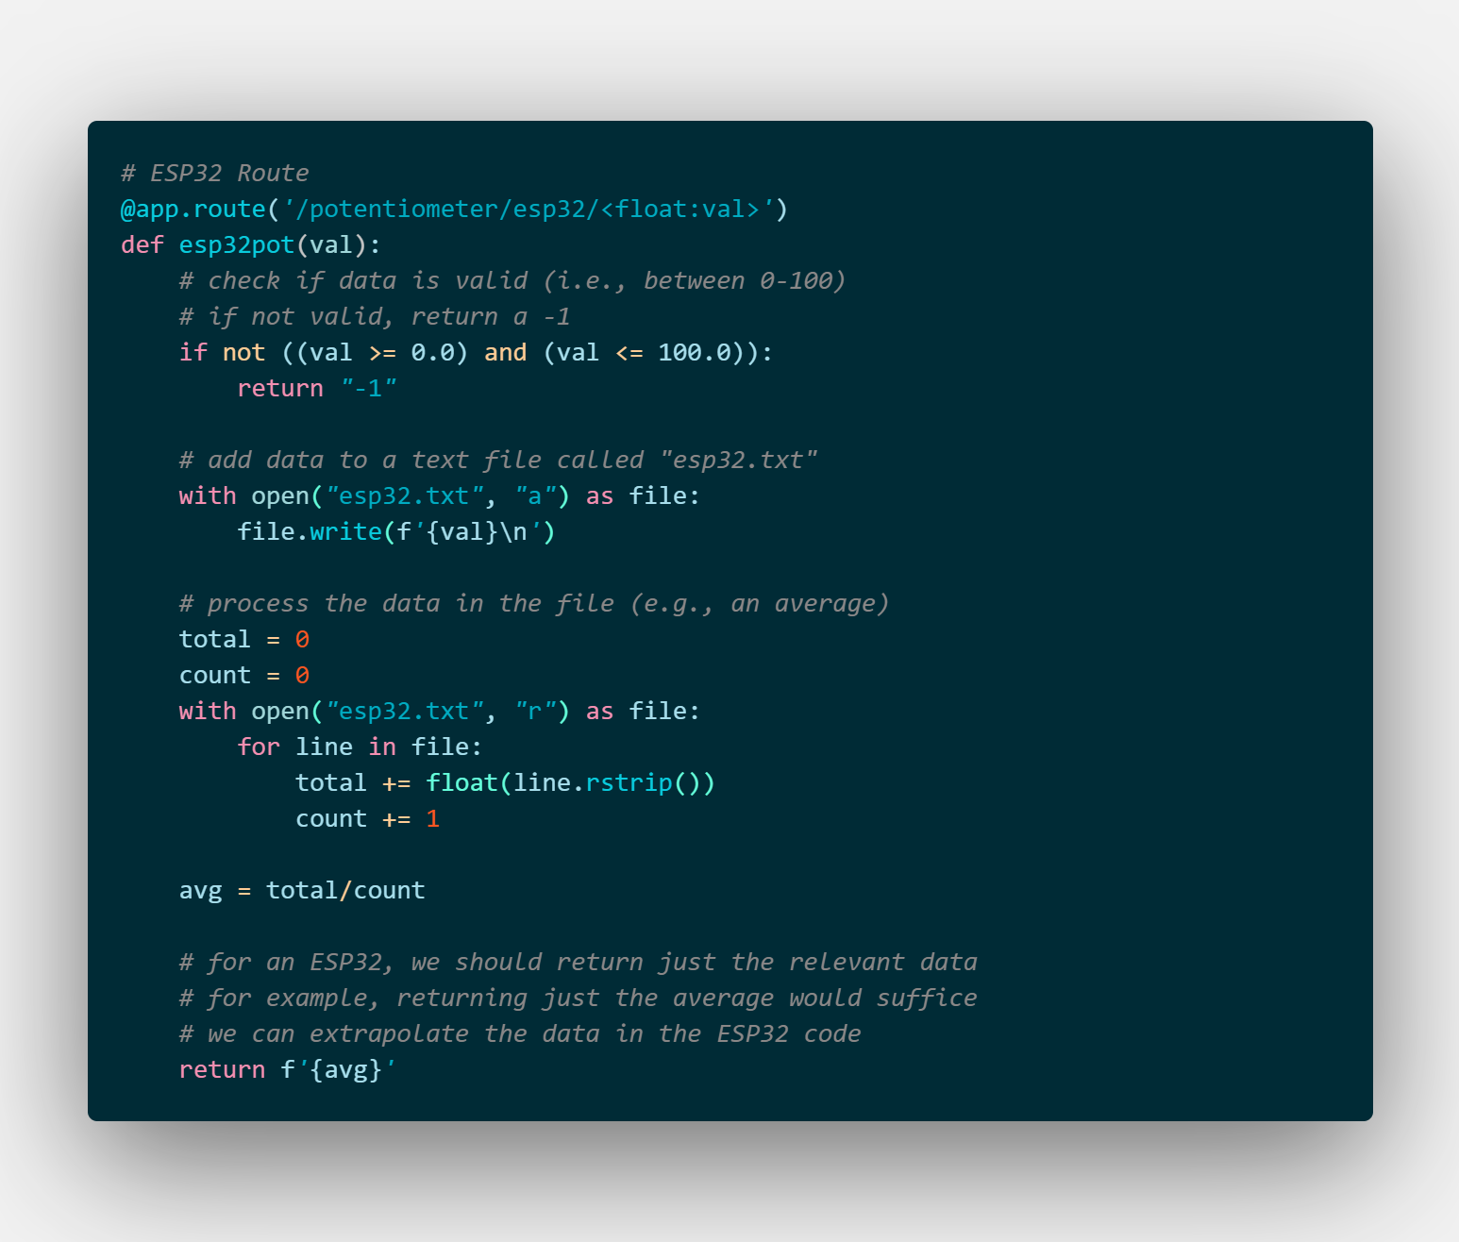
Receive Data from ESP32 through URL
Flask Stores Data in Persistent Storage
Flask Processes Data
Processed Data is Returned to ESP32

Slide 7
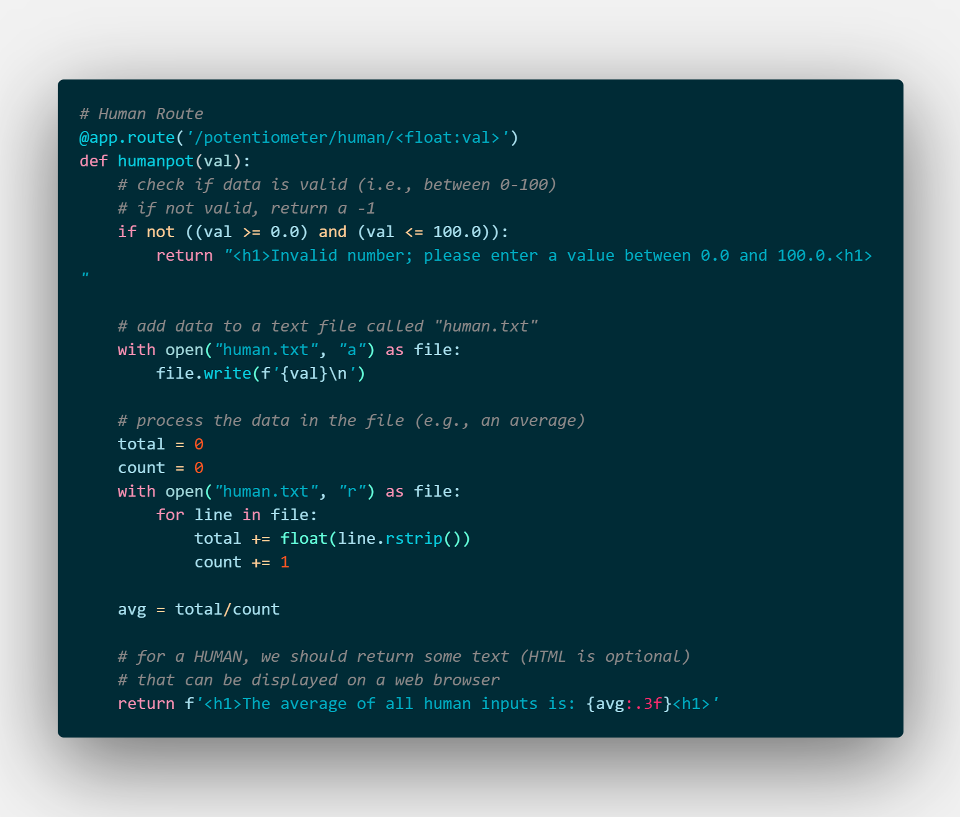
Flask Route Comparison
“Human” Route
“ESP32” Route

Slide 8
Flask Route Comparison
“Human” Route
“ESP32” Route

Slide 9
Demo #1: Pretend You’re the IoT Device
http://10.17.154.215:5000/potentiometer/human/<some_value>
Connect your phone/laptop to UPStudent (if it’s not already on it)
Replace <some_value> with a float between 0 and 100
Use a decimal point for integers (i.e., instead of 10, use 10.0)

Slide 10
Demo #2: IoT Applications
http://github.com/uyechi23/FlaskESP32ConceptDemo
Upload the .ino file to your ESP32
(ESP32 → esp32potdemo → esp32potdemo.ino)
Connect a potentiometer’s middle pin to 33 on your ESP32

