Slide 1
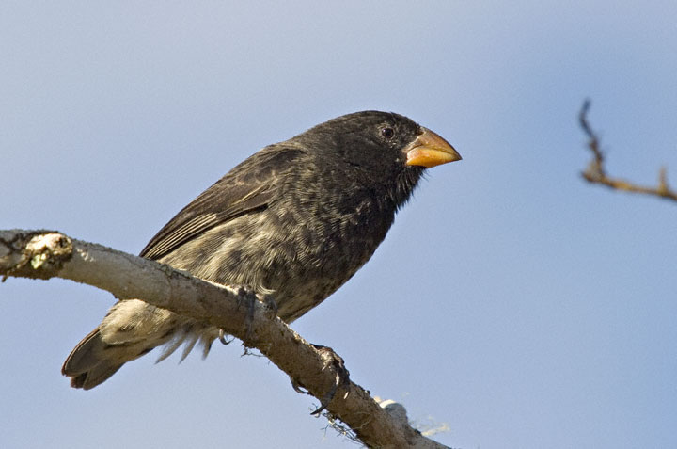

Microevolutionary patterns
We now know that we can study evolution in real time
Average weight
16.06 g
(1976)
17.13 g
(1978)
Response to selection
6.7% ∆ body size in
1 generation (2 years)
Let’s assume only 1% is evolutionary
(Grant and Grant, 2002)

Slide 3
Let’s do the calculations:
If a population increased by 1% every generation starting from ~16 g:
In 200 years
43 g
In 500 years
193 g
In 1,000 years
2.3 kg
In 2,000 years
335 kg
In 10,000 years
6.47 x 10¹⁹ kg

Slide 4
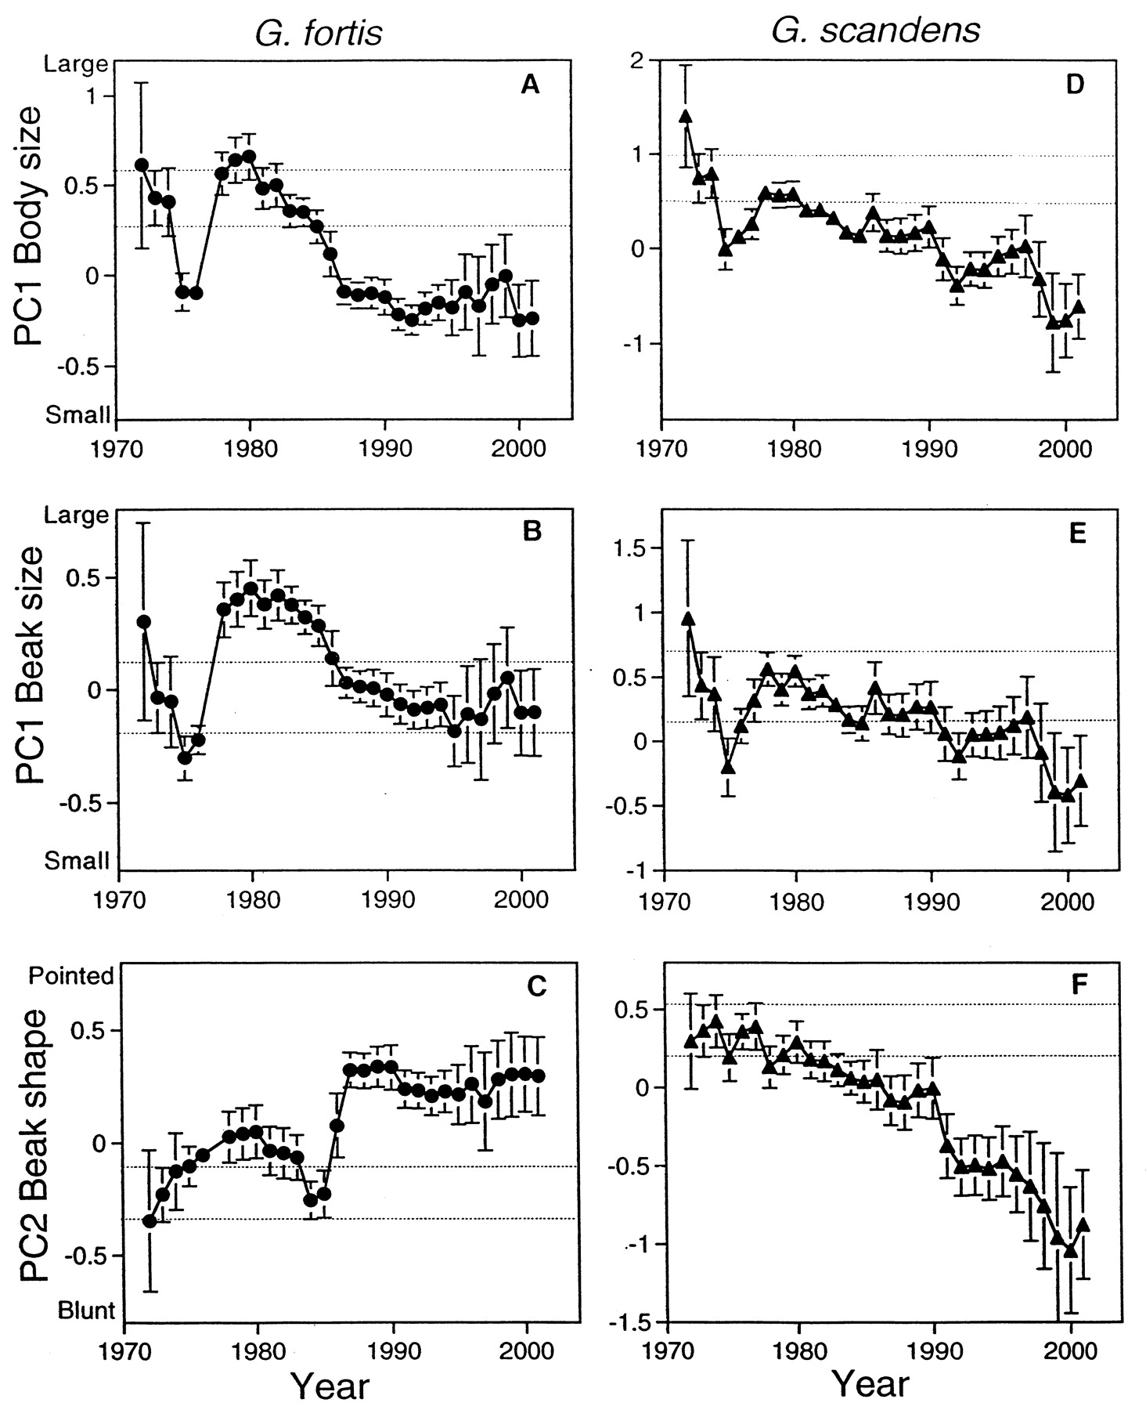
But evolution often reverses itself!
Let’s instead simulate going up or down randomly
(Brownian motion)
(Grant and Grant, 2002)

Slide 5
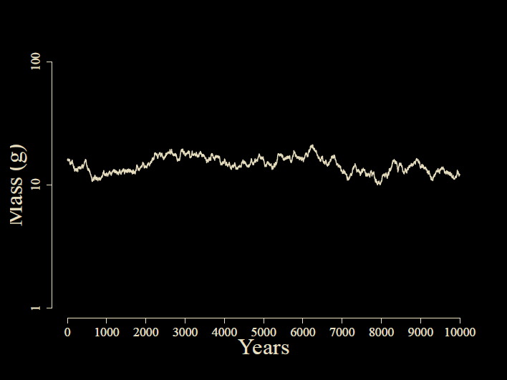
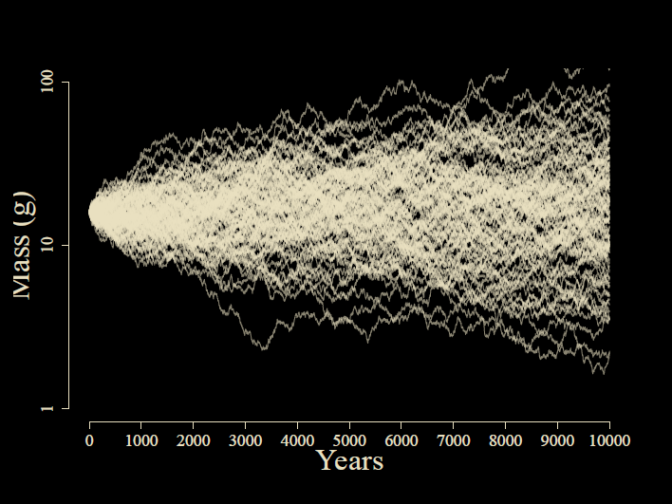
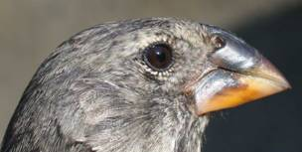

Slide 6
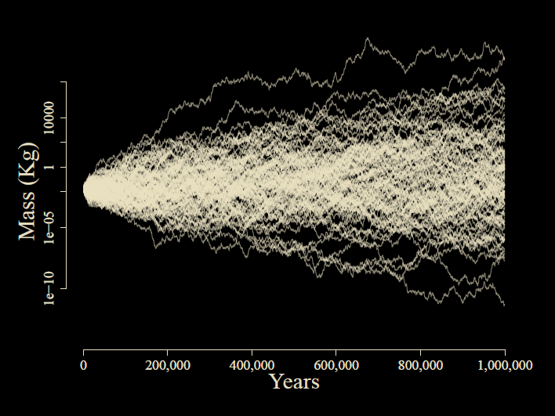

Slide 7

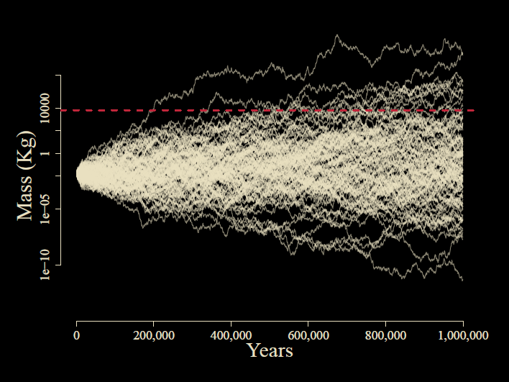

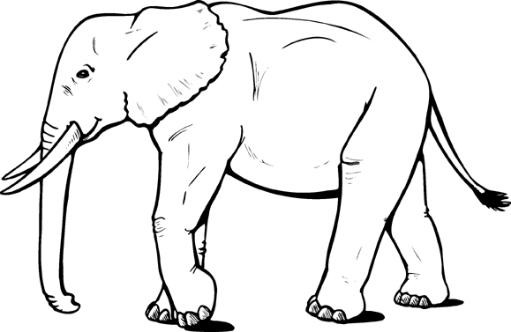
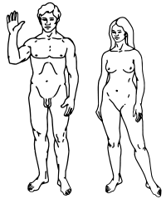
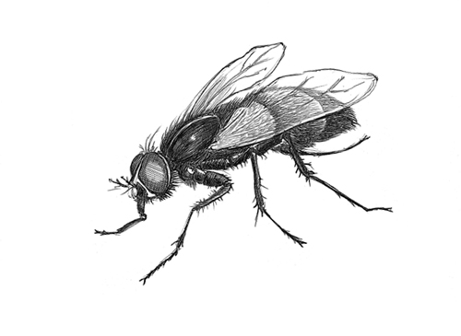

Slide 8
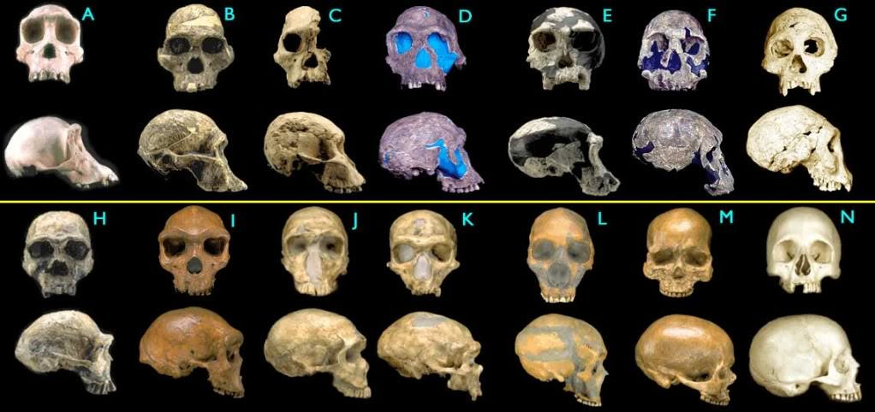
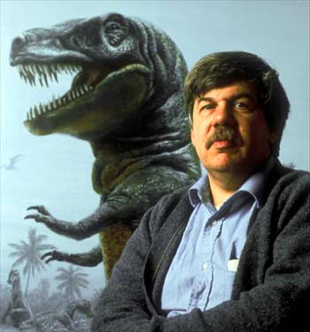
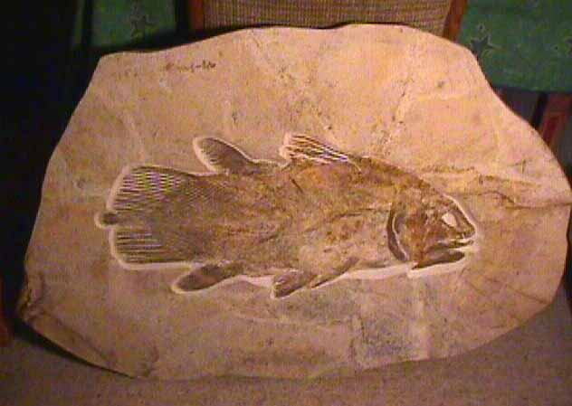
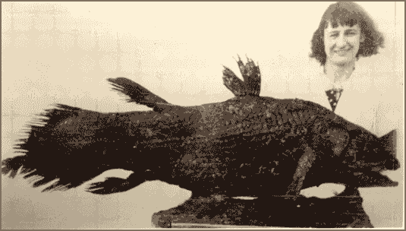
What does the fossil record say?
The pattern is stasis
Stephen Jay Gould

Slide 9
The Paradox of Stasis (Hansen & Houle 2004): Organisms seem to be able to evolve far more than they ever do
Empirical studies often find:
Strong (and often persistent) directional selection
(Hereford et al. 2004, Morrissey & Hadfield 2012)
High levels of additive genetic variance
(Mousseau & Roff 1987, Houle 1992)
Rapid evolutionary rates
(Hendry & Kinnison 1999, Kinnison & Hendry 2002)
…yet stasis in the fossil record
(Gingerich 1983, 2002)
Notes:
Perhaps headlines from Kingsolver’s paper?

Slide 10
Does microevolution even matter for long-term change?

Slide 11
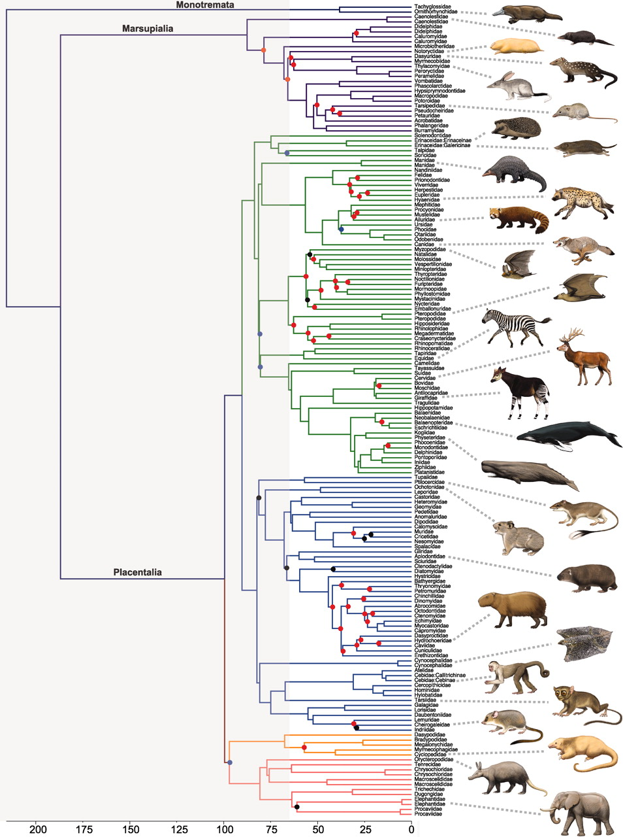
So what do comparative biologists use to model evolution on a phylogeny?
Patterns in phylogenetic comparative data
Gradual Brownian motion!
Notes:
Scaling across the tree of life however, reveals a dramatic phenotypic diversity, and we find that evolution behaves not too differently than Brownian motion.

Slide 12
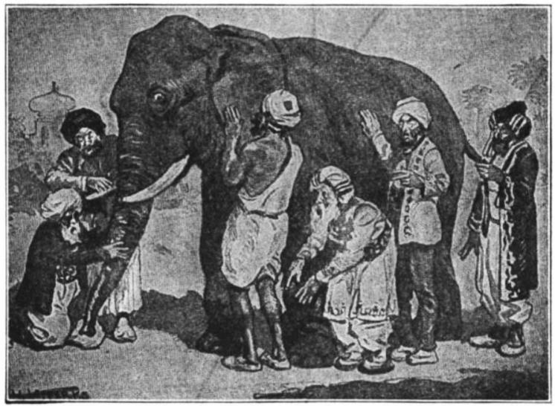
The Elephant in the Dark
Each of us touches one place
And understands the whole in that way.
…
If each of us held a candle there,
And if we went in together,
We could see it.
Notes:
Many of you are probably familiar with the Indian story of the Blind men and the Elephant, or in other versions, the Elephant in the Dark. The story comes in many versions, but the common theme is that a group of men disagrees about the nature of an elephant because they are unable to perceive beyond a small portion of its body. If you will indulge me, I’d like to read a portion of one of my favorite versions of this story, but the Persian Poet Rumi.

Slide 13
How can we see the pattern across scales of time?
All studies of phenotypic evolution measure comparable quantities
Time interval
Time interval
Pop A
mean(z)
Pop B
mean(z)
Pop A
mean(z)
Pop B
mean(z)
Pop X
We measure two quantities:
(1) “time for evolution”
(2) Δ mean body size
Notes:
Luckily, regardless if you are a paleontologist, a field biologist or a comparative biologist, you basically study the same thing. We have two populations, separated by time, and we measure a change in mean.

Slide 14
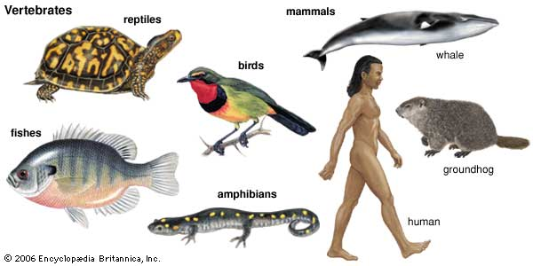
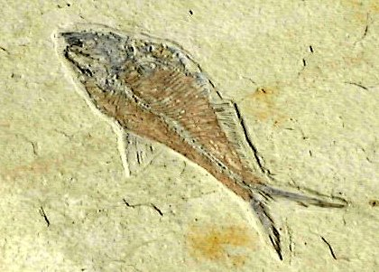
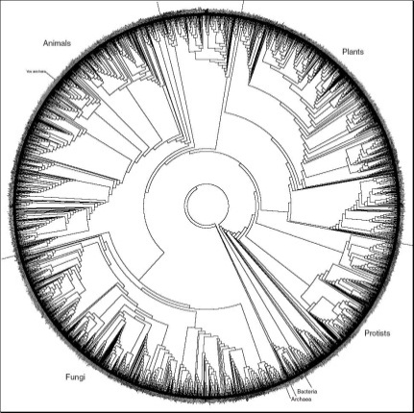
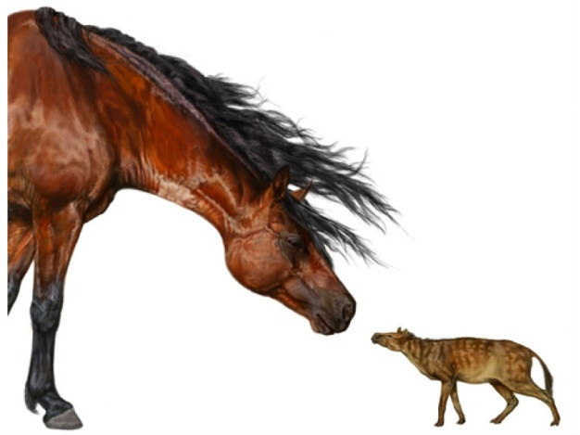
Phenotypic divergence database (Uyeda, Hansen, Arnold & Pienaar, 2011. PNAS.)
Only animals, mostly vertebrates, but also some inverts
Field, Fossil and Phylogenetic comparative data
Only traits related to linear body size change

Slide 15
>8000 data points from
> 150 studies
Intervals from < 1 yr to 360 my

Slide 16
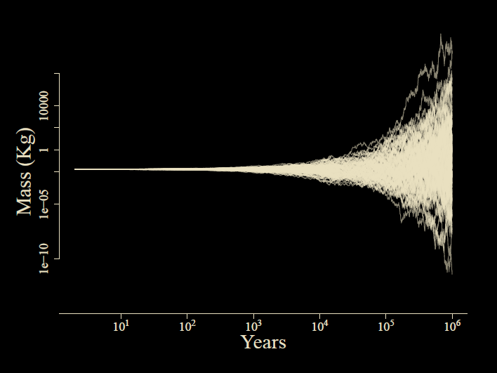

Slide 17
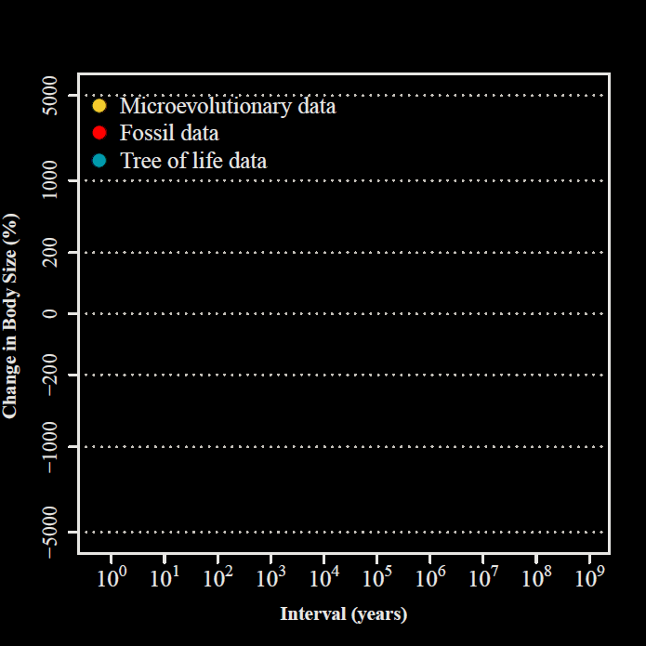
Uyeda et al.,
PNAS, 2011

Slide 18
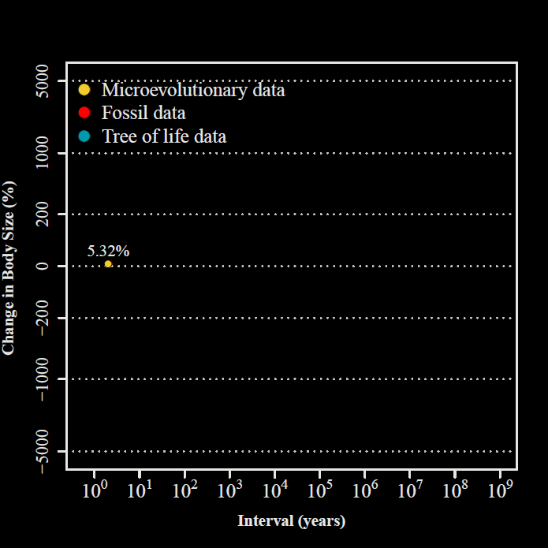
2 years
Uyeda et al.,
PNAS, 2011

Slide 19
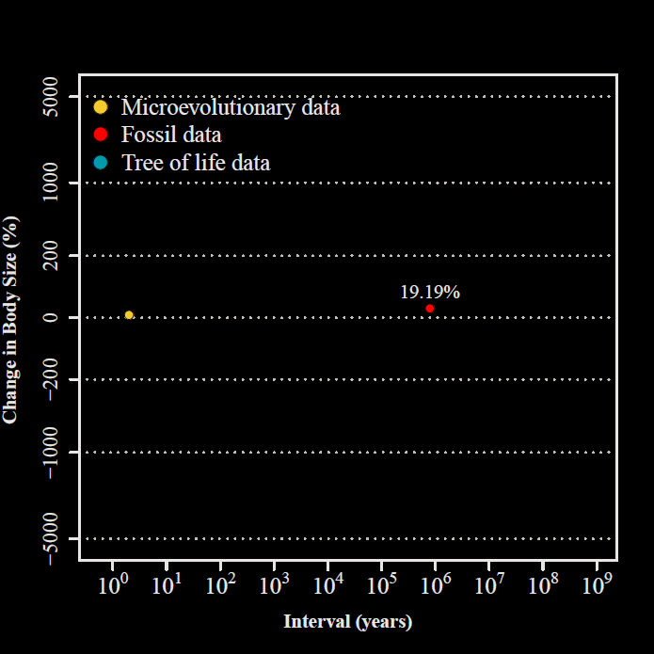
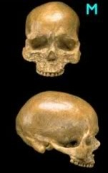
800,000 years
Uyeda et al.,
PNAS, 2011

Slide 20
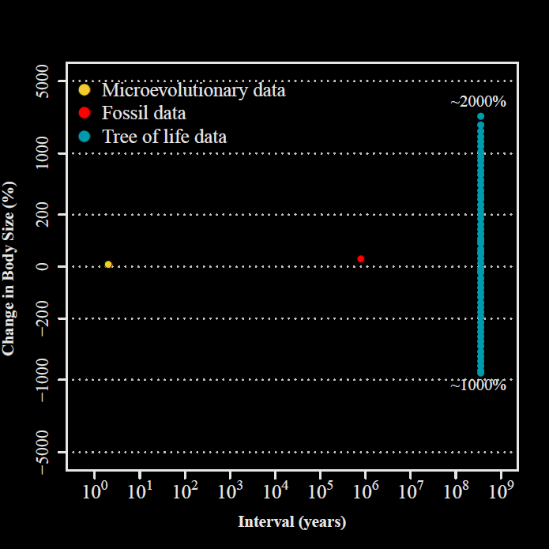
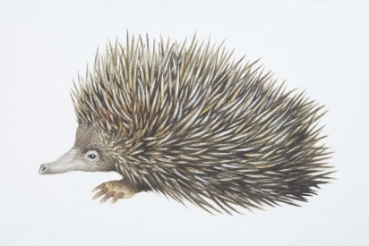
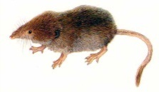
332.4 my

Slide 21
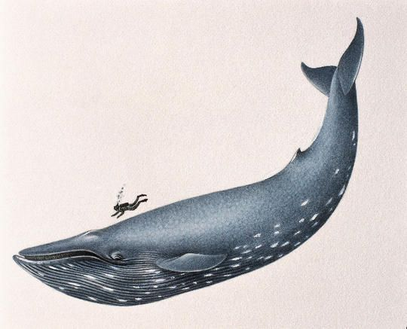
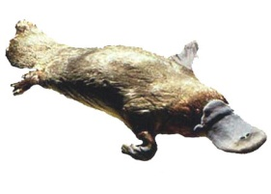
332.4 my
Uyeda et al.,
PNAS, 2011

Slide 22
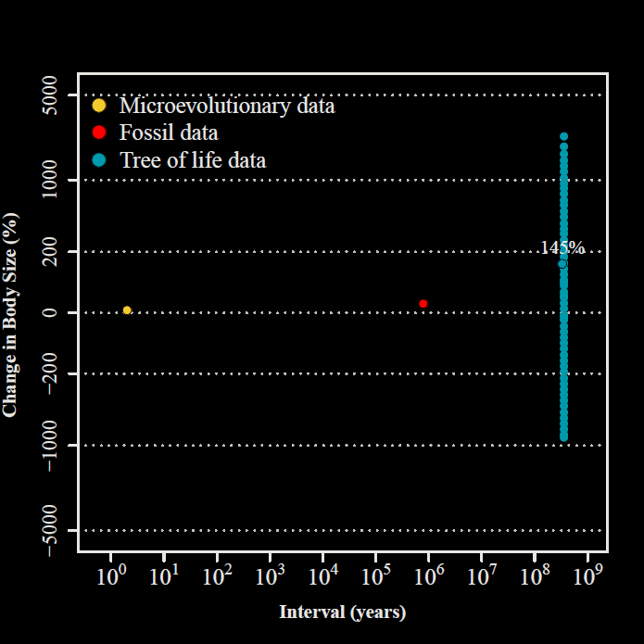
Uyeda et al.,
PNAS, 2011

Slide 23
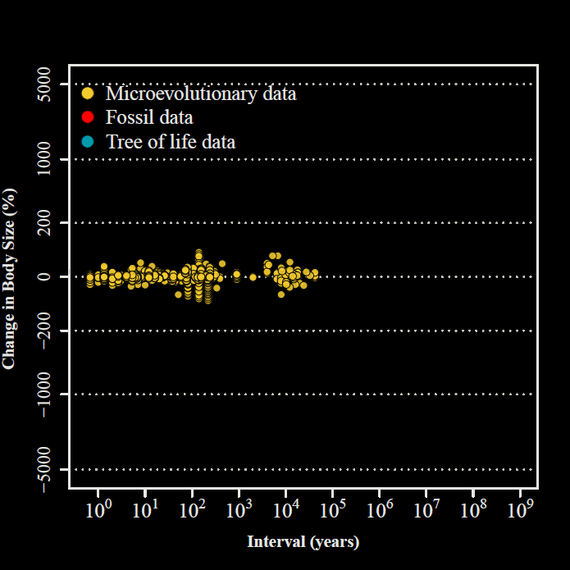
Uyeda et al.,
PNAS, 2011

Slide 24
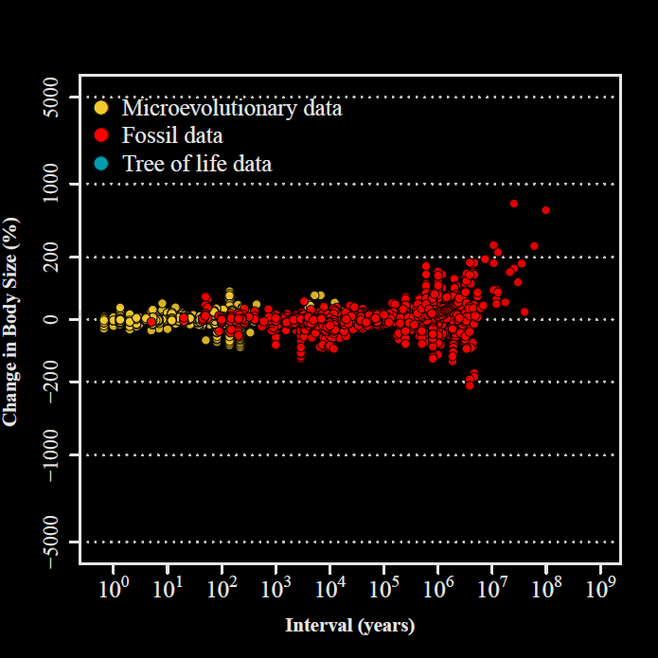
Uyeda et al.,
PNAS, 2011

Slide 25
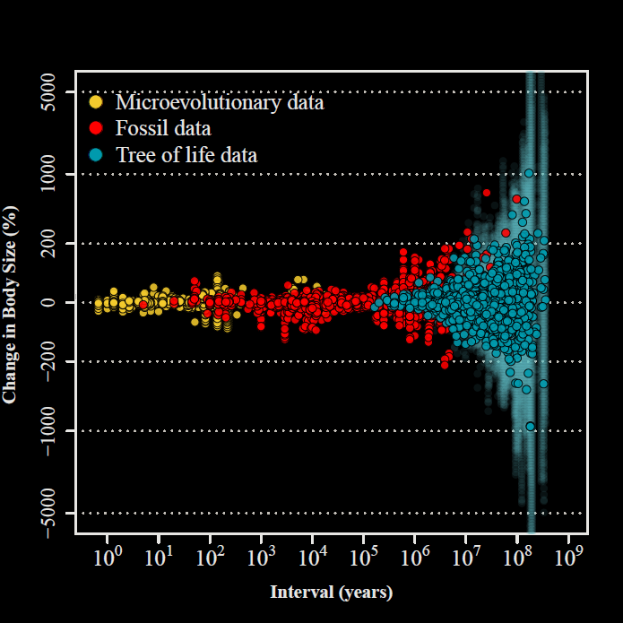

“The Evolutionary Blunderbuss”
Uyeda et al.,
PNAS, 2011

Slide 26
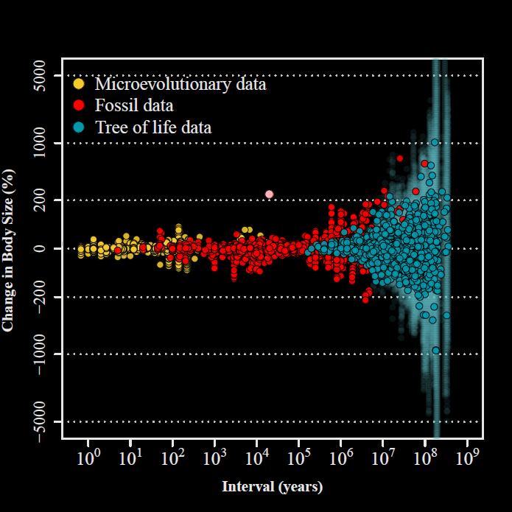
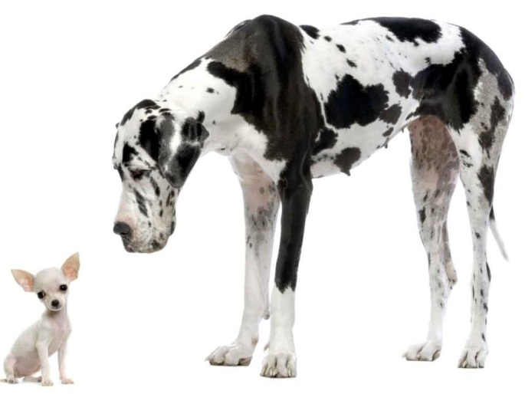
Uyeda et al.,
PNAS, 2011

