Slide 1
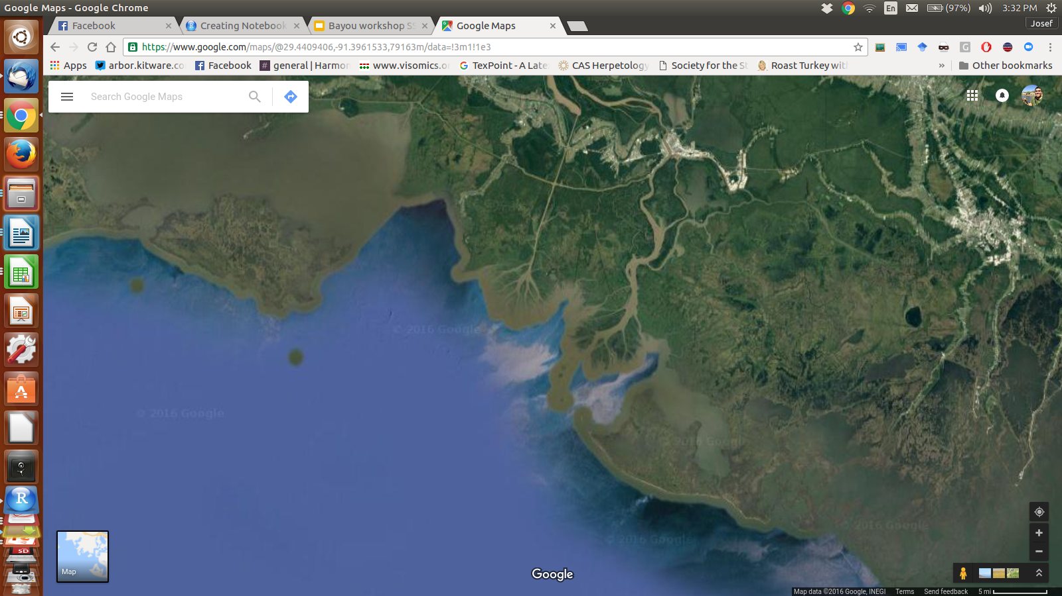

workshop
SSB 2017
Josef C Uyeda
josef.uyeda@gmail.com

Slide 2
What do we want to know?
The dynamics of adaptive trait evolution over macroevolutionary time and how these dynamics are influenced by selective factors

Slide 3
What processes affect quantitative trait evolution?
Natural selection
Genetic drift
Mutation
et al.

Slide 4
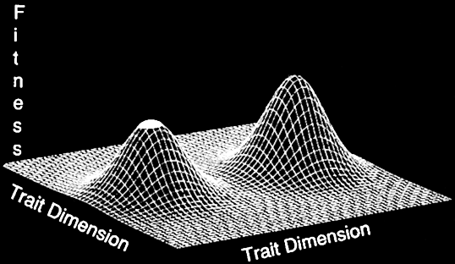
Adaptive Landscapes

Slide 5
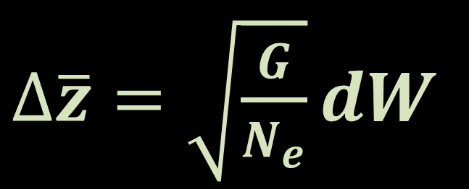
Quantitative Genetics
(Lande 1976)
Genetic Drift
$∆\overline{z}=\sqrt{\frac{G}{N_{e}}}dW$
= Brownian Motion

Slide 6
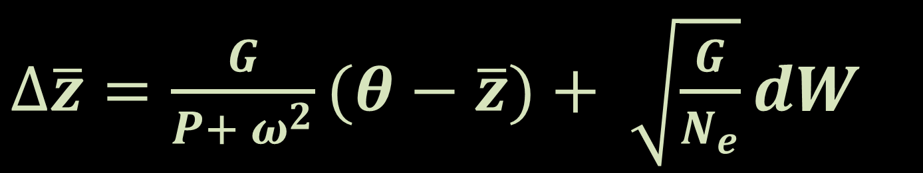
Quantitative Genetics
(Lande 1976)
Genetic Drift + Natural Selection
$∆\overline{z}=\frac{G}{P+ ω^{2}}(θ−\overline{z})+ \sqrt{\frac{G}{N_{e}}}dW$
= Ornstein-Uhlenbeck

Slide 7
But…
Brownian Motion ≠ Genetic Drift
Ornstein-Uhlenbeck kind of means selection…

Slide 8
Quantitative Genetics
(Lande 1976)
Genetic Drift + Natural Selection
$∆\overline{z}=\frac{G}{P+ ω^{2}}(θ−\overline{z})+ \sqrt{\frac{G}{N_{e}}}dW$
= Ornstein-Uhlenbeck

Slide 9

Ornstein-Uhlenbeck
Adaptation + Random Evolution
$∆\overline{z}=α(θ−\overline{z})+σdW$

Slide 10
Hansen 1997
“Imagine we start with an infinite number of populations …and allow them to evolve independently but with [a] selective factor in a fixed state…the average adaptive optimum eventually reached by these populations is a hypothetical entity different from the actual optimum realized in specific populations, but it is a better measure of adaptation, because it reflects the influence of a selective factor against a maximally randomized background.”

Slide 11
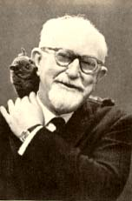
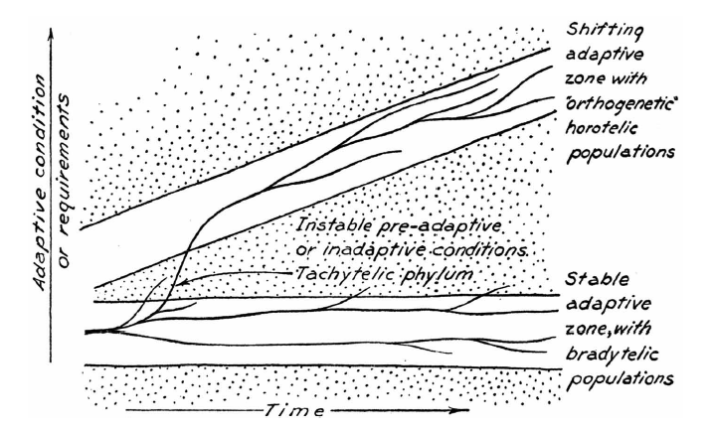
Simpson’s Adaptive Zones

Slide 12
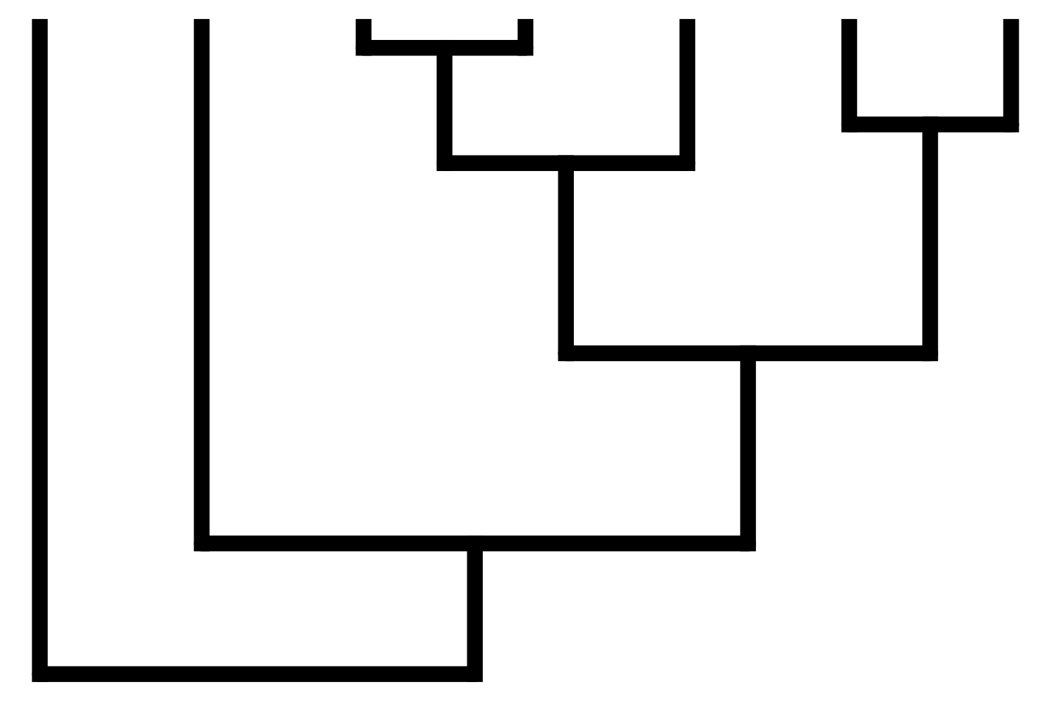
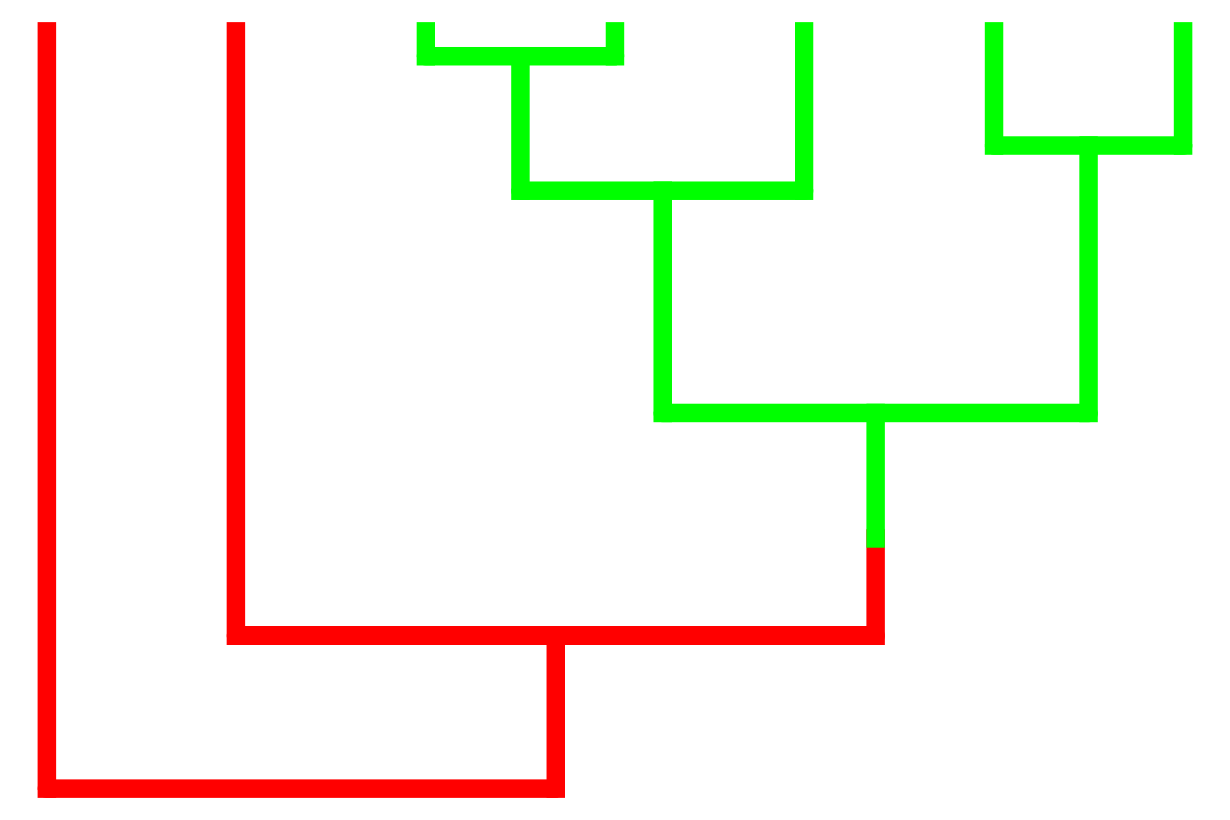
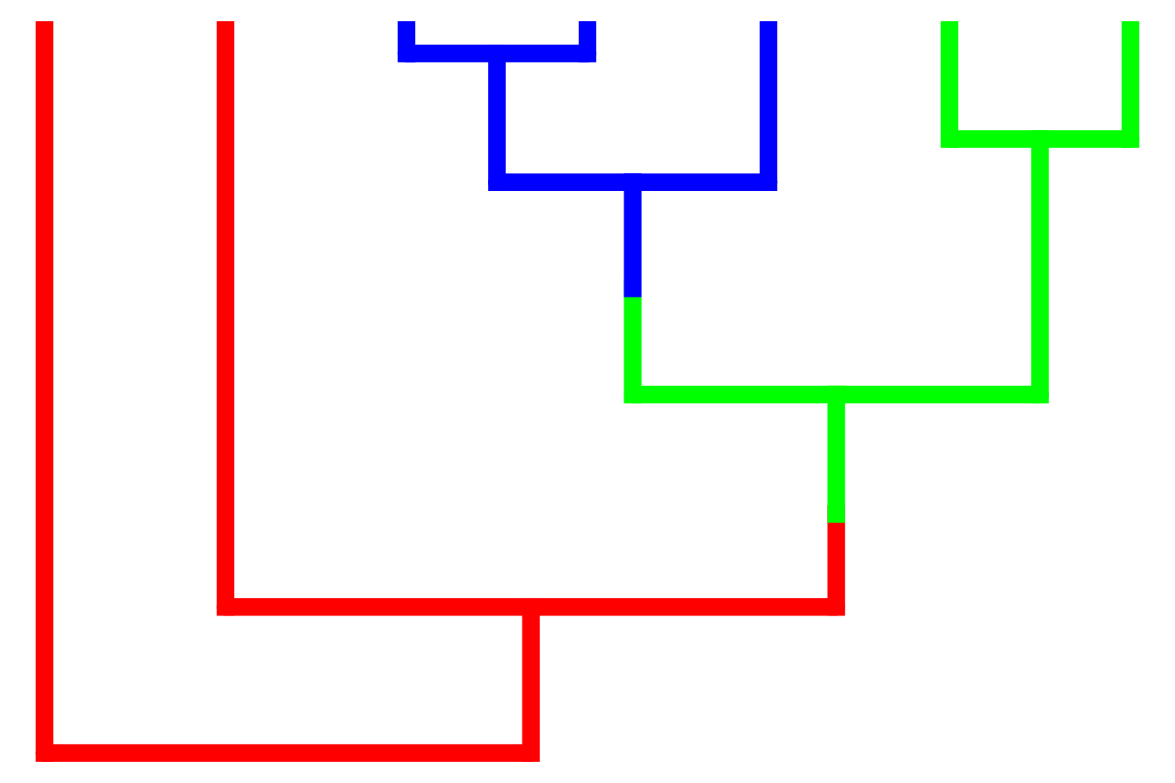







Slide 13
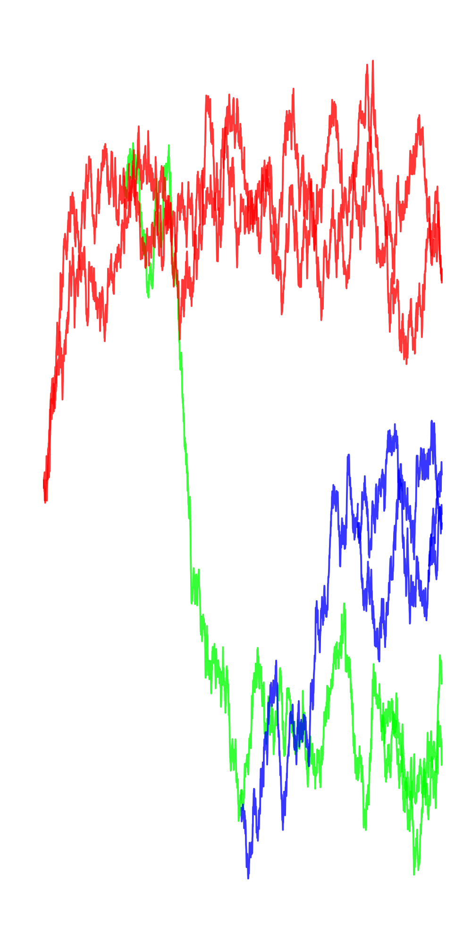
θ₁
θ₂
θ₃
σ²
α
ln2/α = Phylogenetic Half-Life
Ornstein-Uhlenbeck
(Hansen 1997, Butler & King 2004)

Slide 14
Implementations
Multi-optima OU models (R packages)
ouch (Butler and King )
OUwie (Beaulieu)
SLOUCH (Hansen, Pienaar & Orzack)
mvSLOUCH (Bartoszek)
mvMORPH (Clavel)
surface (Ingram)
l1ou (Khabbazian, Ane and Yu)
bayou (Uyeda)

Slide 15
Implementations
OUM (ML)
ouch
Ouwie
+ α/σ shifts
OUwie
+ evolving predictors
SLOUCH
mvSLOUCH
mvOUM
ouch
mvMORPH
mvSLOUCH

Slide 16
Compare models
(e.g. by AIC)
Best Model
(Hansen 1997, Butler & King 2004)

Slide 17
But…
Best model may still be bad
Notes:
This model has some issues when it comes to statistical estimation of parameters (likelihood ridges of correlated parameters).
However, only small areas on that ridge may be biologically realistic or feasible. Ignored by current methods.

Slide 19
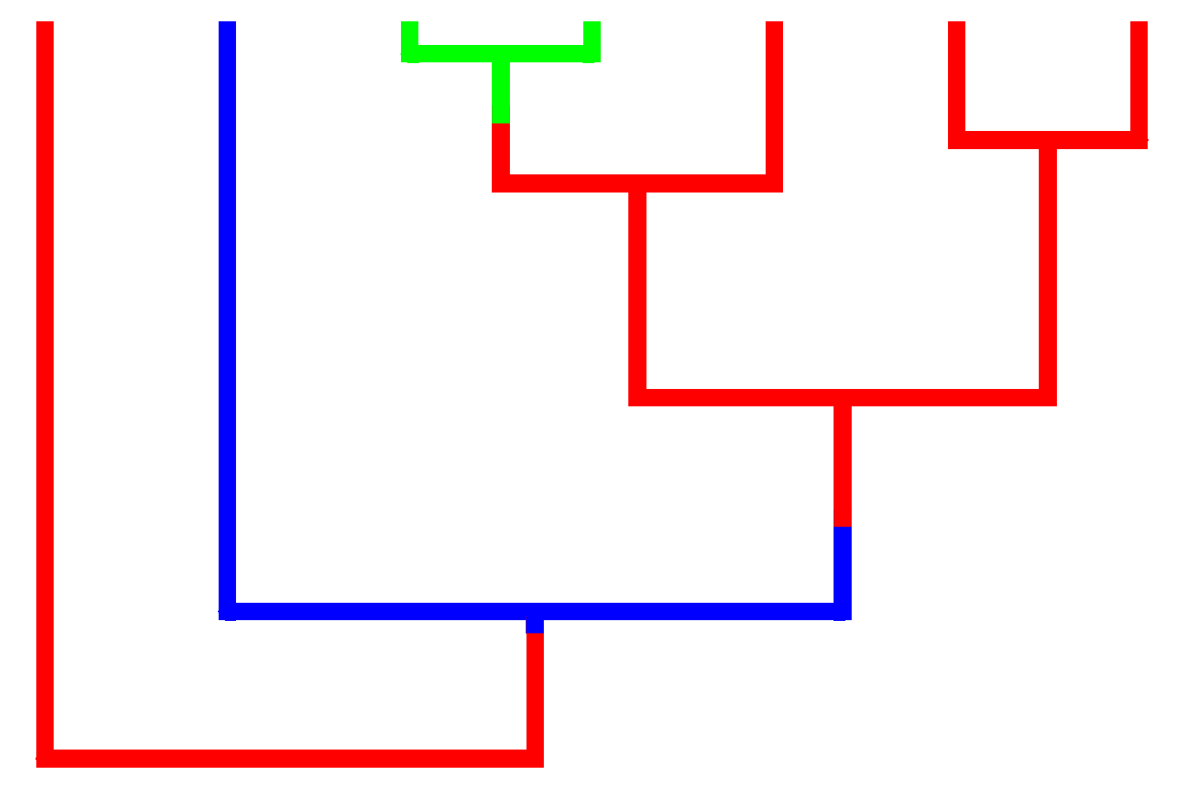
Uyeda & Harmon 2014

Slide 20
Implementations
OUM (ML)
ouch
Ouwie
+ shift detection
l1ou (ML + lasso)
surface (stepwise AIC)
bayou (rjMCMC)
+ α/σ shifts
OUwie
+ evolving predictors
SLOUCH
mvSLOUCH
mvOUM
ouch
mvMORPH
mvSLOUCH

Slide 21
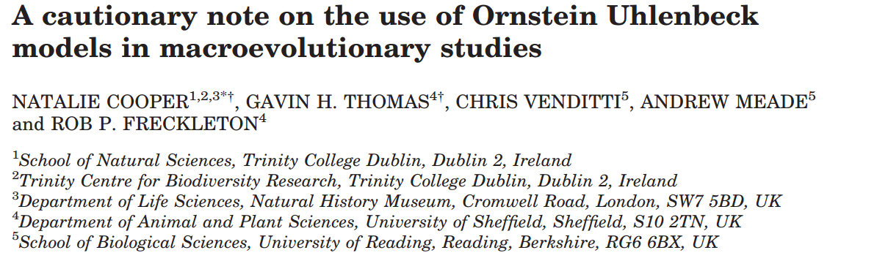
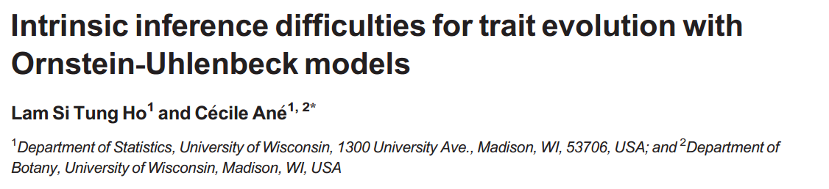
Notes:
But recently, there have been many papers questioning the inferences that are made with comparative approaches; perhaps best encapsulated by an entire symposium at a recent evolution conference on the “dark side of comparative methods”.

Slide 22
But…
Best model may still be bad
Biological meaning lost when applied to comparative data
Notes:
This model has some issues when it comes to statistical estimation of parameters (likelihood ridges of correlated parameters).
However, only small areas on that ridge may be biologically realistic or feasible. Ignored by current methods.

Slide 23
Bayesian Reversible-Jump Markov Chain Monte Carlo
Prior on parameters (like normal MCMC)
Prior on number and location of regimes
Special “birth-death proposals” that move between models of different dimensions

Slide 24
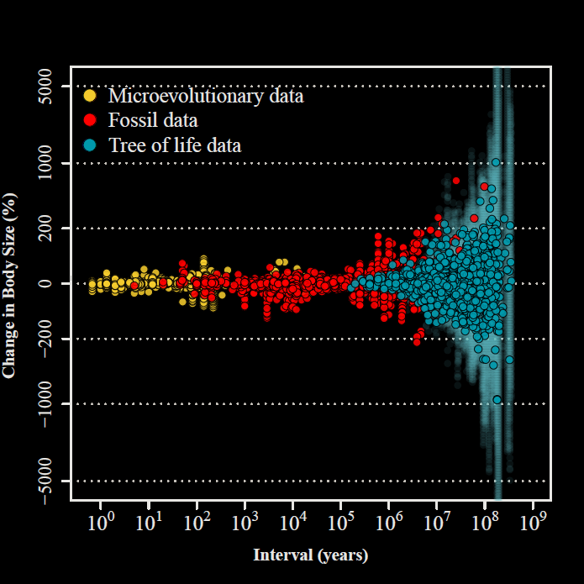
Bayesian - biological priors
“Blunderbuss” Parameterization
σ²/(2α)
ln2/α

Slide 25
Uyeda & Harmon 2014
Bayesian - biological priors
Quantitative Genetics Parameterization
(Lande 1976)
Stabilizing Selection
α = h²V_{P}/(V_{P}+ω²)
Genetic Drift
σ² = h²V_{P}/N_{e}

Slide 26
Bayesian - biological priors
The strength of OU models is that they represent a realistic process model for how adaptation changes traits over time.
Even weakly informative priors (e.g. believable limits to trait values) can make models “better behaved” & more interpretable.

