Slide 1
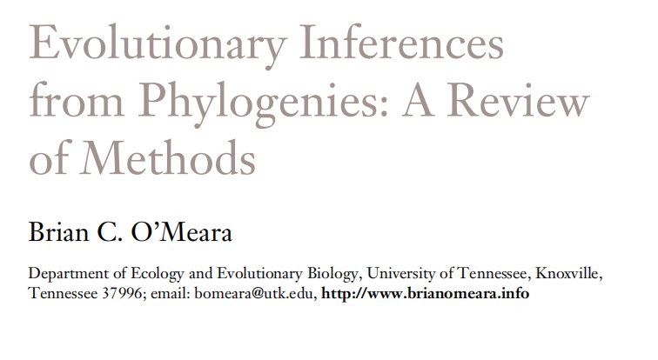
Today's reading due

Slide 2
Jukes-Cantor Model (JC69)
Q matrix (instantaneous rates)
A C G T
A -3β β β β
C β -3β β β
G β β -3β β
T β β β -3β
Q =

Slide 3
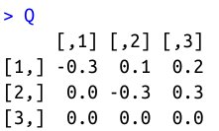
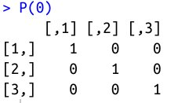
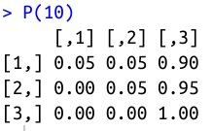
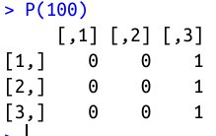
Transition probabilities
P = e^{Qt}
Matrix exponentiation

Slide 4
JC69 is our most basic model. We will be able to do amazing things with generalizations of this one model!
A C G T
A - β β β
C β - β β
G β β - β
T β β β -
Q =

Slide 5
Back to biology - Are JC69's assumptions realistic?
Assumptions of JC69:
1. All substitutions equally likely
2. Base frequencies equal
3. Every site has equal probability of substitution
4. Process is constant through time
5. Sites are independent of each other
6. Substitution is Markovian (memoryless)
7. All sites have the same evolutionary history
8. Time-reversible
Can we relax any of these assumptions?

Slide 6
Back to biology - Are JC69's assumptions realistic? Modifying Q
Assumptions of JC69:
1. All substitutions equally likely
2. Base frequencies equal
3. Every site has equal probability of substitution
4. Process is constant through time
5. Sites are independent of each other
6. Substitution is Markovian (memoryless)
7. All sites have the same evolutionary history
8. Time-reversible
Can we relax any of these assumptions?

Slide 7
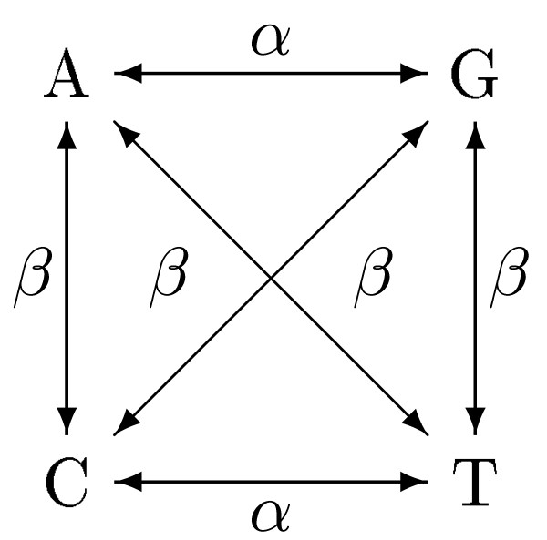
Kimura 2 Parameter model: K2P
A C G T
A - β α β
C β - β α
G α β - β
T β α β -
Q =

Slide 8
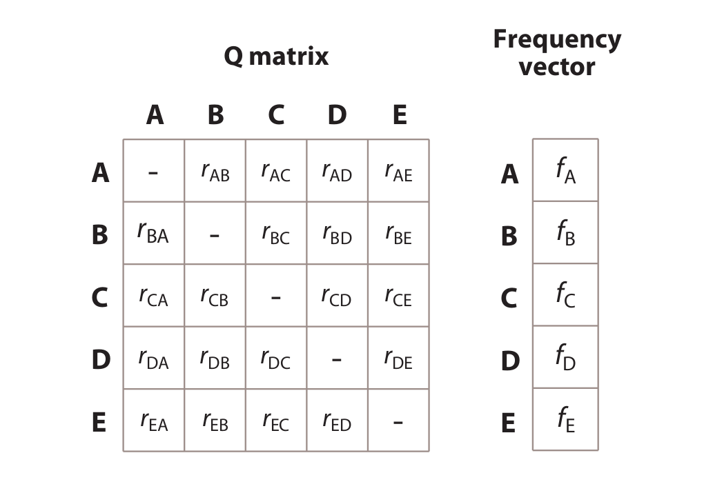
Our general CTMC model:

Slide 9
Differences between statistical phylogenetics and parsimony
Branch lengths in expected # of changes vs. minimum # of changes
Probabilistically incorporate all possible paths, not just the shortest path
Flexibility to modify and compare models
Can easily convert branch lengths to time (w/fossils or other constraints)
All data informative, not just parsimony-informative sites

Slide 10
Representing hypotheses & processes with transition matrices
(Important skill!!)

Slide 11
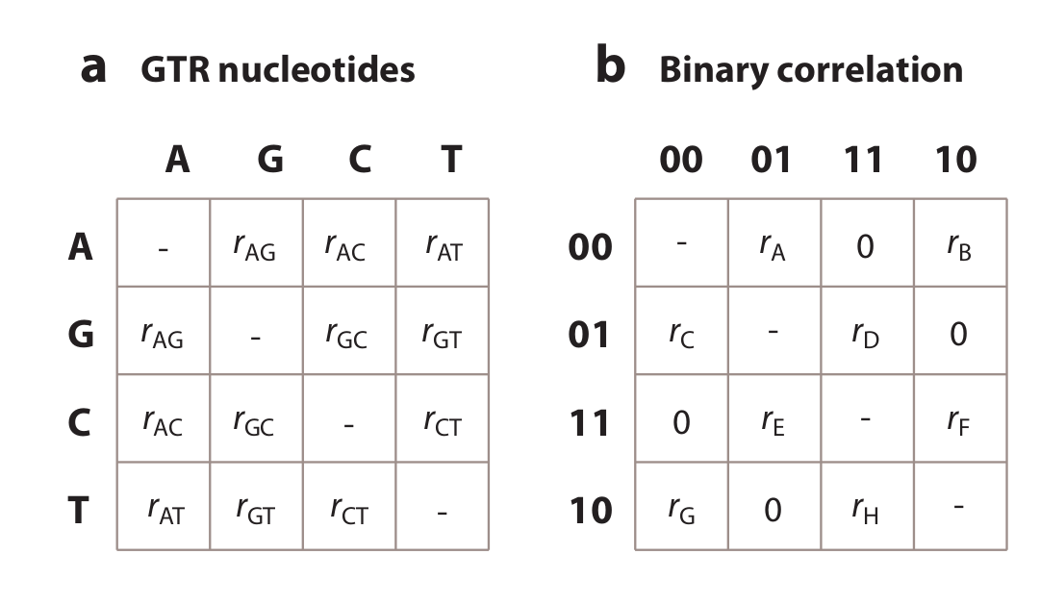
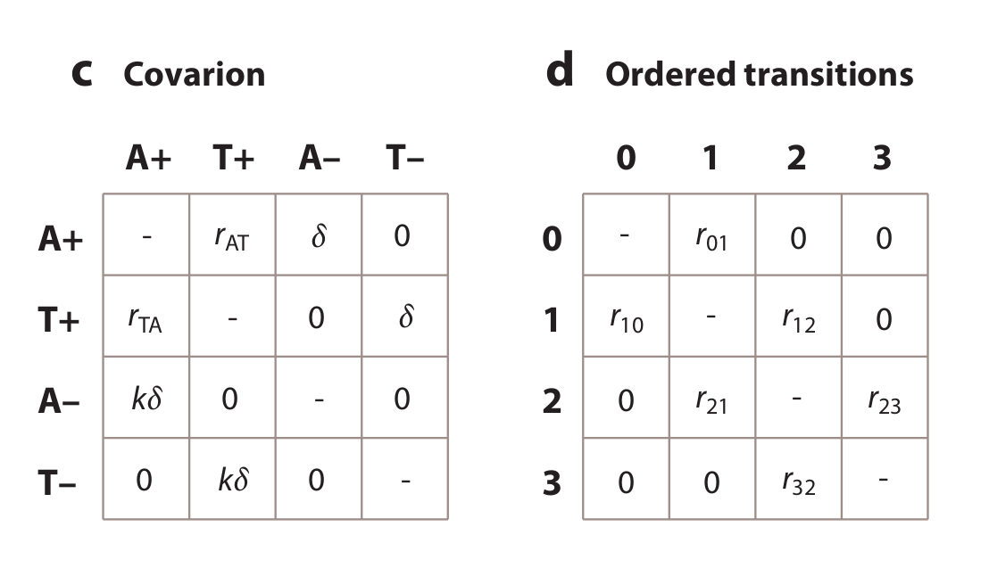
Interpreting Q matrices
A. B.
How many parameters for each?
What do the models suggest about evolution?
C. D.

Slide 12
Modifying assumptions 3 & 4
Assumptions of JC69:
1. All substitutions equally likely
2. Base frequencies equal
3. Every site has equal probability of substitution
4. Process is constant through time
5. Sites are independent of each other
6. Substitution is Markovian (memoryless)
7. All sites have the same evolutionary history
8. Time-reversible
Can we relax any of these assumptions?

Slide 13
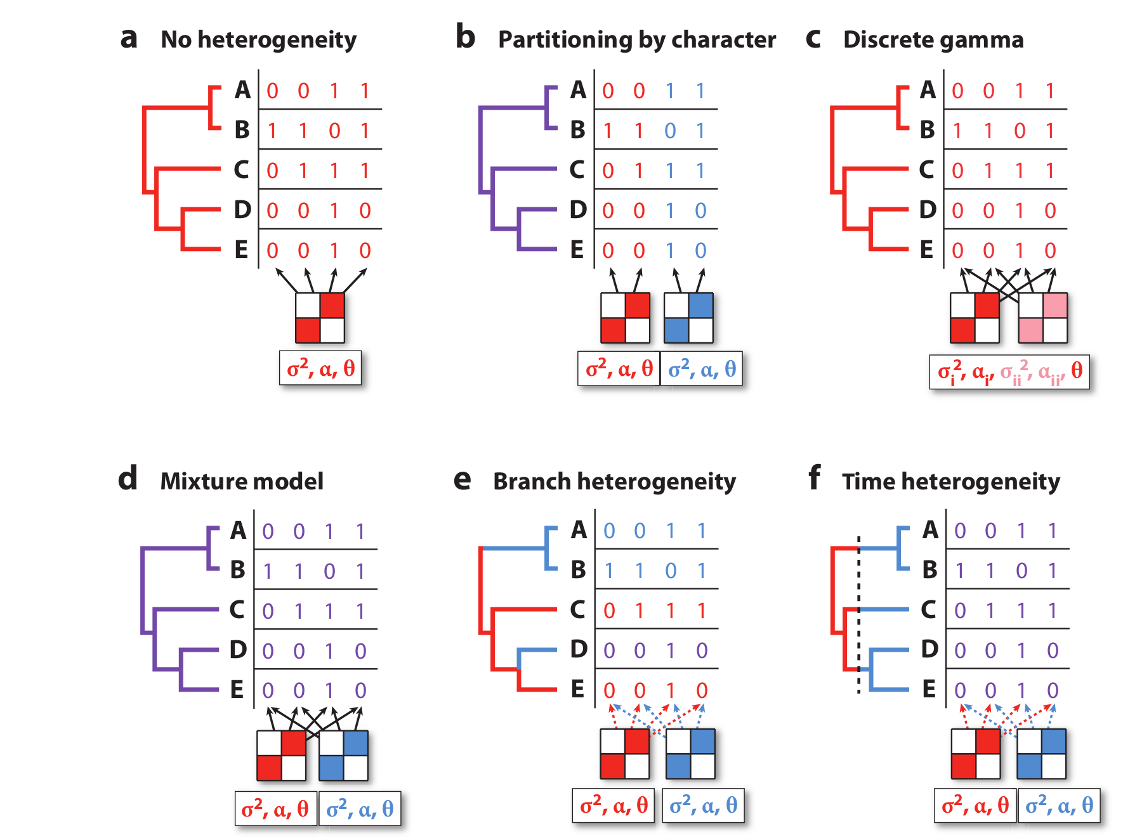
Dealing with among-site and time-heterogeneity

Slide 14

Let's practice reading methods

Slide 15
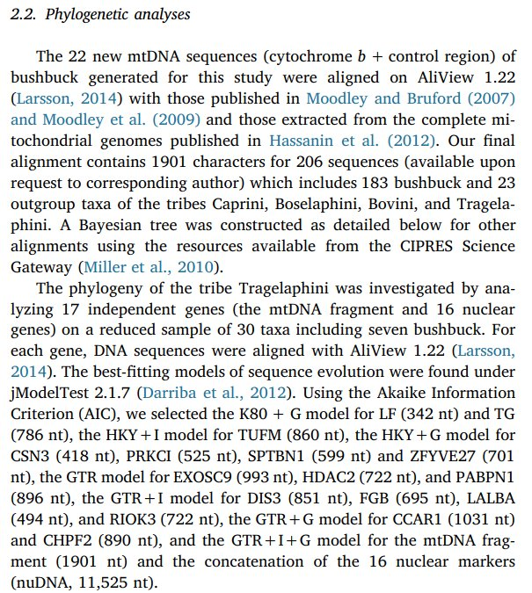
Methods interpretation

Slide 16
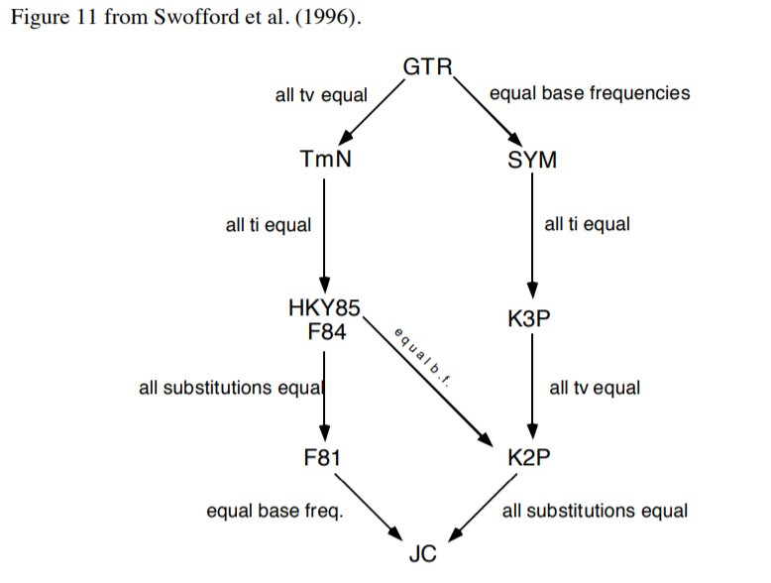
Relationships among models

Slide 17
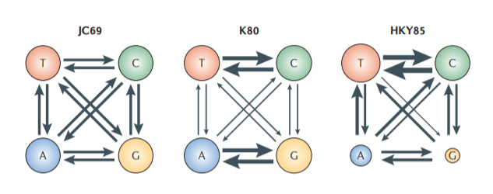
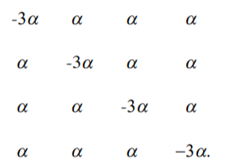
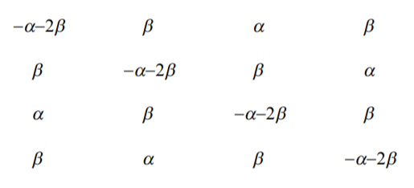
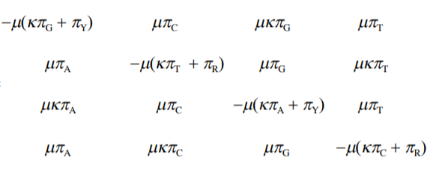
Adding process complexity

Slide 18
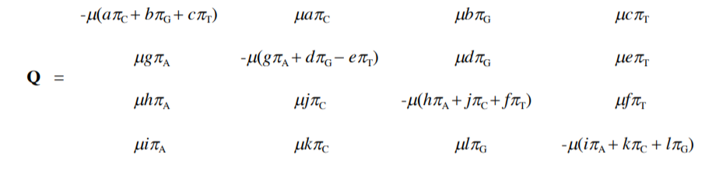
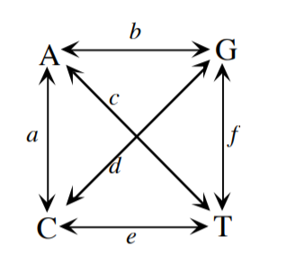
General Time-Reversible Model

Slide 19
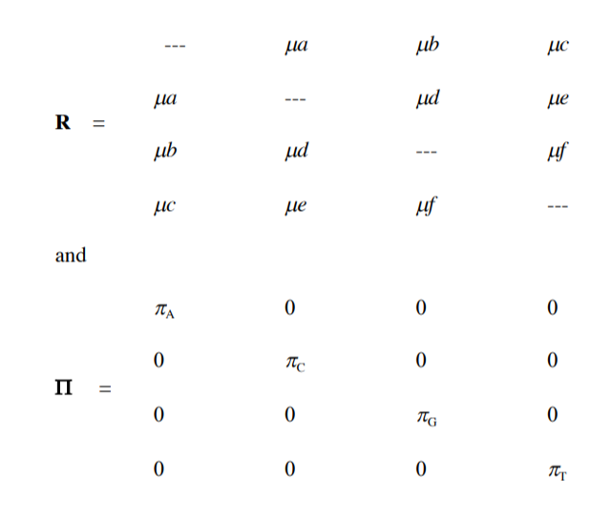
General Time-Reversible Model Decomposed

Slide 20
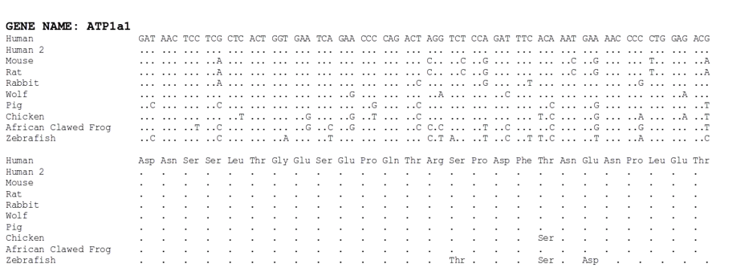
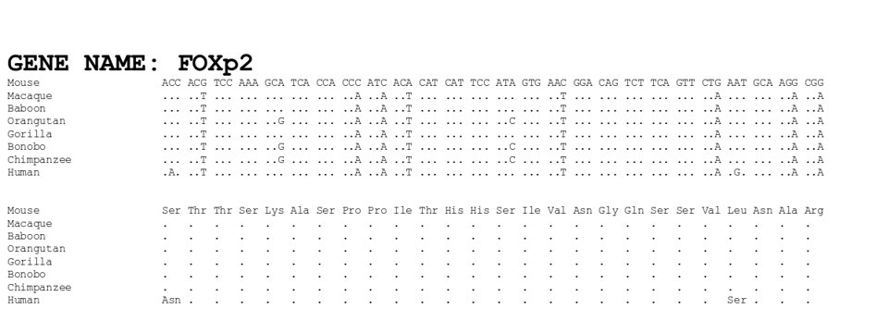
Among-site rate variation

Slide 21
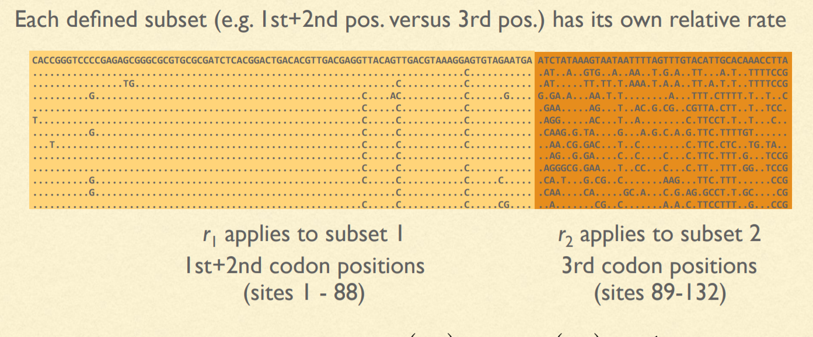
Site-specific rates

Slide 22
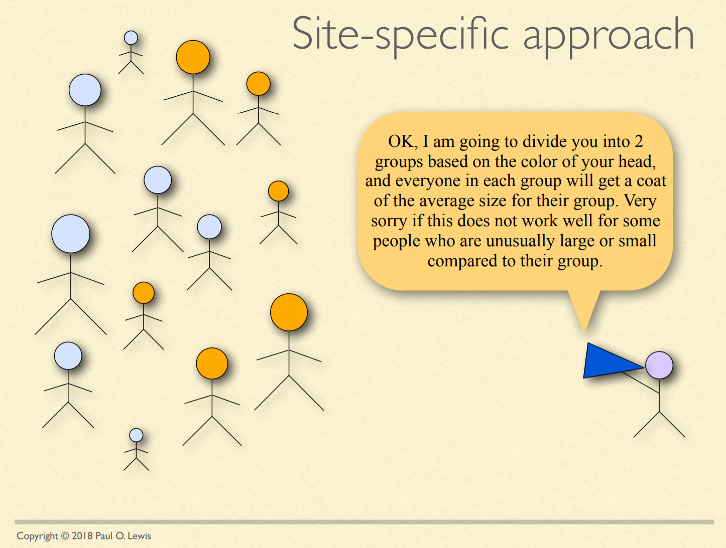
Site specific approach

Slide 23

Site specific approach leads to some misfit rates

Slide 24

Mixture model approach

Slide 25
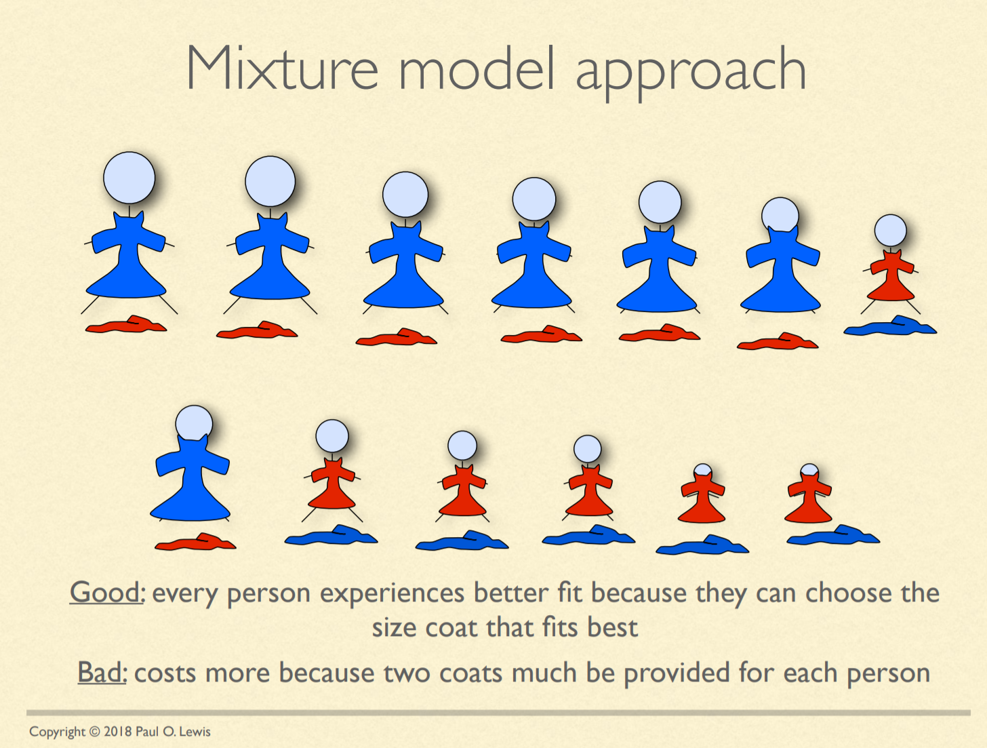
Mixture model results in better fits, but costs more.

Slide 26
Invariable sites model
Every site has a probability, P_{invar} of being invariant
P_{invar} estimated from the data
Every site gets its likelihood estimated in two parts: If it were invariant & variable (as normal)
Often designated "+I" (e.g. HKY85 + I)

Slide 27
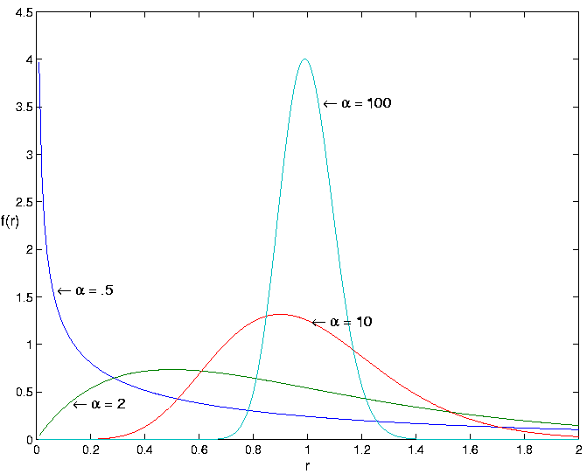
Gamma-distributed rates
Rate categories set by a discrete gamma distribution (e.g. 4 rate categories)
Estimate α
Site likelihoods calculated for each rate category and summed
" + G " or “ + Г ”
(e.g. HKY85 + I + G)
See recent work suggesting 4 categories is not enough to prevent biases....

Slide 28
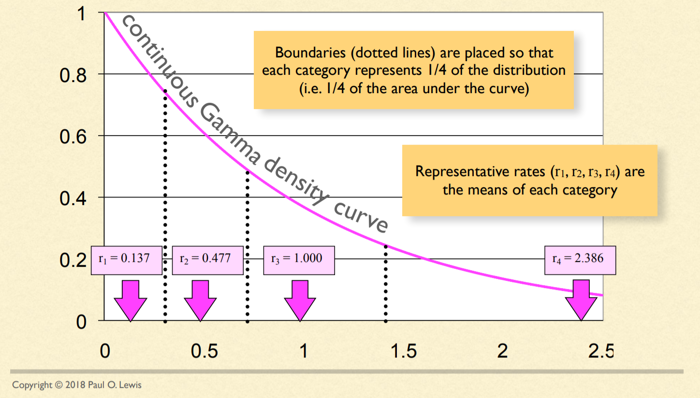
Discretizing the Gamma distribution

Slide 29
GTR+R
"Free rates model" - Relaxes assumption that the rates have to follow a Gamma distribution subject to the constraint that the mean of the rates is 1.
i.e. Directly estimates the distribution

Slide 30
What about...
Assuming every site has the same exchangeability and stationary frequency?
Every branch has the same process?
Every time slice?
Amino acid models?
Nonreversibility?
= Lots more models!
Don't sweat all the details, go back to:
What biology can do that you can't:
Give every site its own parameters governing change, change those parameters on any branch at any time, and allow sites to interact with one another.
You have to group and simplify that complexity so that sites and branches share parameters you can actually estimate.

Slide 31
Assumptions of a GTR + Γ/R; and the models that extend it
Assumptions of GTR + Γ/R:
1. All substitutions equally likely
2. Base frequencies equal
3. Every site has equal probability of substitution -> Still constrained. Consider overparameterized unique Q and pi to every site (not practical), then figure ways to simplify and group to naturally cover site-variation (e.g. partitions, site-profile heterogenous, Q mixture models)
4. Process is constant through time -> Relative site rates constant but extension to models with heterotachy exist. For varying Q and composition, nonhomogenous/nonstationary models.
5. Sites are independent of each other -> Context-dependent and coevolutionary models
6. Substitution is Markovian (memoryless) -> Covarion/hidden state fake non-Markovian behavior, but still key assumption to almost all models.
7. All sites have the same evolutionary history -> Species tree models
8. Time-reversible -> Time irreversible models

Slide 32
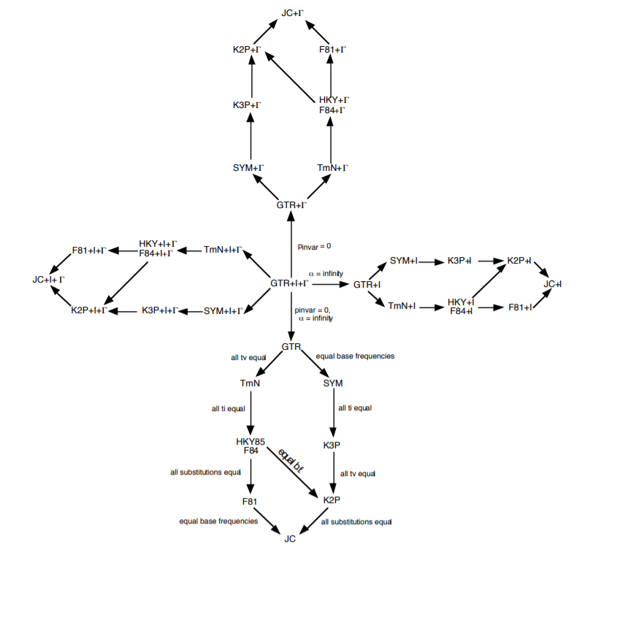
OK...but how do we decide which model to use?!?!

Slide 33
Model testing
Ideally, fit all models while simultaneously estimating tree
More practical:
Start with a not-too-bad tree, fit all the possible models, rank them by some criterion, pick the best one and use in a full analysis
Criteria: Likelihood ratio test, Akaike Information Criterion, Bayesian Information Criterion, Decision Theory, Bayesian model selection, Bayesian hypothesis testing or model averaging

Slide 34
Methods interpretation II

