Slide 1
Species tree estimation & the multispecies coalescent

Slide 2
Back to biology - Are JC69's assumptions realistic?
Assumptions of JC69:
1. All substitutions equally likely
2. Base frequencies equal
3. Every site has equal probability of substitution
4. Process is constant through time
5. Sites are independent of each other
6. Substitution is Markovian (memoryless)
7. All sites have the same evolutionary history

Slide 3
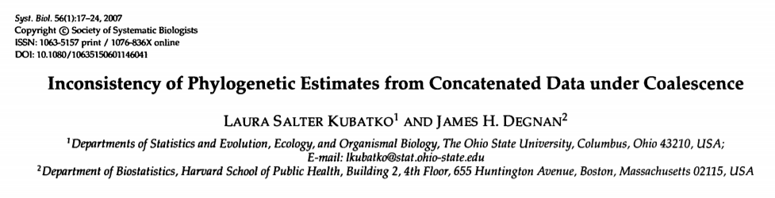
Concatenated gene sequences - assumes every gene has same evolutionary history

Slide 4
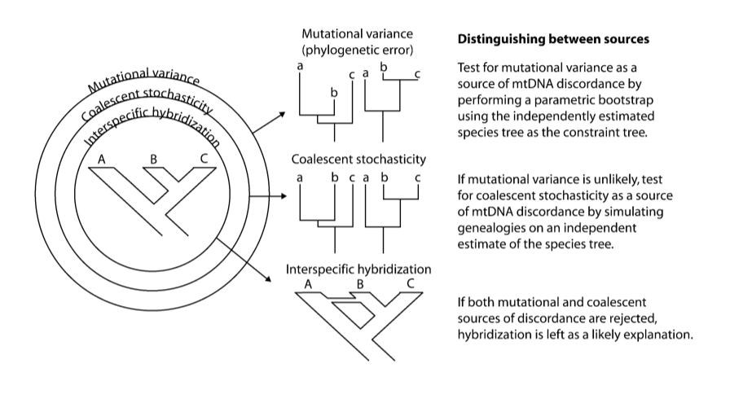
Stochasticity from:

Slide 5
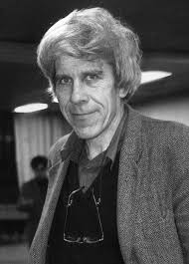
“As I write these words, even so as to be able to write them, I am pretending to a unity that, deep inside myself, I now know does not exist. I am fundamentally mixed, male with female, parent with offspring, warring segments of chromosome that interlocked in strife millions of years before Europe existed or saw any of the human violence that became later, for sure, embedded in my ancestry.” - WD Hamilton

Slide 6
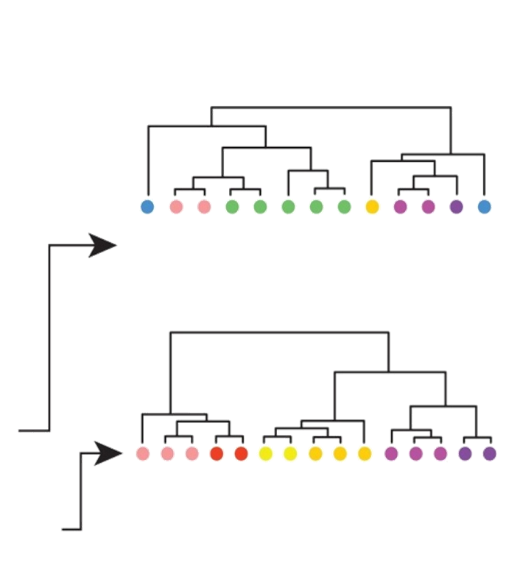
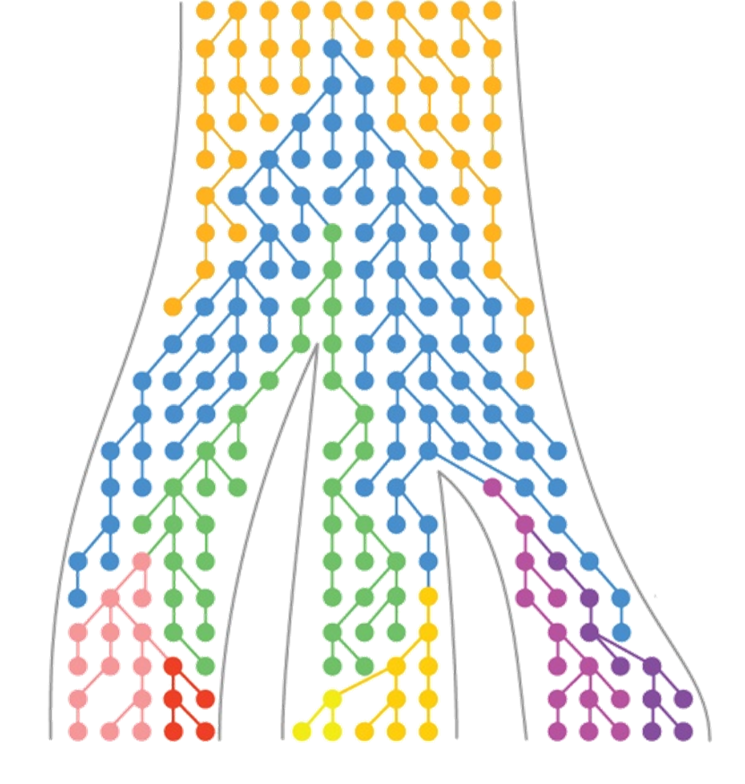
Incomplete lineage sorting

Slide 7
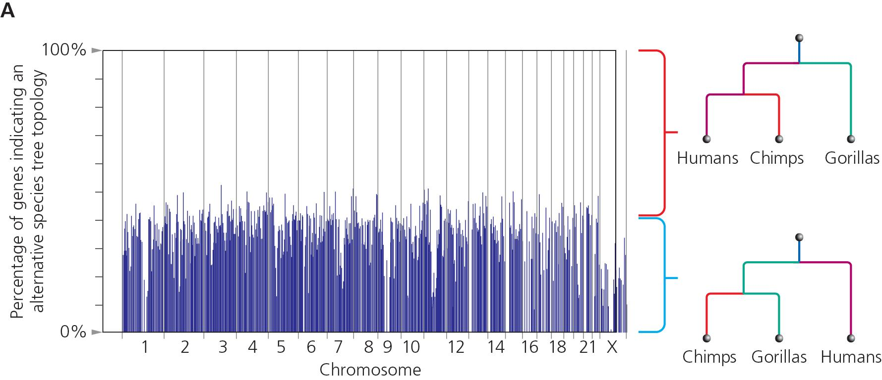

Slide 8
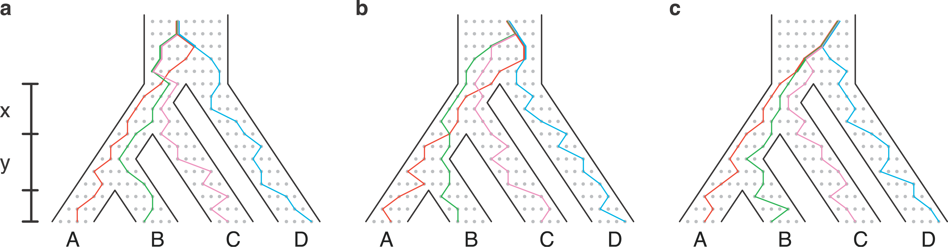
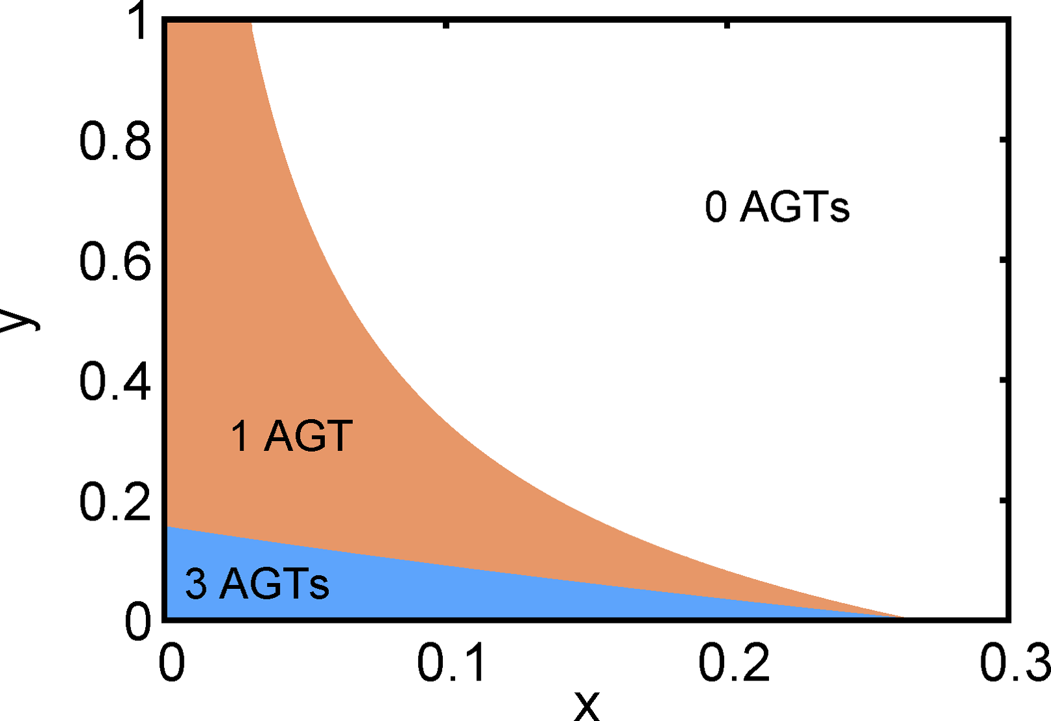
The “Anomaly zone” AGT - Anomalous gene tree with higher likelihood than the tree species topology

Slide 9
ILS will result when branches are short & population sizes are large
(often mistakenly thought only to occur in recent radiations, but ancient short internal branches just as at risk!)

Slide 10
The Coalescent
Coalescence - MRCA of a pair of genes
Built on standard population genetics (e.g. Wright-Fisher model)
Key parameter - Effective population size
(May be very different from “census population size)
Expected # of generations to coalescence - 2Ne

Slide 11
The Coalescent
What is the probability two copies of a gene in a randomly breeding population have an ancestor 1 generation ago?
1/(2Ne)
What about j generations ago?
(1-1/(2Ne))^{j} * 1/(2Ne)

Slide 12
Genetic drift & the molecular clock
The chance of someone's copy of an allele drifting to fixation is:
1/(2N_{e})
Let ν be the rate of neutral mutations per allele, per generation
Every generation there will be:
2N_{e}ν mutations
Therefore, alleles turn over at rate ν

Slide 13
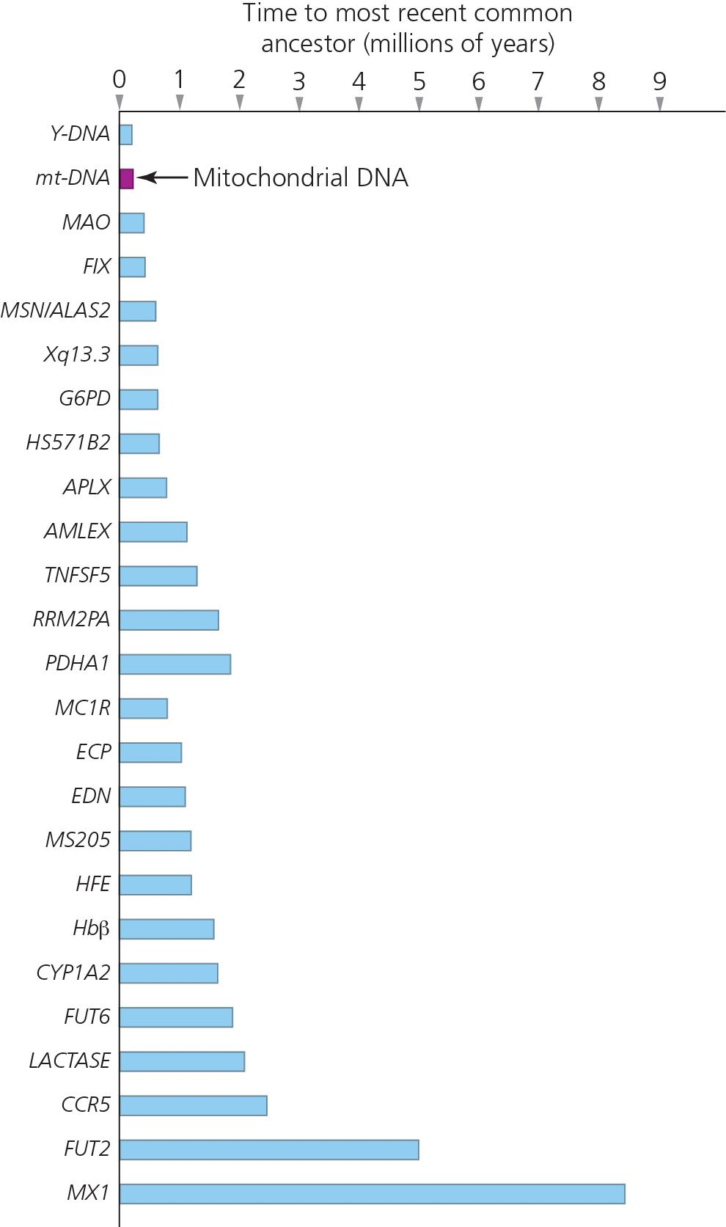
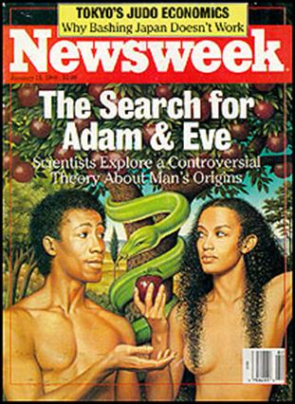
Coalescent times vary among genes
Why??
All genes eventually trace
back to a common ancestor:
a mutant allele that existed
in a single individual (i.e.
“mitochondrial Eve” and
“Y-chromosome Adam”). BUT NOTE: “mEve” and “yAdam” were
real individuals that were part of a
larger population. And there was
nothing special about them...every
gene has to trace back to a single
individual, but it will be a different
individual living at a different time
(e.g. MAO-Karen, APLX-Gengis)

Slide 14
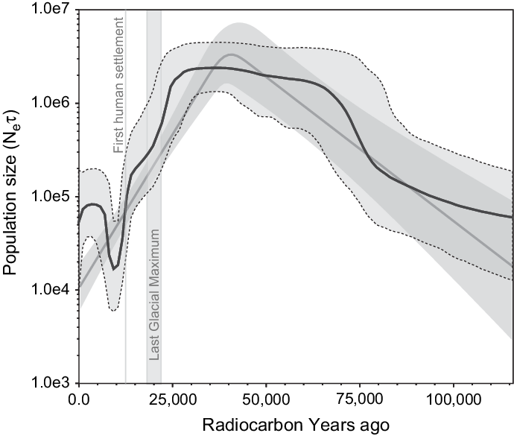
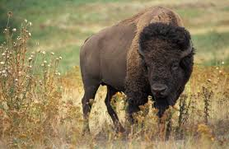
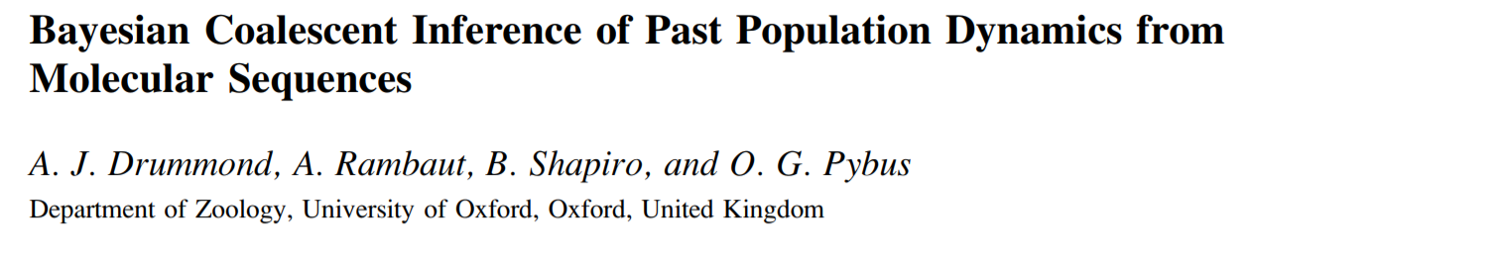
The Coalescent
Coalescence-time measured in units of Ne

Slide 15
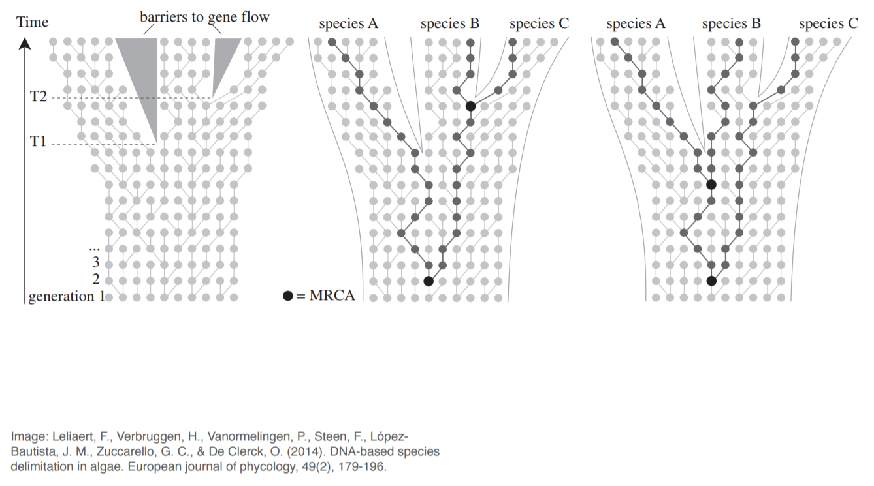
The Multispecies Coalescent

Slide 16
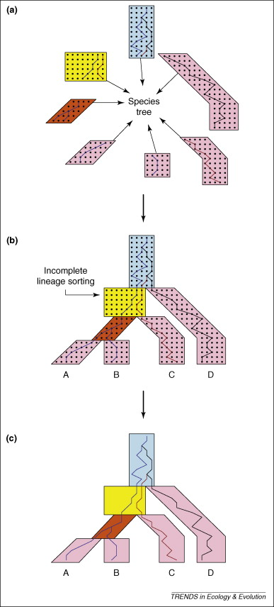
P(D_{i} | Q_{i}, π_{i}, ψ_{i}) = standard likelihood of gene tree
P(ψ_{i} | S) = Likelihood of gene tree given the species tree
“AND” rule:
P(D₁, D₂...D_{n} | S) =
P(D₁ | Q₁, π₁, ψ₁)*P(ψ₁ | S) x ...
x P(D_{n} | Q_{n}, π_{n}, ψ_{n})*P(ψ_{n} | S)

Slide 17

Methods & software
Parsimony - “MDC” species tree that minimizes deep coalescences (can be inconsistent estimator)
ML - STEM (Kubatko & Degnan 2007). Requires gene trees to be well-estimated and clock-like
Bayesian - BEST, *BEAST, BPP. Bayesian approaches that integrate over uncertainty in gene trees. Great models...but complex and hard to converge!

Slide 18
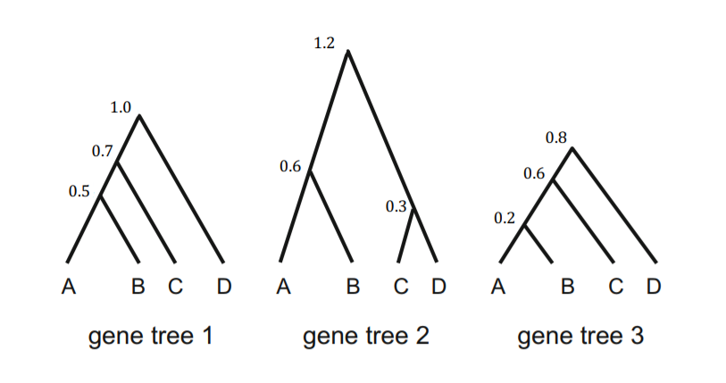
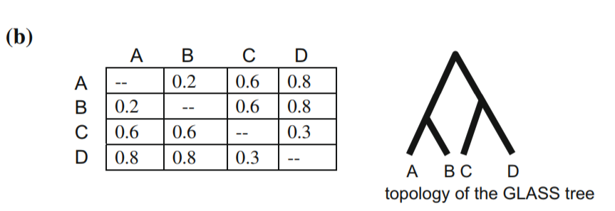
Other methods
Concordance analysis- BCA/BUCKy. Semi-parametric clustering of gene trees into “concordance blocks” without regard to process
Summary methods- Uses properties of multispecies coalescent to summarize gene trees. STAR/STEAC/GLASS

Slide 19
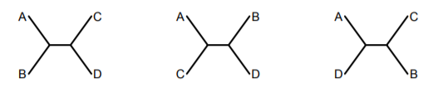
Other methods
Quartets approaches: ASTRAL/SVDQuartets
Avoids calculating full likelihood, instead focuses on site patterns over 4 taxon combinations. Good for SNPs and genomic scale data

Slide 20
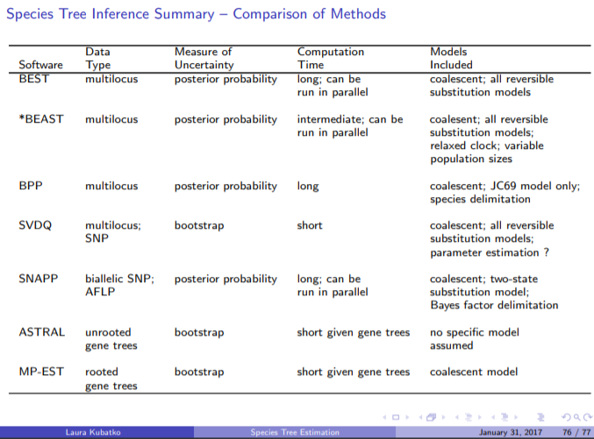

Slide 21
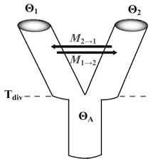
Adding gene flow...
Often limited to a small number of species using multispecies coalescent models
e.g. IM & MSNC based models
(Wakeley & Hey 98, Nielsen &
Wakeley 2001; Meng & Kubatko 2009)

Slide 22
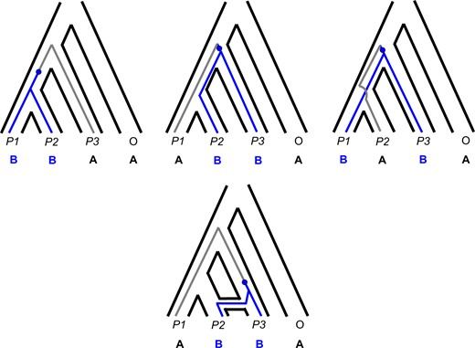
ABBA - BABA tests
Quartet based method:
(((Sp1,Sp2),Sp3),Out)
A B B A
B A B A
D = [sum(ABBA) – sum(BABA)] / [sum(ABBA) + sum(BABA)]
H0: f(ABBA) = f(BABA)
H1: Hybridization increases either ABBA or BABA (Sp2 x Sp3) or (Sp1 x Sp3) respectively.

Slide 23
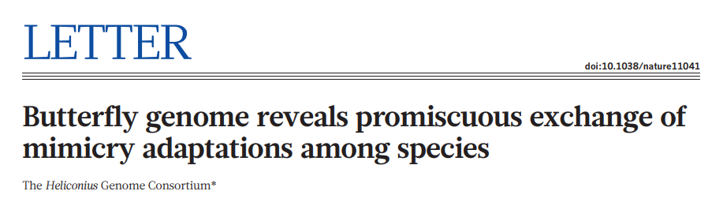
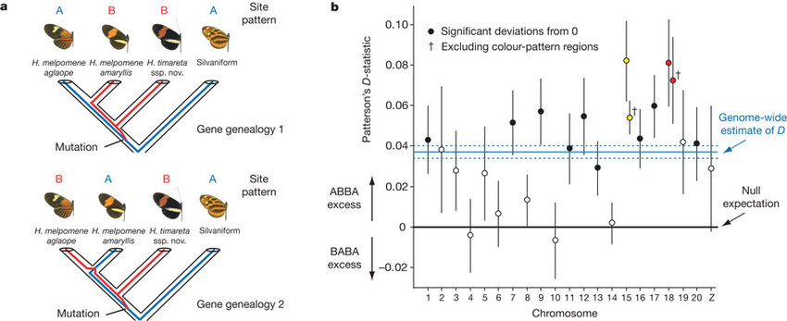
Robust & powerful for closely related species (w/o convergence), not great for quantifying amount of introgression or directionality.

Slide 24
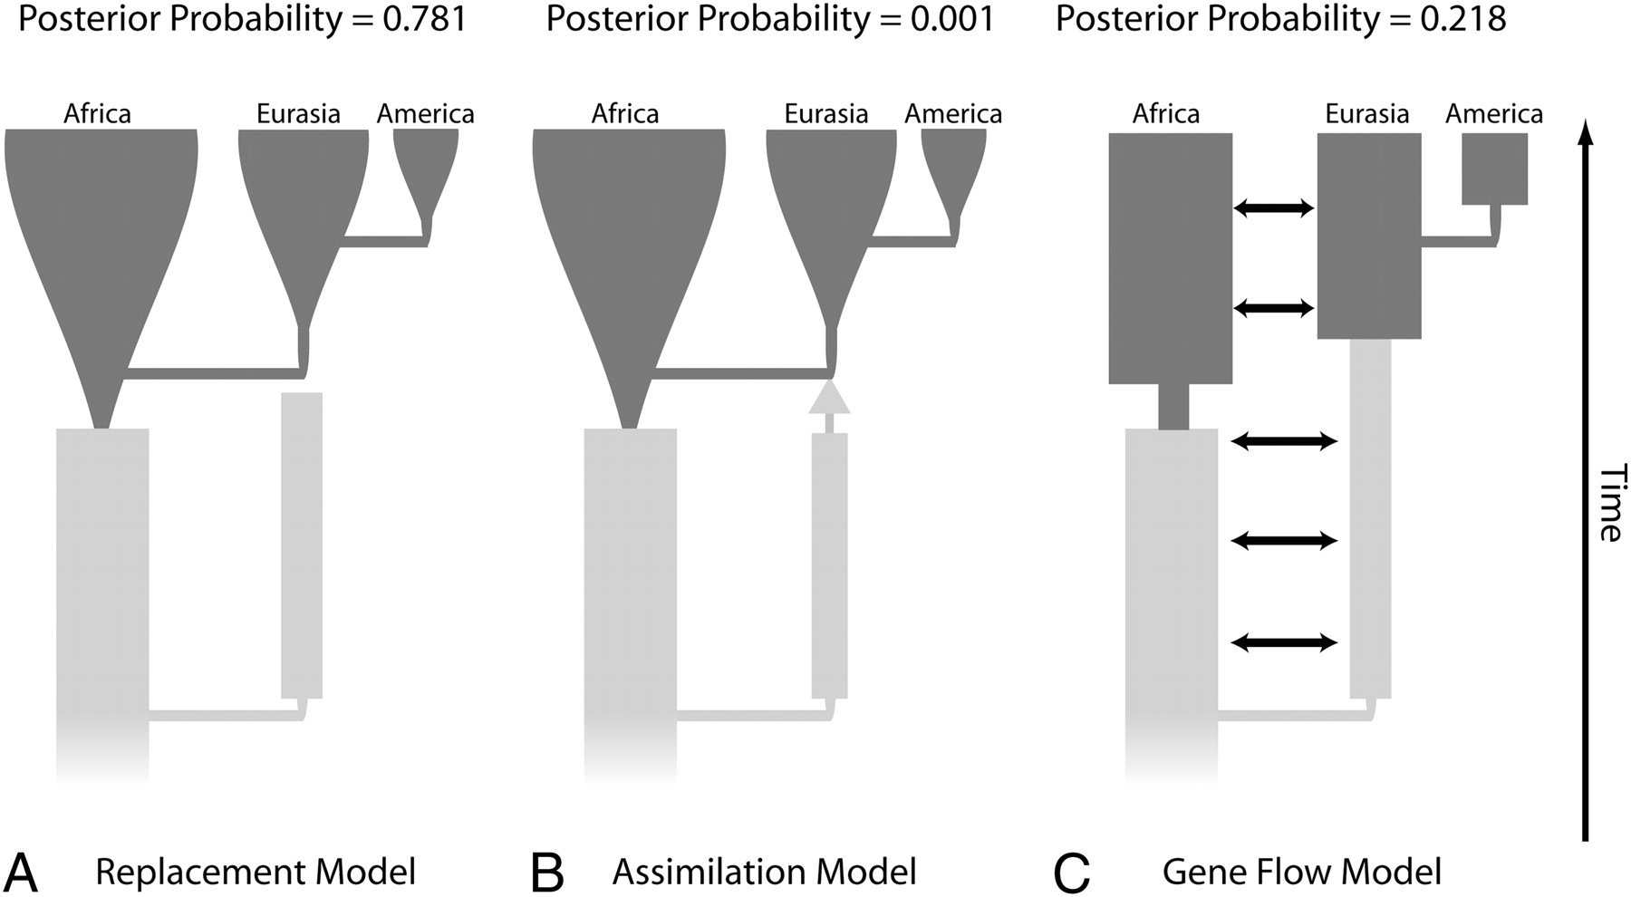
Hypothesis testing

Slide 25
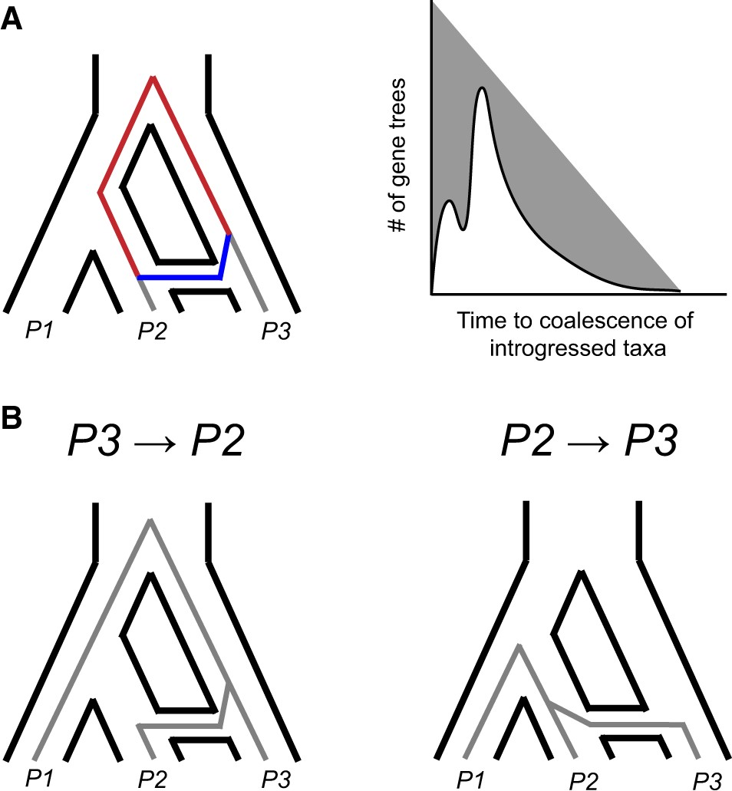

Coalescence times provide information on the timing, direction, and presence of introgression. (A) Postspeciation introgression between P2 and P3 allows them to coalesce more quickly at introgressed loci (blue). This reduces their whole-genome divergence relative to P1 and P3, an asymmetry that can be used to test for introgression. Since coalescence can now occur at one of two times, after introgression (blue) or after speciation (red), it also results in a bimodal distribution of coalescence times across loci (right figure). The more recent peak of this distribution can be used to estimate the timing of introgression. (B) The direction of introgression between P2 and P3 affects the time to coalesce of P1 and P3 at introgressed loci. P2 → P3 introgression allows P1 and P3 to coalesce more quickly (right), reducing their divergence at introgressed loci.
Notes:
Figure 4 Coalescence times provide information on the timing, direction, and presence of introgression. (A) Postspeciation introgression between P2 and P3 allows them to coalesce more quickly at introgressed loci (blue). This reduces their whole-genome divergence relative to P1 and P3, an asymmetry that can be used to test for introgression. Since coalescence can now occur at one of two times, after introgression (blue) or after speciation (red), it also results in a bimodal distribution of coalescence times across loci (right figure). The more recent peak of this distribution can be used to estimate the timing of introgression. (B) The direction of introgression between P2 and P3 affects the time to coalesce of P1 and P3 at introgressed loci. P2 → P3 introgression allows P1 and P3 to coalesce more quickly (right), reducing their divergence at introgressed loci.
Unless provided in the caption above, the following copyright applies to the content of this slide: © The Author(s) 2021. Published by Oxford University Press on behalf of Genetics Society of America.This is an Open Access article distributed under the terms of the Creative Commons Attribution License (https://creativecommons.org/licenses/by/4.0/), which permits unrestricted reuse, distribution, and reproduction in any medium, provided the original work is properly cited.© The Author(s) 2021. Published by Oxford University Press on behalf of Genetics Society of America.

Slide 26
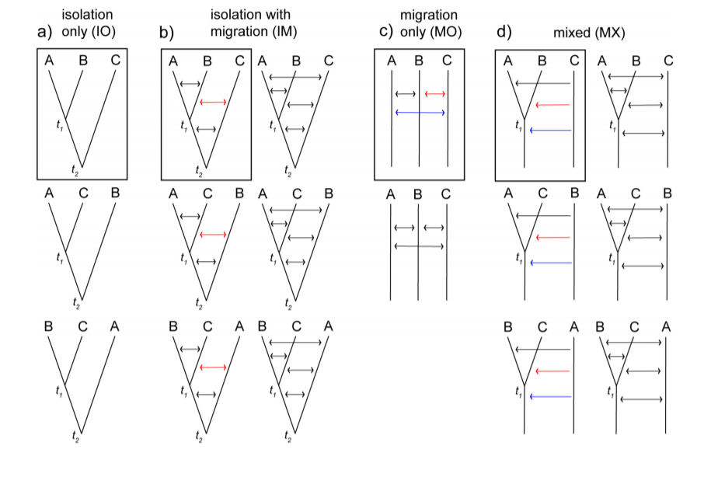
Search among all possible models... PHRAPL (Jackson et al. 2017)

Slide 27
Some general thoughts...
Scaling multispecies coalescent to genomic scale is hard, adding more data doesn't necessarily improve estimation
Filter genes to those with strong phylogenetic signal
Interrogate your data

Slide 28
