Slide 1
Continuous-Time Markov Models
Markov assumption = probability of change depends only on current state, not how long it has been in that state

Slide 2
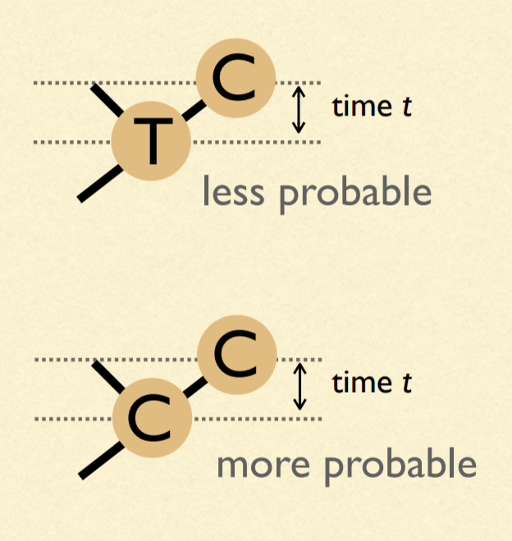
Our model of change depends on time: We must estimate branch lengths
Units of branch length will be expected number of substitutions per site
(= rate of substitions x time)

Slide 3
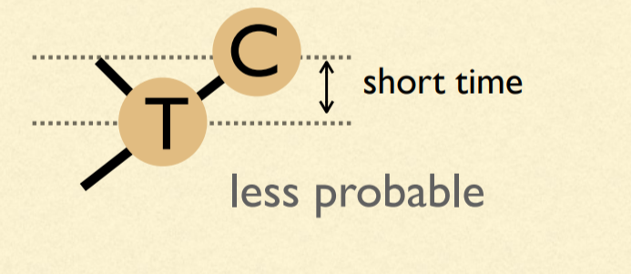
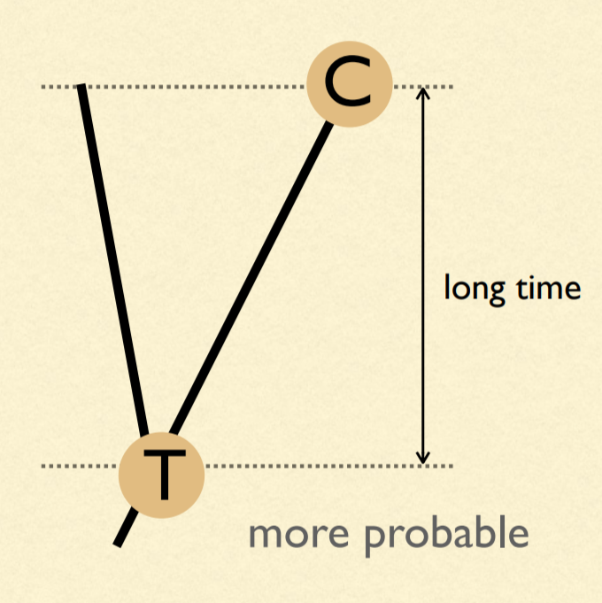
Probabilities are dependent on time

Slide 4
μ = 4β
A
β
β
β
β
A
T
G
C

Slide 5
A (very) simple phylogeny...
time
A
A
P_{AA} =
Probability nothing happened +
Probability something happened, but that the last thing that happened ended in an A

Slide 6
A (very) simple phylogeny...
time
A
A
P_{AA} = (e^{-μt} ) + (1 - e^{-μt})(1/4)
Probability something doesn't happen
Probability at least one thing happens
Probability that the last thing that happened ends in an A

Slide 7
A (very) simple phylogeny...
time
A
G
P_{AG} = (1 - e^{-μt})(1/4)
Probability at least one thing happens
Probability that the last thing that happened ends in an G

Slide 8
A (very) simple phylogeny...
time
A
C
P_{AC} = (1 - e^{-μt})(1/4)
Probability at least one thing happens
Probability that the last thing that happened ends in an C

Slide 9
A (very) simple phylogeny...
time
A
T
P_{AT} = (1 - e^{-μt})(1/4)
Probability at least one thing happens
Probability that the last thing that happened ends in an T

Slide 10
One last bit...substitutions vs. "events"
ν = (3/4)μt = 3βt
4ν/3 = μt
Only 3 out of 4 events results in a substitution. Thus, we can define the expected number of substitutions for a given time interval t as ν.

Slide 11
P_{AA} = (e^{-μt} ) + (1 - e^{-μt})(1/4)
P_{AG} = (1 - e^{-μt})(1/4)
P_{AC} = (1 - e^{-μt})(1/4)
P_{AT} = (1 - e^{-μt})(1/4)

Slide 12
P_{AA} = (1/4) + (3/4)(e^{-4ν/3} )
P_{AG} = (1/4) - (1/4)(e^{-4ν/3})
P_{AC} = (1/4) - (1/4)(e^{-4ν/3})
P_{AT} = (1/4) - (1/4)(e^{-4ν/3})
Sanity check: Do they all add to 1?

Slide 13
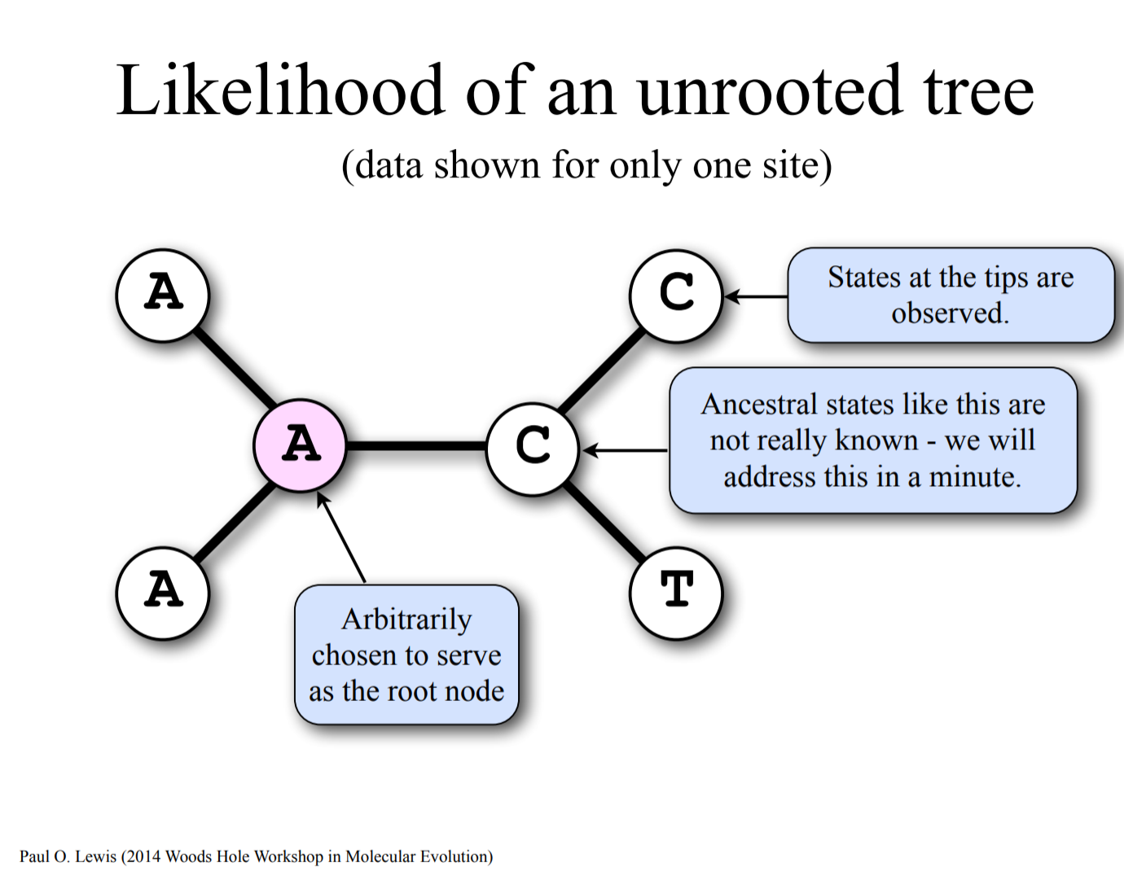

Slide 14
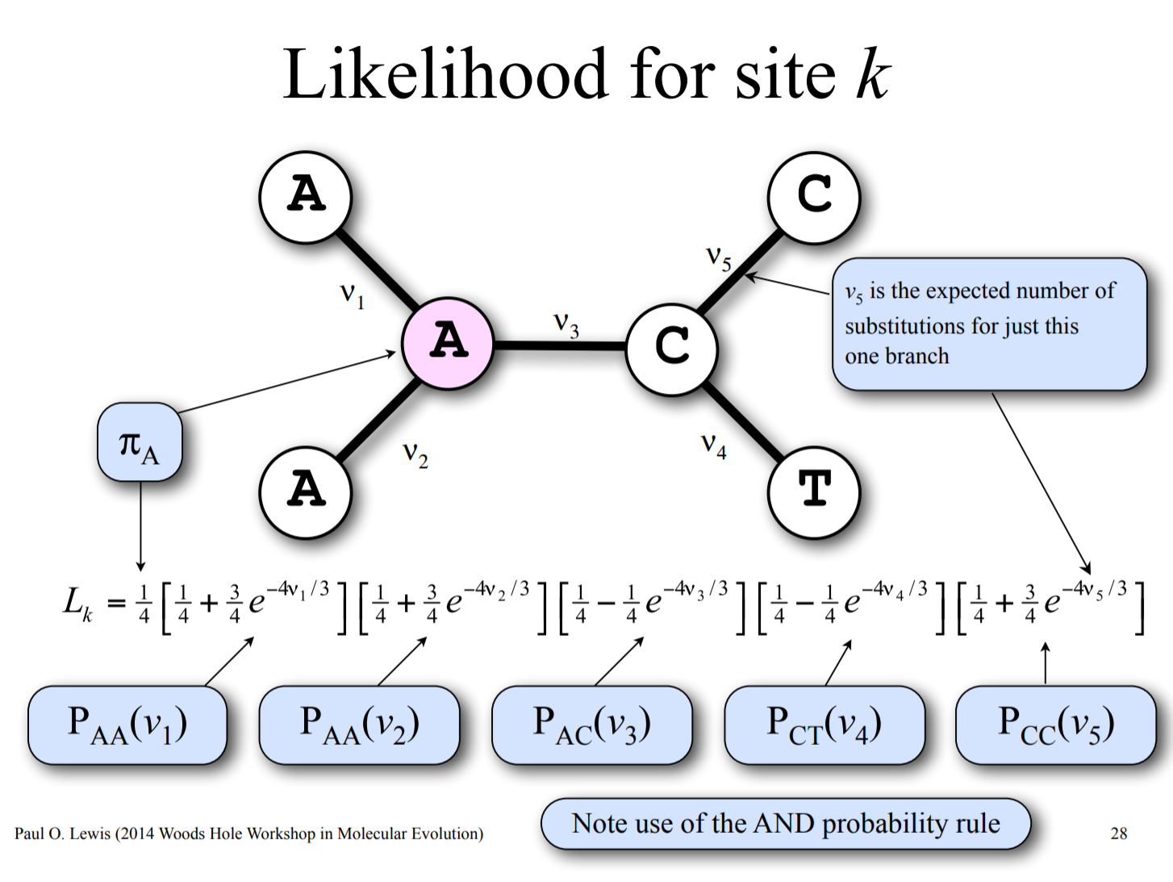

Slide 15
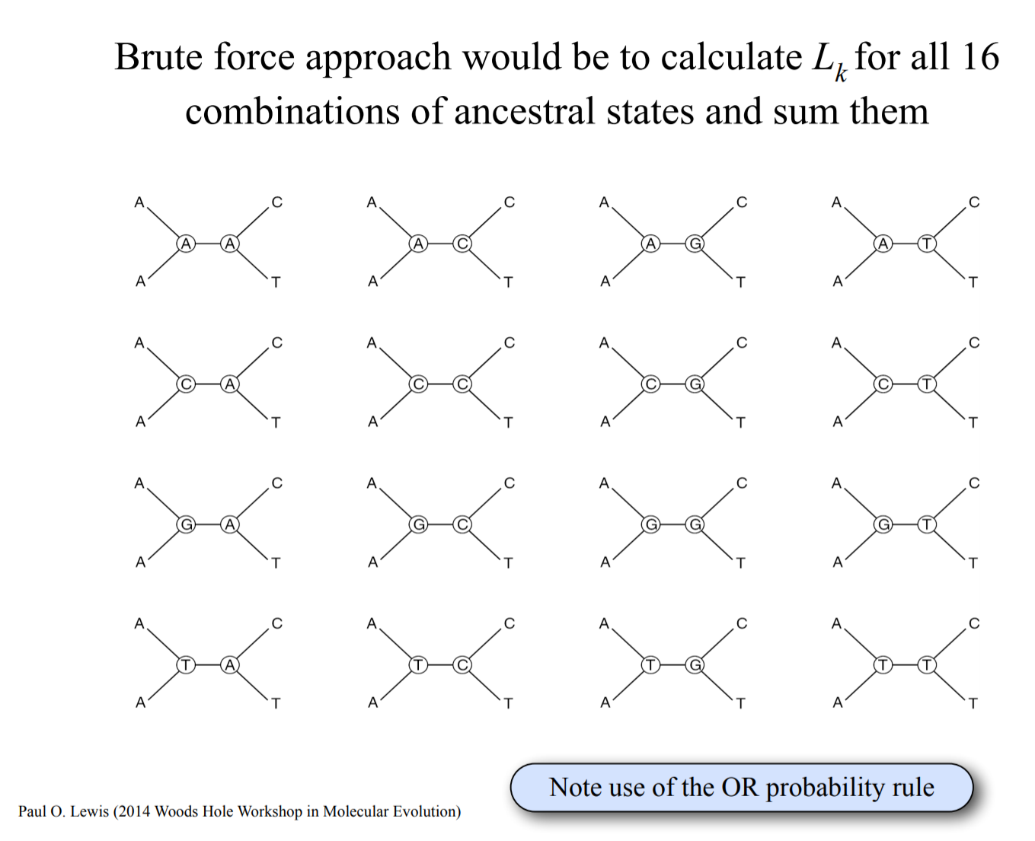

Slide 16
Pruning algorithm

Slide 17
Pruning algorithm

Slide 18
Pruning algorithm

Slide 19
Pruning algorithm

Slide 20
Pruning algorithm

Slide 21
Pruning algorithm

Slide 22
Pruning algorithm

Slide 23
Pruning algorithm

Slide 24
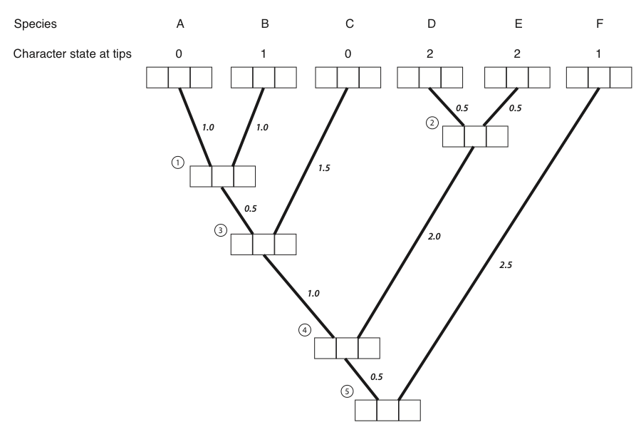
1 0 0
0 1 0
1 0 0
0 0 1
0 0 1
0 0 1

Slide 25
1 0 0
0 1 0
1 0 0
0 0 1
0 0 1
0 0 1
0.12 0.12 0.1

Slide 26
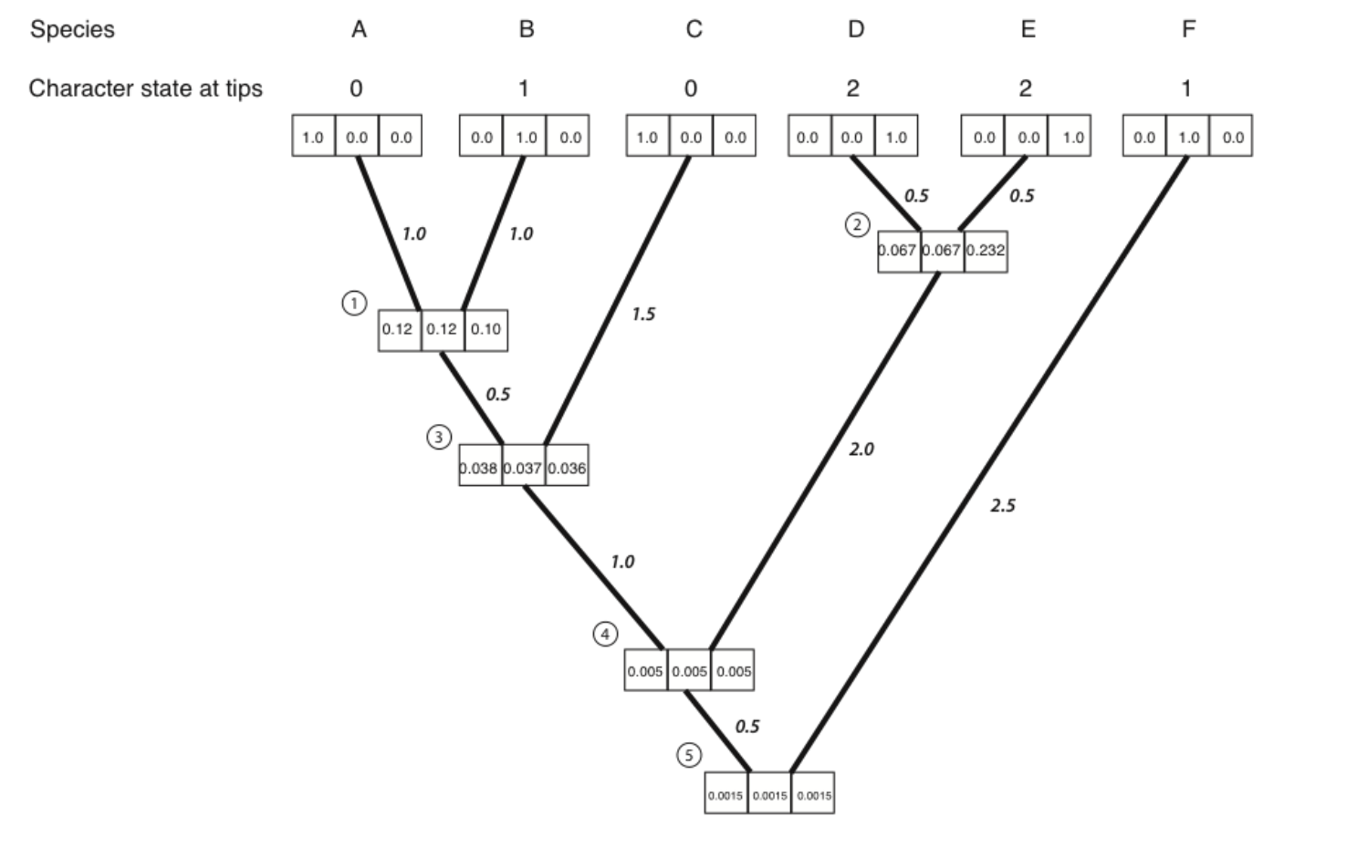

Slide 27
Lab Exercise in R
Goal:
Get some experience R
Understand probability, likelihoods, and Bayesian inference using non-phylogenetic models (linear regression)

