Slide 1
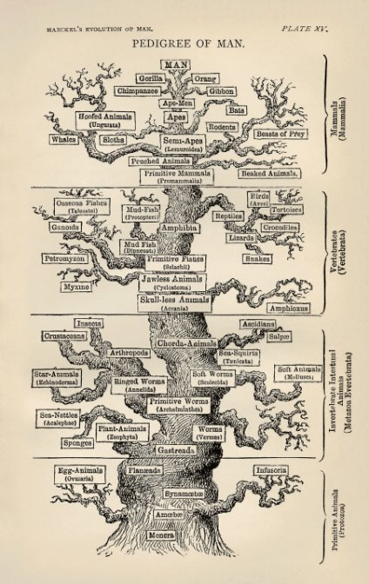
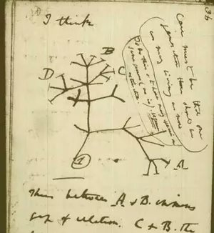
A brief history of phylogenetics

Slide 2

The four cannibalistic schools of phylogenetics history
Evolutionary Taxonomy
(Pre-1960s)
Phenetics
(1950s-70s)
Cladistics
(1960s-90s)
Statistical Phylogenetics
(1970s- present)

Slide 3
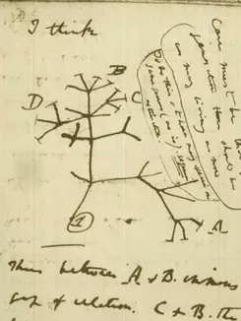
History of phylogenetics: Evolutionary taxonomy
No objective methodology
Relies on expert opinion and a lifetime of study
Strengths? Weaknesses?

Slide 4
History of phylogenetics: Phenetics
Numerical taxonomy and distance methods
Measure overall similarity
Sokal, Sneath, and Rohlf (1960s) argued
phenetics provided much needed reproducibility
How do you measure similarity?
What are the drawbacks of this approach?

Slide 5
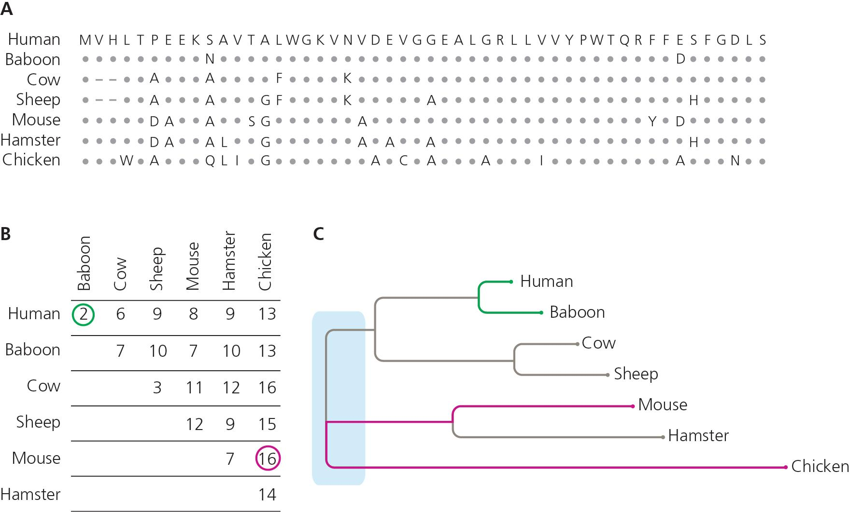
Distance methods
Still used for fast tree estimation (and under many conditions, are consistent estimators of the true tree)
Notes:
The figure here shows A) a protein alignment of 7 species of vertebrate (human, baboon, cow, sheep, mouse, hamster, chicken). B) A raw count of the number of amino acid substitutions for all pairwise comparisons between the same taxa arranged as a distance matrix. C) Distance-based phylogenetic inference attempts to build a phylogeny that best describes the distance matrix, with more closely related species being placed more closely together based on overall similarity.

Slide 6
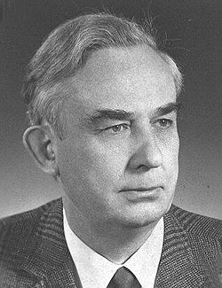
History of phylogenetics: Cladistics
Coined "phylogenetic systematics"
Grouping should not be based on overall trait similarity, but only on shared derived traits (synapomorphies)
Taxonomy based on monophyly
Parsimony & Occam's Razor- The simplest explanation is probably the correct one
Willi Hennig (1966)

Slide 7
Phenetics didn't always have the goal of finding the "true" evolutionary history
"Phenogram"
Cladogram

Slide 8

Example: What’s the phylogenetic relationship?

Slide 9
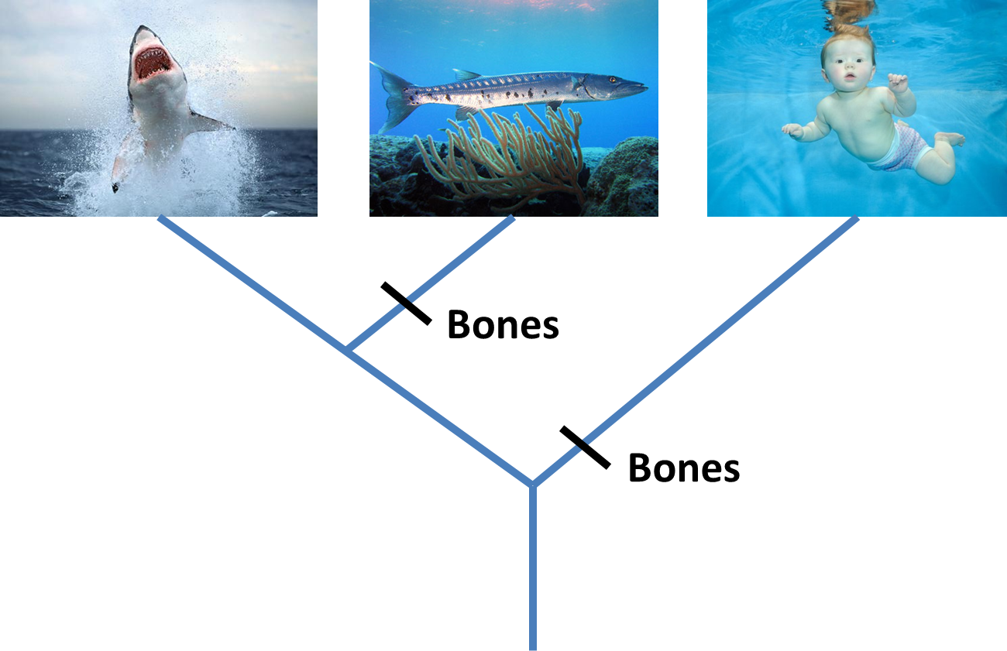
Example: Mapping bones

Slide 10
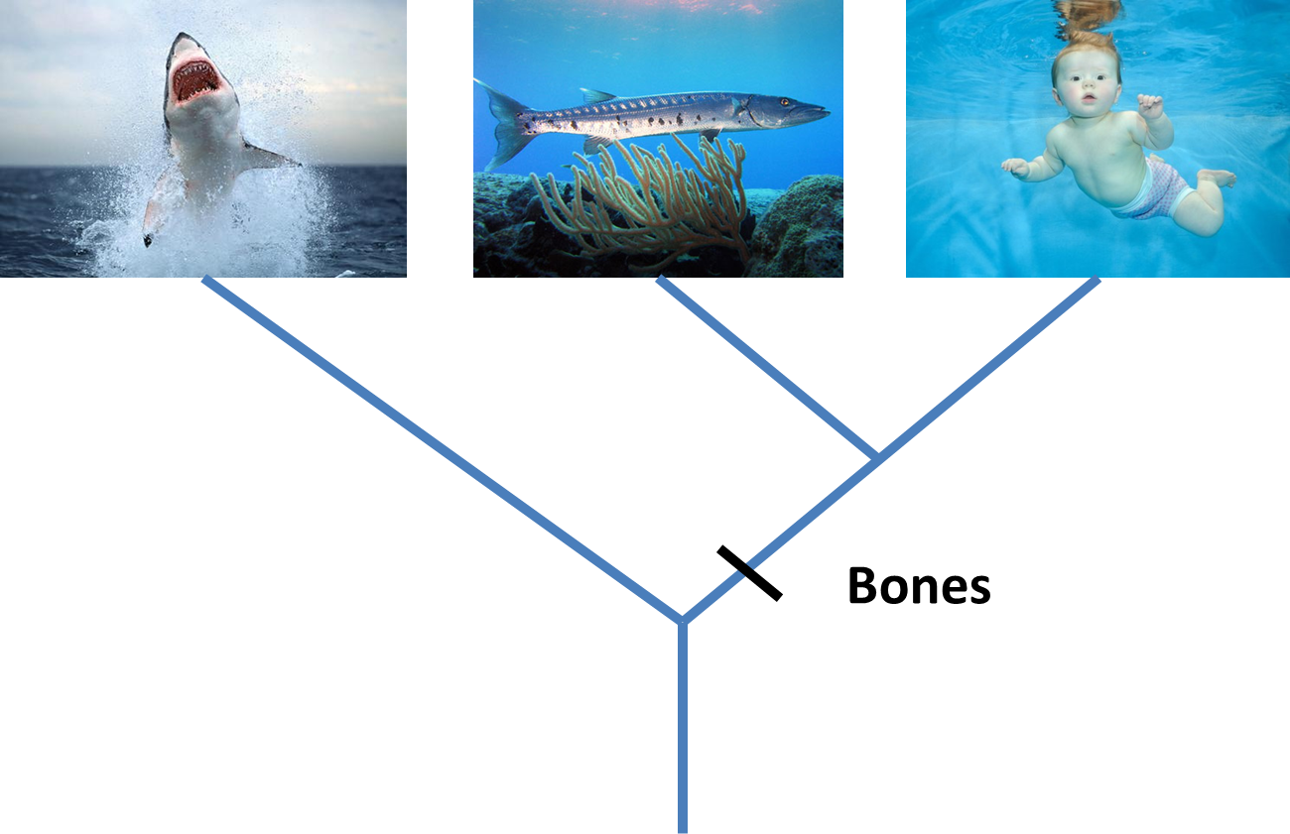
Example: More parsimonious

Slide 11
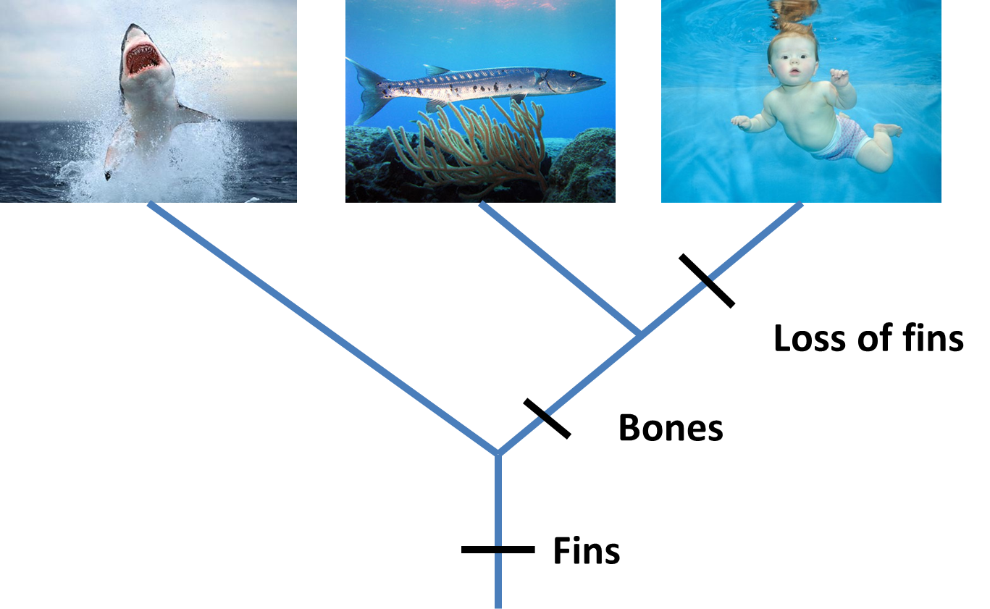
Example: Adding characters

Slide 12
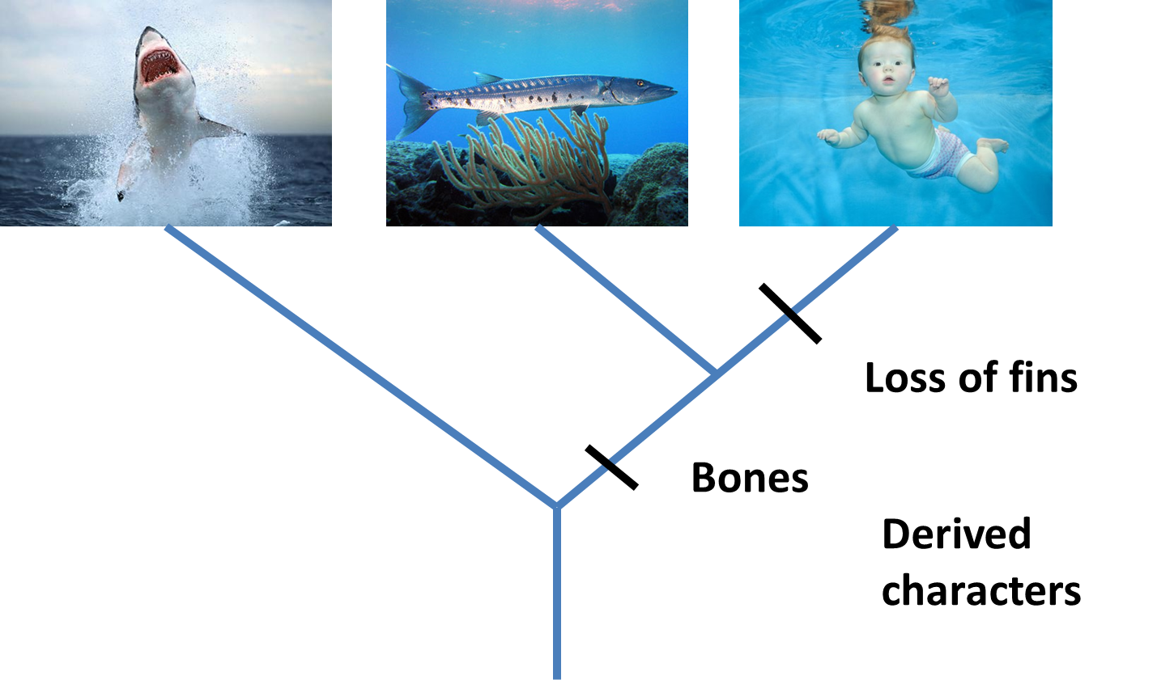
Derived Characters = Apomorphies

Slide 13
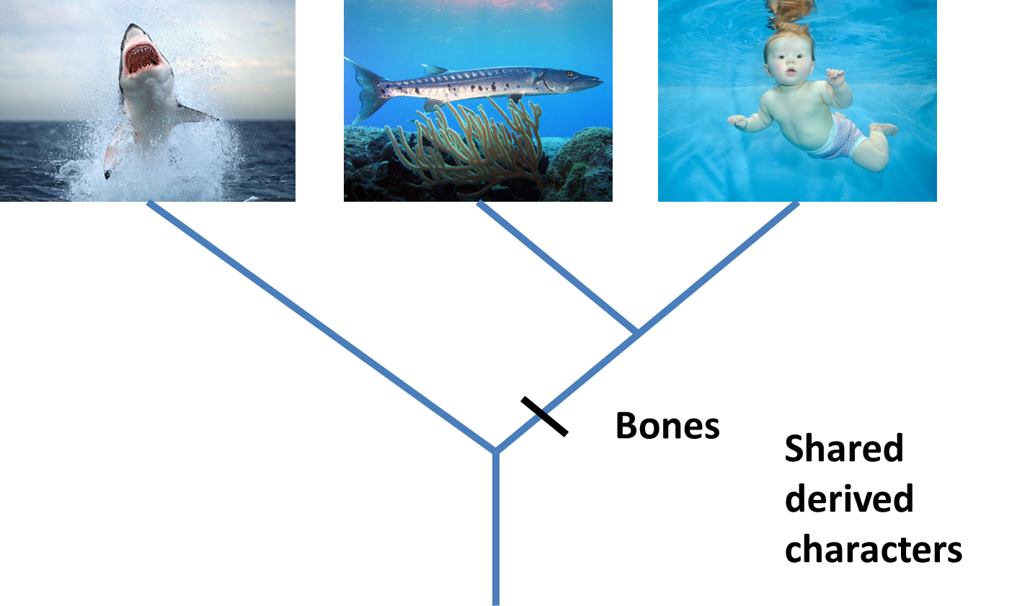
Shared derived characters = Synapomorphies

Slide 14

Shared ancestral characters = Symplesiomorphies

Slide 15
Comparing similarity vs. cladistics
Overall similarity takes all characters equally
Cladistics only considers synapomorphies, and excludes autapomorphies & symplesiomorphies
Best supported hypothesis: Minimizing steps
Critical role of outgroup to distinguish derived vs. ancestral characters
Also note that characters are defined as derived/ancestral relative to the taxa being considered (the ingroup)

Slide 16
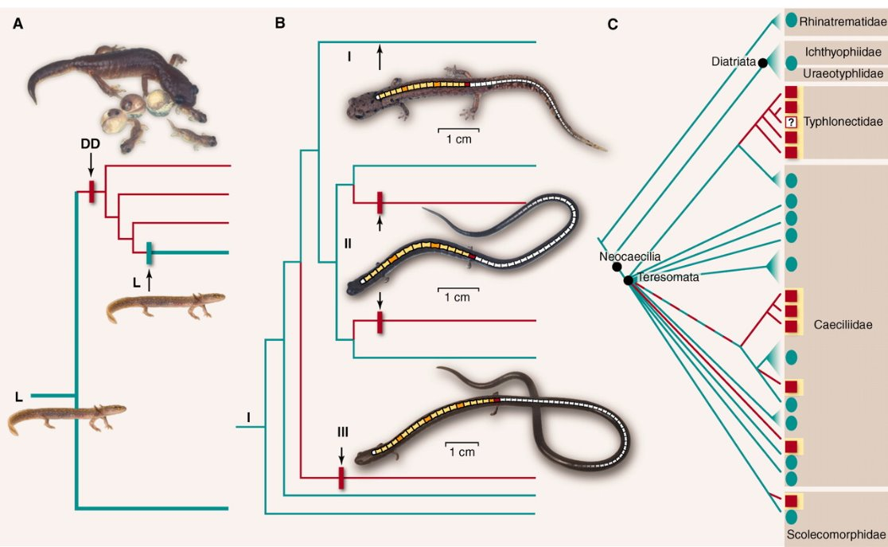
Homoplasy – Evolutionary reversals and/or convergence

Slide 17
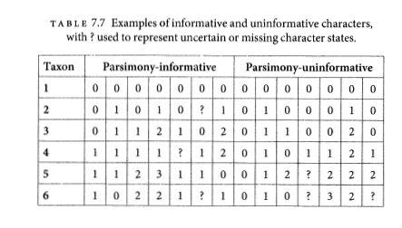
Parsimony informative vs. uninformative
Must have at least 2 taxa with shared traits in 2 different states.
Characters

Slide 18
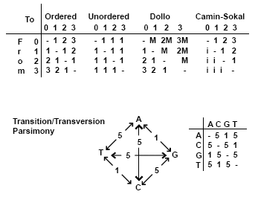
Generalized Parsimony
Step matrices
By Peter Forey, Link to source

Slide 19
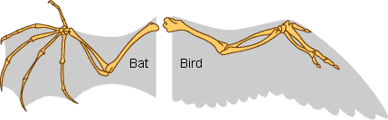
Homology
Primary homology = Initial hypothesis of homology due to similarity
Secondary homology = Implied homology via single origin on phylogeny by parsimony analysis
Underlines importance of character construction - often surprisingly subjective
“Reciprocal illumination” Hennig 1966

Slide 20
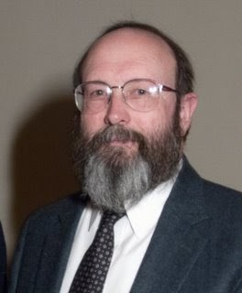
History of phylogenetic inference: Statistical phylogenetics
Luca Cavalli-Sforza, Anthony Edwards and later, Joseph Felsenstein
Probabilistic models of trait evolution
Showed statistical issues with parsimony, e.g. "the Felsenstein zone"
-> Highlighted the importance of simulation!
Maximum Likelihood & Bayesian inference
Joe Felsenstein

Slide 21
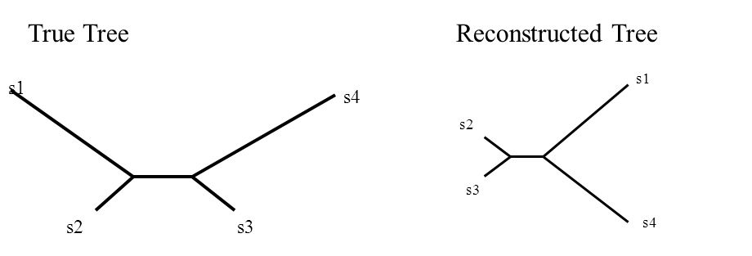
The Felsenstein Zone and Long-Branch Attraction
Lack of statistical consistency of parsimony.
Consistency: An estimator converges on the truth as more data are added

Slide 22
An oversimplification of the problem...
Under the cladistics philosophy (model), homoplasy is a “mistake” in character construction
Coding independently evolved traits the same, look closer and you'll see they're different!! (e.g. wings of birds & wings of bats)
But for DNA, complete convergence is real (a “T” is a “T” is a “T”, no matter how it became that)
As similarity by convergence becomes more common than similarity by shared ancestry, parsimony fails, and no “looking closer” at the character will save it.

Slide 23
Parsimony's main assumption of "Occam's Razor" had unclear implications
What are we assuming about the evolutionary process?
Rare changes or "no common mechanism" (Tuffley and Steele 1997)
Inconsistent estimator in real datasets with homoplasy – defined as an estimator that gets more and more certain of the wrong answer as more data is added.

Slide 24
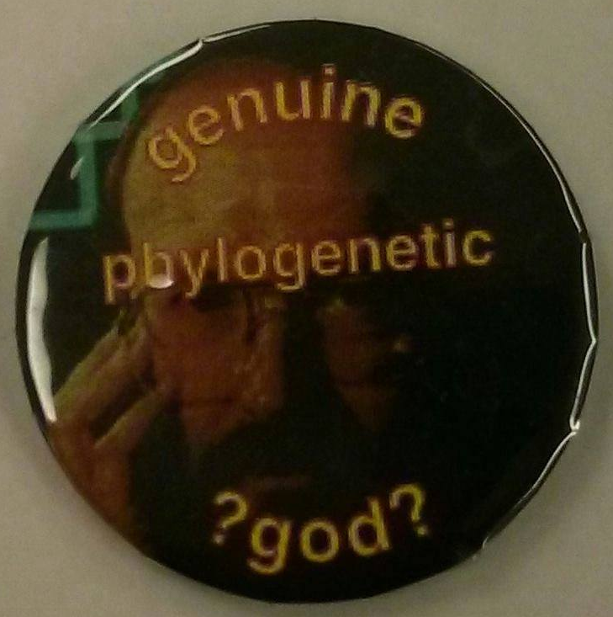
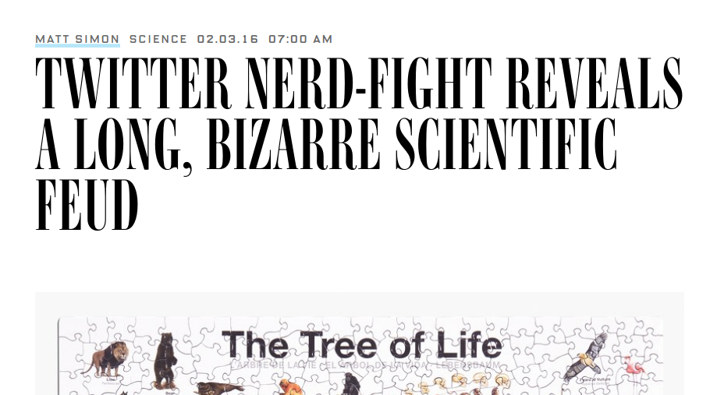
A history of conflict in science
#ParsimonyGate

Slide 25
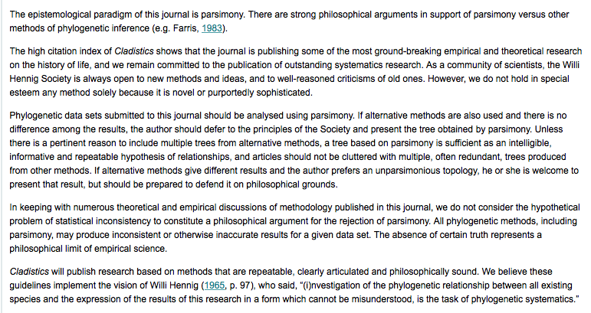
Parsimonygate

Slide 26
Ultimately, parsimony is less an inflexible modeling paradigm
As pointed out in the policy, other models can be inconsistent if the model does not fit or is not adequate for the data-generating process.
But statistical phylogenetics gave a way to parameterize processes, connect them to knowledge from population genetics, and test for adequacy and fit in ways that parsimony did not.
This ultimately led to statistical phylogenetics being the dominant paradigm in phylogenetics from sequence data.

Slide 27
Parsimony still commonly used for:
Morphological analyses (though probabilistic models exist here too)
Starting trees
Simplified reconstruction of the history of trait change (ancestral state reconstructions)

Slide 28
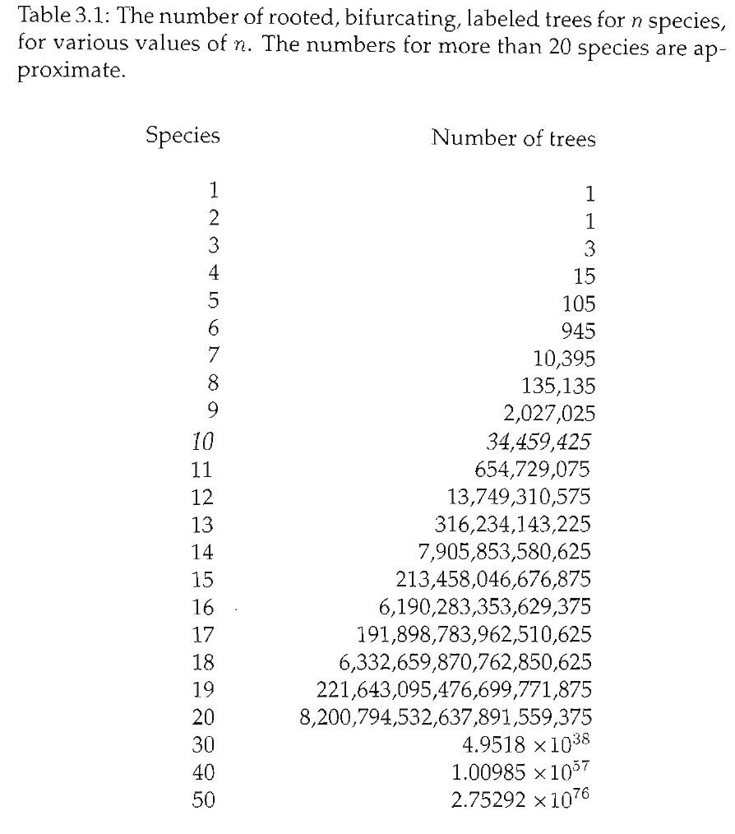
Finding the best tree:
Exhaustive searches
How do you find the most parsimonious tree?
One way:
1. Try every possible tree.
2. For each tree, count min # of steps
3. Choose the tree with the fewest # steps
Too many trees.

Slide 29
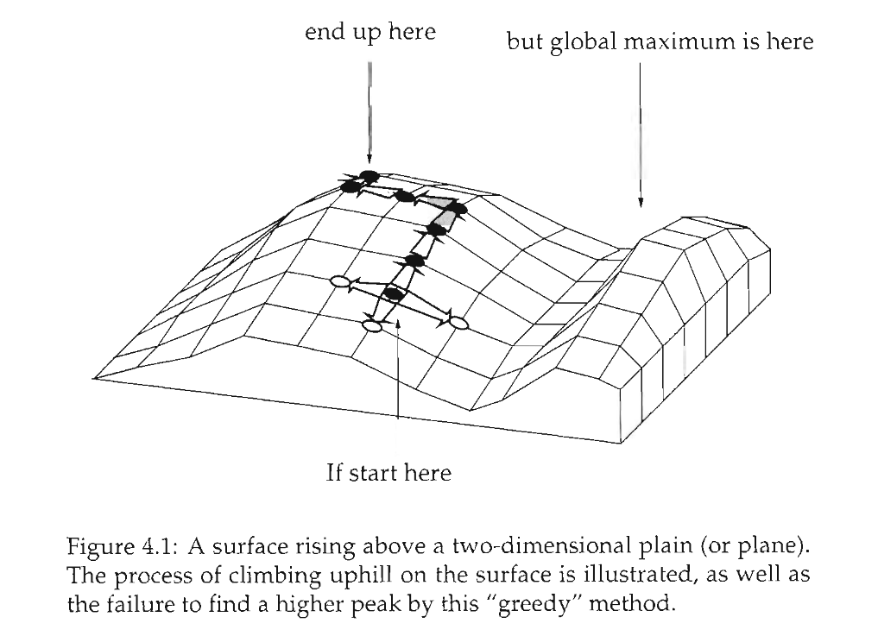
Heuristic searches
Don’t try every tree.
“Hill-climbing algorithm”
Wander around under certain rules. Hope that what you eventually stop at is the best.
Not guaranteed to find the best tree.
Can be improved by lots of random starting points.
(Not necessary for parsimony, exact algorithmic solution possible with a “branch and bound” search)

Slide 30
Tree space
Each point on the grid is a possible tree.
Trees next to each other are “1 step away” via algorithmic manipulation
Start at a random tree.
Try all trees that are nearby, choose the one that’s best
Keep doing that until you can’t make the tree any better.

Slide 31
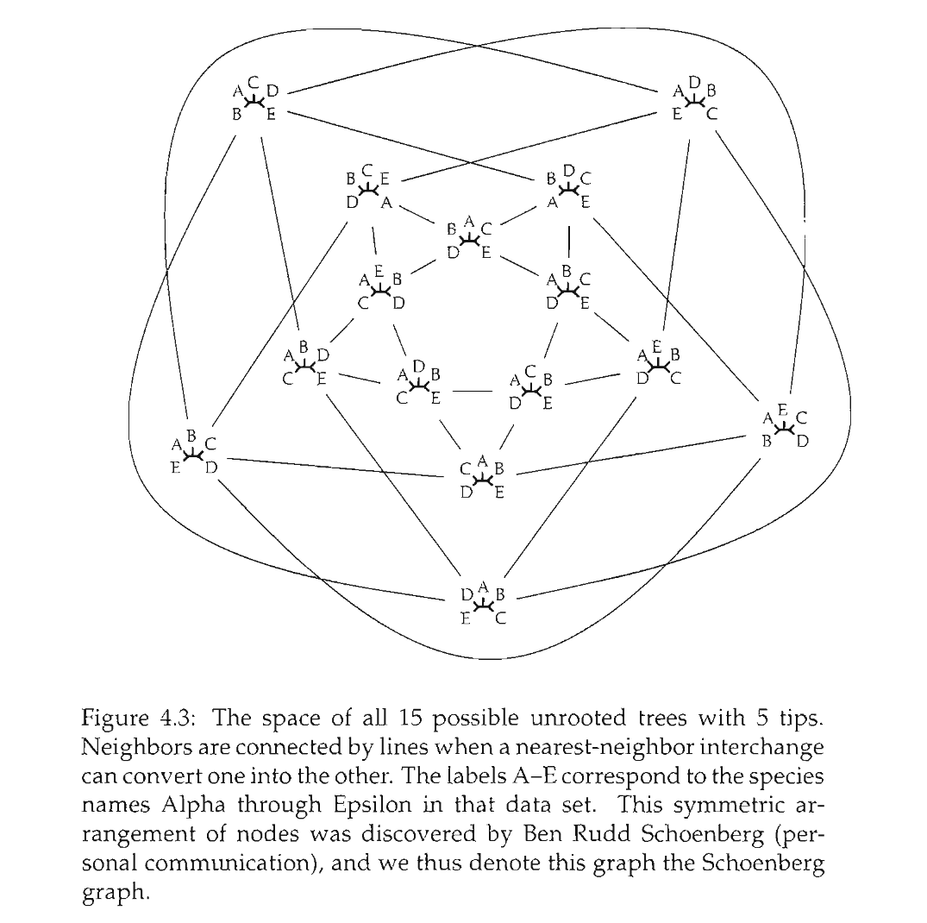
Visualizing tree space

Slide 32
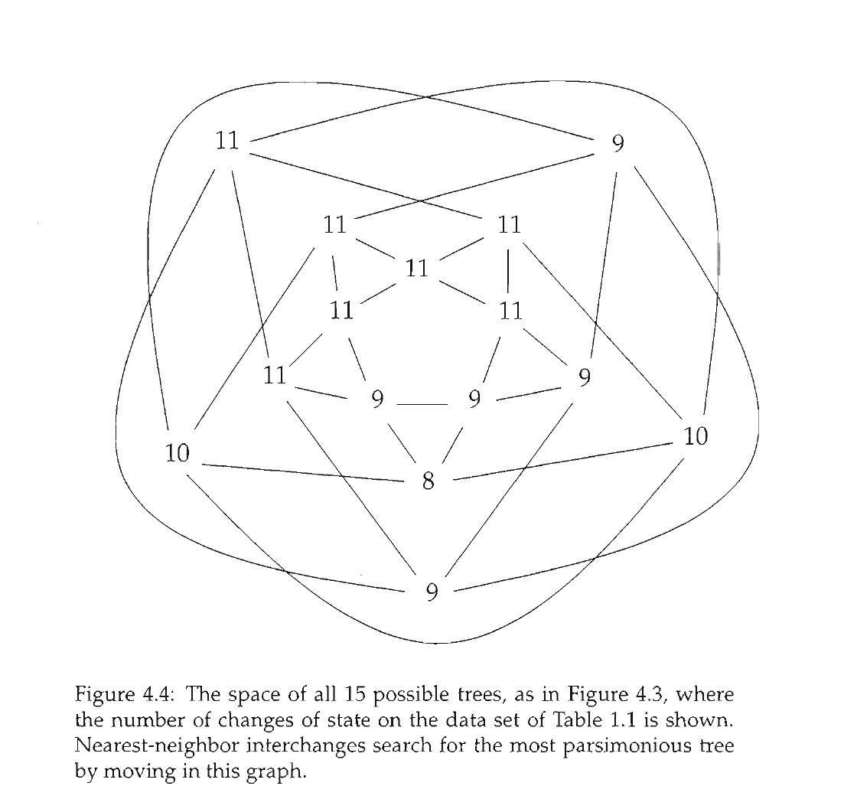
Finding the shortest tree in treespace

Slide 33
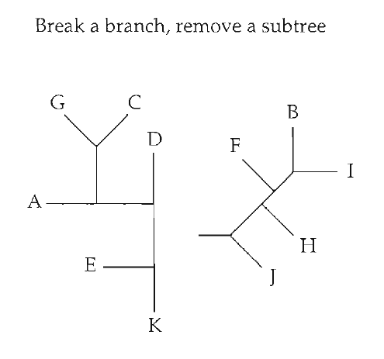
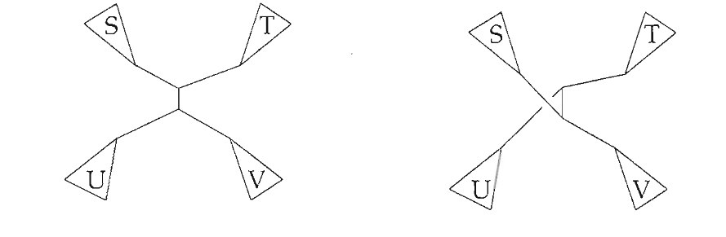
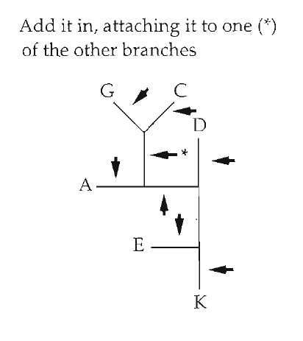
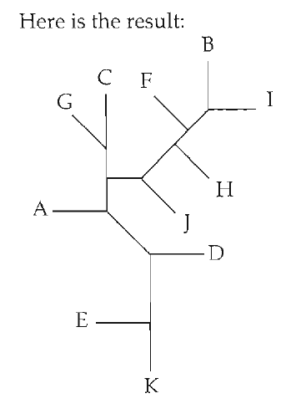
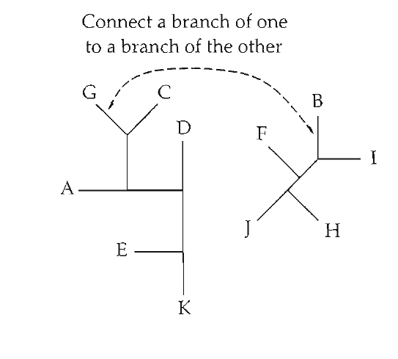
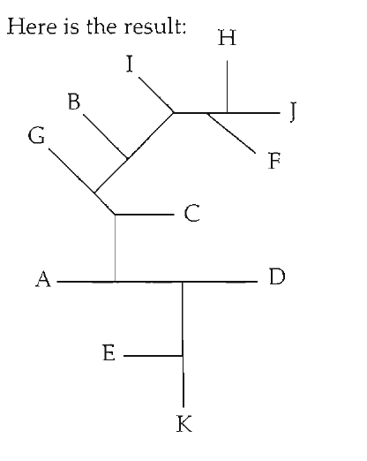
Tree space connectivity is defined by "moves"
Nearest Neighbor Interchange (NNI)
Tree bisection and reconnection (TBR)
Subtree pruning and regrafting (SPR)

Slide 34
Distance between tree spaces changes depending on which moves you use
NNI fastest, least computationally intensive, but the largest distances between trees
TBR slowest, most computationally intensive, but shortest distances between trees
SPR intermediate

Slide 35
Navigating tree space
Optimization/gradient descent (here ascent) is a general problem in computational analyses
It is always a balance of speed (NNI faster than SPR faster than TBR) and how efficiently you move across tree space (TBR connects more trees than SPR which is more than NNI)
Unless you sample all trees, a heuristic search may not be sure you ever find the global peak.
Trying lots of different starting points can increase your confidence.

Slide 36
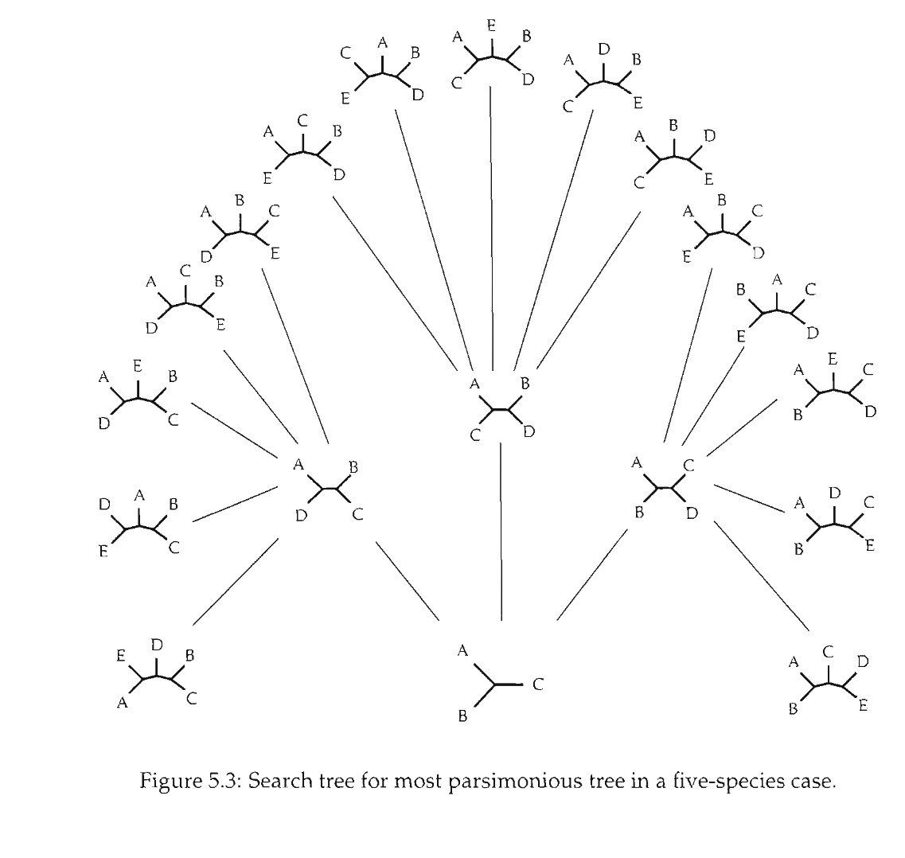
Parsimony has an exact algorithm
Branch and bound

Slide 37
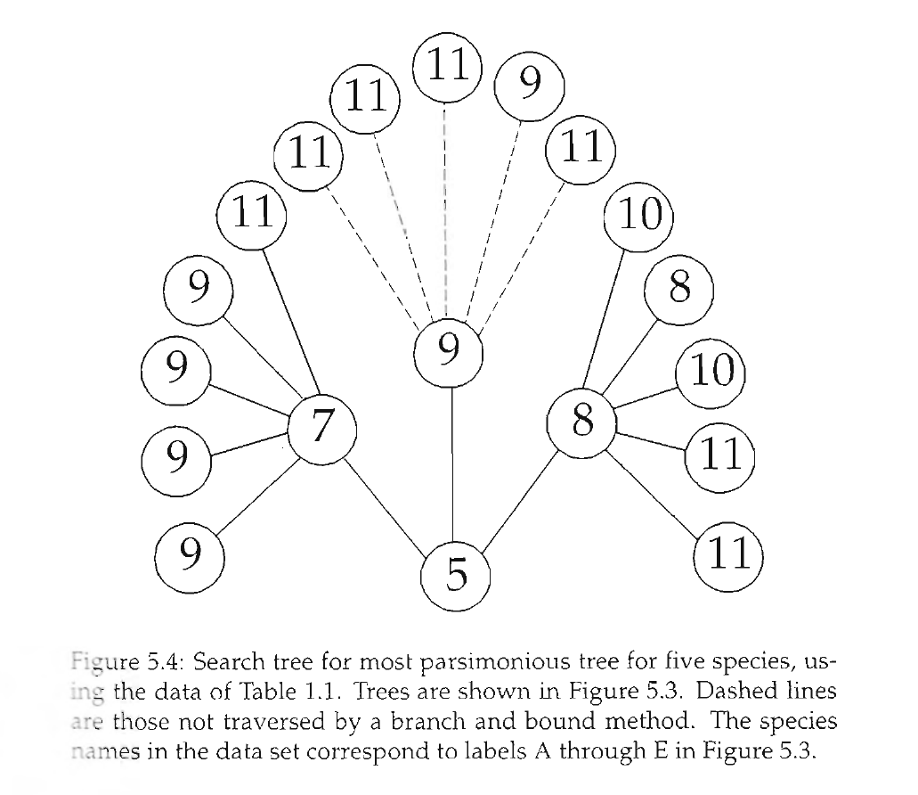
Branch and bound

