Slide 1
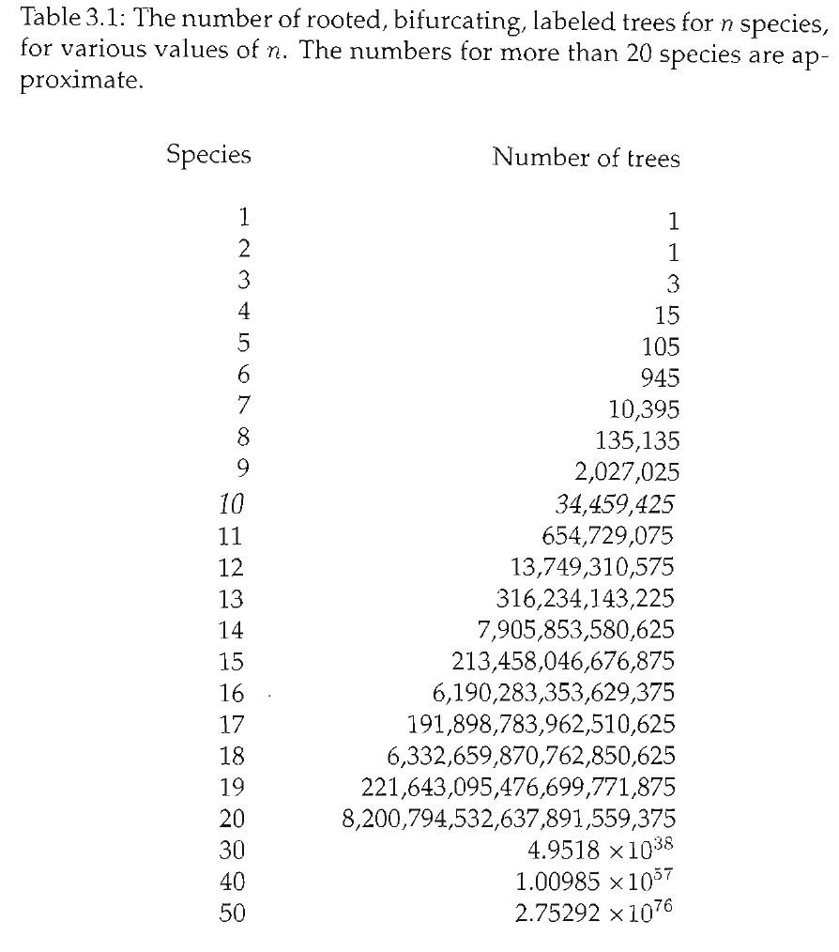
Practical considerations
How do you find the most parsimonious tree?
One way:
1. Try every possible tree.
2. For each tree, count min # of steps
3. Choose the tree with the fewest # steps
Too many trees.

Slide 2
Finding the best tree:
Exhaustive searches
How do you find the most parsimonious tree?
One way:
1. Try every possible tree.
2. For each tree, count min # of steps
3. Choose the tree with the fewest # steps
Too many trees.

Slide 3
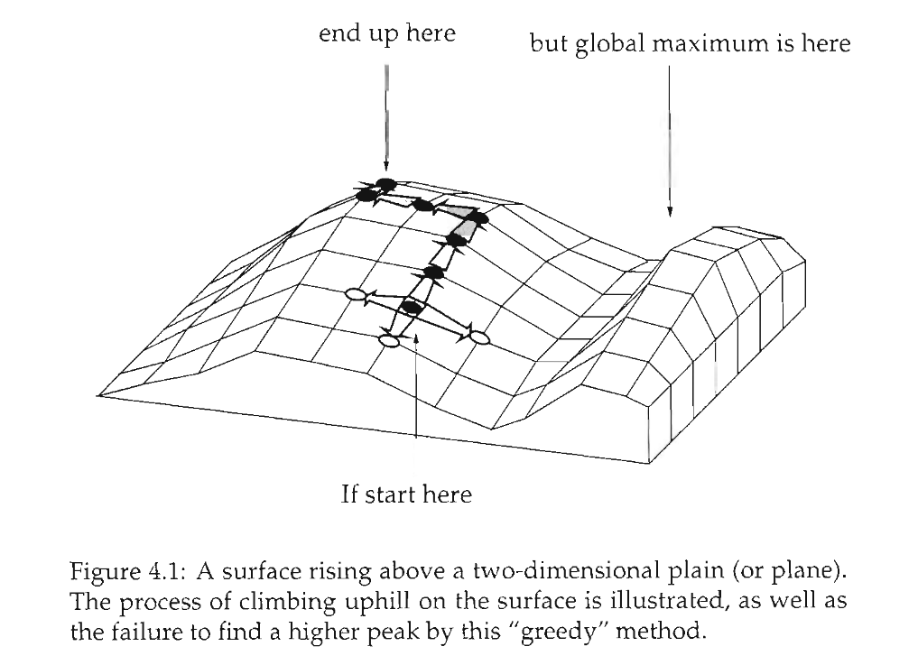
Heuristic searches
Don’t try every tree.
“Hill-climbing algorithm”
Wander around under certain rules. Hope that what you eventually stop at is the best.
Not guaranteed to find the best tree.
Can be improved by lots of random starting points.
(Not necessary for parsimony, exact algorithmic solution possible with a “branch and bound” search)

Slide 4
Tree space
Each point on the grid is a possible tree.
Trees next to each other are “1 step away” via algorithmic manipulation
Start at a random tree.
Try all trees that are nearby, choose the one that’s best
Keep doing that until you can’t make the tree any better.

Slide 5
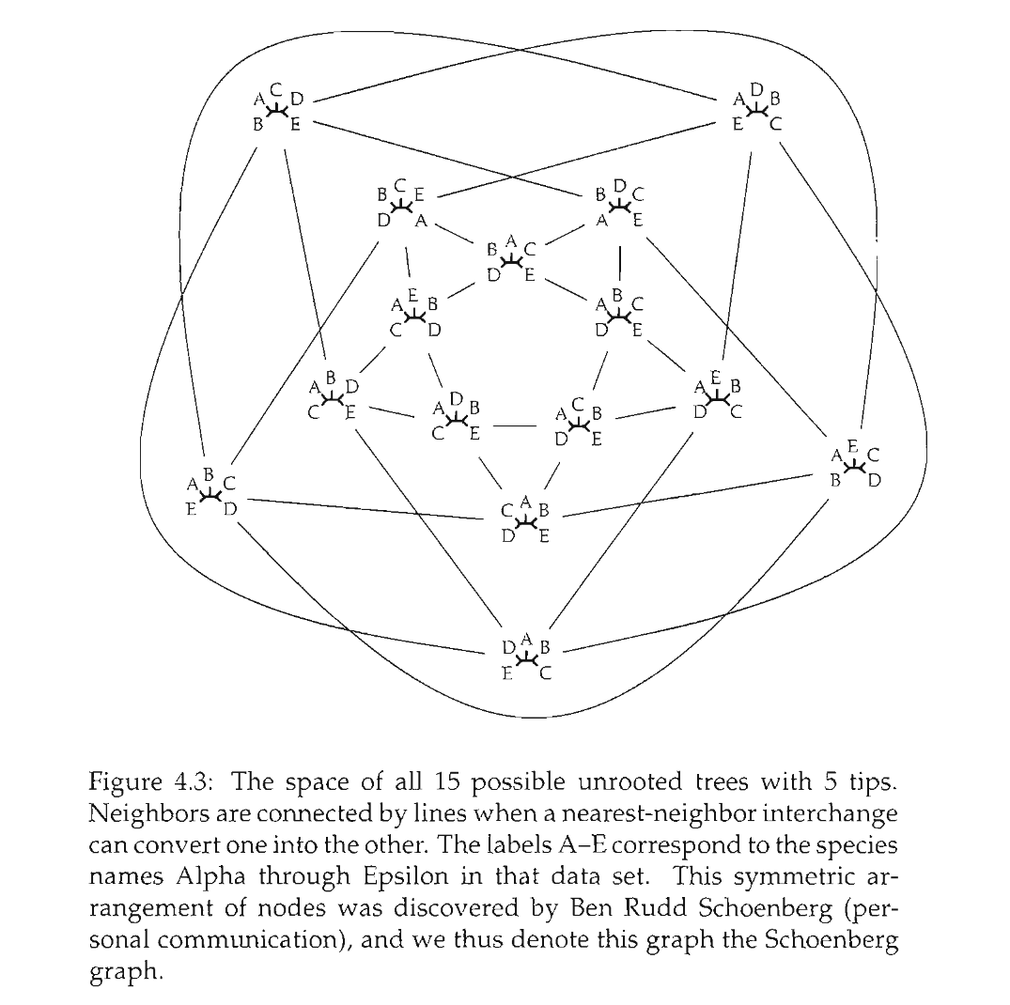
Visualizing tree space

Slide 6
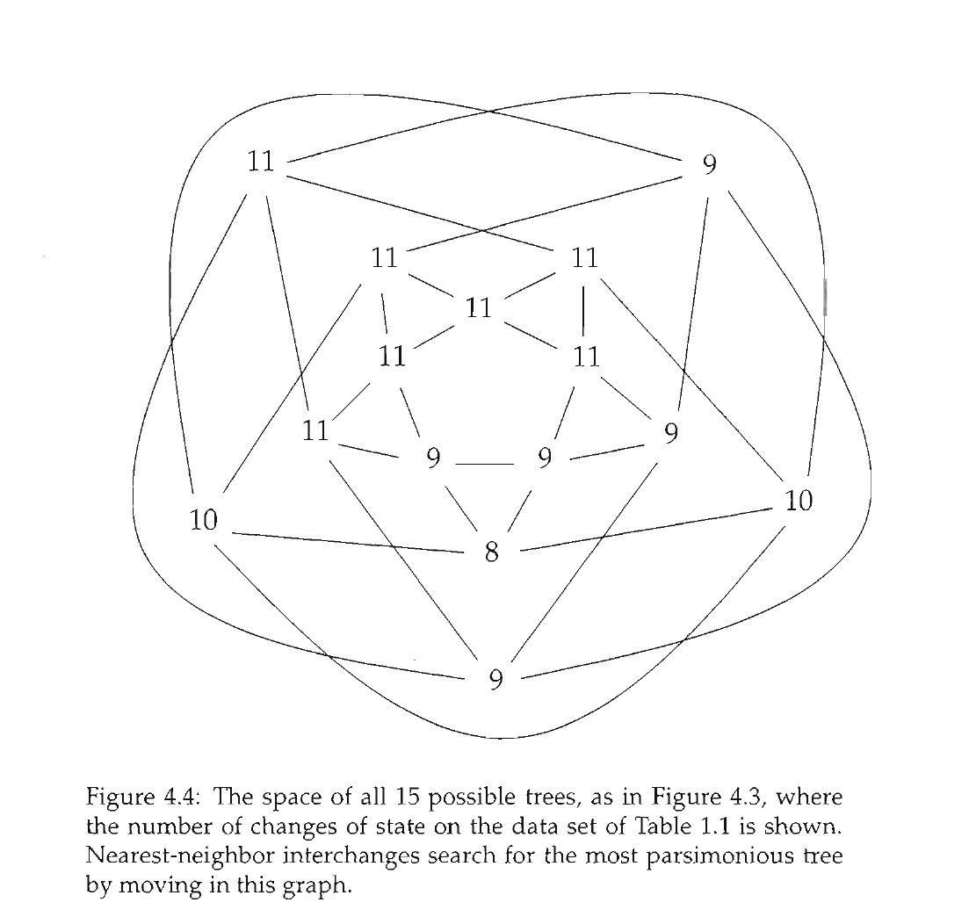
Finding the shortest tree in treespace

Slide 7
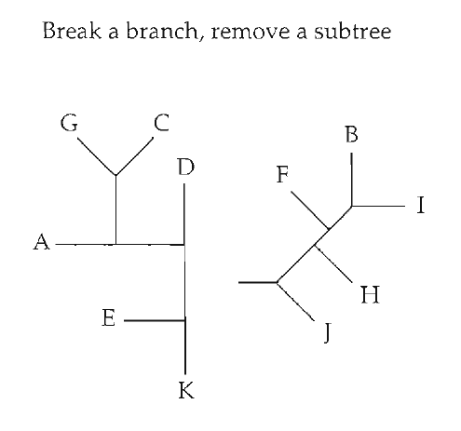
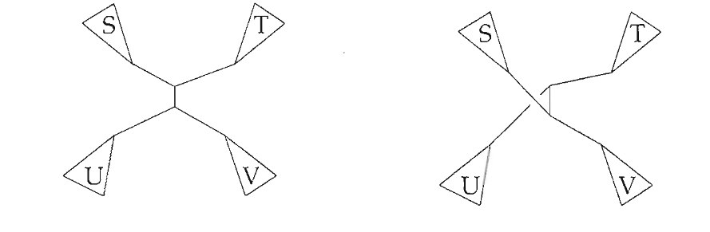
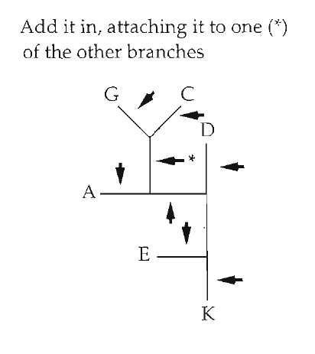
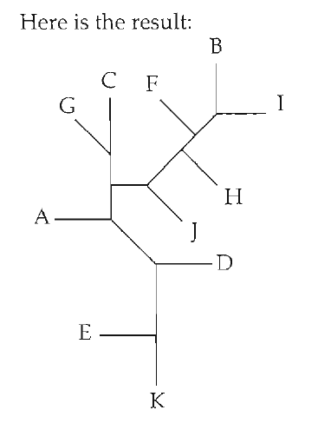
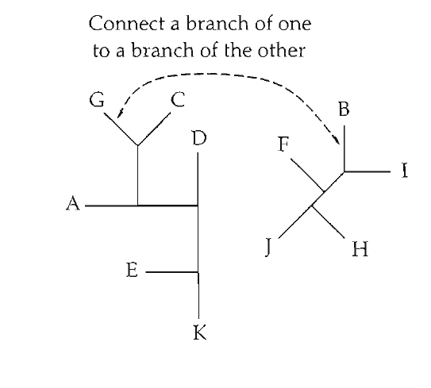
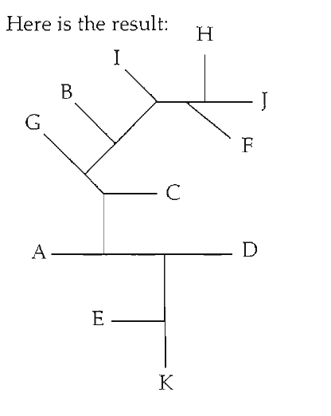
Tree space connectivity is defined by "moves"
Nearest Neighbor Interchange (NNI)
Tree bisection and reconnection (TBR)
Subtree pruning and regrafting (SPR)

Slide 8
Distance between tree spaces changes depending on which moves you use
NNI fastest, least computationally intensive, but the largest distances between trees
TBR slowest, most computationally intensive, but shortest distances between trees
SPR intermediate

Slide 9
Navigating tree space
Optimization/gradient descent (here ascent) is a general problem in computational analyses
It is always a balance of speed (NNI faster than SPR faster than TBR) and how efficiently you move across tree space (TBR connects more trees than SPR which is more than NNI)
Unless you sample all trees, a heuristic search may not be sure you ever find the global peak.
Trying lots of different starting points can increase your confidence.

Slide 10
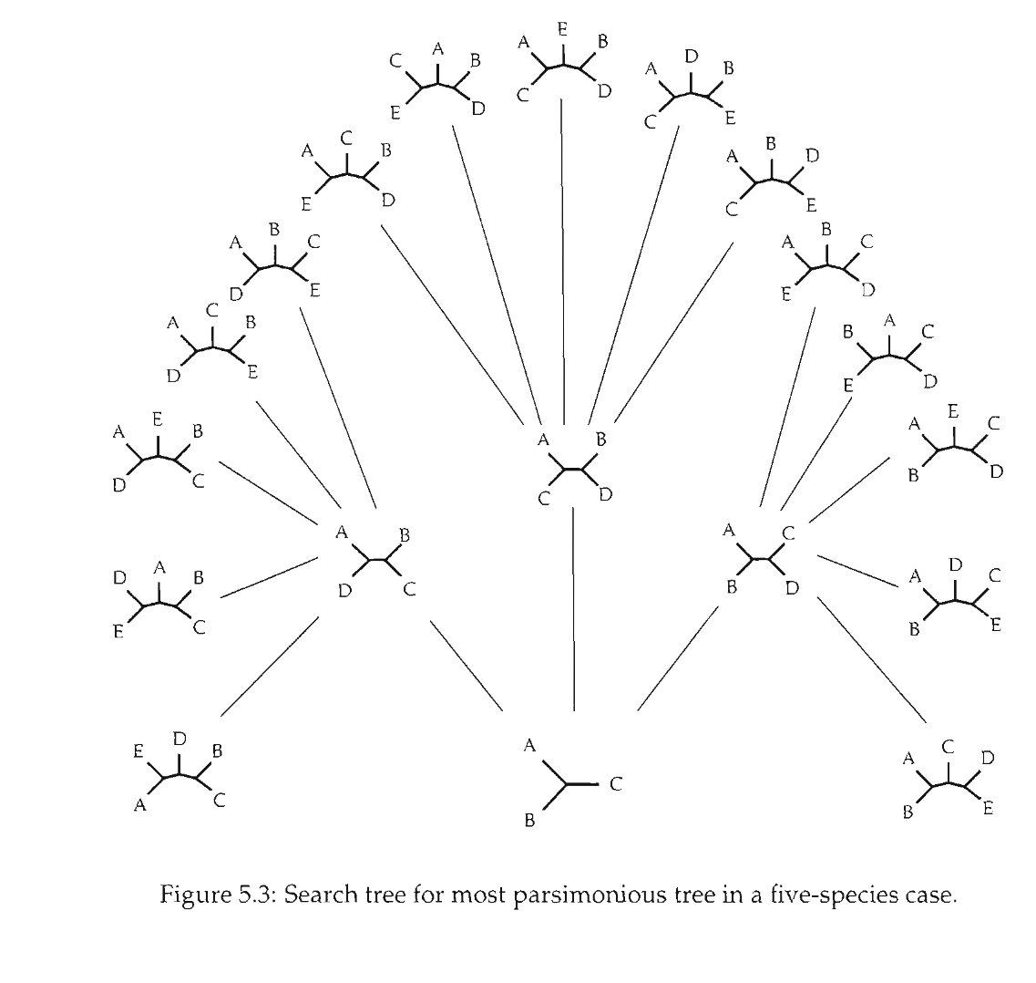
Parsimony has an exact algorithm
Branch and bound

Slide 11
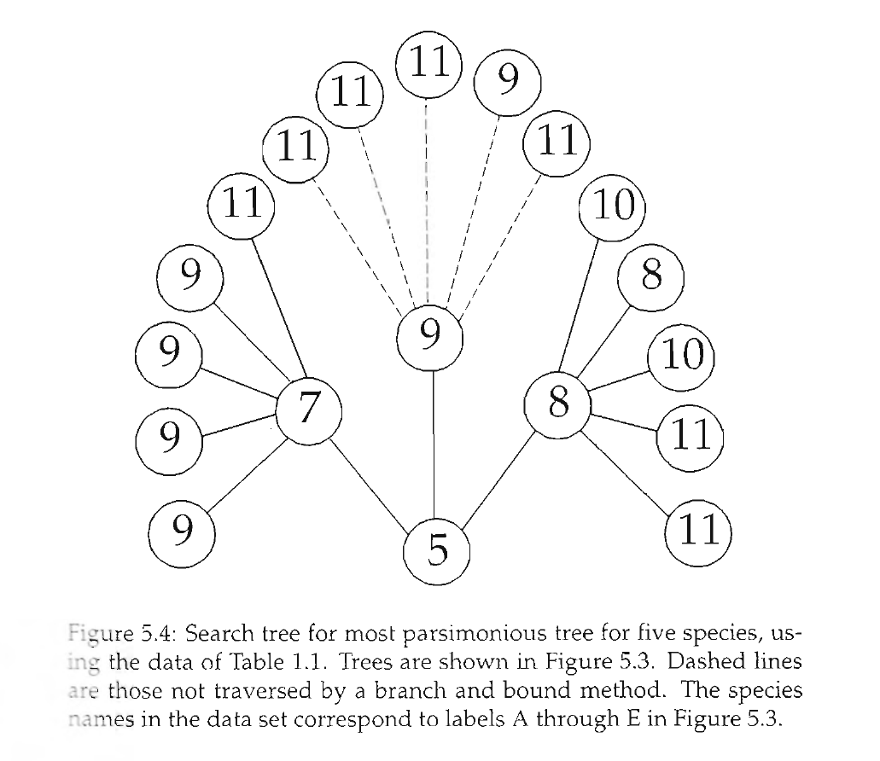
Branch and bound

Slide 12
Felsenstein and the birth of statistical phylogenetics
How do we think about probabilities and trees?

Slide 13
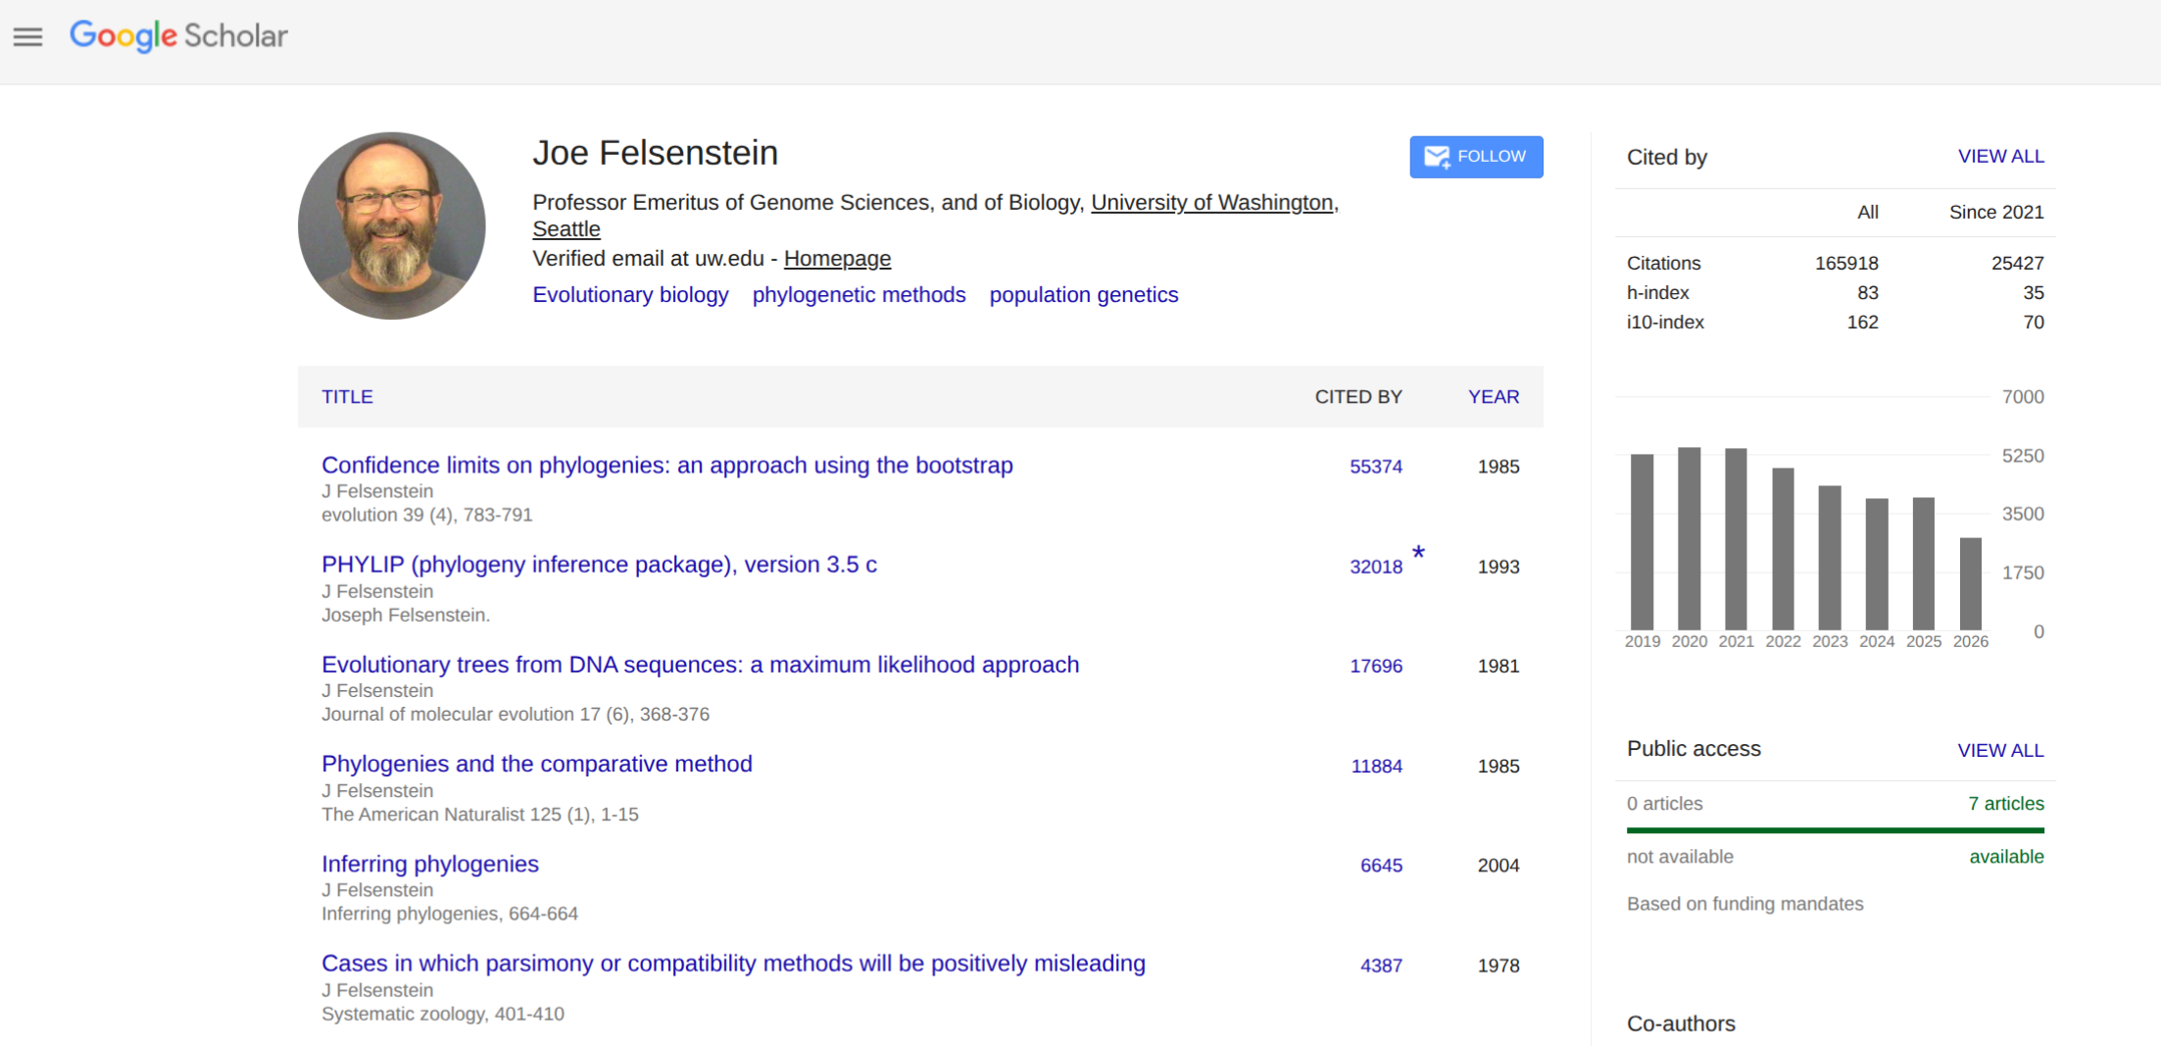
Joe Felsenstein

Slide 14
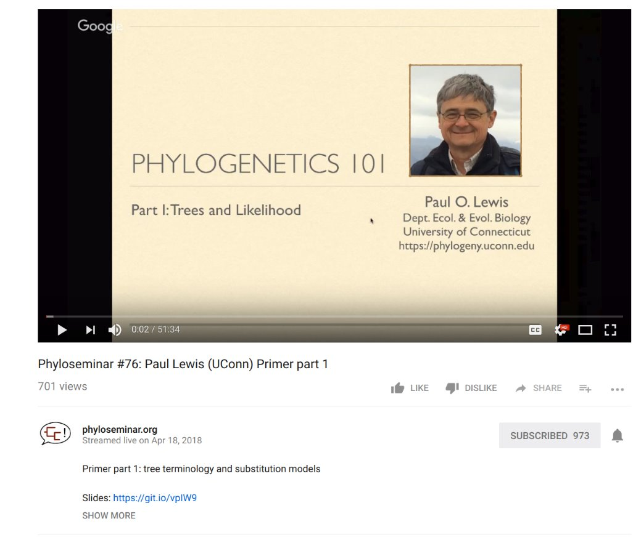
Disclaimer: Heavily borrowed material from Paul Lewis (UConn)
Check out Paul Lewis' website for EXCELLENT teaching materials!

Slide 15
If two DNA sequences are unrelated, what percent of bases (aligned sites) do you expect to be identical?
50%
25%
0%
I need more information

Slide 16
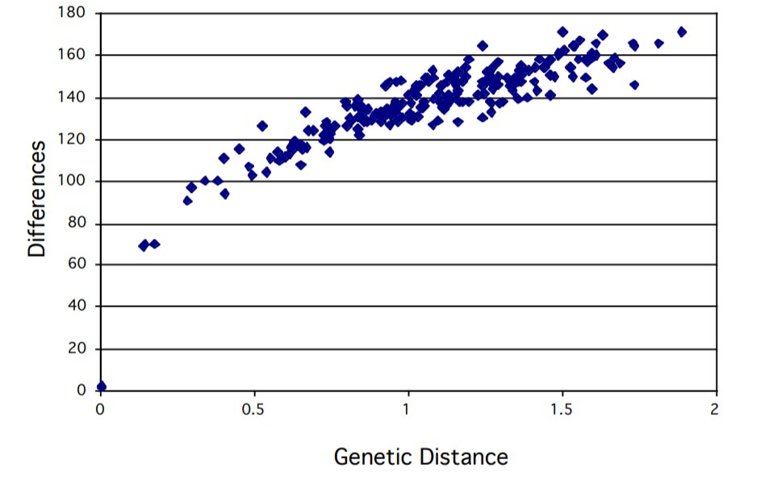
Why do we need statistics and probability?

Slide 17
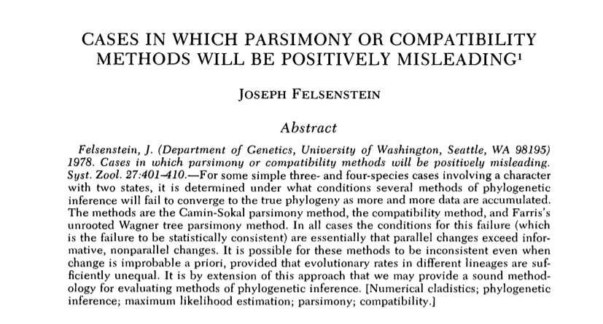
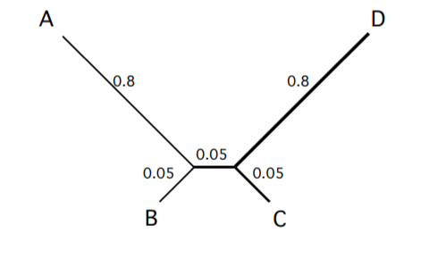
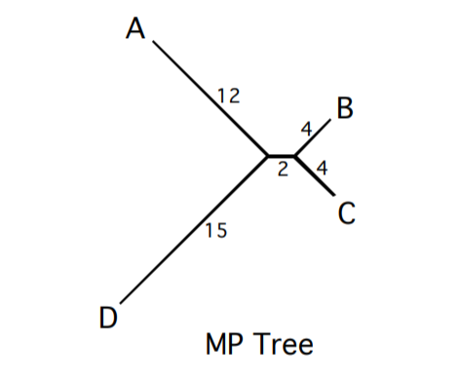
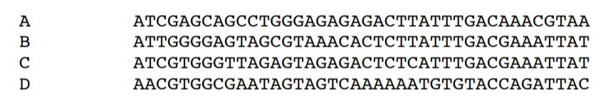
Long branch attraction

Slide 18
Conditional probabilities
P( | )
P( | )
Read as: The probability of this alignment (the data) GIVEN or CONDITIONAL UPON this being the true tree.

Slide 19







How do we treat trees probabilistically?
Let’s simplify to a binary (0/1) trait
(rather than 4 DNA bases)
If 1 or 2 come up, a substitution occurs
Otherwise, no substitution occured
If a substitution occurs, choose which substitution occurs by a coin flip.

Slide 20
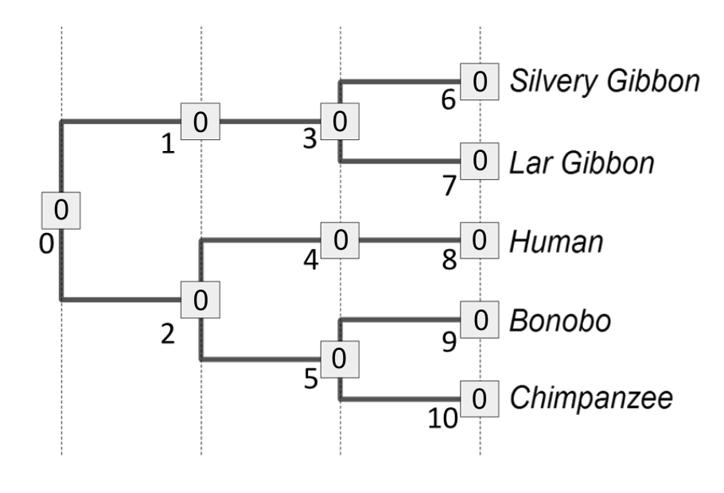
Generating data on a tree

Slide 21
Initialize root
0

Slide 22
Step 1
0
0

Slide 23
Step 2
0
0
0

Slide 24

Step 3 and 4
0
0
0
0
0

Slide 25

Step 5
0
0
0
0
0
0

Slide 26
Step 6
0
0
0
0
0
0
1

Slide 27
Step 7-10
0
0
0
0
0
0
0
0
1
1
1
What was the probability of this outcome?

Slide 28
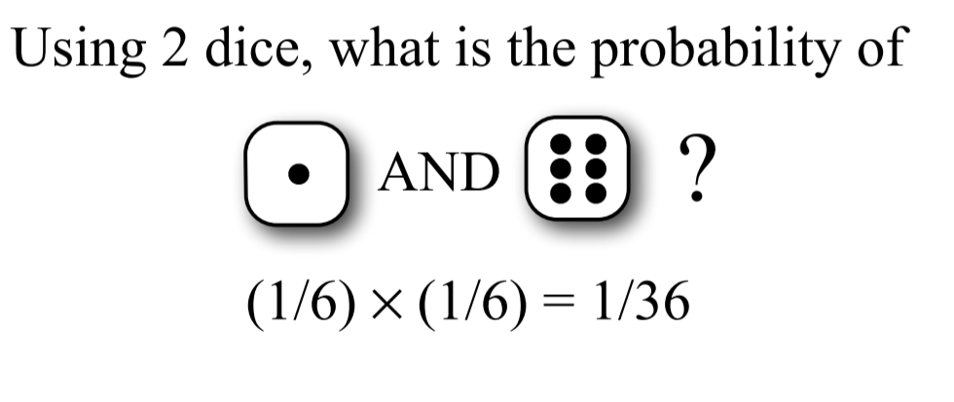
Combining probabilities:
The AND rule
If two independent events occur, MULTIPLY their individual probabilities to get the full probability of an event. Each roll of the dice (and each flip of the coin) is independent.

Slide 29
Combining probabilities:
Calculating a likelihood
0
0
0
0
0
0
0
0
1
1
1
L(T₁ | D, N_{i})=P(D, N_{i}|T₁)* = (4/6)⁹ x [(2/6)(1/2)]¹=0.0043
Read as: The likelihood of Tree 1 given the data at the tips (D) and nodes (N_{i}) is equal to the probability of the data and node states given Tree 1 is true. (We can’t ask “is Tree 1 true” so simply, so we use the word Likelihood instead)

Slide 30
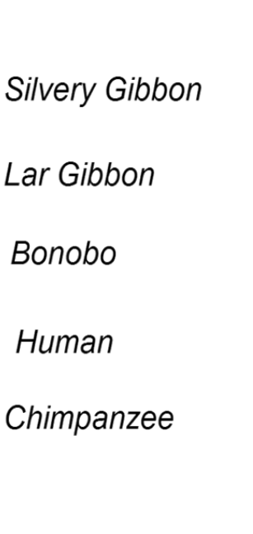
Combining probabilities:
The Likelihood under an alternative topology
0
0
0
0
0
0
1
0
0
0
1
Likelihood(D, N_{j}|T₂)* = (4/6)⁸ x [(2/6)(1/2)]²=0.0011

Slide 31
Node states are usually unknown
0
0
0
1
1

Slide 32
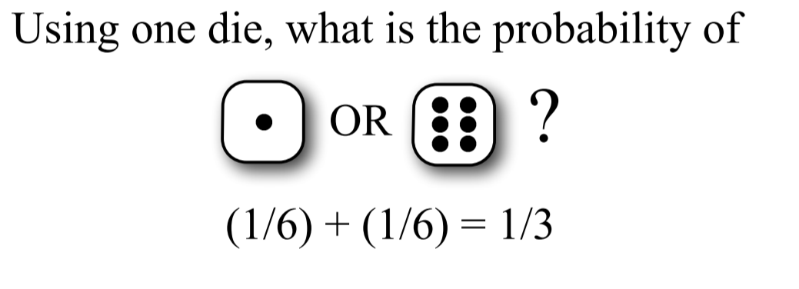
Combining probabilities:
The OR rule
Two mutually exclusive probabilities should be ADDED together to get the total probability of the two events

Slide 33
Combining probabilities:
Calculate likelihood of another possible history
0
0
1
0
1
1
0
0
1
0
1
Likelihood (D, N_{k}|T₁)=(4/6)¹ x [(2/6)(1/2)]⁹=0.000000066
This is a possible outcome under Tree₁, but not especially likely!

Slide 34
Combining probabilities:
Yet another history under the same tree
0
1
1
0
1
0
0
1
1
1
1
Likelihood (D, N_{k}|T₁) = (4/6)⁷ x [(2/6)(1/2)]³=0.00027
This is also a possible outcome, a little bit more likely!

Slide 35
Calculating likelihoods over all possible histories
0
0
0
1
1
There are 2⁶ = 64 possible node assignments for Tree₁. We could calculate the likelihood of each one, then ________ them together, to get the total Likelihood(Tree₁ | Data).
Now, like parsimony, you can do either a heuristic or exhaustive search for the tree with the maximum likelihood)

Slide 36
Biology will want continuous time
We used discrete time blocks to do our dice rolling
Change in evolution can happen anytime, continuously

Slide 37
Continuous-time Markov Models
Markov assumption = probability of change depends only on the current state, not how long it has been in that state.

Slide 38
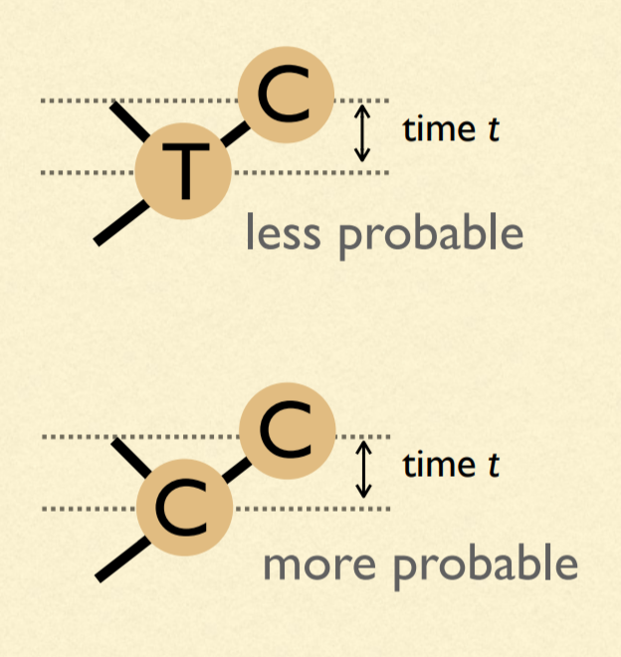
Our model of change depends on time: must have branch lengths
Units of branch length will be expected number of substitutions per site
(= rate of substitions x time)

Slide 39
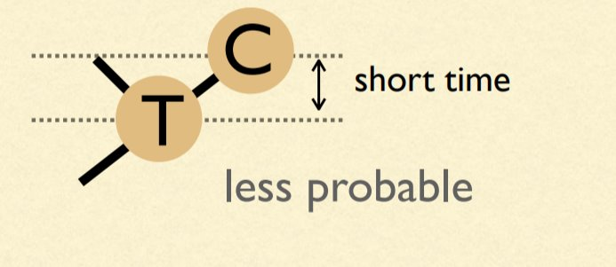
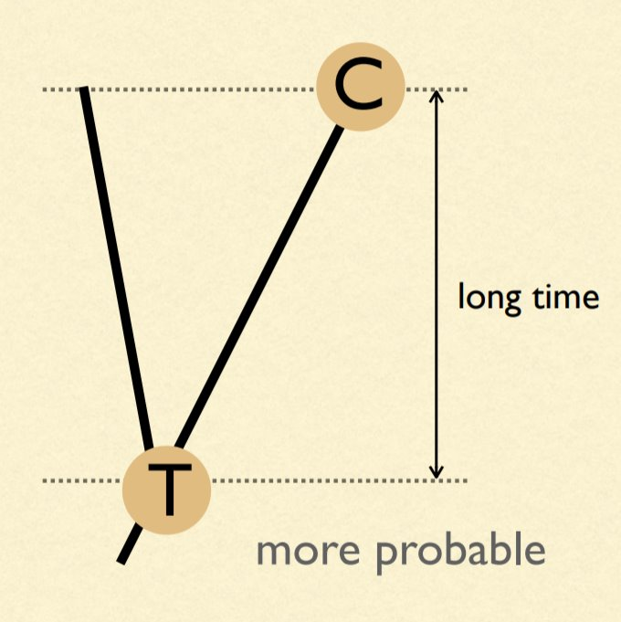
Probabilities are dependent on time

Slide 40
Event probabilities
μ = 4β
A
β
β
β
β
A
T
G
C

Slide 41
CTMC on a (very) simple phylogeny...
time
A
A
P_{AA} =
Probability nothing happened +
Probability something happened, but that the last thing that happened ended in an A

Slide 42
Staying the same
time
A
A
P_{AA} = (e^{-μt} ) + (1 - e^{-μt})(1/4)
Probability something doesn't happen
Probability at least one thing happens
Probability that the last thing that happened ends in an A

Slide 43
A substitution
time
A
G
P_{AG} = (1 - e^{-μt})(1/4)
Probability at least one thing happens
Probability that the last thing that happened ends in an G

Slide 44
Another possible substitution
time
A
C
P_{AC} = (1 - e^{-μt})(1/4)
Probability at least one thing happens
Probability that the last thing that happened ends in an C

Slide 45
The last possible substitution
time
A
T
P_{AT} = (1 - e^{-μt})(1/4)
Probability at least one thing happens
Probability that the last thing that happened ends in an T

Slide 46
Substitutions vs. "events"
ν = (3/4)μt = 3βt
4ν/3 = μt
Only 3 out of 4 events results in a substitution. Thus, we can define the substitution rate ν.

Slide 47
Putting all four possible events together
P_{AA} = (e^{-μt} ) + (1 - e^{-μt})(1/4)
P_{AG} = (1 - e^{-μt})(1/4)
P_{AC} = (1 - e^{-μt})(1/4)
P_{AT} = (1 - e^{-μt})(1/4)

Slide 48
Sanity check: do they all add to one?
P_{AA} = (1/4) + (3/4)(e^{-4ν/3} )
P_{AG} = (1/4) - (1/4)(e^{-4ν/3})
P_{AC} = (1/4) - (1/4)(e^{-4ν/3})
P_{AT} = (1/4) - (1/4)(e^{-4ν/3})

Slide 49
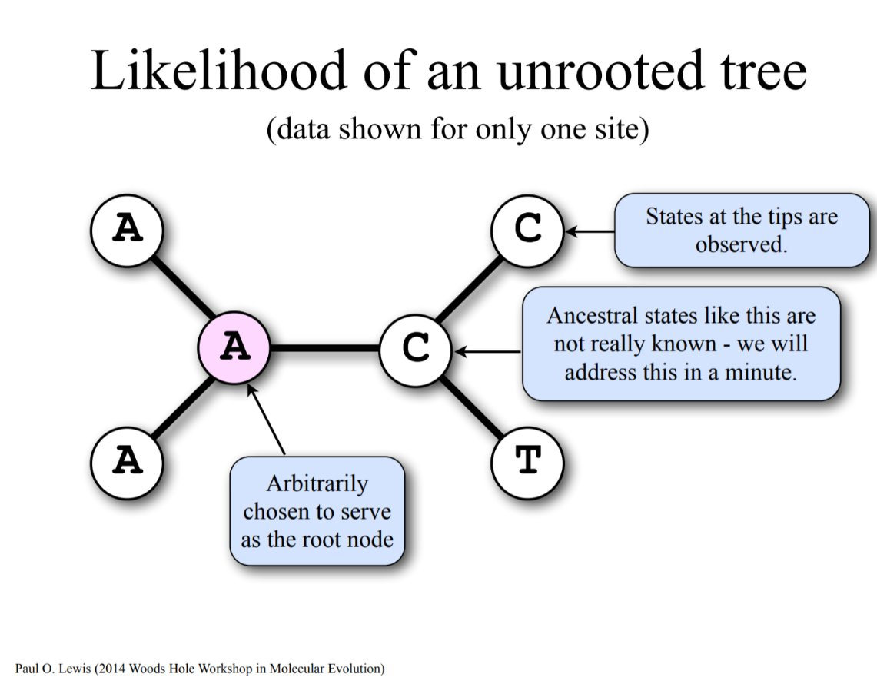
Likelihood of an unrooted tree

Slide 50
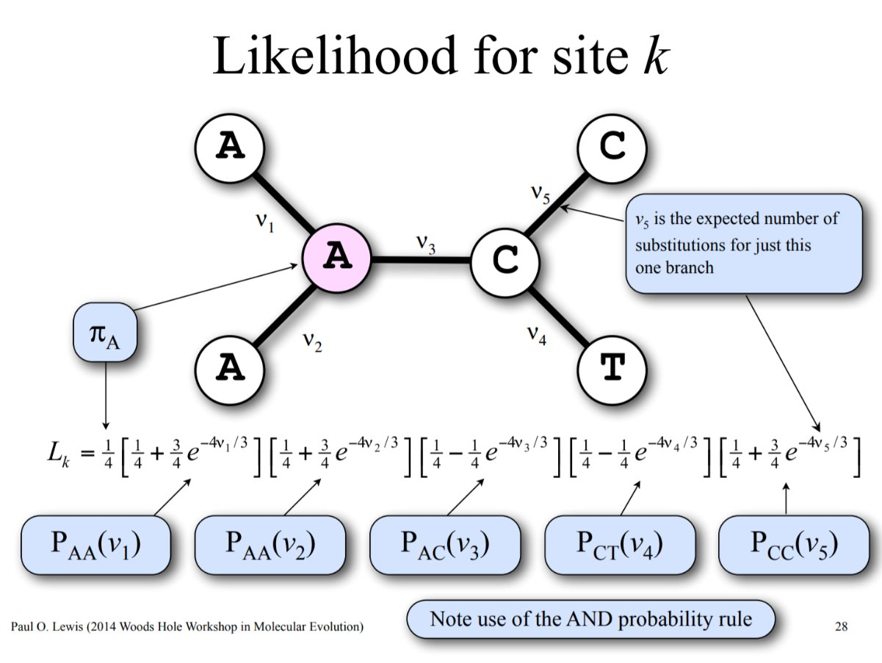
Calculating the likelihood of a single history and site

Slide 51
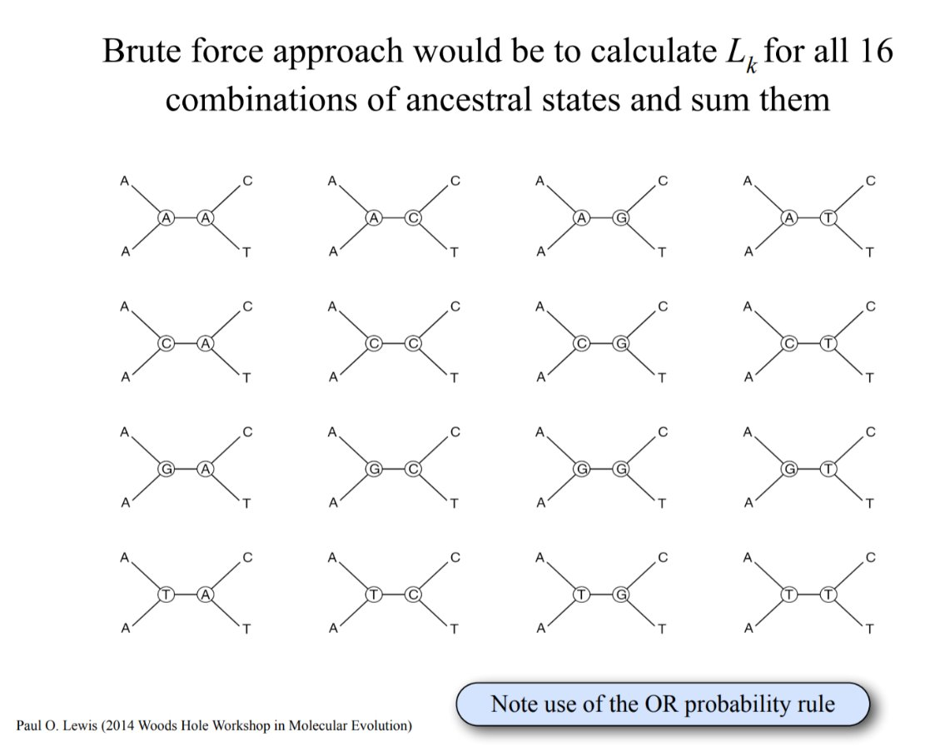
All possible node histories by brute force

Slide 52

Felsenstein '81 pruning algorithm. Repeated patterns in possible ancestries

Slide 53
This repetition repeats for each set of 4 trees

Slide 54
And it repeats again

Slide 55
And for the last four

Slide 56
And shared bipartitions across rows

Slide 57
2nd row shared bipartition

Slide 58
3rd row shared bipartition

Slide 59
4th row shared bipartition

Slide 60
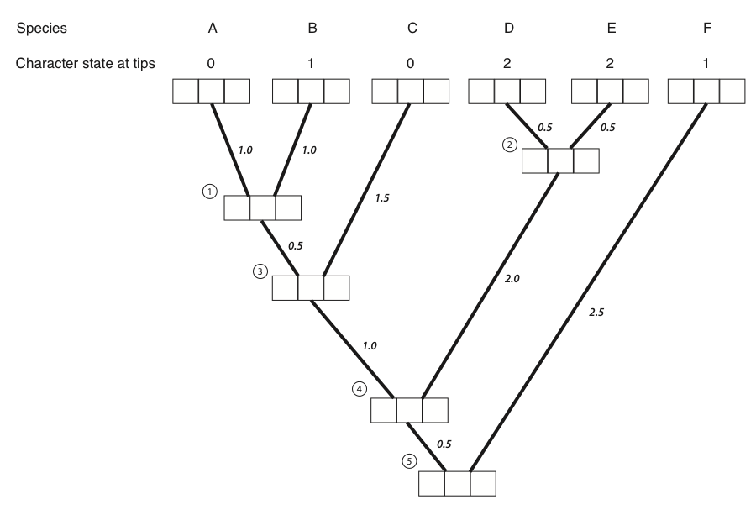
Redundant calculations enable efficient algorithm
1 0 0
0 1 0
1 0 0
0 0 1
0 0 1
0 0 1

Slide 61
Traverse the nodes filling in likelihoods
1 0 0
0 1 0
1 0 0
0 0 1
0 0 1
0 0 1
0.12 0.12 0.1

Slide 62
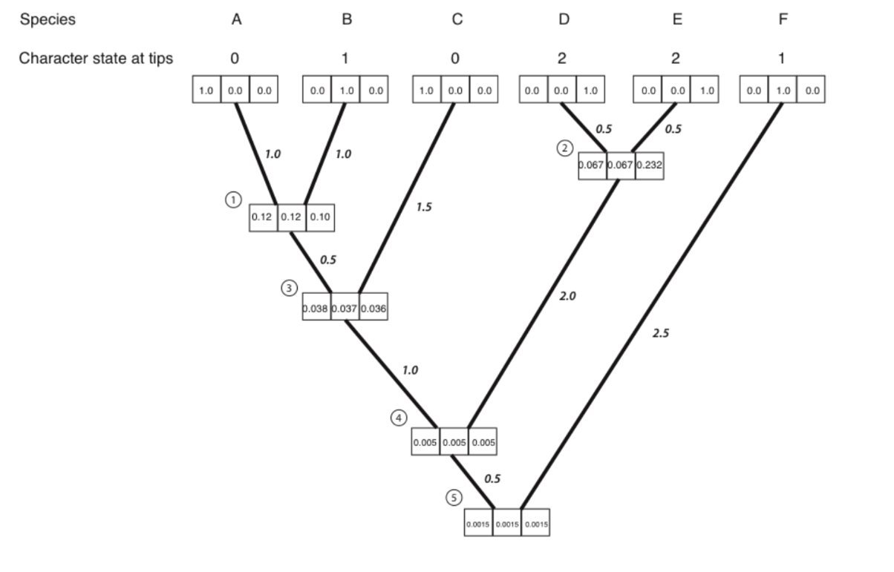
Traverse the nodes filling in likelihoods

